Slide 1
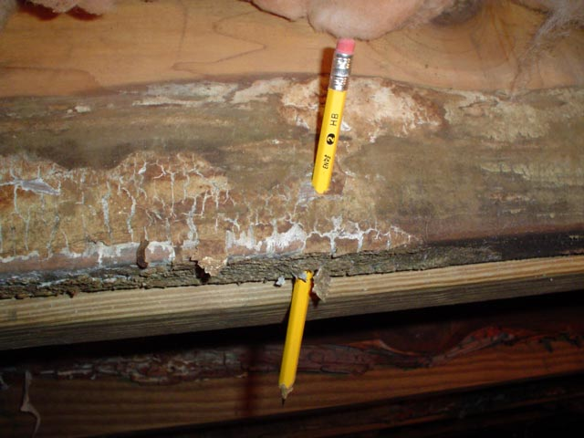
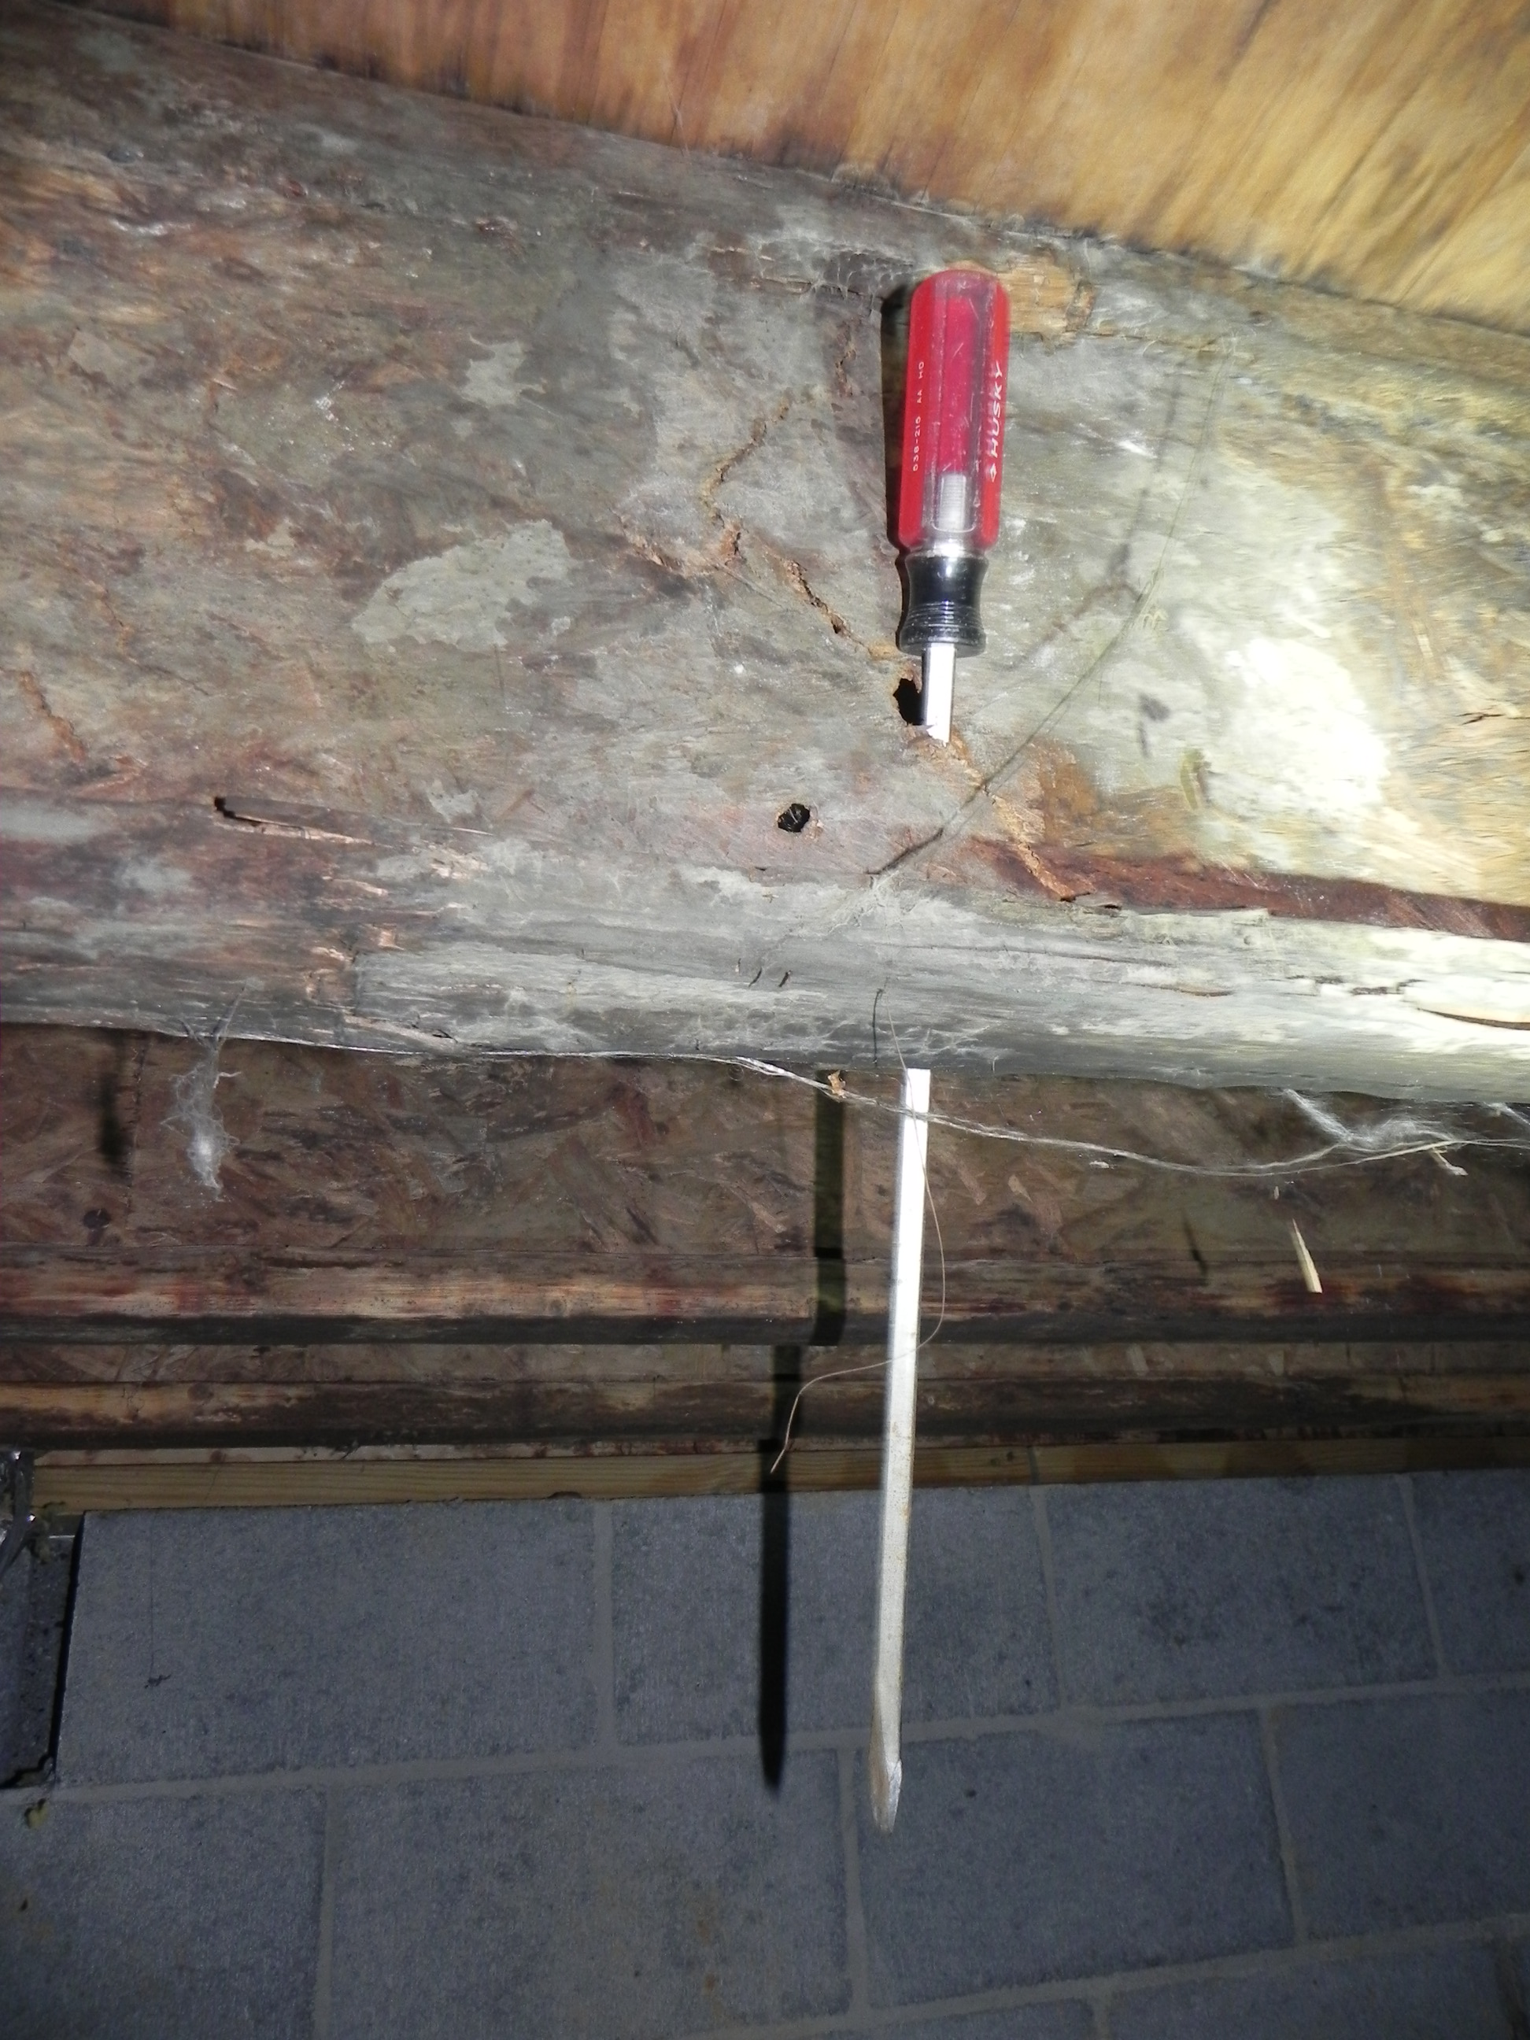
Recognition of Wood Decay Fungi
and their damage

Slide 2
Goals of this presentation:
For you to be able to:
recognize non-decay fungi (those that are present in wood but that do
not damage the structural integrity of the wood) and wood decay fungi
(which impact the structural integrity of wood, weakening its ability to
provide support).
detect conditions which contribute to excess moisture in the crawl
provide control methods which will prevent or correct wood decay in
structures in compliance with the Rules of the Georgia Structural Pest
Control Commission.

Slide 3
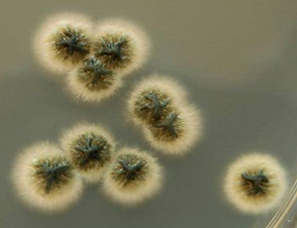
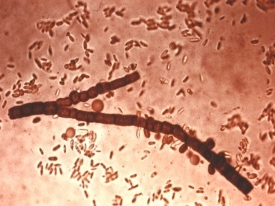
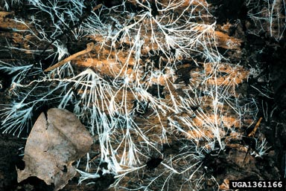
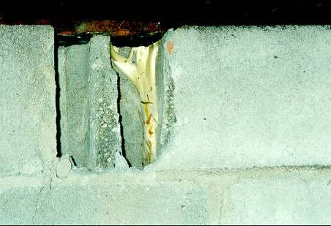
Some Fungus Terminology
First, let’s learn a little about fungi to be able to recognize some
common types of fungi and the effects they might have on wood that
we find in the crawl space of homes.
spores
hyphae
mycelia
rhyzomorph
These are microscopic
These can be seen with the naked eye

Slide 4
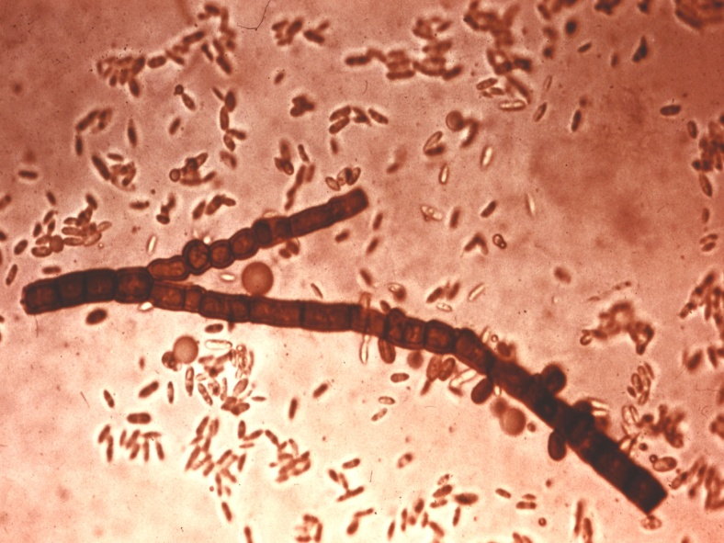
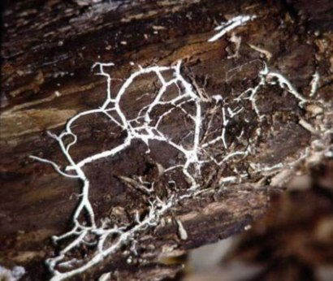
Spores are like microscopic
seeds. They are produced
by sporophores, or fruiting
bodies of fungi. When these
asexual spores germinate,
they form hyphae.
Hyphae are root-like, long,
branching, filamentous cells
(microscopic strands) that grow
from the spores and feed on wood.
Mycelia are a mass, group or
bundle of branching hyphae.
They appear like spiderwebs.

Slide 5

Fungi reproduce asexually by
microscopic seed-like spores
which float on air currents and
attach to wood.
Spores of surface molds and
mildews that are present on the
wood germinate when wood
contains at least 20% moisture,
but these non-decay fungi don’t
structurally damage the wood.
Spores of wood decay fungi begin
to germinate and grow hyphae
which damage wood when the
wood has at least 28% moisture.

Slide 6
So…
let’s look at the 2 types of fungi that we often
see in crawl space homes:
non-decay fungi which do not impact
the structural integrity of wood
and
wood decay fungi which do impact the
structural integrity of structural wood)

Slide 7
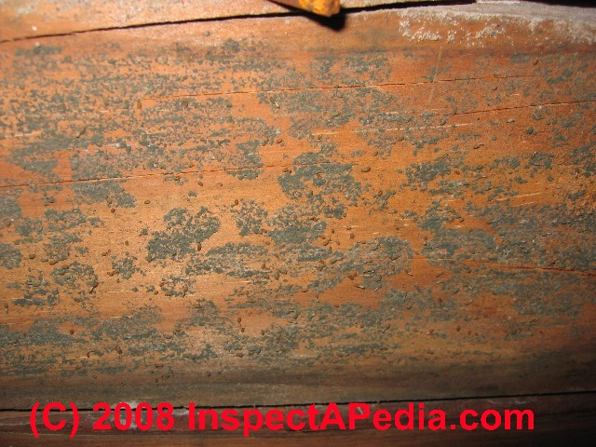
A non-decay fungus
A non-decay fungi
is a plant-like organism
that lacks chlorophyll
and uses starches, sugars,
proteins, and/or fats in
wood storage cells in for
food.
It does not impact the structural integrity of wood!

Slide 8
Non-Decay Fungi
(start developing at 20% moisture levels or > in wood)
1. Surface-staining fungi - Molds and Mildews
2. Sap-staining fungi – Blue stain fungi (occur in live trees)
They use starches, sugars, proteins, and/or fats in wood
storage cells in for food. They don’t use cellulose,
hemicellulose or lignin in the cell walls for food and, thus,
they do not affect the structural integrity of wood.

Slide 9
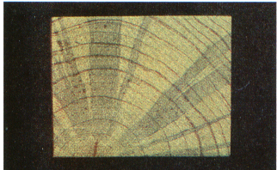
Non-decay Fungi
Surface-staining fungi
(Molds & Mildews)
Sap-staining fungi
(Blue stain fungi)
10

Slide 10
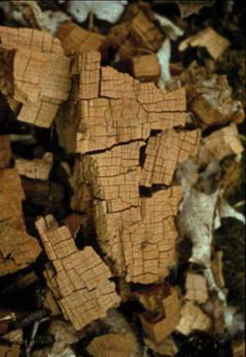
A wood decay fungus
is a plant-like organism that lacks
chlorophyll and uses cellulose,
hemicellulose and/or lignin in the
cell walls of wood for food.
It may impact the structural integrity
of structural wood, resulting in a
reduction of its strength
30

Slide 11
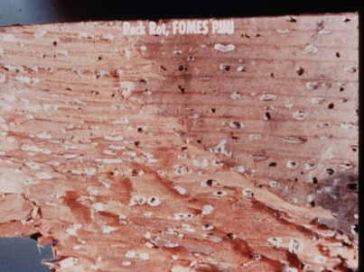
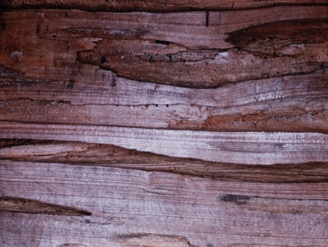
First, let’s recognize 2 wood decay fungi that develop only in live trees or logs:
(start developing at high moisture levels in wood of live trees or logs)
1. White Pocket Rot
2. Pecky Rot
No control is needed of these wood decay fungi in structural wood

Slide 12
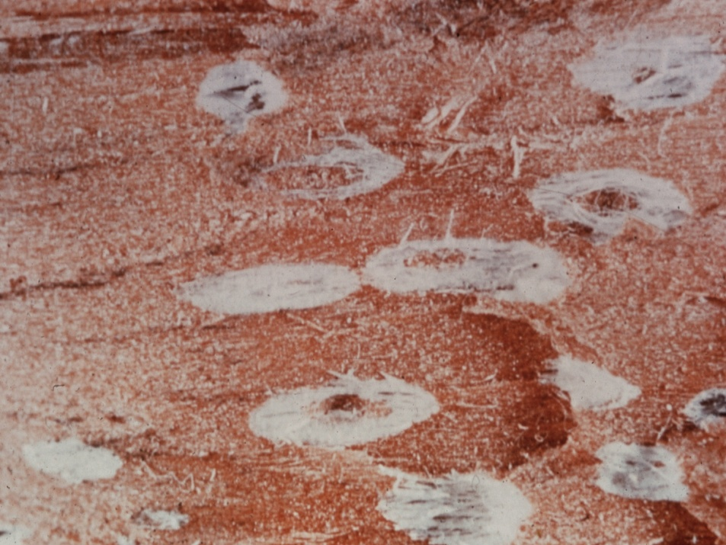
White Pocket (Pock Rot)
Attacks live trees, not dry structural wood of homes
It creates small cavities
that look like pock marks
The cavities are filled with
white cottony fungus
When the lumber is cut,
the fungus dies, but its
evidence remains
No control is required, as he fungus is already dead in structural wood

Slide 13

White Pocket Rot

Slide 14
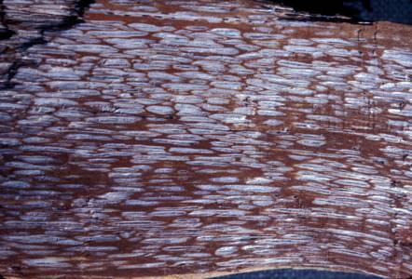
White Pocket Rot
This is a split section of a pine tree with white-pocket rot caused by
Phellinus pini. The white areas are de-lignified zones where the
fungus has been removed lignin but not the cellulose. White-pocket
rot fungi cause a selective attack on lignin and hemicellulose in wood.

Slide 15
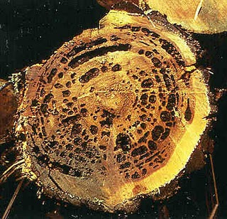
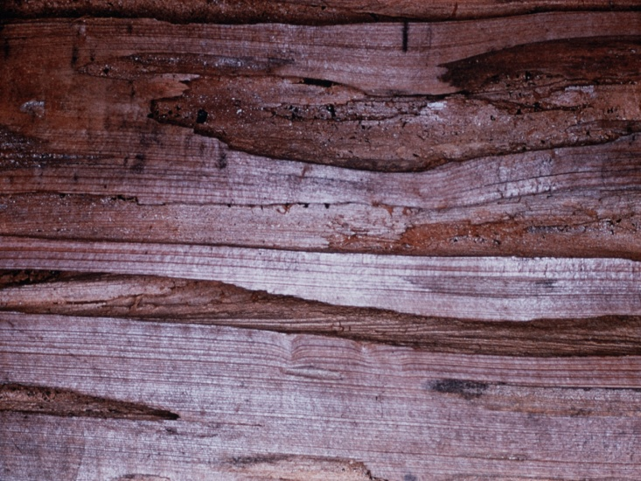
Pecky Rot
Attacks live trees, especially cypress &
cedar, not dry structural wood of homes
It creates channel-like cavities
filled with soft, decayed wood
When the lumber is cut, the
fungus dies, but its evidence
remains
It often costs more than sound
lumber due to its “rustic” look.
No control is required, as the fungus is already dead in structural wood

Slide 16
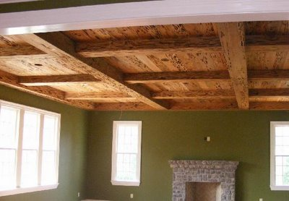
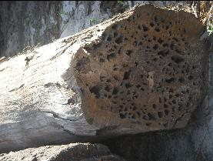
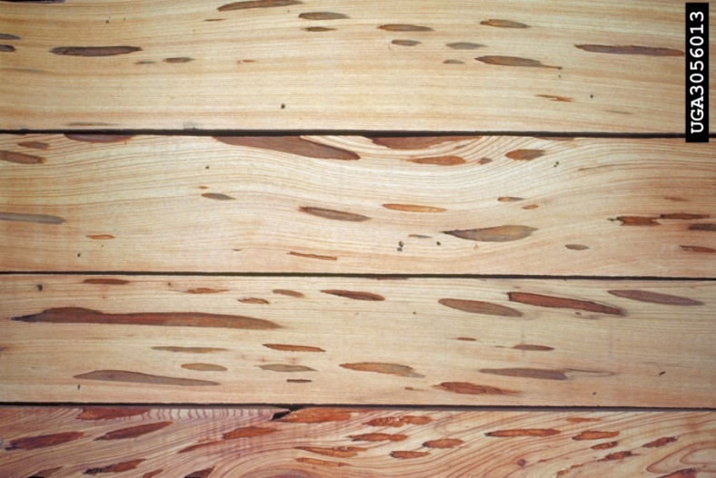
Pecky Rot
Pecky cypress is used as panneling,
flooring, and even as beams inside
homes
It may take as many as 125 years
to develop inside cypress trees

Slide 17
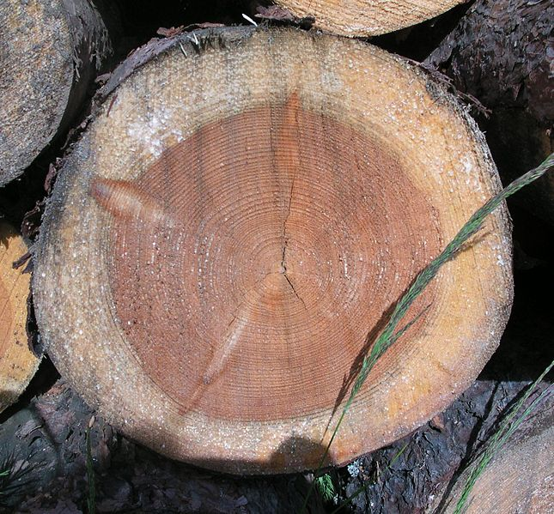
Before we talk about wood decay…
let’s learn a bit about wood
bark
sapwood
heartwood

Slide 18
Resistance to wood decay
heartwood
Heartwood is the darkened wood
located at the center of the log.
It is comprised of old cells
that have died and darkened.
The darkening is caused by
chemicals…some of which
provide degrees of durability
or resistance to decay…and
some even to attack by some
termites and beetles.
Heartwood of cedar, black locust, walnut, redwood, cypress
and white oak contain chemicals that make it resistant to decay.

Slide 19
Sapwood has no significant
resistance to wood decay
During the growing season,
new cells are produced just
beneath the bark. These
living cells form sapwood.
In the spring, growth is rapid
and the cell walls are thin.
The summer growth cells
are produced more slowly
and are more compact.
The difference in appearance
forms the annual rings.
The cells in the sapwood are
living and transport the sap
up the tree.
sapwood
20

Slide 20
So, what are the growth requirements
for
wood decay fungi?

Slide 21
There are 4 growth requirements for wood decay fungi
Wood
Moderate temperatures
Oxygen
Moisture

Slide 22
The growth requirements for Wood Decay Fungi
Wood (a food source) – cellulose, hemicellulose and lignin that
compose the cell walls of plants serve as food for wood decay fungi
Moderate temperatures – optimum temperatures for growth of
fungi are between 60 and 90 degrees F.
Oxygen – air is seldom a limiting factor for fungal growth unless
it’s submerged in water or buried several feet underground.
Moisture – the control of the moisture in wood is the most
important principle in the control of wood decay. Wood will not
decay below the fiber saturation point (the point at which wood
cell walls will not absorb more moisture). The FSP of most
woods ranges between 20 to 35% moisture (GA DOA – 28%). Molds
and mildews can start to occur on wood with 20% moisture levels
or greater in wood; therefore, their presence is a good indicator
that the structure has excess moisture and needs to be controlled.
Keeping wood moisture levels below 20% provides a good safety
margin for wood decay.

Slide 23
So, how do wood decay fungi impact
the structural integrity of wood?

Slide 24
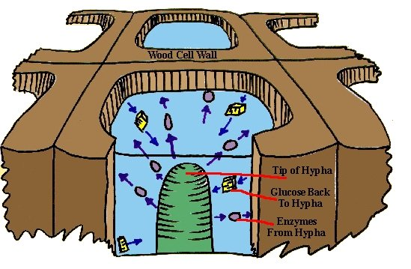
How do wood decay fungi cause decay in structural wood?
The way that fungi cause decay is through the action of enzymes secreted
at the tips of hyphae of wood decay fungi. These enzymes attack the
linkages between sugar units that comprise cellulose and hemicellulose,
thereby liberating the constituent sugars and making them available as
that might be liberated travel back to the tip of the hyphae, without a
film of liquid water. The water serves as a transport medium, and
without it wood cannot decay.

Slide 25
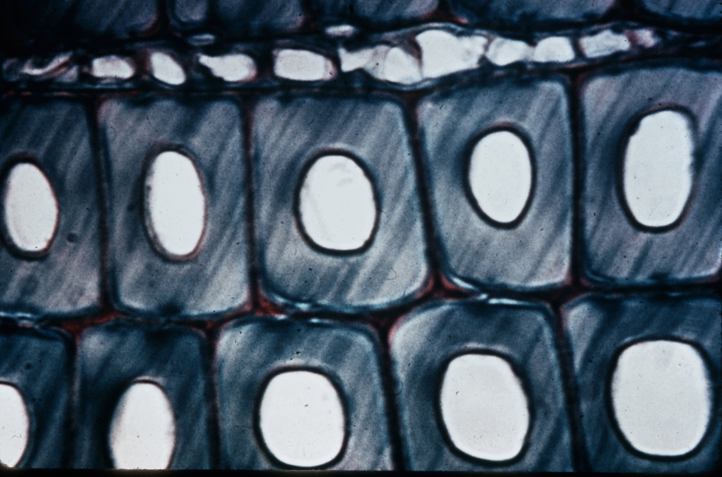
Normal cell walls of sound wood
Thickness of cell wall
Healthy cell walls are thick! Cellulose, hemicellulose and
lignin give the cell walls rigidity and give wood strength.

Slide 26
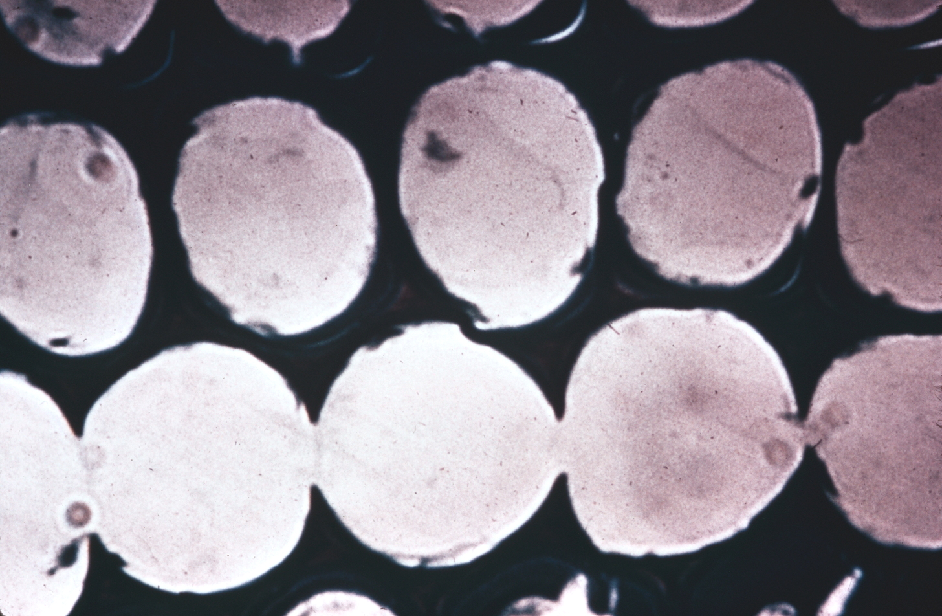
Wood cells are thiner after attack by wood decay fungi
Thickness of cell wall
Notice how thin the cell walls have become!

Slide 27
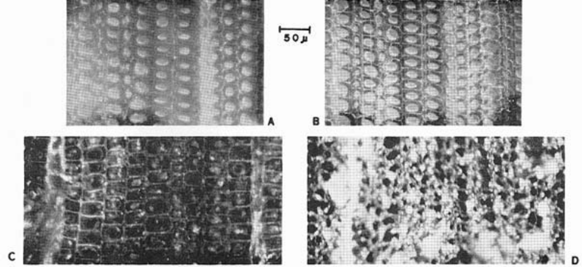
Photomicrographs of sound & brown-rotted pine showing
effects of moisture condition & decay on the cell size of wood
A B
C
Sound pine Sound pine
(H2O saturated) (Air-dried)
D
Brown-rotted Brown-rotted
pine pine
(H2O saturated) (Air-dried)
A Block of sound pine (water-saturated condition) – note swelling of cell walls
B Same block after air-drying. The size of the cells have diminished only slightly.
C Block of brown-rotted pine with residual weight of approximately 50 percent. Shows little
difference in size of cells compared with those of sound pine in water-saturated condition.
D Same block after air-drying. Thickness of cell walls has diminished greatly as has size of cells from
those in water-saturated condition and both have diminished more than in the air-dried sound block.

Slide 28
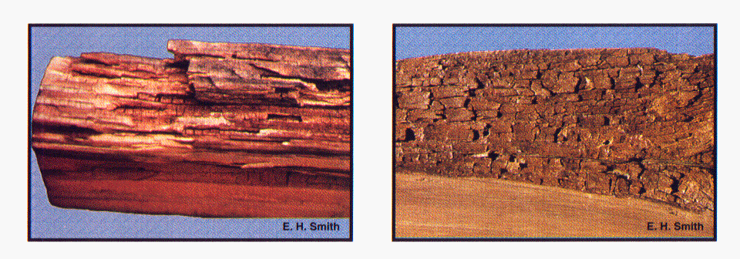
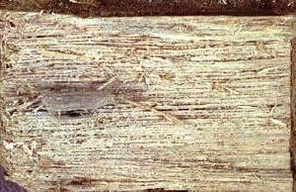
Recognition of Wood Decay Fungi
That attack the structural wood of homes
(start developing at 28% or > moisture levels
In buildings and require control)
1. Brown rot fungi - attacks softwoods
2. Water conducting rot fungi
(Poria incrassata)
attacks softwoods & hardwoods,
even woods that are normally
resistant to brown rot and white rot
3. White rot fungi - attacks hardwoods

Slide 29
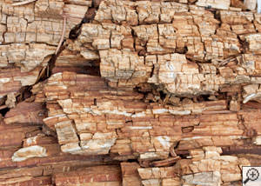
Brown Rot Fungi – found in softwoods only
Damaged wood is dark brown to black in color (it appears
charred or burned)
When pinched between
fingers…it feels like
sawdust
There is abnormal
shrinkage of the wood
Cracks form across the
grain of the wood
forming cubes
(called “checking”)
It often develops in wet/dry/wet/dry situations

Slide 30
Brown Rot Fungi
Brown Rot Fungus
It causes considerable loss in
wood strength very early in the
decay process, often before
decay characteristics are seen.
Cell wall carbohydrates
(cellulose and hemicellulose)
are degraded extensively
during decay leaving a
modified, lignin-rich substrate.
Commonly, brown rot causes
decay in structural wood of
buildings where large losses of
wood strength often result.
30

Slide 31
Brown Rot Fungi
In the advanced stage of brown
rot decay, the softwood cracks
perpendicular to the grain of the
wood and “checks” into cubicle
pieces (cubicle brown rot).
Little to no integrity remains in
this decayed wood.
Commonly, it’s called been dry
rot.
This term is misleading because
moisture must be present for the
decay to occur.

Slide 32
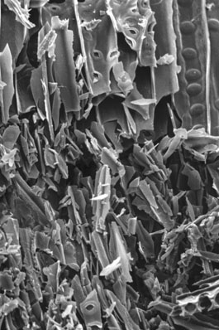
Wood impacted by Brown Rot at the cellular level
This scanning electron micrograph
of brown-rotted wood shows the
wood cell walls crumbling into
minute fragments .

Slide 33
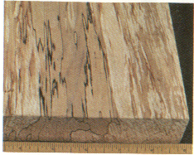
White Rot Fungi – found only in hardwoods
Wood that is newly infested by
white rot fungi is bleached white
in color and has dark lines
running through it, although
little damage occurs in early
stages of white rot decay.
There is no abnormal shrinkage
of the wood
It can digest cell wall components,
including hemicellulose and lignin

Slide 34
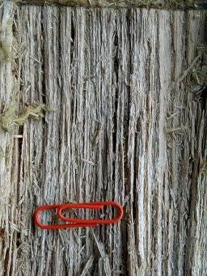
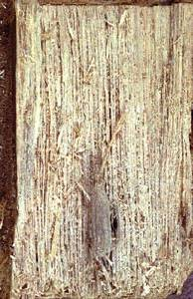
Late Stages of White Rot Decay
Damaged wood is fibrous and spongy when old and may produce a very “musty odor”

Slide 35
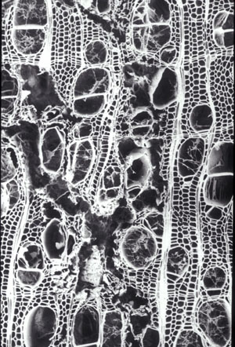
White Rot Fungi
This is a cross section of wood with white rot
Showing the fungus has degraded some cells completely, but not others.

Slide 36
Water Conducting Fungi – attacks both softwoods
& hardwoods
(Poria incrassata)
Is a type of brown rot that does not
need elevated wood moisture to
attack structural wood
Forms a taproot-like organ of
mycelium called a rhizomorph
to conduct water to sound wood
A rhizomorph can be up to 25 feet long and up to 1” in diameter
(normally ¼” to ½” in diameter)
It gets moisture from a remote source (like a voided porch with no
ventilation, a faucet leak outside, or a pipe leak inside the crawl)
Damage to the wood occurs rapidly & appears like brown rot

Slide 37
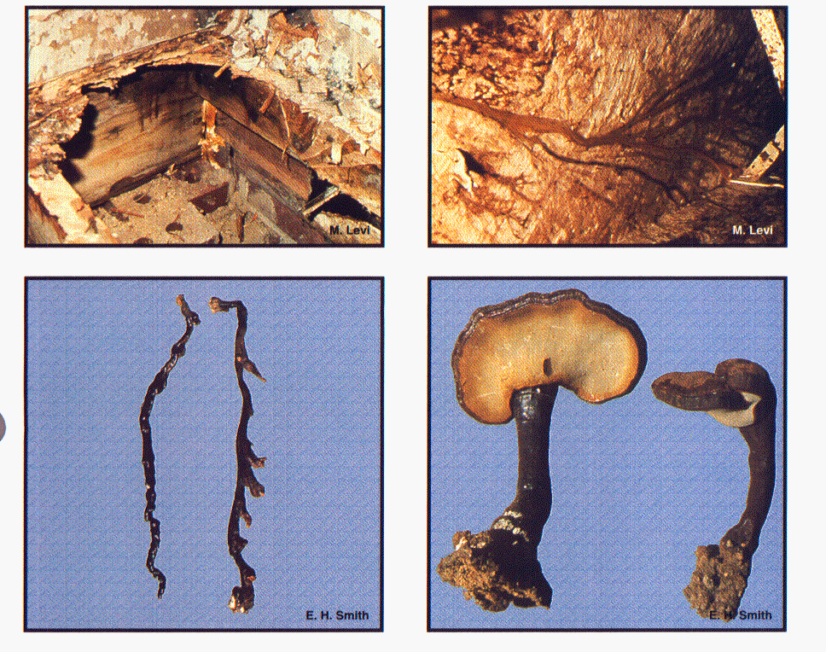
Rhyzomorphs
Mycelial fan sucking up moisture from soil
Notes:
8
27

Slide 38
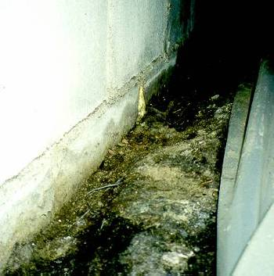
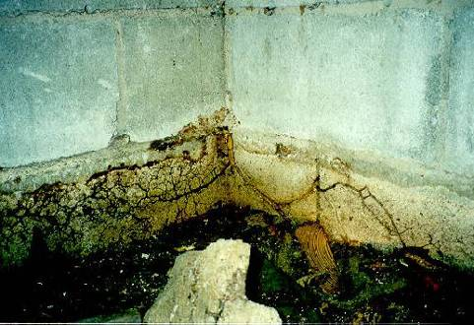
Poria incrassata
(water-conducting rot)

Slide 39
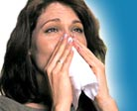
What are some problems associated with excess
moisture in the crawl space caused by fungi?
Health related problems
For example, residents of homes
with mold are at an elevated risk
for both respiratory infections and
bronchitis. When mold spores are
inhaled by an immuno-compromised
individual, some mold spores may begin to grow on living tissue,
attaching to cells along the respiratory tract and causing further
health problems.

Slide 40
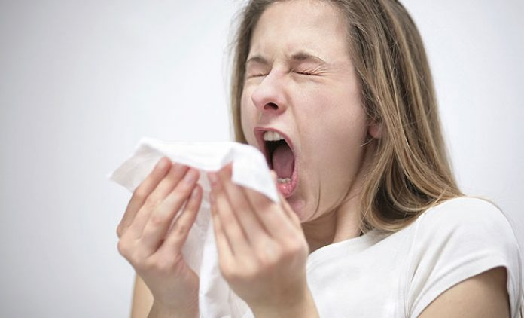
Condensate in walls allows molds and mildew to grow,
some of which may cause health problems for certain
individuals.
Allergies, asthma and other conditions can be triggered
or caused by certain molds and mildew for some people.
40

Slide 41
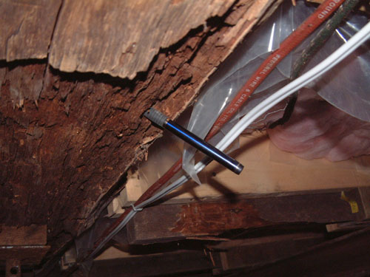
Damage to structural timbers from wood decay fungi
Significant damage to structures occur each year from
wood decay fungi. Homeowners see damage in structural
lumber, log homes, eaves, garage doors, exterior door trim,
window casings and other wood used in construction.
However, sometimes homeowners don’t see the wood
decay occurring in structural wood of the crawl space.

Slide 42
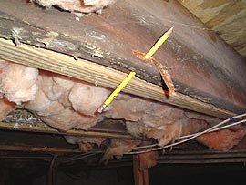
Damage to structural timbers from wood decay fungi
According to Ohio State University, replacement materials
needed to repair damage caused by decay account for
nearly 10% of U.S. annual wood production.
Wood rot destroys about 20 billion board feet of timber
each year – far more than the annual amount destroyed
by fire damage.

Slide 43
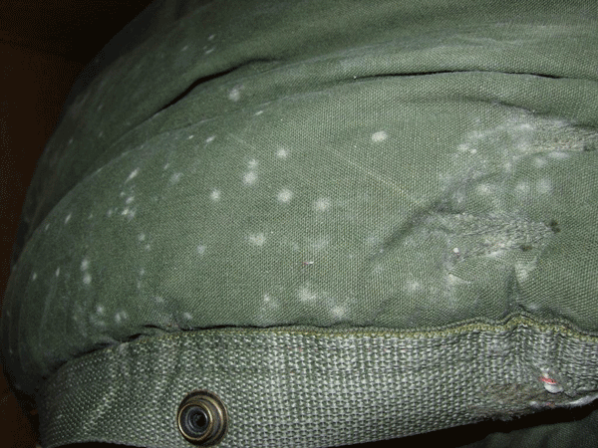
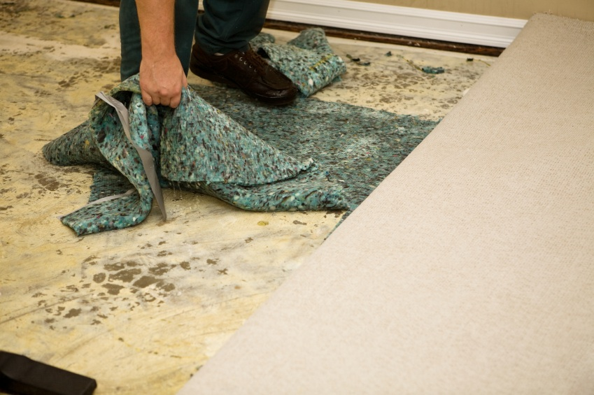
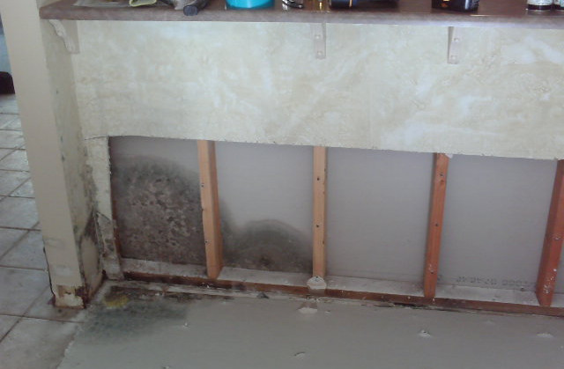
Damage to the home and its contents
Mold and mildew may cause damage
to contents of homes and may also
cause health problems
Mold on clothes
mold on carpet, padding, & wood mold on sheetrock & structural wood

Slide 44
Damage to the home and its contents
Wood and fiber based materials are subject to swelling when wet,
whether by exposure to water vapor the in the air or from
condensation surfaces.
High moisture levels can also encourage corrosion of metal items.
  Structural wood (especially in the crawl space) and flooring
  Doors and windows, baseboards and other millwork
  Cabinets
  Furniture
  Picture frames
  Wooden art, books, paper items ($$$)
  Pianos and other musical instruments ($$$)

Slide 45
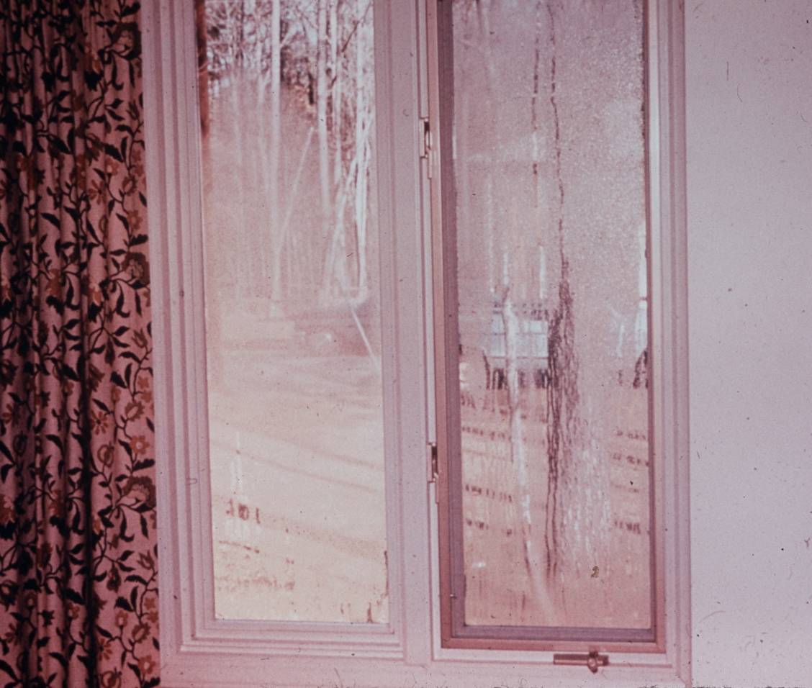
Increased relative humidity inside crawl spaces causes
the condensation of water, damaging window and allowing the development of molds & mildews inside
the home.
The high levels of humidity in
crawl spaces can be a problem
in both summer and winter. In
homes built on crawl spaces,
evaporation of moisture from
the earth is a major source of
humidity inside the home.
When cold air meets warm air,
water vapor condenses at the
interface.

Slide 46

Increased relative humidity
on the inside the structure
causes the increase of energy costs
to run the air-conditioner & dehumidifier
Controlling humidity in your
crawl space can help you save
money on energy bills.
In addition, it can make you feel
more comfortable in your home.

Slide 47
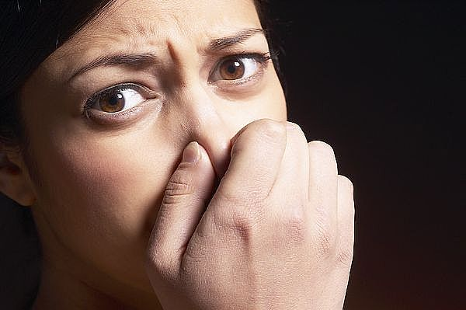
Molds and mildews developing inside the crawl space of homes that have excess moisture in the crawl
space cause bad odors inside of the home.
No one likes the smell of a “moldy” home!

Slide 48
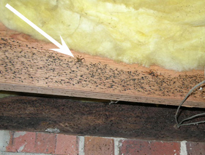
Excessive moisture levels in the crawl space of homes facilitates conditions which favor many pests
that may enter the home:
American and Smoky brown cockroaches
Cave or camel crickets
House centipedes
Slugs
Psocids (book lice)
Carpenter ants
Old house borers
Powder post beetles
Subterranean termites

Slide 49
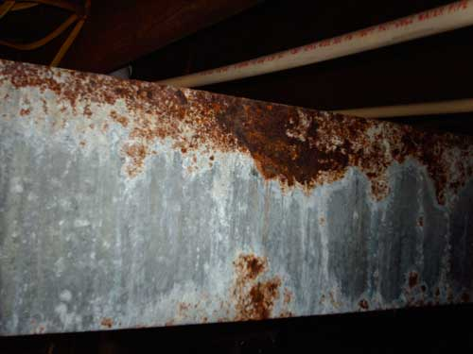
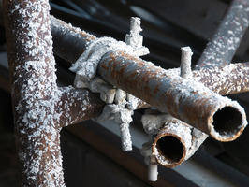
Foundation vents that are left open in the winter may result in moisture conditions in the crawl space which cause rusty pipes, rusty heating units, and frozen water pipes

Slide 50
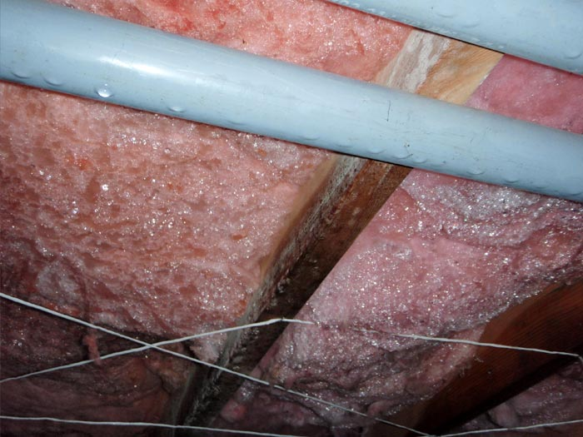
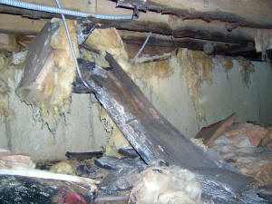

Excessive moisture in the crawl
space may ruin subfloor insulation
the insulation may retain moisture
and loose its insulation value
the insulation may get so water-
logged that it falls to the ground
the insulation may develop mold
and mildew all over it.
50

Slide 51



What are some causes of excess moisture in the crawl?
High environmental moisture.
Georgia is located in an area of
high moisture.
Moisture intrusion from the
surrounding environment (high
humidity, rain, ice, moisture
Crawl space moisture evaporating
from the soil and condensing on
structural wood of the crawl space

Slide 52




What are some causes of excess moisture in
the crawl space?
Plumbing leaks

Slide 53


What are some causes
of excess moisture
in the crawl space?
Landscape features:
A grade that is tilting
down to the structure,
overwatering shrubs
and flower beds that
are adjacent to the
exterior foundation
walls of the crawl space

Slide 54




What are some causes of excess moisture in
the crawl space?
Uninsulated or poorly insulated heating or AC ducts

Slide 55


What are some causes of excess moisture in
the crawl space?
Large heating/AC ducts block cross ventilation
of the air in the crawl space

Slide 56


What are some causes of excess moisture in the crawl?
lack of proper vents
(size, number and
placement)
and/or
a vapor barrier

Slide 57







What are some causes
of
excess moisture
in the crawl space?
Lack of proper vents (size)

Slide 58

What are some causes of excess moisture in
the crawl space?
Lack of proper ventilation (shrubbery blocks air-flow)

Slide 59
What are homeowner concerns?
Health related problems
Damage to structural members of the home
Damage to the home and its contents
Development of molds inside the home
Increased energy costs
Bad odors inside the home
Infestation of nuisance pests inside the home
Infestation of wood destroying organisms in
the crawl space
Damage to pipes and freezing of pipes

Slide 60
So, how do we prevent wood decay in crawl space homes?
Keep the moisture level of wood
in crawl spaces below the FSP.
60/100

Slide 61






Moisture meters used to detect moisture levels in wood
Moisture meters used to detect moisture
levels in wood
Delmhorst moisture meters
Tramex moisture meters
If the moisture meter has pins:
Consult the temperature and
type of wood charts to
interpret the moisture meter
readings.
Always point the pins along
the grain of the wood

Slide 62

Temperature Conversion Chart
Temperature Conversion Chart
Excessive moisture that could enable wood decay spores to germinate and cause wood decay to structural timbers of the crawl space.
26 + 3 = 29

Slide 63
Temperature Conversion Chart
Temperature Conversion Chart
Excessive moisture that needs to be controlled, but not yet active wood decay in the structural wood of a crawl space.
20 + 3 = 23

Slide 64
So, what kind of services do most PCOs
use to control or prevent wood decay
fungi in crawl space structures?
Inspect to determine the moisture source
Isolate wood-to-earth contacts
Provide adequate ventilation
Install vapor barriers
Chemical treatment of wood (BORACARE)
A growing # of PCOs provide encapsulation of the crawl

Slide 65
And…what are the minimum standards
required to control or prevent wood
decay fungi in structures?
64/100

Slide 66
So, what are the minimum standards
for the control or the prevention
of Wood Destroying Fungi?
(4) Minimum adequate treatment for control or prevention of
wood destroying fungi shall include the following:
(a) When infestation is located in a crawl space, treatment shall
include the Installation of a polyethylene or other water
impervious vapor barrier to at least seventy (70) percent of the
exposed soil surface in the enclosed space and insure that
ventilation of the under-floor space between the bottom of the
floor joists and earth meets the current requirements of the
International Residential Building Code, the latest edition as
adopted and amended by the GA Dept. of Community Affairs.

Slide 67

A vapor barrier traps moisture underneath it

Slide 68
Installation of a polyethylene or other water impervious vapor barrier to a minimum of seventy (70) percent of the exposed soil surface in the enclosed space…
and insure that ventilation of the under-floor space between the bottom of the floor joists and earth meets the current requirements of the International Residential Building Code, the latest edition as adopted and amended by the GA Dept. of Community Affairs.
40’
V
40’
x 24’
960 sq.ft.
Does this meet the standards
for control of wood destroying fungi?
6.4 sq. ft.
Foundation
wall
150
960
2’
6.4 sq. ft.
x 144
921.6 sq. in.
75% coverage of soil by vapor barrier/retarder
24’
V V
7.2 vents
Uncovered
soil
128 921.6
In order to meet the standard for proper ventilation, the crawl must have at least 70% coverage of the soil with a Class 1 vapor barrier (4 or 6 mm) and have a minimum of
1 sq. ft. of ventilation/150 sq. ft. of soil with a vent within 3’ of each corner (to outside)
It has only 5 standard vents (an insufficient # of sq. ft. of ventilation) and it does not have any vents within 3’ of each corner to the outside of the crawl space
NO! Why?
V V
Vapor barrier
7.2 vents = 8 vents

Slide 69
In order to meet the standard for proper ventilation, the
crawl must have at least 70% coverage of the soil with a
Class 1 vapor barrier (4 or 6 mm) and have a minimum of
1 sq. ft. of ventilation/150 sq. ft. of soil with a vent within 3’
of each corner (to outside)
40’
40’
x 24’
960 sq.ft.
V V
V
Foundation
wall
This meets the standard for adequate ventilation.
6.4 sq. ft.
150
960
2’
6.4 sq. ft.
x 144
921.6 sq. in.
75% coverage of soil by vapor barrier/retarder
24’
V V
7.2 vents
Uncovered
soil
128 921.6
V V V
Vapor barrier
7.2 vents = 8 vents

Slide 70
Does this crawl space meet the ventilation requirements?
It has 8 standard vents (8” X 16”) and a Class 1 vapor barrier
24’ – 6’ =18’
40’
X18’
720 sq. ft.
40’
X 24’
960 sq. ft.
V V V
V
Yes, it meets the standard!
V
3’
720 sq. ft.
960 sq. ft.
150 960 sq. ft.
= 75%
Coverage of soil by vapor barrier
24’
6.4 sq. ft.
24’
3’
6.4 sq. ft.
X 144 sq. in.
921.6 sq. in.
Why does it meet the standard?
It has a Class 1 vapor barrier that covers at least 70% of the soil of the crawl and
has 8 standard vents with a vent within 3’ of each exterior corner
7.2 vents
128 921.6
V V V
7.2 = 8
Standard
vents
40’

Slide 71
Remember – the crawl must meet the ventilation requirements!
It has 4 standard vents (8” X 16”)
Does the crawl space soil have 90% coverage with a 4 or 6 mm vapor barrier
with at least 1 sq. ft. of ventilation per 1,500 sq. ft. of soil in the crawl space,
with the vents placed within 3 feet of each corner or have cross ventilation?
V
V
40’
X 25’
1,000 sq.ft.
A class 1 vapor barrier covers all but 1’ of soil on two sides
23’ X 40’ = 920 sq. ft. 25’ X 40’ = 1,000 sq. ft. 920 sq. ft. = 92% coverage
1,000 sq. ft.
.67 sq. ft.
1,500 1,000
.67 sq. ft.
X 144 sq. in.
96.48 sq. in.
25’
.75 vent
Yes, it does. The vapor retarder cover > 90% of the soil
of the crawl and there is the correct amount of sq. ft. of
ventilation. It has vents within 3’ of 3 corners
does have cross ventilation.
128 96.48
.75 = 1 vent, but must have at least a standard vents within 3’ of each of the 4 corners
V
V
40’
70/100

Slide 72
This crawl space has 3 standard vents (8” X 16”) and
the Class 1 vapor barrier covers all the soil except 1’ on two sides
23’ X 40’ = 920 sq. ft. 25’ X 40’ = 1,000 sq. ft. 920 sq. ft. = 92% coverage
1,000 sq. ft.
V
40’
X 25’
1,000 sq. ft.
The Class 1 vapor barrier covers all but 1’ of soil on two sides
Does it meet the standards
for the control of wood destroying fungi?
.67 sq. ft.
1,500 1,000
.67 sq. ft.
X 144 sq. in.
96.48 sq. in.
25’
.75 vent
Yes, it does! Why?
It has a Class 1 vapor barrier that covers at least 90% of the soil of the crawl and has
1 sq. ft. of ventilation/1,500 sq. ft. of crawl space soil with at least two standard vents providing cross-ventilation
128 96.48
V
.75 = 1 vent, but must have at least 2 standard vents with cross ventilation
V
40’

Slide 73


Minimum adequate treatment for the control or prevention
of wood destroying fungi in crawlspace structures
(b) In addition to the above requirements, when an infestation of water conducting
fungi is located in a crawlspace, control measures shall include the following:
1. Cut the visible rhizomorphs and scrape visible fungal growth from the foundation walls.
2. Removal of all wooden contacts between buildings and inside crawlspace soil,
other than those wooden supports which have been treated with preservatives
to a minimum preservative retention designed for ground contact.
Wood touching soil – Not OK
Wood not touching soil - OK

Slide 74



All these wooden supports need to be removed and replaced with house jacks

Slide 75







Removing wood-to-earth contacts (unless pressure-treated for ground
contact) or properly insulate them from contact with the soil
Most often, we replace wooden piers or posts with properly installed house jacks (supports)

Slide 76
Chemical treatments to the wood are not required, but may help control wood decay fungi/surface
molds & mildews
BORA-CARE, Borathor, BoRam, and other borate products
are used most often by PMP
Borates are highly toxic to plant life
Applied with spray equipment or brush
Following label directions is critical to success
(read and follow the label)
The source of moisture must be addressed to ensure
long-term control of wood decay fungi and surface fungi
80

Slide 77

To dye or not to dye…that is the question
Wood treatment for control of wood decay fungi
You are not required to add a dye or a marker to a borate treatment
when you treat wood for the control of wood decay fungi…but adding
dye to the borate solution makes it easier to insure that all the wood is
treated.
If you use a borate treatment for the
control of subterranean termites in
wood, you will need to add a dye or
a marker to the borate solution.
Wood treatment for control of subterranean termites

Slide 78
Preventing excess moisture in crawl spaces is a complicated issue in the South
There will be times when adequate ventilation and
a vapor barrier will not prevent wood decay or any
of the other problems that are often associated with
excess moisture in the crawl space.

Slide 79
Other services
some PCOs use to prevent or control
excess moisture in crawl space wood:
Fix plumbing leaks and roof leaks
Altering the grade to improve poor drainage
Foundation water-proofing and adding french drains
or other drainage systems to improve poor drainage
Venting dryer vent to outside (not crawl space)
Insulation of H/AC ducts
Adding gutters
Installing sump pumps
Encapsulation

Slide 80


Repairing plumbing and roof leaks

Slide 81

Altering the grade is necessary when the grade is responsible for accumulating H O in the crawl
2
Poor grade,
channeling
rain water
into the crawl
Crawl space
Altered grade,
channeling rain water away from the crawl
Crawl space
85

Slide 82


Installing a Foundation Waterproofing
and a French Drainage System
Foundation waterproofing is necessary to prevent soil moisture from entering the structure through the foundation wall and a French drainage system is installed adjacent to the bottom of the foundation wall at the footer and covered with a bed of crushed rock (gravel) to permit water to drain into the drainage system and away from the structure.

Slide 83

Efflorescence in a “dug-out” crawl space
Efflorescence is a crystalline deposit on surfaces of masonry, stucco or concrete. It looks like white powder. It is an indication of a moisture problem in the crawl space.
This crawl space probably needs foundation
water proofing and a French drainage system
90

Slide 84


A dryer vent is disconnected and is dumping moisture into the crawl space
It needs to be corrected!

Slide 85

Insulation of heating/AC ducts
When the temperature of
the crawl space air is
significantly different from
the temperature on the
outer surface of the ducts
or the insulation of poorly
insulated ducts, “sweating”
or condensation occurs…
often contributing to decay
of structural wood near the
ducts and the accumulation
of excess moisture in the
crawl space.
Installing insulation to replace poorly insulated ducts that “sweat”, causing excess moisture in the crawl space

Slide 86




Installing gutter systems
Roof runoff and improper
grading allow water to
collect where it can enter
the crawl space through
cracks in the foundation
walls. Functioning gutters
and a finished grade that
slopes away from the house
ensures bulk moisture is
kept out of the crawl space.
No gutters
Gutters
“The Ugly”
Finished
grade sloping
towards home
“The Bad” “The Good”
Finished grade
sloping away
from home

Slide 87

Installing a sump pump in a crawlspace

Slide 88


Encapsulation…
The most expensive, but best option
for controlling and/or preventing wood decay fungi
Before After

Slide 89
If you choose to enter into a contract for control of wood decay fungi in GA…
If you sell a contract for control of wood destroying fungi, your treatment
must meet the minimum standards for control of wood destroying fungi.
However, if you sell the contract for control of excess moisture of the
crawl space or just sell an Encapsulation contract and do not refer to
control of wood destroying fungi, that work is not under the jurisdiction of
the Department of Agriculture which regulates the pest control industry.

Slide 90

Confucious knew
a lot about wood
decay fungi

Slide 91
Confucious say:
“When too much
water gets in the
crawl, there’s a
fungus among us”

Slide 92
Confucious say:
“Wet wood
is
no good!”

