Slide 1
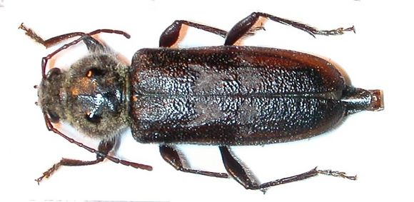
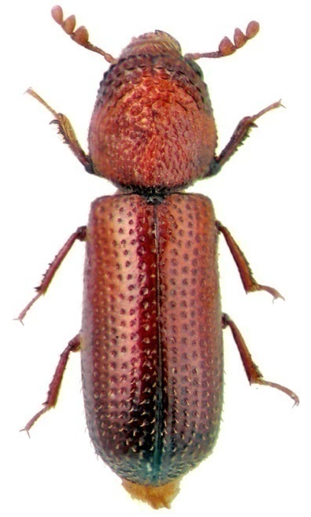
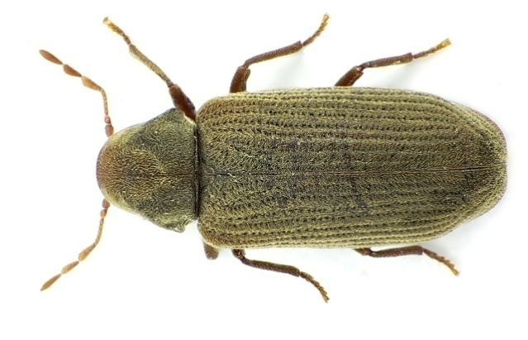
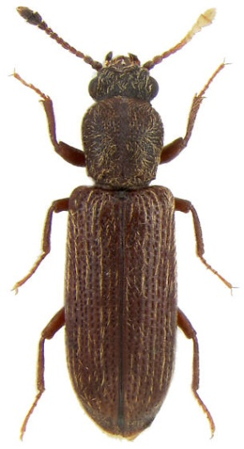
Identification of
Wood Destroying Beetles
and Their Damage
SUBFAMILY LYCTINAE
True Powder Post Beetle
FAMILY ANOBIIDAE Deathwatch or Furniture Beetle
FAMILY BOSTRICHIDAE
False Powder Post Beetle
FAMILY CERAMBYCIDAE
Old House Borer

Slide 2
Wood Destroying Beetles
Many different species and families of beetles attack wood
Most are not considered pests
  Their pest status depends on whether they can re-infest
  dry seasoned wood
In order of importance, these are the most important beetles that
attack and re-infest dry structural wood are:
  Powder post beetles (family Anobiidae)
  Old house borer (Hylotrupes bajulus)
  Powder post beetles (subfamily Lyctinae of family Bostrichidae)
  Powder post beetles (family Bostrichidae)

Slide 3
Reinfesting Wood Destroying Beetles
Remember the acronym LABO:
L yctinae – True Powder Post Beetle
A nobiidae – Deathwatch & Furniture Beetles
B ostrichidae – False Powder Post Beetle
O ld House Borer – Cerambycidae – Long horned wood borer

Slide 4
Characteristics used to identify the wood destroying beetle responsible for infesting dry structural wood
Time of year emerged from structural wood
Size & shape of exit hole (LABO)
Frass (sawdust)
Type of wood (hardwood or softwood)
Age of wood (new or old)
Size of insect (LABO)
Moisture of wood
Type of wood product infested

Slide 5
Time of the Year Emergence Occurs
L yctid = emerges December to early Spring
A nobiid = emerges April to June
B ostrichid = who cares, we rarely ever
see’em
O ld House Borer = emerges June to August

Slide 6
Size & Shape of Exit Hole (LABO)
Remember the acronym LABO
L yctid = Little Lyctid
(Round shape & 1/32” to 1/16” in diameter)
A nobiid = Average Anobiid
(Round shape & 1/16” to 1/8” in diameter)
B ostrichid = Big Bostrichid
(Round shape & 1/8” to 3/8” in diameter)
O ld House Borer = Oversized Old House Borer
(Oval shape and ¼” to 3/8” in diameter)

Slide 7
Feel & Consistency of Frass
Lyctid = very fine (like flour or baby
powder) & loosely packed
Anobiid = gritty (fine powder and small,
bun-shaped pellets, loosely packed
Bostrichid = fine to coarse powder, tightly
packed
Old House Borer = very fine powder and
tiny pellets, tightly
packed in galleries

Slide 8
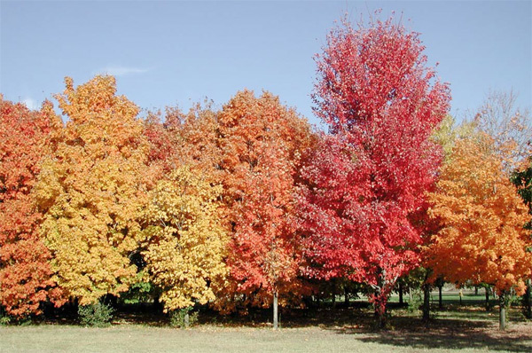
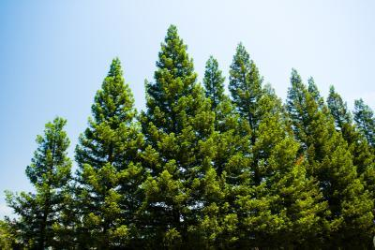
Type and Age of Wood
Hardwood
trees (oak & ash) loose
their leaves
in Fall &
Winter
Softwood
trees (pine &
spruce) don’t
loose their needles in Fall & Winter
New = 10 years or less since tree was fell Old = > 10 years from when tree was fell
Lyctid = usually new, but occasionally old
hardwood
Anobiid = usually old, but occasionally new
softwood & hardwood
Bostrichid = new softwood & hardwood
Old House Borer = usually new, but occasionally
old softwood

Slide 9
Size of the Reinfesting Wood Destroying Beetle Adult
Remember the acronym LABO
L yctid = Little Lyctid = up to ¼” in length
A nobiid = Average Anobiid = up to 1/3” in length
B ostrichid = Big Bostrichid = variable, 1/8” to ¾”
in length
O ld House Borer = Oversized Old House Borer =
from 5/8” to 1¼” in length (3/4”)

Slide 10
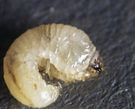
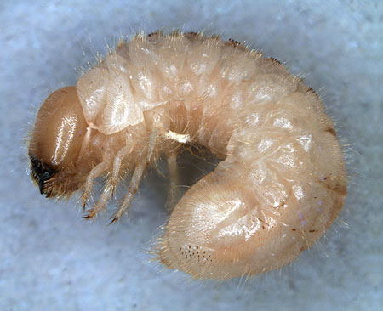
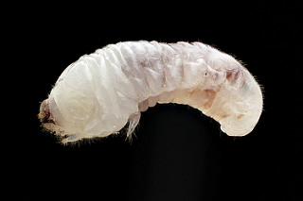
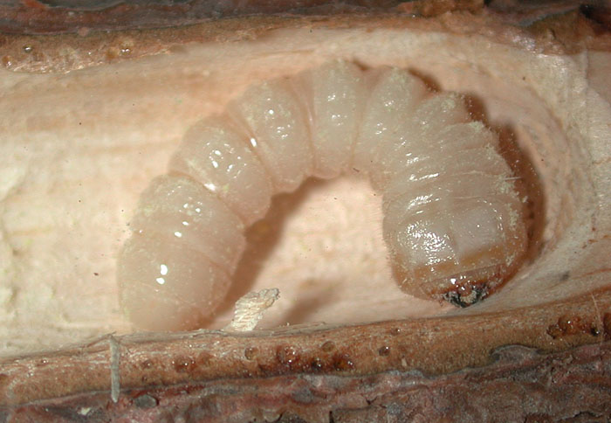
Size of the Reinfesting Wood Destroying Beetle Larva
Remember the acronym LABO
L ittle Lyctid = up to ¼” in length
A verage Anobiid = up to 1/2” in length
B ig Bostrichid = variable, 1/2” to 1” in length
O ver-sized Old House Borer = up to 1¼”
to 1½” in length

Slide 11
Moisture Requirements of Wood Destroying Beetles in Structural Wood
Lyctid = 6% to 30%
Anobiid = 13% to 30%
Bostrichid = 13% to 30%, some species higher
Old House Borer = at least 13%

Slide 12
Types of Wood Products Attacked By Reinfesting Wood Destroying Beetles
Lyctid = lumber and newly manufactured
products (cabinets & flooring),
usually found inside structures
Anobiid = Some manufactured products,
structural timbers and lumber
(most often found in crawl spaces)
Bostrichid = Manufactured products,
structural timbers and lumber
Old House Borer = Structural timbers and
lumber

Slide 13
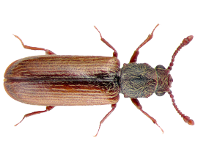
Life Cycle and Habits of Lyctid PPBs
True Powder Post Beetles
Adults are active in late winter to early spring
They infest hardwoods only!
They prefer new wood, less than 10 yrs. old,
but occasionally attack old wood.
Development usually takes about 1 year
Larva up to ¼” long, adults up to ¼” long
Their frass is fine, feels like flour or talcum powder and is loosely
packed
They require a high starch content in wood. Starch content
decreases with the age of the wood, so sometimes they fail to
attack old hardwoods

Slide 14
Identification of Adult
True Powder Post Beetles
The adult beetle is approximately ¼” in length
The head of the adult beetle is visible from
above, while the heads of both the Anobiid PPB
and the Bostrichid PPB are hidden under the
pronotum.
The True PPB is about the size of a stored product
beetle, but the last 2 segments of the antennae of
the True PPB are enlarged (clubbed).

Slide 15
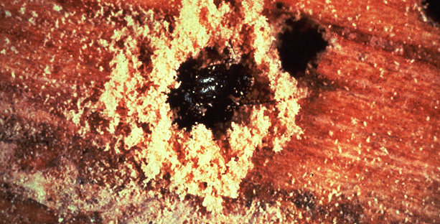
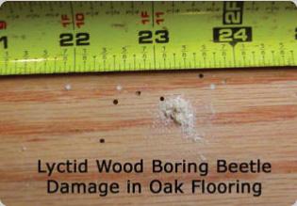
Identification of the True PPB from its frass
True PPBs emerge from 1/16” to 1/32”
diameter round exit holes in hardwoods
Their frass (sawdust) is very fine and
loose around the exit hole. It feels like
talcum powder or flour.

Slide 16
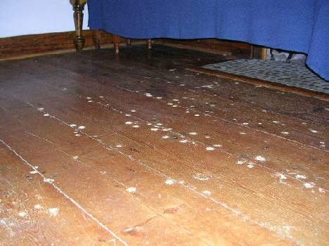
True PPB infestation and damage to wood flooring
Lyctids are not found in a
lot of homes.
They infest bamboo, oak,
and other hardwood
flooring and sometimes
hardwood cabinets.
Most often they emerge from the flooring within months of when
the flooring was installed. The flooring should be removed, thrown
away and replaced or fumigated and reinstalled.

Slide 17
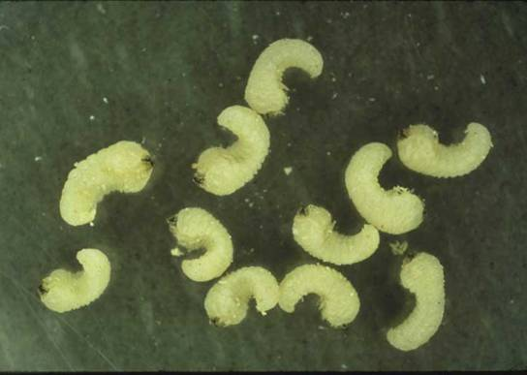
Size & Identification of True PPB Larvae
Lyctid larvae are C-shaped, up to ¼” long, and have an enlarged
thorax with legs that have long claws

Slide 18
Economic Importance of True PPBs
They only attack hardwoods.
Since homes are built of softwoods (pines & furs), Lyctids
are no threat to the structural integrity of our customers’
homes.
Hardwood flooring and furniture is sometimes infested.
It can be removed and replaced or removed, fumigated in a
vault or a van, and returned to the home.
Fumigation of the home is seldom warranted

Slide 19
Life Cycle and Habits of Anobiid PPBs
Deathwatch & Furniture Beetles
They emerge, mate, and lay eggs in April - June
Larvae develop in 1-5 years, commonly every 2
or 3 years in GA
Larvae are up to ½” long, adults up to 1/3” long
They tend to prefer old wood - 10 yrs. or older
Their frass feels gritty & streams out from emergence holes
They infest both softwoods & hardwoods
They are found east of Rockies (California) and are found
most commonly in Southeast (because of high moisture)

Slide 20
Life Cycle and Habits of Anobiid PPBs (continued)
Anobiids require moisture levels of 13% to 30% in wood to develop
That’s why they are often confined to the crawl space
They may infest wood inside the home if it is a “lake home” and the
heating/AC unit is not used that often.
Foreclosed homes that sit unoccupied for a long time without the heat
or AC may develop Anobiid infestations.

Slide 21
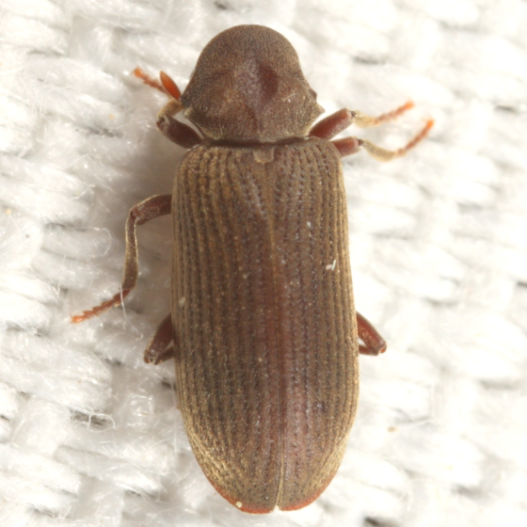
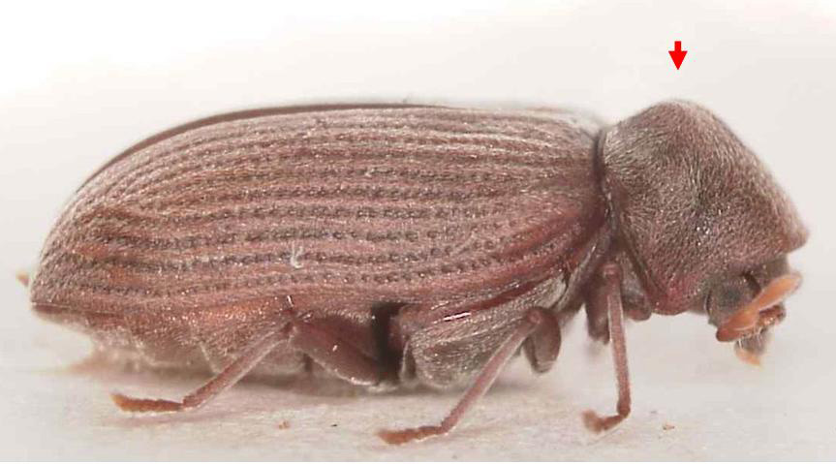
Identification of Adult Anobiid PPBs
Adult Anobiid PPBs generally have parallel lines running
lengthwise on their elytra and their head is hidden beneath

Slide 22
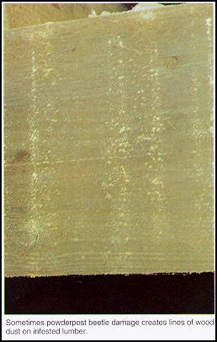
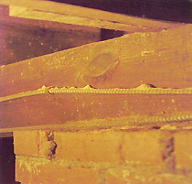
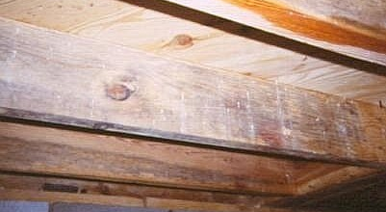
Frass streams down from exit holes in crawl space wood when PPBs exit
Exit holes are round and are from
1/8” to 1/16” in diameter
Anobiid frass often piles up on top of
ductwork in the crawl space, falls on top
of items stored in the crawl space, and
gets caught in spider webs

Slide 23
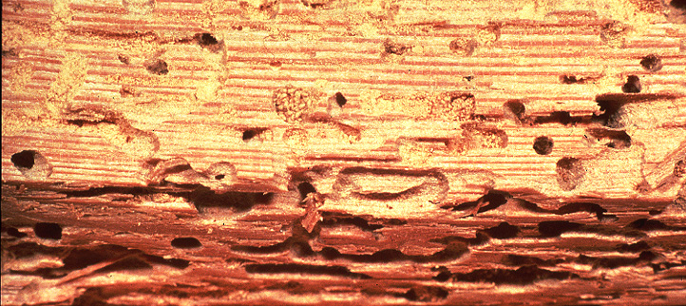
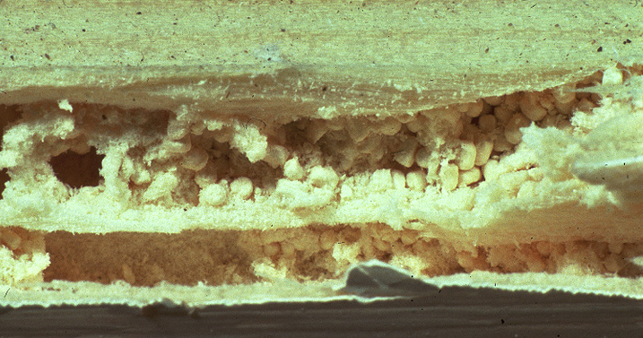
Anobiid PPB frass feels “gritty”
Anobiid larvae digest cellulose in wood with enzymes and
they excrete bun-shaped pellets. They get mixed with the
sawdust they produce as they bore through wood and it
makes their frass feels “gritty.”

Slide 24
Economic Importance of Anobiid PPBs
They attack both softwoods and hardwoods.
Since homes are built of softwoods (pines & furs), Anobiid PPBs can
present a significant threat to the structural integrity of our customers’
homes as well as their furniture and possessions.
Hardwood flooring and furniture are occasionally infested.
If Anobiid PPBs only infest structural wood below the 1st floor level of
the home, a wood treatment with a Borate product will usually provide
excellent control of PPBs in crawl space wood.
Fumigation of the home is usually warranted whenever the PPB
infestation is found above the 1st floor level of the home or is found on
the exterior of the home…but when the exterior wood is wet, the
fumigant may not penetrate the wood enough to kill the PPBs.

Slide 25
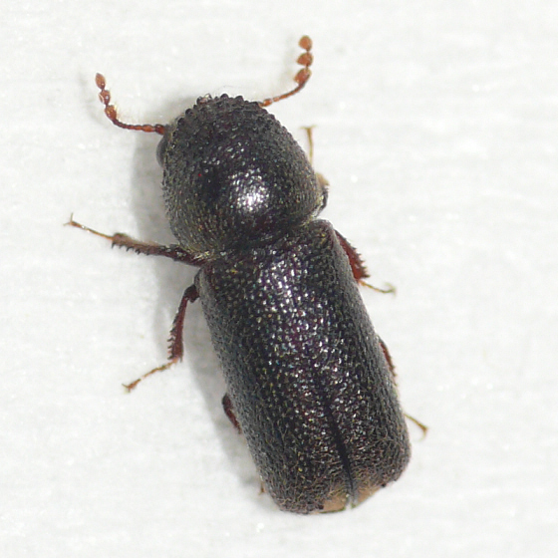
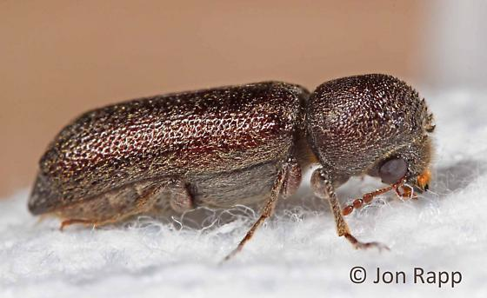
Life Cycle and Habits of Bostrichid PPBs
False Powder Post Beetles
They prefer new wood, less than 10 years old
They infest both softwoods and hardwoods
Bostrichids are rarely found in homes in
North America
They rarely re-infest the home
Often are found in bamboo or rattan
furniture, Asian or Mexican woods

Slide 26
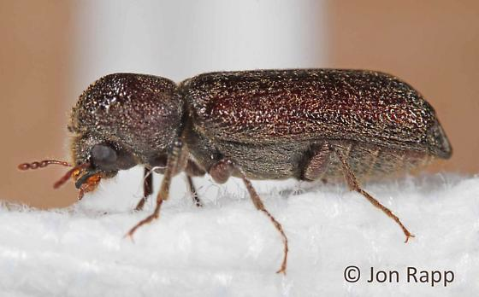
Identification of Adult Bostrichid PPBs
False Powder Post Beetles
False PPBs are shaped more rectangular
than oval.
Their heads are hidden from above
Their antennae have 3 enlarged
segments (clubbed)

Slide 27
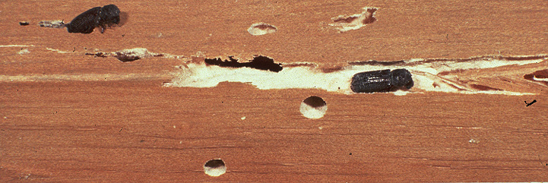
Both larval and adult Bostrichids eat wood
The Adult Bostrichid PPB makes round exit holes that are
1/8” to 3/8” in diameter as it emerges from the wood

Slide 28
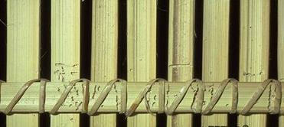
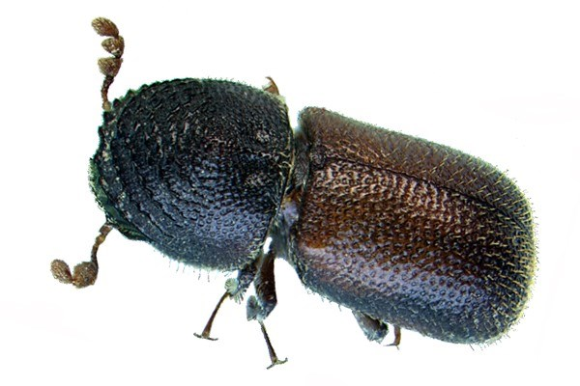
The Bamboo Borer attacks bamboo & rattan furniture

Slide 29
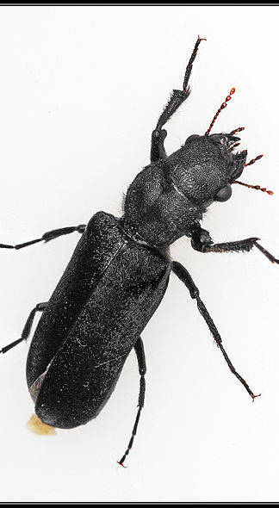
The Black Polycaon beetle is native to California
Adult false powder post beetles
are dark brown or black, sometimes
with reddish mouthparts, legs, and
antennae. Adults of most species are
about ¼” long, but one very
abundant native California species,
the black Polycaon, is 1½” to 2”
long. The head of this Bostrichid
beetle is visible from above. Its life
cycle can take up to 20 years to
complete.

Slide 30

Economic Importance of Bostrichid PPBs
Bostrichids rarely attack structural wood
in the U.S.
Flooring, furniture, and art objects are
occasionally infested.
Fumigation of infested furniture and art
objects is occasionally warranted.

Slide 31
Life Cycle and Habits of the Old House Borer
The Old House Borer is the only
Cerambycid beetle that reinfests
structures in the Southeastern U.S.
OHBs emerge from wood, mate
& lay eggs in June - August
OHB larvae require from 3 to 12 years
for development and mature larvae
are up to 1½” long
Contrary to it’s name, the OHB prefers
new wood that is less than 10 years old,
mostly due to the need for the larvae to be
in wood with a higher resin content.
Occasionally, they are found in old wood.
OHB activity typically drops during the Winter
OHBs are found primarily east of the Mississippi River

Slide 32
Identification of Adult Old House Borers
The adult OHB beetle is
about 5/8” to 1” in length
from the tip of the head
to the end of the abdomen.
There are two shiny black
raised areas on the pronotum
and there are many fine gray
hairs on the sides of pronotum
There are white chevron
marks on each elytra

Slide 33
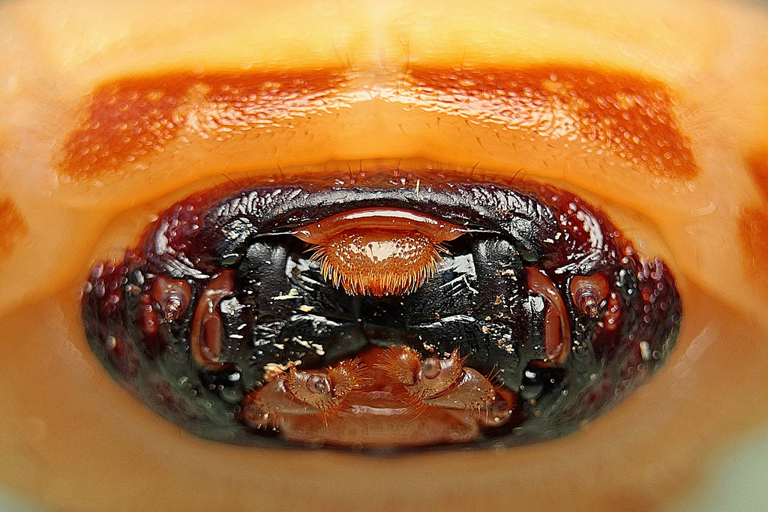
Identification of Old House Borer Larvae
The cream-colored larvae are up to 1½” in length.
On each side of the head are three distinct, dark eyes
(ocelli) arranged vertically behind the mouthparts.

Slide 34
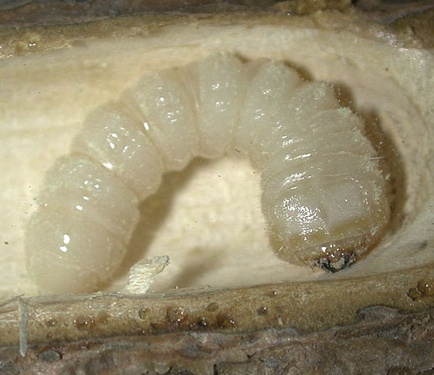
Identification of Old House Borer Larvae
(referred to as Round headed borers)
The larva, while chewing with
its mandibles, makes a rasping
or clicking sound (similar to
the sound produced by clicking
fingernails), often audible to
the homeowner.

Slide 35
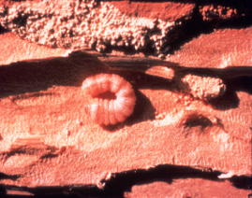
Identification of Old House Borer Damaged Wood
Where the OHB larvae
feed in wood, they leave
ripple-like ridges that
are parallel to each other

Slide 36
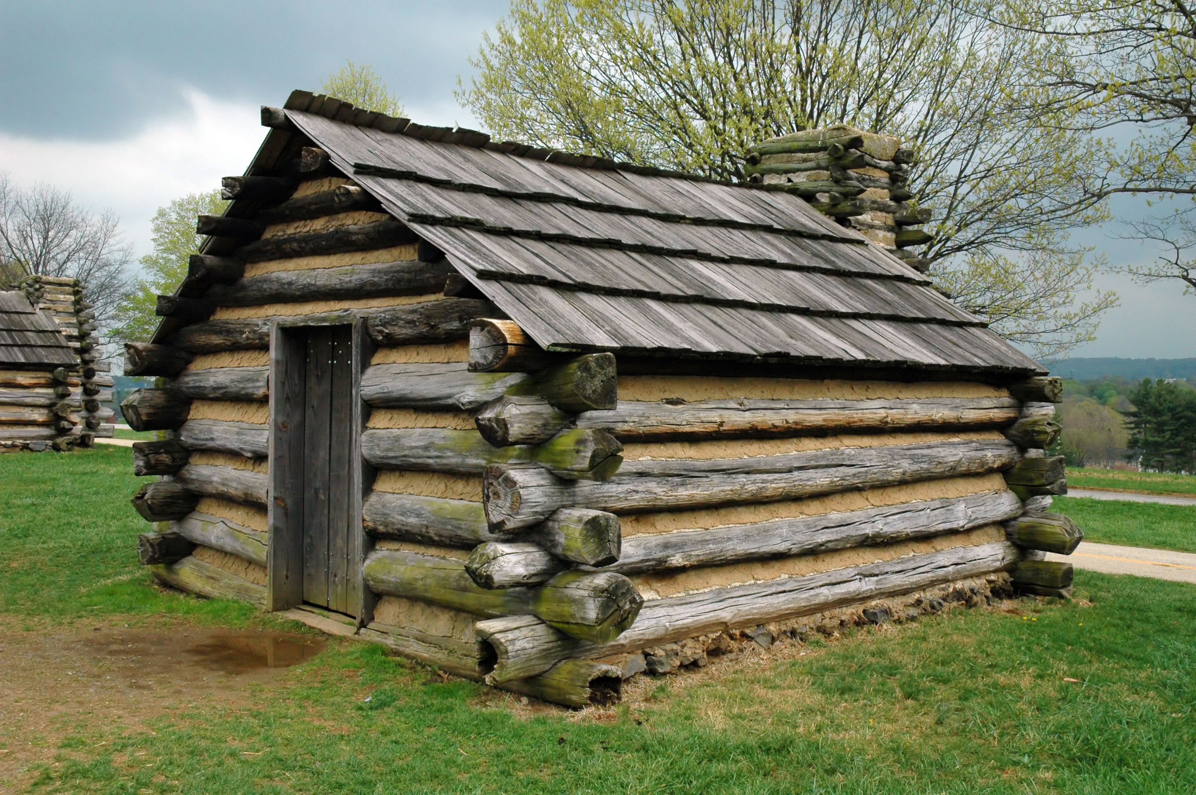
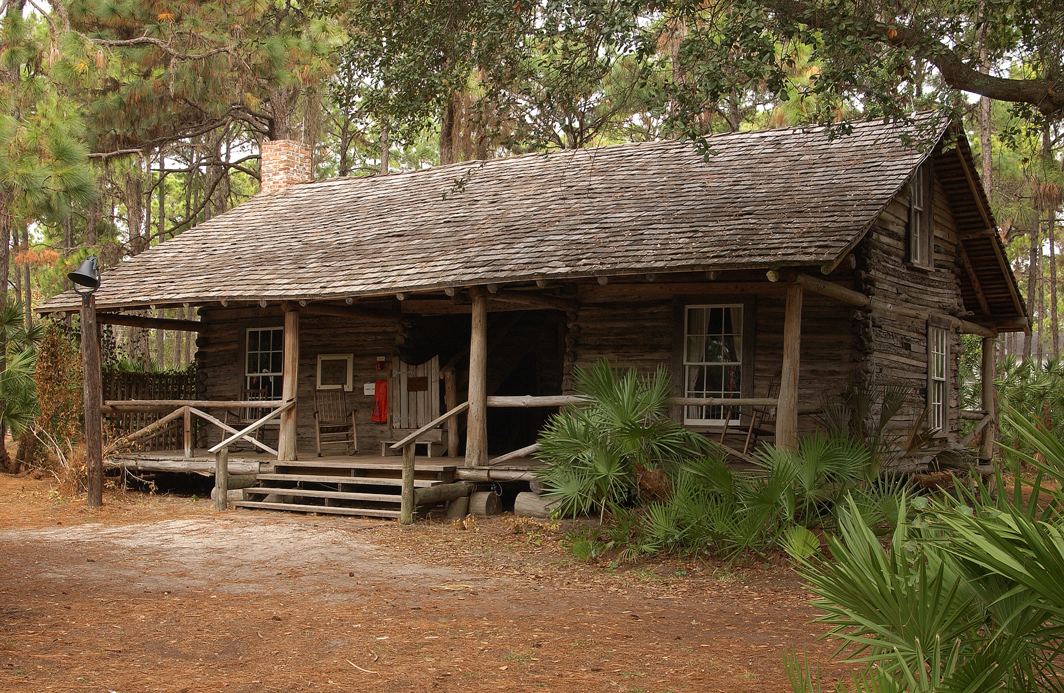
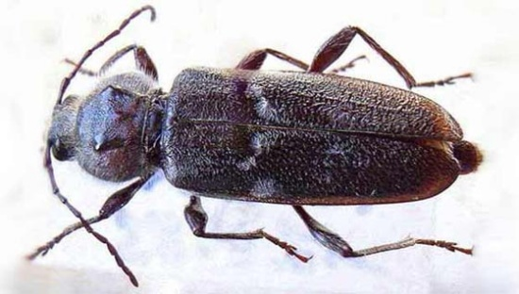
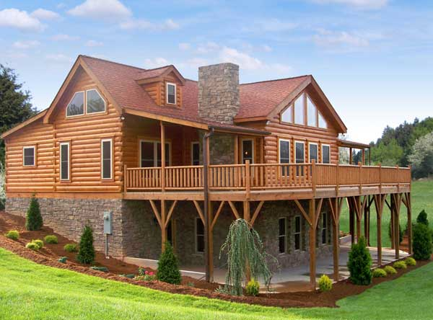
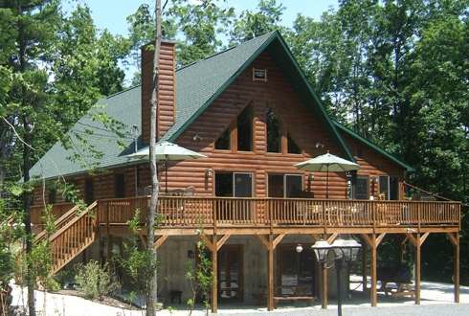
Log Cabins
An enemy of log cabins!

Slide 37
Economic Importance of Old House Borers
The majority of OHBs are generally found in thick timbers
of a building. Very few ever have been located in wood less
than one-inch thick.
Most structural infestations are started by OHB larvae in
the original construction timber.
Most infestations remain localized where excessive wood
moisture is found, in areas such as poorly vented attics and
leaky roofs. Beetles will flourish, spread to other structural
items and cause much damage in a short period of time.

Slide 38
Economic Importance of Old House Borers
(continued)
Old House Borers can cause a significant amount of
damage in a short period of time.
Sometimes OHB infestation and damage in an attic goes
unnoticed for a long period of time.
Fumigation of lumber or structures is the only absolute
method of eliminating old house borer infestations,
particularly in structures.
The fumigation of a structure with Vikane gas fumigant
readily penetrates structural wood and can kills all stages
of the Old House Borer.

Slide 39
Comparison of Reinfesting Wood Destroying Beetles
Type of Beetle |  | LYCTID |  | ANOBIID |  | BOSTRICHID |  | CERAMBYCID
Type & Age |  | Hardwoods only |  | Soft & Hardwoods |  | Soft & Hardwoods |  | Softwoods only
of Wood |  | usually New |  | Old |  | New |  | usually New
Attacked |  | < 10 years old |  | > 10 yrs old |  | < 10 yrs old |  | <10 | yrs. old
 |  | Lumber, usually newly |  | Manufactured products, |  | Manufactured products |  | Structural timbers
Type of Product |  | manufactured products |  | structural timbers & |  | structural timbers & |  | and lumber
 |  | & flooring |  | lumber |  | lumber
Evidence |  | Round holes: |  | Round Holes: |  | Round Holes: |  | Oval Holes:
of |  | 1/32" - 1/16" |  | 1/16" - 1/8" |  | 1/8" - 3/8" |  | 1/4" - 3/8"
Damage |  | Frass is fine, like talcum |  | Frass feels gritty/coarse |  | Frass is fine to coarse |  | Frass is very fine
(Holes & Frass) |  | powder, loosely packed |  | loosely packed in |  | & more |  | powder with tiny
 |  |  |  | galleries |  | tightly | packed | pellets packed in | tightly galleries
Wood
Moisture |  | 6% to 30% |  | 13% to 30% |  | 6% to 30% |  | At least 13%
Content |  |  |  |  |  | (some species higher)
Length |  | 1 year |  | Usually 2 to 3 years |  | Usually 1 year |  | 3 to 12 years
of Life Cycle |  | (Maybe 3 months) |  | (1 to 5 years or longer)

Slide 40
Damage by Common Reinfesting Wood Boring Beetles
Insect | Wood | Age of | Shape of | Size of
Type | Type | Wood | Exit Holes | Exit Holes | Reinfesting?
Lyctid | Hardwoods | Usually New, | Round | 1/32" to 1/16" | Yes
Beetles |  | Occasionally
 |  | Old
Anobiid | Softwoods & | Usually Old, | Round | 1/16' to 1/8" | Yes
Beetles | Hardwoods | Occasionally
 |  | New
Bostrichid | Softwoods & | New | Round | 1/8" to 3/8" | Rarely
Beetles | Hardwoods
Old House | Softwoods | Usually New, | Oval | 1/4" to 3/8" | Yes
Borer |  | Occasionally
 |  | Old

Slide 41
Now that we’ve learned about the reinfesting wood destroying beetles…
Let’s learn about other non-reinfesting wood boring beetles.
There are many beetles that infest wood. Many of them
only infest wet wood (live trees or recently cut trees) and
will not reinfest dry structural wood. In most cases, they
will not need to be treated.
You need to be able to distinguish between reinfesting
wood boring beetles (which usually require treatment) and
non-reinfesting wood boring beetles (which usually do
not require treatment. Sometimes, that is very difficult.

Slide 42
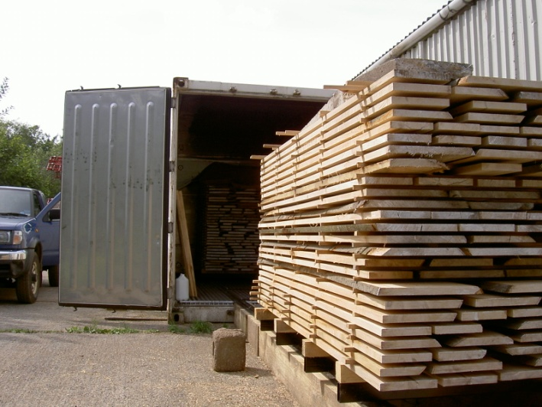
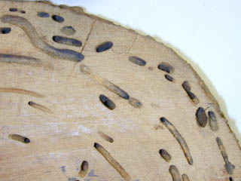
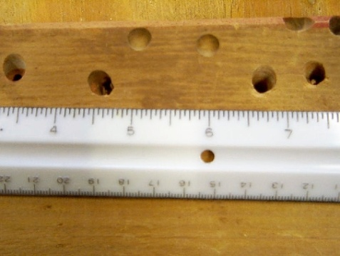
The Non-reinfesting Wood Boring Insects
Sometimes homes are built
with wood that is not properly
kiln-dried.
The wood boring insects are
already in the tree before it is
cut and used in homes.
The end result may be that
non-reinfesting wood boring
beetles emerge from the wood
after the house is built. In most
cases, treatment is not required.

Slide 43
Identifying the Wood Destroying Insect
Since we normally don’t find the adult or larva of the wood
destroying insect to identify, we must rely on other
characteristics to determine whether it is a non-reinfesting
wood boring insect that does not require treatment…and
that’s where the fun begins!
So, here’s all that you need to know about these other
wood destroying insects that do not reinfest dry structural
wood.

Slide 44
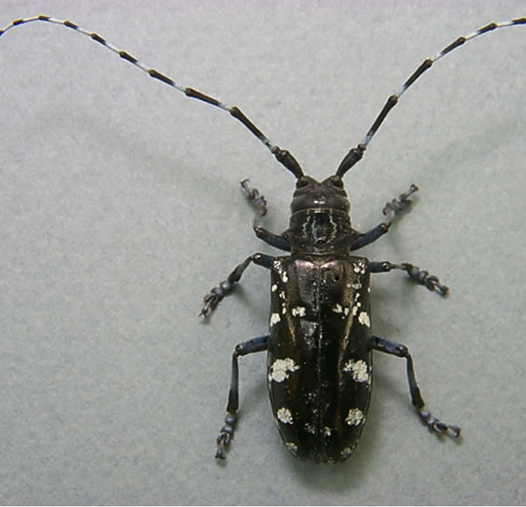
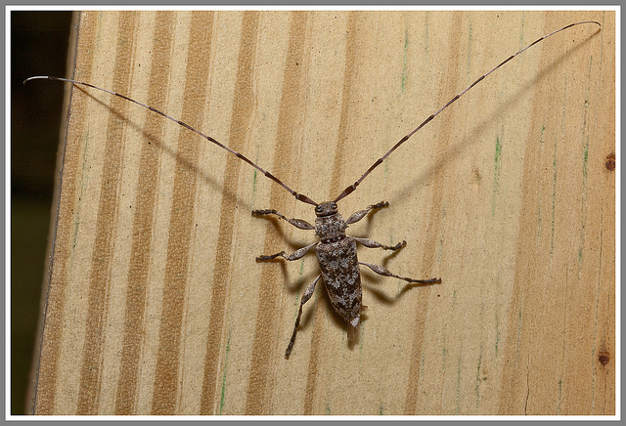
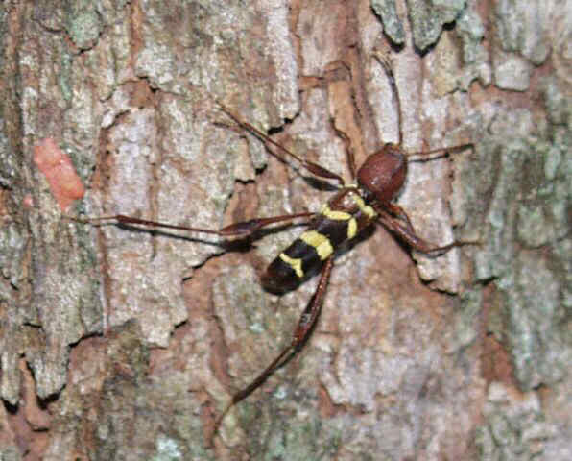
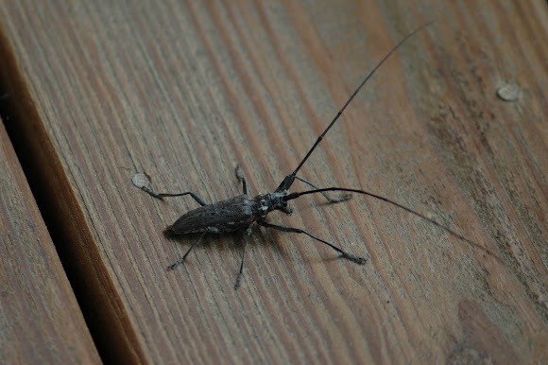
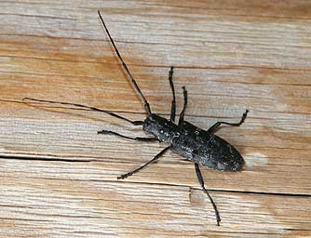
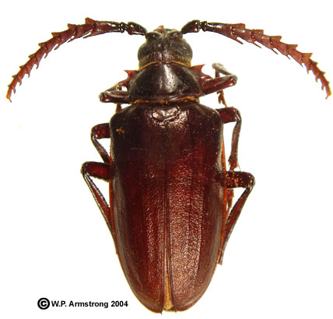
The Non-reinfesting Cerambycid Beetles
Long-horned wood borers

Slide 45
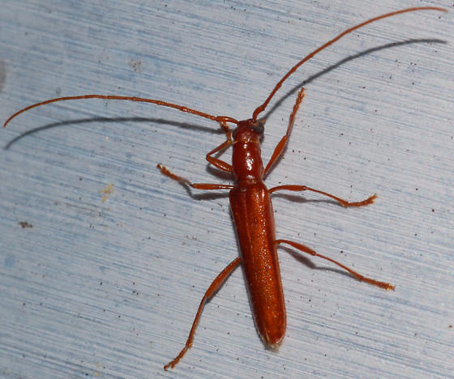
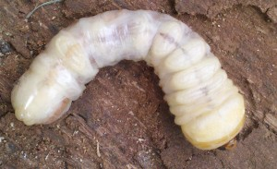
Non-reinfesting Cerambycid Beetles
The adult beetles are called
Long-horned wood borers
because of their long antennae.
Their larvae are called
Round-headed borers
because of their round heads.

Slide 46
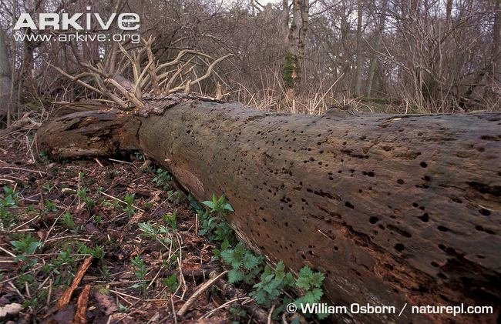
Non-reinfesting Cerambycid Beetles
Most Cerambycid beetles attack
live, dead, or dying trees and do
not reinfest dry structural wood
of homes.
They may emerge from newly built homes that have been
constructed with lumber that has not been kiln-dried.
Once they emerge, they will not reinfest the wood…unless
it is significantly moist.
Fumigation is generally not needed, nor recommended.

Slide 47
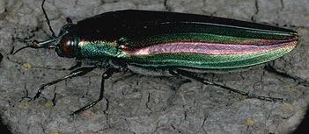

Non-reinfesting Buprestid Beetles
Metallic wood borers
They are called Metallic wood
borers as adults because of
their metallic-like color.
They are called flat-headed
borers as larvae because of
the broad flattened-shape
of the head of the larvae.
They often are found under
the bark of firewood.

Slide 48




Non-reinfesting Buprestid Beetles
Metallic wood borers infest trees
at the time of harvest before use
in construction.
A few Buprestids may have an
extremely long life cycle, which
may be as long as 51 years.
They may emerge from newly built homes that have been
constructed with lumber that has not been kiln-dried.
They are not a re-infesting wood boring beetle unless the
wood used is wet, occasionally found in log cabin homes.
Fumigation is generally not needed, nor recommended…
but that is up to the customer to decide.

Slide 49

Non-reinfesting Scolytid Beetles
Bark beetles
They are called Bark beetles
because as larvae, they feed
on the underside of bark of
dying, and dead trees.
They are only 1 to 6 mm
in size.
They do not damage structural wood of homes and do not need
to be controlled.

Slide 50



Non-reinfesting Scolytid Beetles
The larvae make finger-like galleries
at the interface between the sapwood
and the bark, on the underside of the
bark.
They do not make galleries in the
sapwood or heartwood of the tree,
so they do not damage wood that
will become structural wood.
While feeding, they often transmit
pathogens that may end up killing
the tree.

Slide 51



Non-reinfesting Scolytid & Platypodid Beetles
Ambrosia beetles
They are called Ambrosia beetles.
They attack dead or dying trees
and lay their eggs in the galleries
they make.
They do not damage structural
wood of homes.
No control is needed.
2 to several mm in length

Slide 52


Ambrosia Beetles attack live trees
Signs of Ambrosia Beetle infestation
of a tree (it appears like toothpicks
are sticking out from the tree)
The female Ambrosia beetle tunnels
in a live tree and makes galleries.
She lays eggs in the galleries,
carrying fungus spores.
The larva feeds on the fungus
which digest the wood, removing
toxins from the tree and they
mutually benefit.

Slide 53






Dark staining of the holes and galleries in wood are signs that
Ambrosia beetles attacked the tree as it was dead or dying

Slide 54


The Non-reinfesting Horntail
Family Siricidae - Order Hymenoptera
The adult Wood Wasp or Horntail
is named for the prominent ovipositor
at the end of the female’s abdomen.
These wasps are also harmless and
are common in conifer woods in July
and August. The female drills a hole
into fallen or damaged trunks to lay
her eggs. The larvae develop inside
the wood.

Slide 55


The Non-reinfesting Horntail
Occasionally, the wood is used in homes
without properly being kiln-dried.
They emerge from the ¼” exit holes
of structural wood of homes as adults.
but do not re-infest dry structural wood.
Most of the times, they emerge from
log homes.
No treatment is recommended.

Slide 56
Families of
Non-reinfesting Wood Boring Insects
Family Cerambycidae - Long Horned Wood Boring Beetles
(the Old House Borer is an exception)
(larvae = round headed borers)
Family Buprestidae - Metallic Wood Boring Beetles
(larvae = flat headed borers)
Family Scolytidae - Bark and Timber Beetles
Family Scolytidae & Platypodidae - Ambrosia Beetles
Family Siricidae – Horntails (wood boring wasps)

Slide 57


Treatment Options for Wood Destroying Insects
No treatment is recommended for these non-reinfesting
wood boring beetles.
Recommend that the firewood be removed from inside.

Slide 58

IPM Treatment Option for Powder Post Beetles or Old House Borers where infestation is limited to a few holes a couple of boards.
A few Old House
Borer exit holes
found only in these
pieces of window
trim.
It is recommended
that the infested
pieces of window
trim be removed
and replaced.
Obviously, one can’t guaranty there isn’t hidden infestation
behind walls or that reinfestation will not occur!

Slide 59
Treatment Options for Powder Post Beetles
If the infestation is in flooring and the flooring is less than 1 year old, I suggest that the owner of the home go back to the supplier of the flooring and ask for the flooring to be replaced “free of charge.”
If the flooring is older than 1 year old, I suggest that the flooring be replaced by the owner.
If cabinets are infested, I recommend that they be removed and fumigated.
True Powder Post Beetles

Slide 60
Treatment Options for Powder Post Beetles
If the infestation is widespread and/or heavy in hardwood paneling, expensive furniture, etc. and the price of fumigation is justified or the customer desires fumigation, I recommend that the entire structure be fumigated with Sulfuryl fluoride.
If the infestation in furniture or in cabinets and is not widespread, I recommend that they be removed from the structure and fumigated with Sulfuryl fluoride in a chamber or vehicle.
True Powder Post Beetles

Slide 61
Treatment Options for Powder Post Beetles
If the infestation is only in the wood of the crawl space (subflooring, joists, sill plates, headers, etc.), I recommend:
that the wood be treated with a Borate product in compliance with the label
that a Class 1 vapor retarder be placed over a minimum of 70% of the soil of the crawl space
and ventilation of the under-floor space
between the bottom of the floor joists and
earth meets the current requirements of the
International Residential Building Code, the
latest edition as adopted and amended by the
Georgia Department of Community Affairs.
Deathwatch or Furniture Beetles

Slide 62

All the wood of the crawl space needs to be treated with a Borate product that is labeled for the control of powder post beetles!

Slide 63
Treatment Options for Powder Post Beetles
If the infestation is in the wood of the crawl space (subflooring, joists, sill plates, headers, etc.) and either on the inside or on the outside of the structure, it is recommend:
that the structure be fumigated with Sulfuryl fluoride in compliance with the label
that a Class 1 vapor retarder be placed over a minimum of 70% of the soil of the crawl space
and ventilation of the under-floor space between the bottom of the floor joists and earth meets the current requirements of the International Residential Building Code, the latest edition as adopted and amended by the Georgia Department of Community Affairs.
Deathwatch or Furniture Beetles

Slide 64

If the infestation is in the wood of the crawl space (subflooring, joists, sill plates, headers, etc.) and either on the inside or on the outside of the structure, it is recommend that the structure be fumigated with Sulfuryl fluoride in compliance with the label, that a Class 1 vapor retarder be placed over a minimum of 70% of the soil of the crawl space and ventilation of the under-floor space between the bottom of the floor joists and earth meets the current requirements of the International Residential Building Code, the latest edition as adopted and amended by the Georgia Department of Community Affairs.

Slide 65
Treatment Options for Powder Post Beetles
If there is no infestation in the wood of the crawl space, but the structure is infested either on the inside (1st floor or above) or on the outside of the structure, it is recommend that the structure be fumigated with Sulfuryl fluoride in compliance with the label.
Deathwatch or Furniture Beetles

Slide 66
If the infestation is either in the wood inside the structure (1st floor or above) or on the outside of the structure, it is recommend that the structure be fumigated with Sulfuryl fluoride in compliance with the label.

Slide 67
Treatment Options for the Old House Borer
If there is infestation inside the crawl space and it is very limited in scope, it is recommended that:
the infested wood be removed and that the structure be treated with a Borate product in compliance with the label
that a Class 1 vapor retarder be placed over a minimum of 70% of the soil of the crawl space
and ventilation of the under-floor space between the bottom of the floor joists and earth meets the current requirements of the International Residential Building Code, the latest edition as adopted and amended by the Georgia Department of Community Affairs.
Old House Borer
Obviously, one could
not guaranty that
the treatment would
control the Old House
Borer infestation, as
some infested areas
may be hidden.

Slide 68
Treatment Options for the Old House Borer
If there is infestation inside the attic or
the house (but not in the crawl space)
and it is very limited in scope, it is
recommended that the infested wood
be removed and replaced with new wood.
Wood in the attic may be treated with a
Borate product (following the label).
If the infestation is inside the home, it is also recommended that the customer use a
dehumidifier inside the infested room/s if a heating/AC unit is not used on a regular basis.
If the infestation is in the attic, it is also recommended that ventilation be increased in the attic (attic fan or other means).
Old House Borer
Obviously, one could
not guaranty that
the treatment would
control the Old House
Borer infestation, as
some infested areas
may be hidden.

Slide 69
Treatment Options for the Old House Borer
If there is widespread infestation inside the structure, in the attic, above the subfloor of the crawl space or on the outside of the structure, I recommended that the structure be fumigated with Sulfuryl fluoride in compliance with the label.
Old House Borer

Slide 70
If the infestation is either in the wood inside the structure (1st floor or above) or on the outside of the structure, it is recommend that the structure be fumigated with Sulfuryl fluoride in compliance with the label.

Slide 71

So…that’s all folks!
I hope the information that I have provided you has given you a better understanding of wood destroying beetles.

Slide 72
Identification of Wood
Destroying Beetles
and Their Damage
Course #: W90419
1 hour of WDO

Slide 73
TAKE
A
MINUTE
BREAK
5

