Slide 1
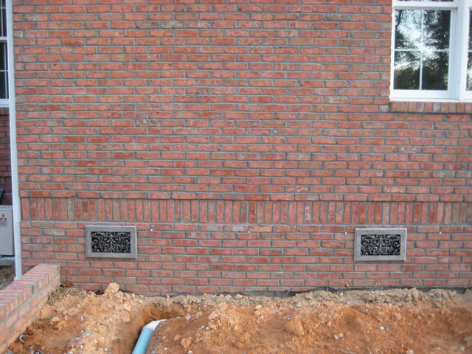
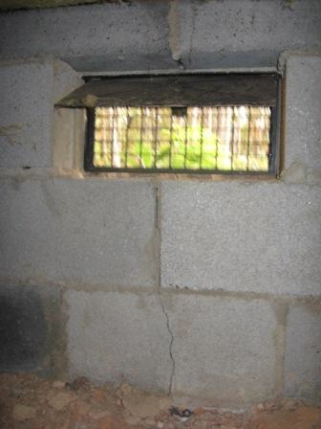
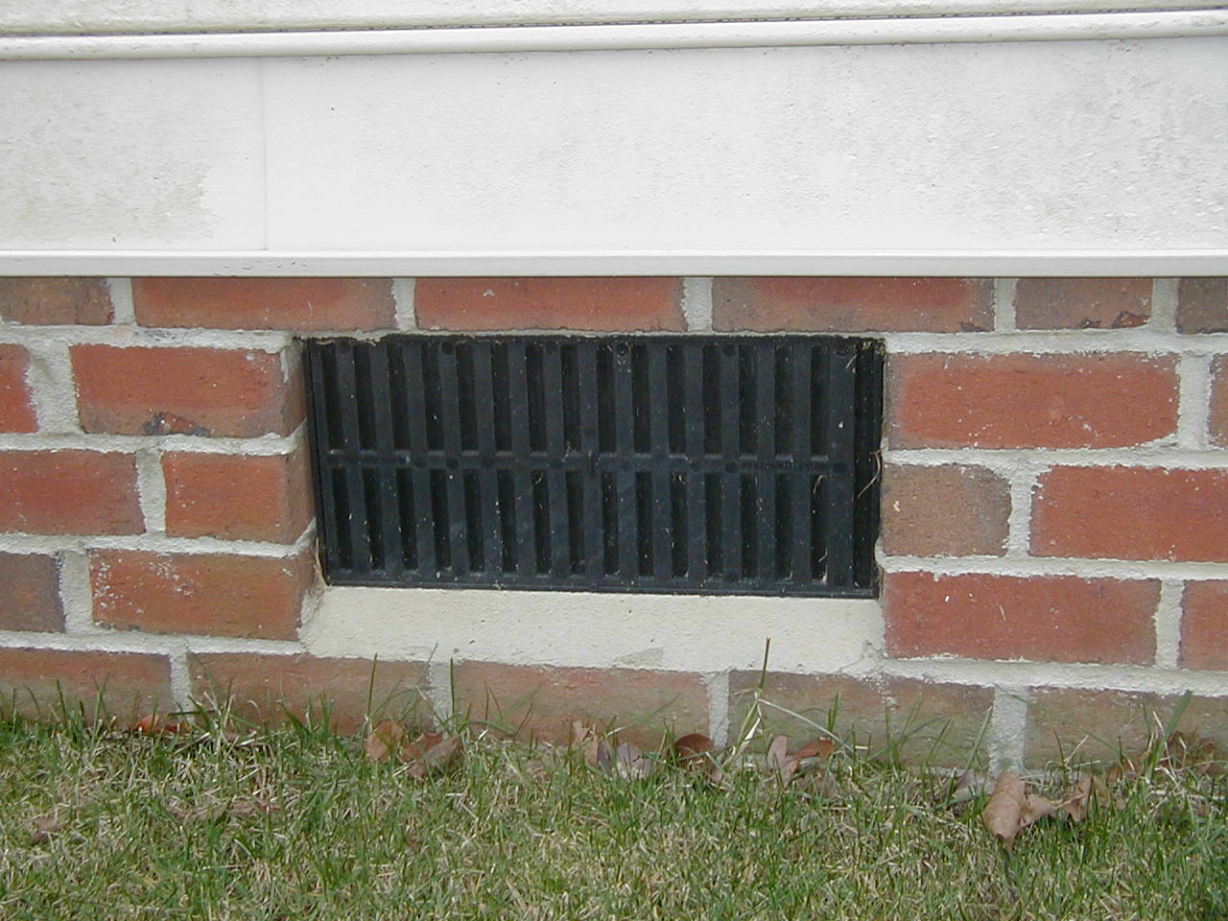
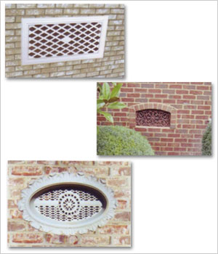
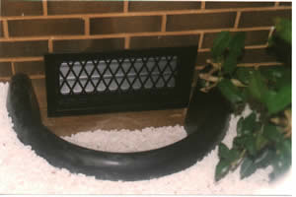
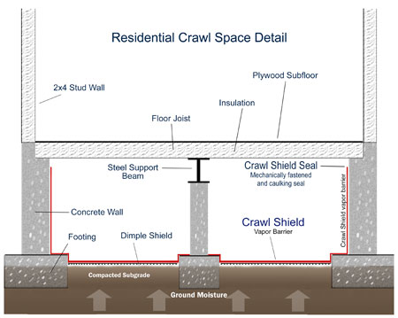
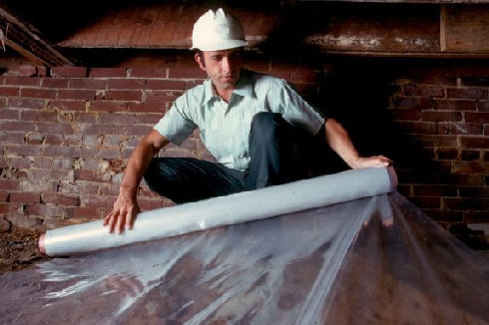
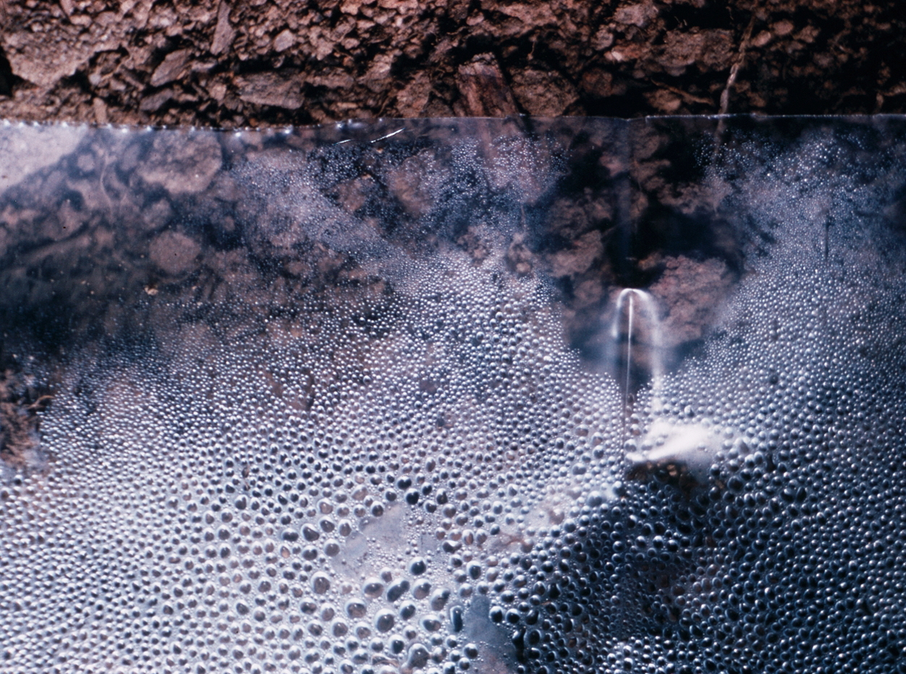
Ventilation
Vapor retarder
1

Slide 2
Ventilation of a crawlspace
Safety in a crawlspace
What is ventilation?
Why ventilate a crawlspace?
Why is it so important to our customers?
Why is it so important to PMPs?
Some examples of poor ventilation

Slide 3
Ventilation of Georgia crawl spaces
Before we discuss ventilation of crawlspaces, we should probably cover…
SAFETY
Hazards
How to recognize hazards
Safety equipment needed to avoid those hazards

Slide 4
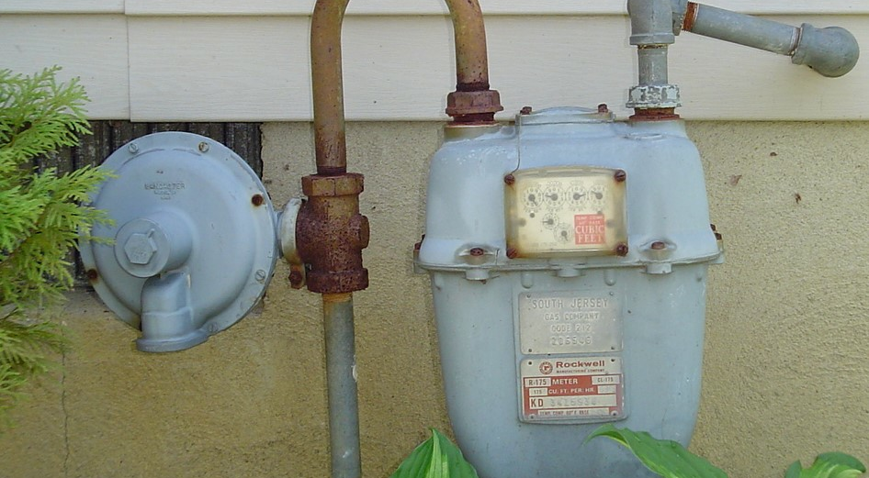
A natural gas leak
If you smell a gas leak, don’t go in the crawlspace!
If you are already in the crawlspace, get the heck out!

Slide 5
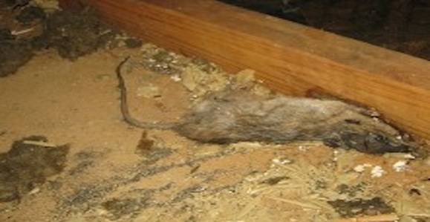
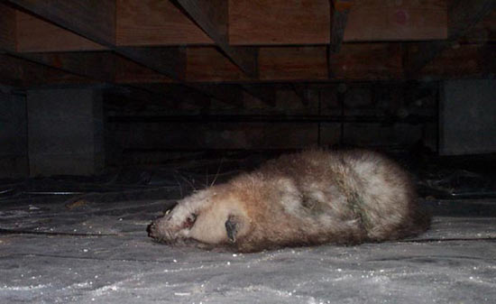
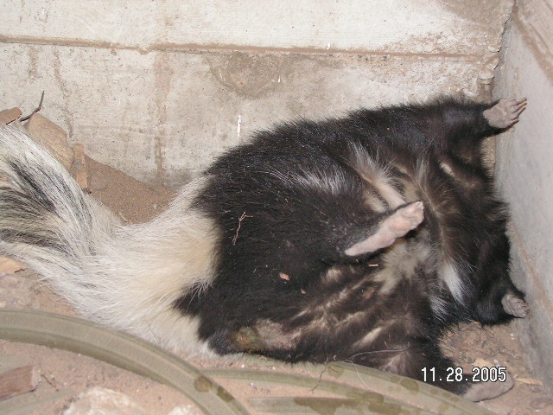
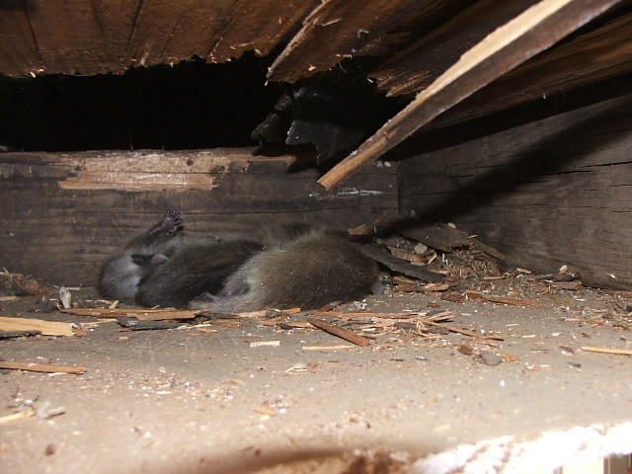
Follow your company’s policy and guidelines on dealing with dead animals!

Slide 6
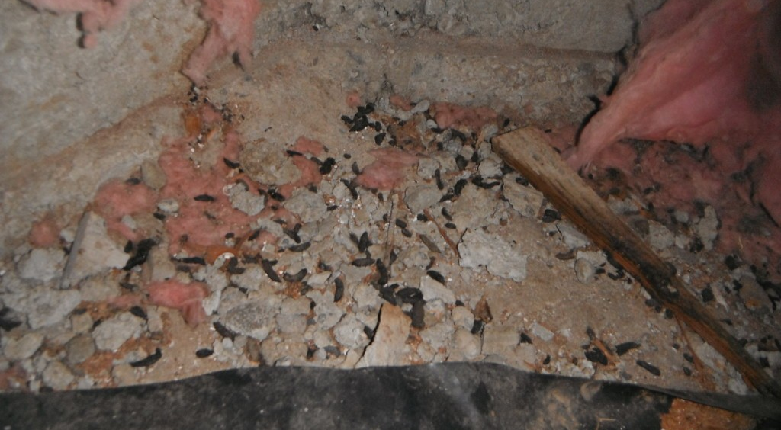
Rodent droppings and other animal fecal material in the crawlspace
Follow your company’s policy and guidelines on dealing with handling animal fecal material!

Slide 7
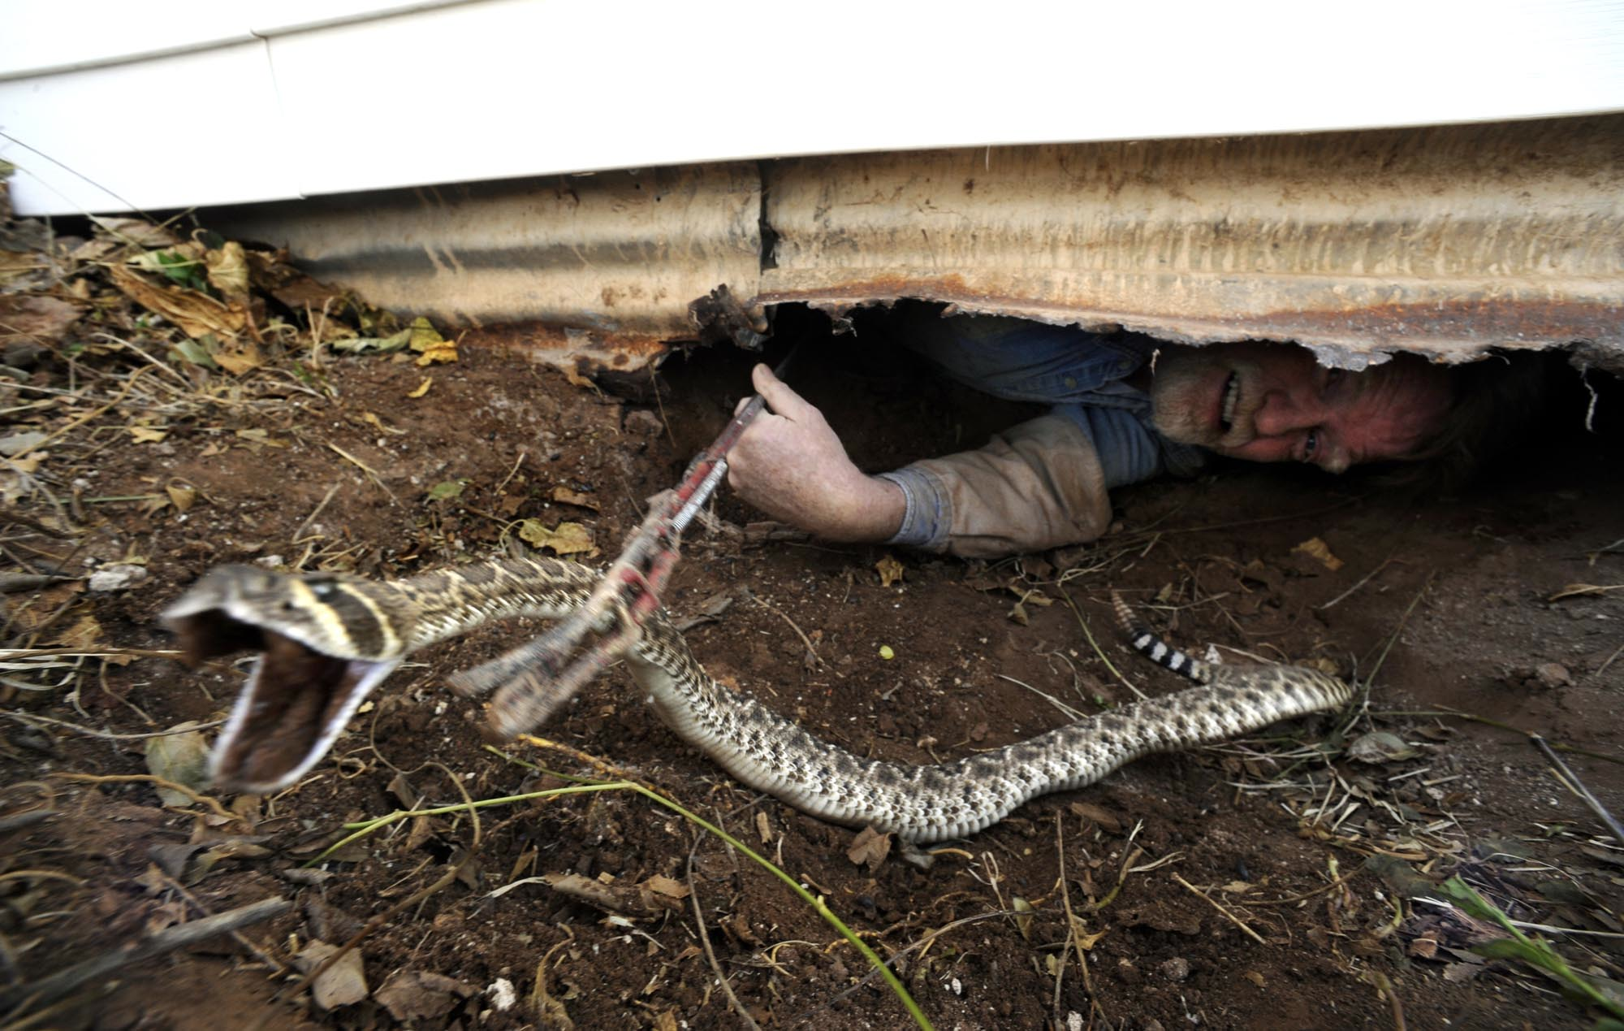
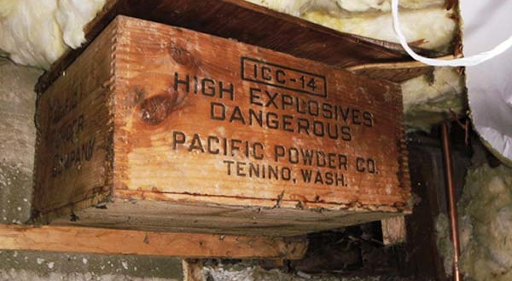
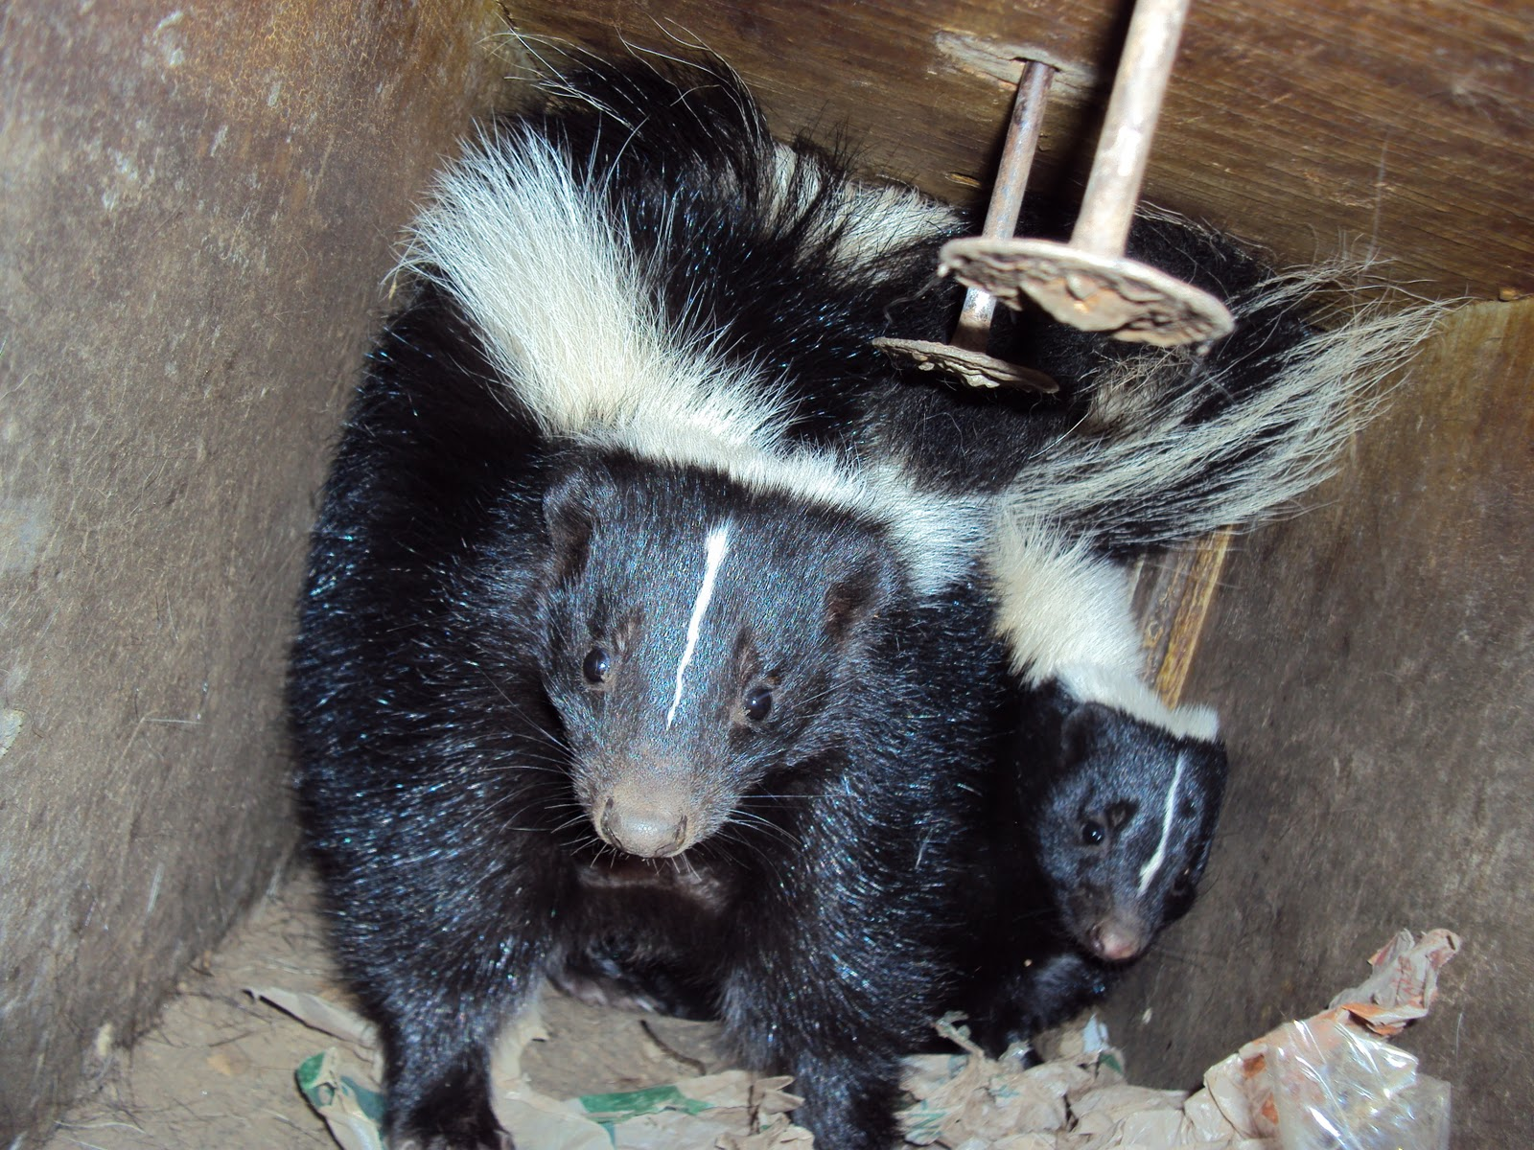
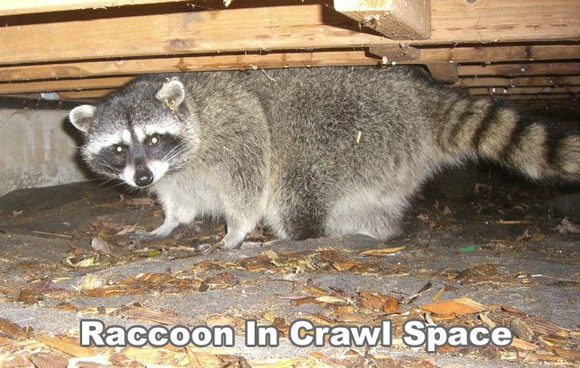
Follow your company’s policy and guidelines on dealing with live animals!
Which crawlspace are you
more comfortable in?

Slide 8

How about this 20’ reticulated python that was found underneath a crawlspace in Fort Lauderdale, FL in 1989?
Perhaps a spare pair of underwear would be in order!

Slide 9
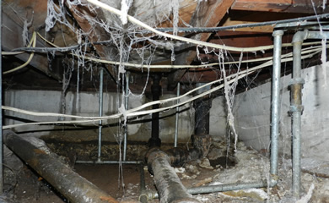
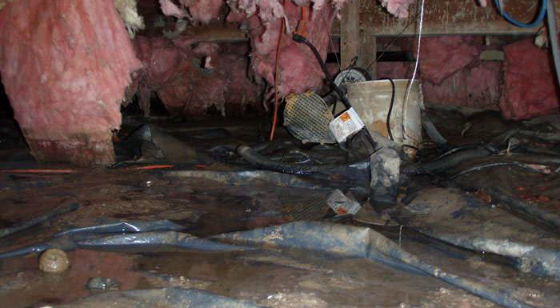
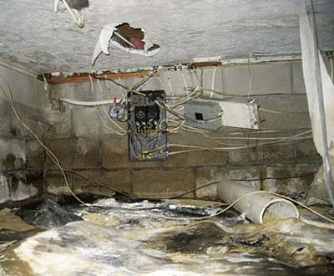
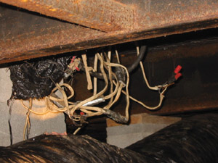
Ground moisture and electricity…
are not
a good
combination!
Follow your company’s policy on avoiding the possibility of electrocution!

Slide 10
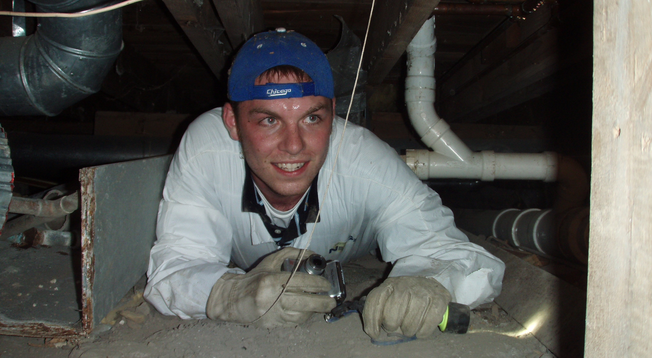
No bump cap…have you ever bumped your head against floor joists?
What’s wrong with this photo?
10

Slide 11
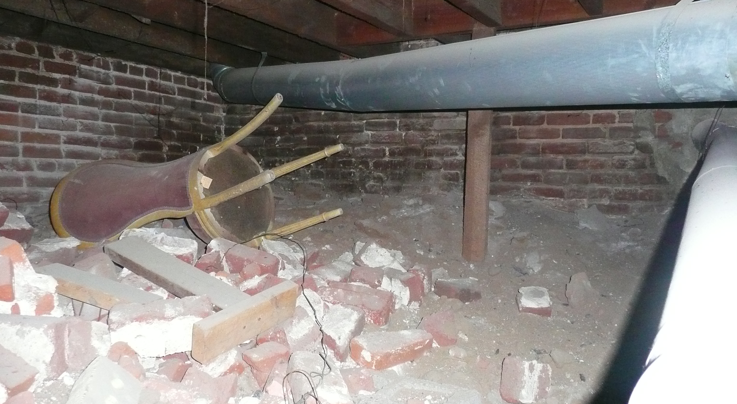
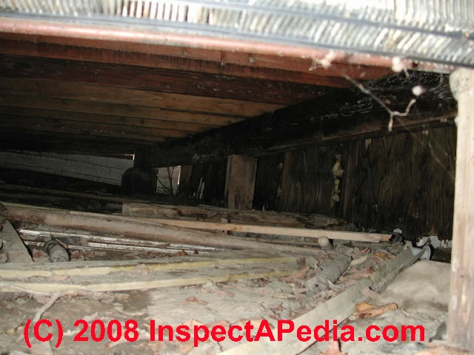
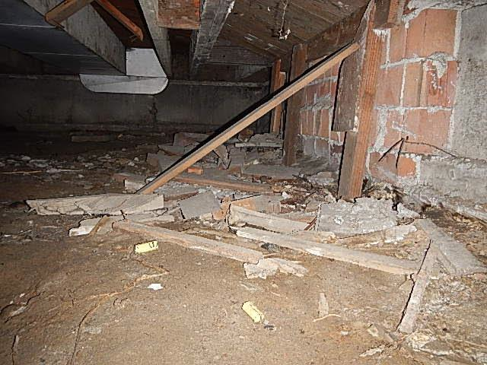
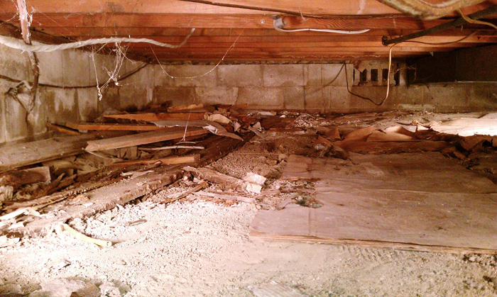
Cuts, scrapes and bruised from debris
Use bump cap, coveralls, gloves, knee pads and safety glasses

Slide 12
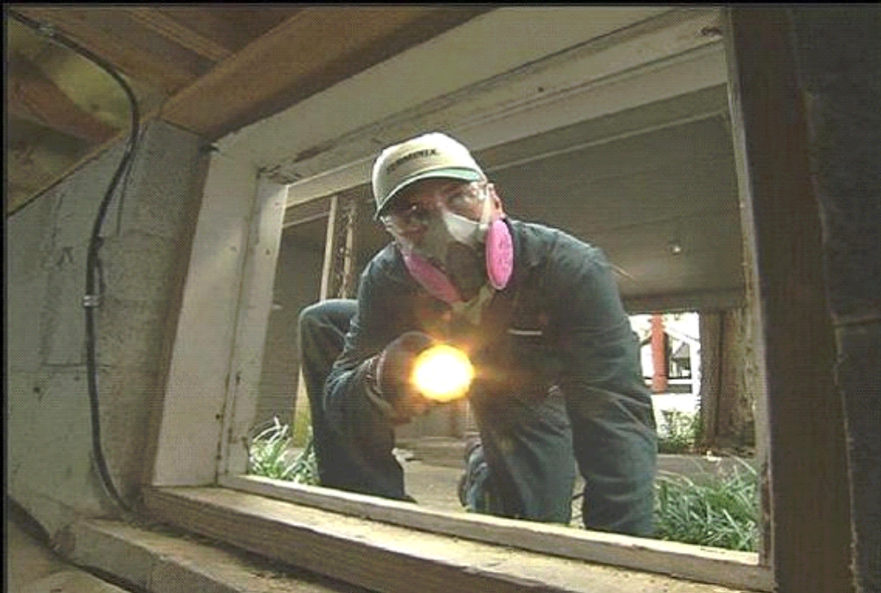
Avoid breathing mold spores and dust that might contain dried animal fecal material
Use a dust respirator or an organic vapor respirator with a dust filter

Slide 13
Crawlspace safety equipment
A good flashlight
Bump cap or hard hat
Vented goggles or safety glasses with temple protection
Organic vapor respirator
Dust respirator
Rubber gloves
Knee pads
Coveralls
Tyvek suit
Ear plugs

Slide 14
Definition of Ventilation
“the provision of fresh air to a room, building, etc.”
“the process or act of supplying a house or room continuously with fresh air”
“the replacement of stale or noxious air with fresh air”
“a system or means of providing fresh air”
“the intentional movement of air from outside a building to the inside”

Slide 15
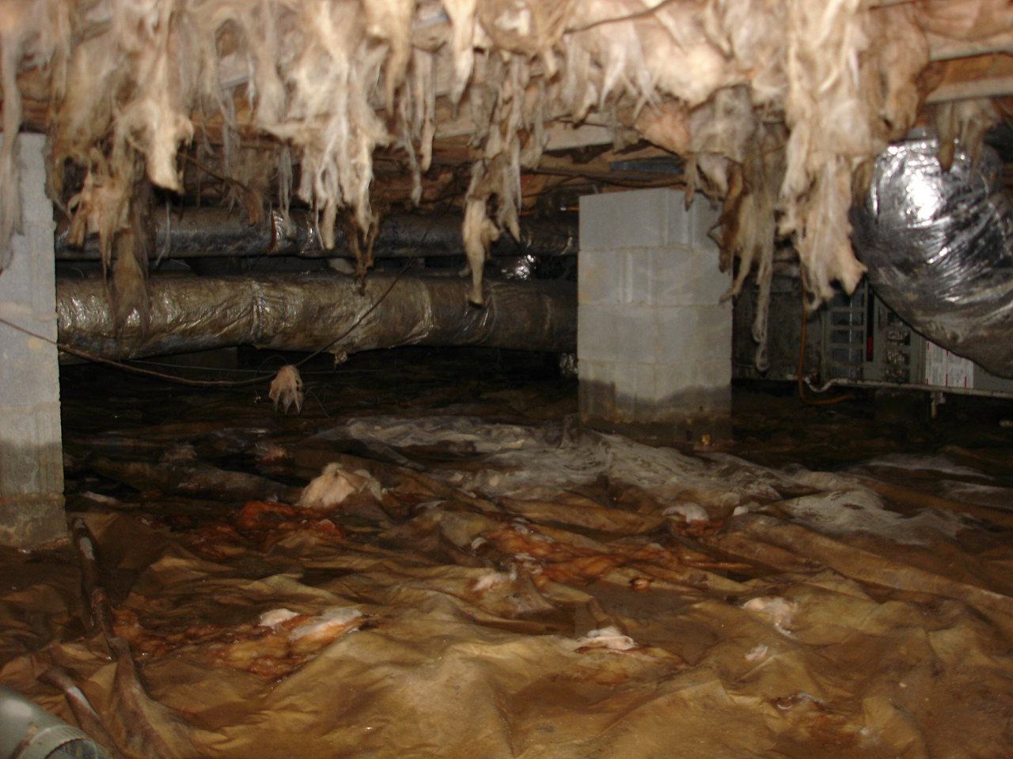
So…why ventilate a crawlspace?
To prevent excess moisture build-up in the crawlspace

Slide 16
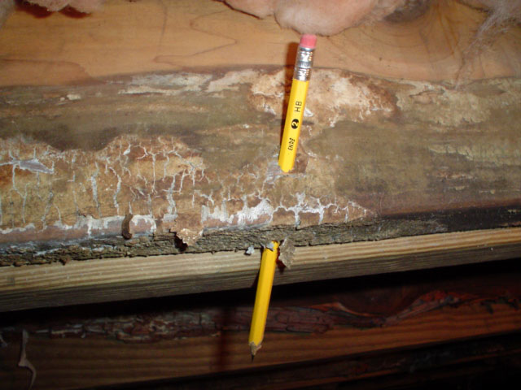
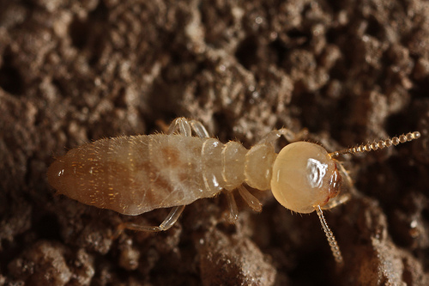
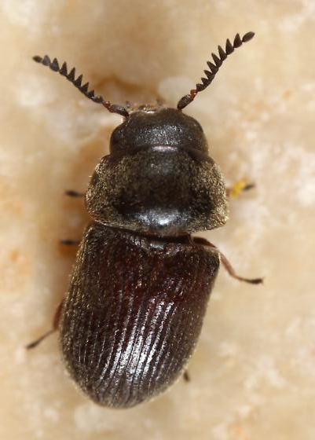
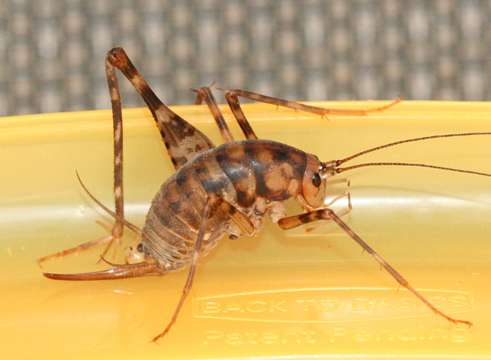
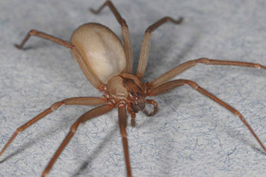
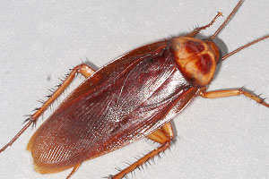
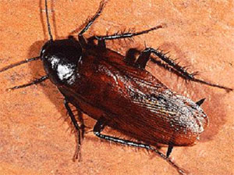
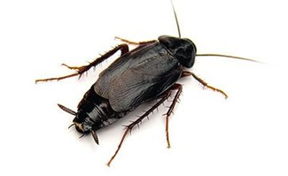
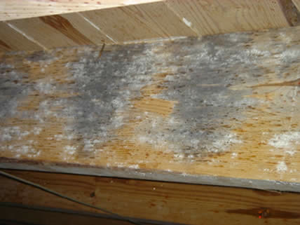
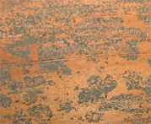
Why is excess moisture so important to our customers?
What sort of pests?
It’s a conducive condition that facilitates the development of many pests.
Structural Damage
Subterranean termites
Powder post beetles
Wood decay fungi
American, Smoky brown and Oriental Cockroaches
Cave and camel crickets
Spiders
Nuisance/ Health
Spores of molds and mildews present on
crawlspace wood and foundation walls
Malodors created by created by moist soil, molds
& mildews in a poorly ventilated crawlspace
Soil micro-organisms

Slide 17
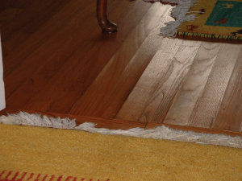
Some other reasons why excess moisture is so important to our customers
Buckling of flooring

Slide 18
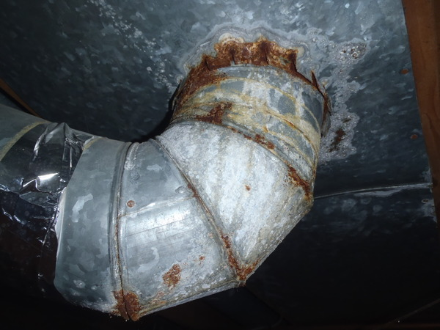
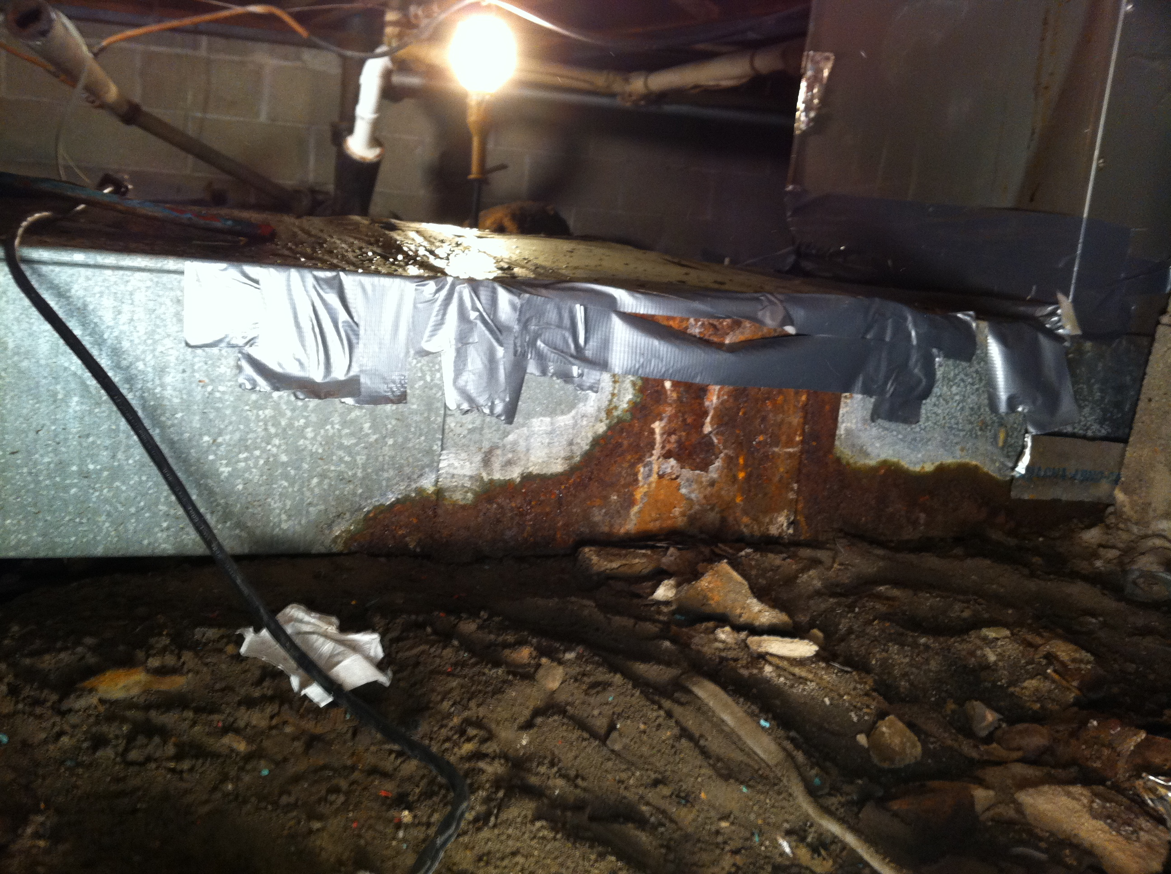
Some other reasons why excess moisture is so important to our customers
Rusting of pipes, ducts and furnace

Slide 19

Some other reasons why excess moisture is so important to our customers
Wet floor insulation has
a lower R value than dry
floor insulation.
Wet insulation doesn’t
insulate the home as well
as dry insulation. It cost
more to heat and air-
condition the home
when insulation is wet.

Slide 20
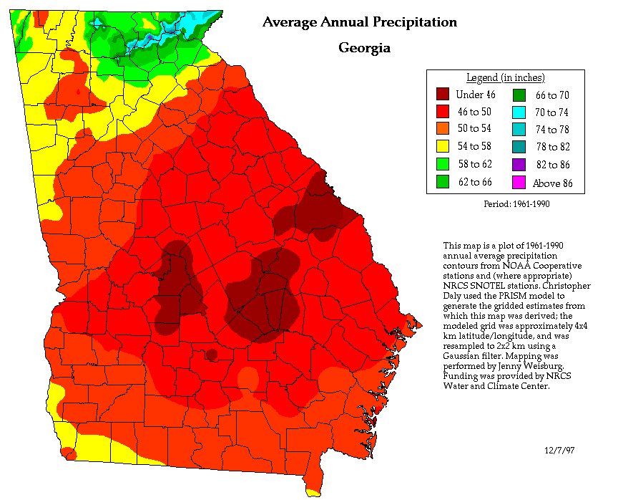
A last reason why excess moisture is so important to our customers
Excess use of energy
(it costs less to air-
condition dry air
than it does wet air)
On a warm summers day, if the humidity
inside the home increases, the air will hold
more heat and the air conditioner will
need to run longer to offset both the
humidity and the warm air.
20

Slide 21
Another reason why excess moisture is so important to our customers…
Attic
LIVING AREA
As air warms, it rises, drawing air from
the crawl space into the living area
Hot & humid air
Cooler air temperature in crawlspace
Hot & humid air
“Stack Effect”

Slide 22
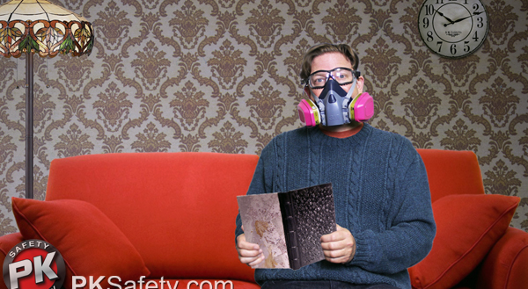
Our customers breathe the air of their crawlspace!
High humidity, creating a stuffy, sticky feeling
A moldy smell
Other odors (dirt, dead animals, etc.)
Excess moisture in the crawlspace results in conditions inside the home which
are sometimes intolerable!

Slide 23



Impact on our customers
Financial
Nuisance/Health
Comfort

Slide 24



Why is ventilation so important to PMPs?
Proper ventilation is important to our customers
A few examples of poor ventilation that allows moisture
build-up in the crawlspace are:

Slide 25
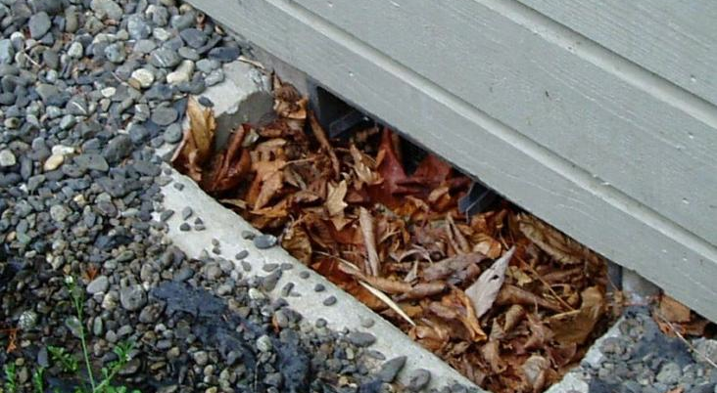
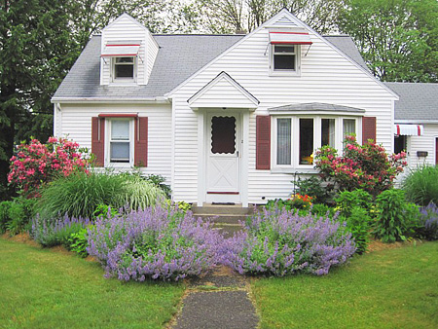
Examples of poor ventilation
Leafs and debris in a foundation vent well block ventilation of the crawlspace
The landscaping looks beautiful, but these flowers and shrubs block the cross-ventilation of this crawlspace home

Slide 26
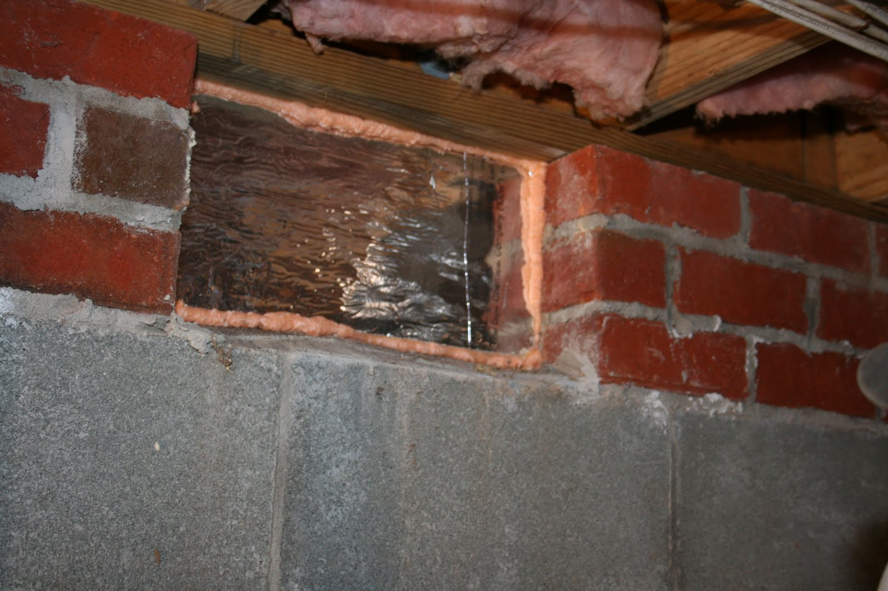
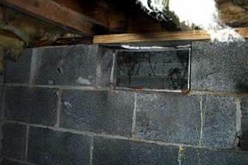
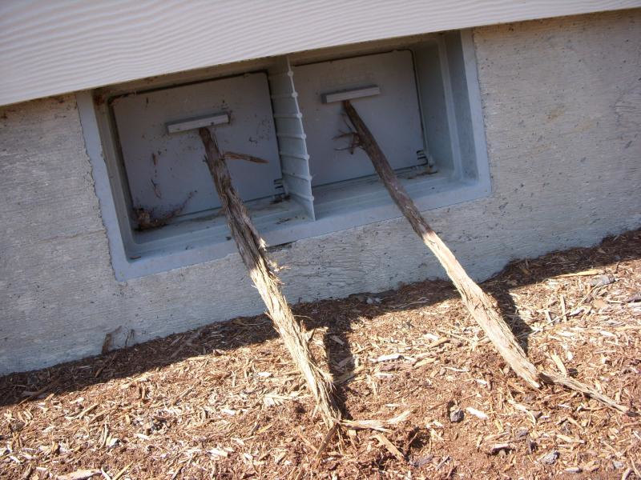
Examples of poor ventilation
Vents that are closed when
they should have been left
open in Spring through Fall
(no encapsulation of crawl-
space, no exhaust system,
no conditioned air, no
dehumidifier in crawl, etc.)

Slide 27
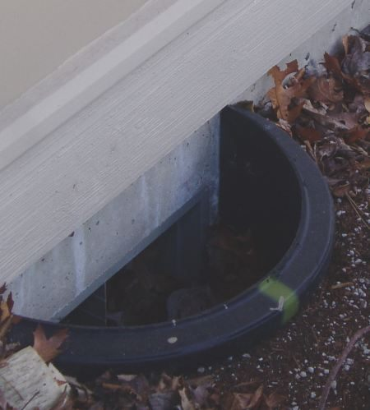
Examples of poor ventilation of foundation vent wells
Vent wells must be
properly installed
This one was not
dug deep enough
and allowed water
to run into the
crawlspace

Slide 28

A poorly installed foundation vent well
enables water intrusion, as evidenced by Efflorescence
What causes Efflorescence?
There are many minerals and salts in the earth. Many of these minerals and salts are
water-soluble; meaning they are capable of being dissolved in water.
As the water percolates through
the earth these water soluble
minerals and salts dissolve into
the water.
When the high water table raises
around your house the water
then absorbs into your porous
concrete foundation.
The water then passes through
your foundation in the form of
capillary action bringing the minerals and salts along for the ride.
When the water changes into vapor (evaporates) the minerals and salts are left behind in
the form of efflorescence, which appears as a white, powdery material left on the
foundation wall.

Slide 29
Foundation Vent Well
Crawlspace soil
is below the exterior grade
The top of vent well should be 4” to 6” above grade
The depth of the hole should be at least 4” deeper than the bottom of the vent
Gravel should be added to about 2” below the bottom of the vent opening
A drainage system is optional
It is recommended that the vent well be anchored to the foundation wall using anchor bolts

Slide 30

An example of poor ventilation
Large duct blocking
cross-ventilation
of the crawlspace
Perhaps a power vent,
properly placed, will
be needed to create the
proper cross-ventilation
30

Slide 31

Problem: Exterior grade sloping toward structure and allowing water to accumulate under crawlspace
Crawlspace
Crawl Space
water moves downhill

Slide 32

A bad drainage problem due to a sloping grade led to this problem in a crawlspace
Obviously, a vapor barrier and vents
didn’t solve this problem!

Slide 33
Methods other than ventilation to prevent moisture build-up in a crawlspace
Alter the exterior grade to slope down and away from the structure
Crawlspace
allows water to drain downhill

Slide 34



Problem: Untreated wood touching the soil of a crawlspace
Untreated wood touching
soil allows soil moisture
to be absorbed and
conducted up through the
wood
As you know, excessive
moisture in wood is a
conducive condition for
mold, mildew and wood
decay fungi

Slide 35






A method to correct this problem:
Remove wood-to-earth contacts (unless pressure-treated for ground contact) or properly insulate them (18” clearance) from soil contact

Slide 36

Problem: Excess moisture drains from soil on the outside through the exterior foundation wall of a dug-out crawlspace into the soil of a crawlspace and puddles-up.

Slide 37
Methods other than ventilation to correct this problem and prevent moisture build-up in a crawlspace
Waterproof the exterior foundation walls of the crawlspace where they extend below grade so that water does not penetrate the foundation wall and enter the crawlspace.
Crawlspace

Slide 38
Another method other than ventilation to prevent moisture build-up in a crawlspace
Install a French drain or other drainage system adjacent to the exterior foundation walls of a crawlspace to drain water away from the foundation wall so that it is not able to penetrate it and get inside
Crawlspace

Slide 39







Methods other than ventilation to prevent moisture build-up in a crawlspace
Waterproofing the exterior foundation walls of the crawlspace where they
extend below grade
Home before waterproofing Excavation to expose Primer applied Bituthene application
application and French the foundation wall
drain installed and the footer
Insulation applied and French Sump pump installed and crushed Topsoil placed over gravel fill
drain installed rock (gravel fill) added to fill trench

Slide 40

Problem: Gutter system empties downspouts adjacent to the exterior foundation walls where water drains into the crawlspace
floor joist
foundation wall
water collects next to foundation wall, penetrates foundation wall and enters crawl
Settled backfill
40

Slide 41
A method to correct this problem and avoid moisture intrusion into a crawlspace
Install a gutter system that extends the downspout a minimum of 4 to 6 feet away from the foundation wall at a 5 degree angle and drains water away from the foundation wall to a lower area
Crawl Space

Slide 42

Problem: Water accumulating in soil of crawlspace
I don’t think a vapor barrier and adequate ventilation is the solution!

Slide 43

Sometimes the problem can’t easily be corrected and another method needs to be used to remove water from a crawlspace
Install a sump pump to remove and prevent the accumulation of water in the crawlspace

Slide 44

Problem: H/AC ducts are sweating (creating moisture) because they are not properly insulated

Slide 45

Problem: H/AC ducts are sweating (creating moisture) because they are not properly insulated
In the summer, when the cool air inside H/AC ducts interfaces with the
hot, humid air of a crawlspace, condensation develops at the surface of
the un-insulated or poorly insulated H/AC ducts
Likewise, during the winter, when the hot air inside ducts interfaces
with the cool, humid air of a crawlspace, condensation develops on the
surface of un-insulated or poorly insulated H/AC ducts

Slide 46

A methods to correct “sweaty” ducts in a crawlspace
Proper insulation of H/AC ducts

Slide 47
I think that you can see
that there may be more to controlling
excess moisture in a crawlspace
than just using vents and a vapor barrier

Slide 48

Ventilation standards for
the control or prevention
of subterranean termites
in crawlspace structures

Slide 49
Present history (04/01/2014 – Present)
Ventilation standards for the control or prevention of subterranean termite in structures
None required!
60’
Garage
25’
DFP
Driveway

Slide 50
However…
Adequate ventilation of a crawlspace is required for both the control
and/or prevention of wood destroying beetles and wood decay fungi
Ventilation of the under-floor space between the bottom of the floor
joists and earth must meet the current requirements of the
International Residential Building Code, the latest edition as adopted
and amended by the Georgia Department of Community Affairs. We
need to be able to determine how many square feet of ventilation to
the outside that a structure needs to meet those standards if we chose
to provide treatment for wood boring beetles or wood decay fungi if
we do not elect one of the 3 “no vents to the exterior” options.
In addition, the vents must meet certain standards
Also, if you use a polyethylene vapor retarder, it must meet certain
standards

Slide 51






Ventilation Openings
Ventilation openings shall be covered for their height and width with
any of the following materials provided that the least dimension of the
covering shall not exceed 1/4 inch (6.4 mm):
Perforated sheet metal plates shall not
be less than 0.070 inch (1.8 mm) thick
Expanded sheet metal plates shall not
be less than 0.047 inch (1.2 mm) thick
Cast-iron grill or grating
Extruded load-bearing brick vents

Slide 52








Ventilation Openings
Hardware cloth of 0.035 inch
(0.89 mm) wire or heavier
Corrosion-resistant wire mesh,
with the least dimension being
1/8 inch (3.2 mm) thick
Standard ventilators (8” x 16”
vents) used by the Pest Control
industry
Standard ventilators (8” x 16”
vents) used by the Building
industry
80

Slide 53

Foundation Vent Well
Well vents are allowed if they are approved vents and do not allow
water to enter the crawlspace
Crawlspace soil
is below the exterior grade
The top of vent well should be 4” to 6” above grade
The depth of the hole should be at least 4” deeper than the bottom of the vent
Gravel should be added to about 2” below the bottom of the vent opening
A drainage system is optional
It is recommended that the vent well be anchored to the foundation wall using anchor bolts

Slide 54

The Vapor Retarder (Barrier) required to meet the ventilation standards of the International Building Code
The vapor barrier must be a Class 1 vapor retarder. A Class I vapor retarder has a permeable level of 0.1 perm or less and is considered impermeable. The perm rating is a measure of the diffusion of water vapor through a material. Any material that has a perm rating of 1 or less is considered to be an adequate vapor retarder for residential construction. The industry standard is a polyethylene material of 4-6 mm. which complies with a Class 1 vapor retarder.
4 – 6 mm

Slide 55




Old House Borer
Lyctinae
Anobiidae
Bostrichidae
Ventilation Standards for the control or prevention of wood boring beetles in crawlspace structures

Slide 56
Present history (04/01/2014 – Present)
Minimum treatment standards for the control of wood boring
beetles in structures when the infestation is on the outside of
the structure or inside the structure, but not in the crawlspace
or for the prevention of wood boring beetles
Minimum adequate treatment for control or prevention of wood boring beetles, including powder post beetles, wood borers and old house borers, shall include the application of a pesticide registered by EPA and/or the Georgia Department of Agriculture, in strict accordance with the product's registered directions for use.
60’
Garage
Must treat the wood of the crawlspace with a pesticide registered for the control or prevention of wood destroying beetles in accordance with its label
No vapor barrier is required
No ventilation is required
25’
DFP
Driveway

Slide 57
Present history (04/01/2014 – Present)
Treatment standards for the control of wood boring beetles when the infestation is located in the crawlspace.
Minimum adequate treatment for control or prevention of wood boring beetles, including powder post beetles, wood borers and old house borers, shall include the application of a pesticide registered by EPA and/or the Georgia Department of Agriculture, in strict accordance with the product's registered directions for use. When infestation is located in a crawl space, treatment shall include the installation of a polyethylene or other water impervious vapor barrier to at least seventy (70) percent of the exposed soil surface in the enclosed space and ensure that ventilation of the under-floor space between the bottom of the floor joists and earth meets the current requirements of the International Residential Building Code, the latest edition as adopted and amended by the Georgia Department of Community Affairs.
Option 1
In this example, there is at least 70% coverage of the soil by a
Class 1 vapor barrier, but less than 90% coverage of the soil
and at least 1 sq. ft. of ventilation per 150 sq. ft. of crawlspace soil
1 sq. ft. ventilation per 150
sq. ft. if vapor barrier covers
at least 70% and less than
90% of the crawlspace soil
60’
X 25’
1,500 sq. ft.
150 sq. ft. 1,500 sq. ft.
60’
Carport
Must have vapor barrier with at least 70% coverage of soil of crawl
Must have adequate ventilation (see above)
Must treat the wood of the crawlspace with a pesticide registered for the control or prevention of wood destroying beetles in accordance with its label
25’
10 sq. ft. ventilation
DFP
Driveway
If you use standard 8” x 16” vents:
10 sq. ft. ventilation
x 144 sq. in./ sq. ft.
1,440 sq. in. ventilation
128 sq. in. 1,440 sq. in. per standard
vent
1,500 sq. ft.
x 70%
1,050 sq. ft.
poly needed
= standard vent (8” x 16”)
11.25 standard vents = 12 standard vents
with 1 vent placed within 3’ of each outside corner
11.25 vents

Slide 58
Present history (04/01/2014 – Present)
Treatment standards for the control of wood boring beetles when the infestation is located in the crawlspace.
Minimum adequate treatment for control or prevention of wood boring beetles, including powder post beetles, wood borers and old house borers, shall include the application of a pesticide registered by EPA and/or the Georgia Department of Agriculture, in strict accordance with the product's registered directions for use. When infestation is located in a crawl space, treatment shall include the installation of a polyethylene or other water impervious vapor barrier to at least seventy (70) percent of the exposed soil surface in the enclosed space and ensure that ventilation of the under-floor space between the bottom of the floor joists and earth meets the current requirements of the International Residential Building Code, the latest edition as adopted and amended by the Georgia Department of Community Affairs.
Option 2
At least 90% coverage of the soil by a Class 1 vapor barrier
(with the required sq. ft. of ventilation and 1 vent
within 3’ of each outside corner of the crawl)
1 sq. ft. ventilation per 1,500
sq. ft. of soil in crawl if vapor
barrier covers at least 90%
of the crawlspace soil
60’
X 25’
1,500 sq. ft.
1,500 sq. ft. 1,500 sq. ft.
60’
Carport
Must have vapor barrier with at least 90% coverage of soil of crawl
Must have adequate ventilation (see above)
Must treat the wood of the crawlspace with a pesticide registered for the control or prevention of wood destroying beetles in accordance with its label
25’
1 sq. ft. ventilation
DFP
Driveways
If you use standard 8” x 16” vents:
1 sq. ft. ventilation
x 144 sq. in./ sq. ft.
144 sq. in. ventilation
128 sq. in. 144 sq. in. per standard
vent
1,500 sq. ft.
x 90%
1,350 sq. ft.
poly needed
= standard vent (8” x 16”)
1.125 standard vents = at least 2 standard vents
(with 1 vent placed within 3’ of each outside corner)
1.125 vents

Slide 59
Present history (04/01/2014 – Present)
Treatment standards for the control of wood boring beetles when the infestation is located in the crawlspace.
Minimum adequate treatment for control or prevention of wood boring beetles, including powder post beetles, wood borers and old house borers, shall include the application of a pesticide registered by EPA and/or the Georgia Department of Agriculture, in strict accordance with the product's registered directions for use. When infestation is located in a crawl space, treatment shall include the installation of a polyethylene or other water impervious vapor barrier to at least seventy (70) percent of the exposed soil surface in the enclosed space and ensure that ventilation of the under-floor space between the bottom of the floor joists and earth meets the current requirements of the International Residential Building Code, the latest edition as adopted and amended by the Georgia Department of Community Affairs.
Option 3
At least 90% coverage of the soil by a Class 1 vapor barrier
(with the required sq. ft. of ventilation and cross-ventilation)
1 sq. ft. ventilation per 1,500
sq. ft. of soil in crawl if vapor
barrier covers at least 90%
of the crawlspace soil
60’
X 25’
1,500 sq. ft.
1,500 sq. ft. 1,500 sq. ft.
60’
Carport
Must have vapor barrier with at least 90% coverage of soil of crawl
Must have adequate ventilation (see above)
Must treat the wood of the crawlspace with a pesticide registered for the control or prevention of wood destroying beetles in accordance with its label
25’
1 sq. ft. ventilation
DFP
Driveway
If you use standard 8” x 16” vents:
1 sq. ft. ventilation
x 144 sq. in./ sq. ft.
144 sq. in. ventilation
128 sq. in. 144 sq. in. per standard
vent
1,500 sq. ft.
x 90%
1,350 sq. ft.
poly needed
= standard vent (8” x 16”)
1.125 standard vents = at least 2 standard vents
(with cross ventilation)
1.125 vents

Slide 60
So…
what if, due to construction or other restrictions, you cannot
properly install the proper vents to meet the ventilation
requirements of the International Residential Building Code
for the control or the prevention of wood boring beetles?
There are 3 options for not meeting the ventilation requirements in a crawlspace.

Slide 61
How many of you are encapsulating
crawlspaces?

Slide 62
  Option #1 – Continuously operating
  mechanical exhaust ventilation
  Exposed earth is covered with a continuous Class I vapor retarder. Joints of the vapor retarder shall overlap by 6 inches
  (152 mm) and shall be sealed or taped. The edges of the vapor
  retarder shall extend at least 6 inches (152 mm) up the stem
  wall and shall be attached and sealed to the stem wall or
  insulation
  and
Continuously operated mechanical exhaust ventilation
at a rate equal to 1 cubic foot per minute (0.47 L/s) for each
50 square feet (4.7m2) of crawlspace floor area, including
an air pathway to the common area (such as a duct or transfer
grille), and perimeter walls insulated in accordance with
Section N1103.2.1 of this code
90

Slide 63
A note from Derrick Lastinger of the Georgia Department of Agriculture
The short version is that the section N1103.2.1 and N1102.2 will need to be changed as Georgia has a specific energy code and this refers to the IBC. Here’s the correct code for Georgia.
402.2.9 Crawl space walls. As an alternative to insulating floors over crawl spaces, crawl space walls shall be permitted to be insulated when the crawl space is not vented to the outside. Crawl space wall insulation shall be permanently fastened to the wall and extend downward from the floor to within 9 inches (229 mm) of the finished interior grade adjacent to the foundation wall. A 3-inch (76 mm) inspection/view strip immediately below the floor joists shall be provided to permit inspections for termites. Exposed earth in unvented crawl space foundations shall be covered with a continuous Class 1 vapor retarder in accordance with the International Building Code. All joints of the vapor retarder shall overlap by 6 inches (152 mm) and be sealed or taped. The edges of the vapor retarder shall extend at least 6 inches (228 mm) up the stem wall and shall be attached and sealed to the stem wall. (Effective January 1, 2011)
Also, refer to Table 402.1.1 ‘Insulation and Fenestration Requirements by Component” of the:2011 GA State Supplements and Amendments to the 2009 IECC to find the specific insulation R-value required on crawl space walls based on climate zone location.”
“

Slide 64
Sizing the fan:
Size to the code minimum. Eliminate the foundation vents when continuously operated mechanical ventilation is provided at a rate of 1.0 cfm for each 50 sq. ft. of under-floor space (e.g., 20 cfm per 1000 sq. ft.) (IRC 2000/2003 Section R408.2, Exception 4; IRC 2006, Section R408.3).
Type of fan:
The code does not specify details about fans used in crawlspaces. One possibility is to follow the Colorado amendments to the IRC. Colorado requires a fan rated for 44,000 hours (five years) of continuous operation with flex connections, or other installation detailing to reduce vibration and noise associated with the fan. The fan must be connected to a trouble light or an alarm to signal occupants when the fan fails.

Slide 65
Option #1, Continuously operating mechanical exhaust ventilation, relies on the negative pressure created in the crawl- space area by the exhaust fan to pull some conditioned air from the living space above.
Arguably, an active radon vent system (which is typically located below the sealed poly) could also satisfy this requirement. In fact, radon mitigation is probably one of the best features of this approach as is the desirable crawlspace to house pressure profile. To my knowledge, this method has not been explored much in the southeast, but could theoretically be successful provided the air leakage through the crawlspace walls is minimal.
Mike Barcik, Director of Technical Services, Southface

Slide 66

Notes:
2.1. Continuously operated mechanical exhaust ventilation at a rate equal to 1 cubic foot per minute (0.47 L/s) for each 50 square feet (4.7m2) of Crawl space floor area, including an air pathway to the common area (such as a duct or transfer grille), and perimeter walls insulated in accordance with Section N1103.2.1 of this code; Traditional crawlspace designs include passive foundations # wall vents that are supposed to let moisture and contaminants escape outside. Yet field research shows that wall vents may make moisture problems worse. Replacing crawlspace vents with an exhaust fan and drawing house air in to condition the crawlspace reduces moisture problems and can increase energy efficiency.
Sizing the fan:
Size to the code minimum. Eliminate the foundation vents when continuously operated mechanical ventilation is provided at a rate of 1.0 cfm for each 50 sq. ft. of under-floor space (e.g., 20 cfm per 1000 sq. ft.) (IRC 2000/2003 Section R408.2, Exception 4; IRC 2006, Section R408.3).
Type of fan:
The code does not specify details about fans used in crawlspaces. One possibility is to follow the Colorado amendments to the IRC. Colorado requires a fan rated for 44,000 hours (five years) of continuous operation with flex connections, or other installation detailing to reduce vibration and noise associated with the fan. The fan must be connected to a trouble light or an alarm to signal occupants when the fan fails.

Slide 67
  Option #2 – Conditioned air supply
  Exposed earth is covered with a continuous Class I vapor retarder. Joints of the vapor retarder shall overlap by 6 inches
  (152 mm) and shall be sealed or taped. The edges of the vapor
  retarder shall extend at least 6 inches (152 mm) up the stem
  wall and shall be attached and sealed to the stem wall or
  insulation
  and
Conditioned air supply sized to deliver at a rate equal to 1
cubic foot per minute (0.47 L/s) for each 50 square feet (4.7 m2)
of under-floor area, including a return air pathway to the
common area (such as a duct or transfer grille), and perimeter
walls insulated in accordance with Section N1102.2 of this
code;

Slide 68
A note from Derrick Lastinger of the Georgia Department of Agriculture
The short version is that the section N1103.2.1 and N1102.2 will need to be changed as Georgia has a specific energy code and this refers to the IBC. Here’s the correct code for Georgia.
402.2.9 Crawl space walls. As an alternative to insulating floors over crawl spaces, crawl space walls shall be permitted to be insulated when the crawl space is not vented to the outside. Crawl space wall insulation shall be permanently fastened to the wall and extend downward from the floor to within 9 inches (229 mm) of the finished interior grade adjacent to the foundation wall. A 3-inch (76 mm) inspection/view strip immediately below the floor joists shall be provided to permit inspections for termites. Exposed earth in unvented crawl space foundations shall be covered with a continuous Class 1 vapor retarder in accordance with the International Building Code. All joints of the vapor retarder shall overlap by 6 inches (152 mm) and be sealed or taped. The edges of the vapor retarder shall extend at least 6 inches (228 mm) up the stem wall and shall be attached and sealed to the stem wall. (Effective January 1, 2011)
Also, refer to Table 402.1.1 ‘Insulation and Fenestration Requirements by Component” of the 2011 GA State Supplements and Amendments to the 2009 IECC to find the specific insulation R-value required on crawl space walls based on climate zone location.”
“

Slide 69
Option #2, Conditioned air supply, is by far the most commonly employed method on new construction. Generally, this strategy works best when the HVAC ductwork is located inside the crawlspace and the equipment has not been oversized.
The advantage of this approach is that the crawlspace can easily be conditioned (with 1 cubic foot per minute per 50 square feet of crawlspace soil) using only one or two small supply registers.
The major disadvantage is that the thermostat inside the home controls the operation of the mechanical system and may not activate the unit at times when the crawlspace needs conditioning, but the living space does not.
Mike Barcik, Director of Technical Services, Southface

Slide 70



Slide 71
If you are encapsulating crawlspaces, this might interest you…
100

Slide 72


A dedicated dehumidifier is a qualified variation of Option #2
A variation of Option #2 is to directly condition the unvented
crawlspace with a dedicated dehumidifier supplying at least 1
cubic foot per minute air per 50 square feet of crawl space soil.
The dehumidifier conditions the crawlspace whenever it operates
and actually controls operation based on a sensor that is located in
that crawl space.
The dehumidifier must be plumbed to automatically drain the
captured condensate away either by gravity, to a sump pump, or to
the air conditioner’s condensate pump.

Slide 73
“In my professional opinion, this is the superior approach to all the
options to provide ventilation in the southeastern U.S. because it
activates crawlspace conditioning based on moisture content
(Relative Humidity) instead of temperature. Moisture control is the
primary purpose of conditioning a crawlspace; if the unvented
crawlspace walls are insulated as per code, the air temperature of the
crawlspace will likely be between the ground and the conditioned
living space above, typically between 60 – 70 degrees Fahrenheit
during a Georgia winter.”
Mike Barcik, Director of Technical Services, Southface

Slide 74
  Option #3
  Exposed earth is covered with a continuous Class I vapor retarder. Joints of the vapor retarder shall overlap by 6 inches
  (152 mm) and shall be sealed or taped. The edges of the vapor
  retarder shall extend at least 6 inches (152 mm) up the stem
  wall and shall be attached and sealed to the stem wall or
  insulation
  and
Plenum in existing structures complying with Section M1601.5,
if under-floor space is used as a plenum.

Slide 75
Option #3 – Plenum in existing structures
“Option #3 should be avoided at all costs. Using a crawlspace as a
plenum is even more risky than the common practice of using
return air plenum spaces above drop ceilings in commercial
buildings, a practice that commonly leads to moisture
condensation and building failure. Ducts should only be made of
duct materials and not building construction materials such as
wood, drywall, and masonry.”
Mike Barcik, Director of Technical Services, Southface

Slide 76

Ventilation standards for the control or prevention of
wood destroying fungi in crawlspace structures

Slide 77
Present history (04/01/2014 – Present)
Minimum adequate treatment for the control or prevention of
wood destroying fungi in crawlspace structures
(4) Minimum adequate treatment for control or prevention of wood destroying fungi shall include
the following:
When infestation is located in a crawl space, treatment shall include the installation of a
polyethylene or other water impervious vapor barrier to at least seventy (70) percent of the
exposed soil surface in the enclosed space and ensure that ventilation of the under-floor space
between the bottom of the floor joists and earth meets the current requirements of the
International Residential Building Code, the latest edition as adopted and amended by the
Georgia Department of Community Affairs.
Option 1
In this example. there is at least 70% coverage of the soil by a Class 1 vapor barrier, but less than 90% coverage of the soil.
and at least 1 sq. ft. of ventilation per 150 sq. ft. of crawlspace soil
1 sq. ft. ventilation per 150
sq. ft. if vapor barrier covers
at least 70% and less than
90% of the crawlspace soil
60’
X 25’
1,500 sq. ft.
150 sq. ft. 1,500 sq. ft.
60’
Carport
Must have vapor barrier with at least 70% coverage of soil of crawl
Must have adequate ventilation (see above)
25’
10 sq. ft. ventilation
DFP
Driveway
If you use standard 8” x 16” vents:
10 sq. ft. ventilation
x 144 sq. in./ sq. ft.
1,440 sq. in. ventilation
128 sq. in. 1,440 sq. in. per standard
vent
1,500 sq. ft.
x 70%
1,050 sq. ft.
poly needed
= standard vent (8” x 16”
11.25 standard vents = 12 standard vents
with 1 vent placed within 3’ of each outside corner
11.25 vents

Slide 78
Present history (04/01/2014 – Present)
Minimum adequate treatment for the control or prevention of
wood destroying fungi in crawlspace structures
(4) Minimum adequate treatment for control or prevention of wood destroying fungi shall include
the following:
When infestation is located in a crawl space, treatment shall include the installation of a
polyethylene or other water impervious vapor barrier to at least seventy (70) percent of the
exposed soil surface in the enclosed space and ensure that ventilation of the under-floor space
between the bottom of the floor joists and earth meets the current requirements of the
International Residential Building Code, the latest edition as adopted and amended by the
Georgia Department of Community Affairs.
Option 2
At least 90% coverage of the soil by a Class 1 vapor barrier
(with the required sq. ft. of ventilation and 1 vent
within 3’ of each outside corner of the crawl)
1 sq. ft. ventilation per 1,500
sq. ft. of soil in crawl if vapor
barrier covers at least 90%
of the crawlspace soil
60’
X 25’
1,500 sq. ft.
1,500 sq. ft. 1,500 sq. ft.
60’
Must have vapor barrier with at least 90% coverage of soil of crawl
Must have adequate ventilation (see above)
Carport
25’
1 sq. ft. ventilation
DFP
Driveway
If you use standard 8” x 16” vents:
1 sq. ft. ventilation
x 144 sq. in./ sq. ft.
144 sq. in. ventilation
128 sq. in. 144 sq. in. per standard
vent
1,500 sq. ft.
x 90%
1,350 sq. ft.
poly needed
= standard vent (8” x 16”
1.125 standard vents = at least 2 standard vents
with either 1 vent placed within 3’ of each outside corner or having cross ventilation
1.125 vents

Slide 79
Present history (04/01/2014 – Present)
Minimum adequate treatment for the control or prevention of
wood destroying fungi in crawlspace structures
(4) Minimum adequate treatment for control or prevention of wood destroying fungi shall include the following:
(a) When infestation is located in a crawl space, treatment shall include the installation of a polyethylene or other water impervious vapor barrier to at least seventy (70) percent of the exposed soil surface in the enclosed space and ensure that ventilation of the under-floor space between the bottom of the floor joists and earth meets the current requirements of the International Residential Building Code, the latest edition as adopted and amended by the Georgia Department of Community Affairs.
Option 3
At least 90% coverage of the soil by a Class 1 vapor barrier
(with the required sq. ft. of ventilation and cross-ventilation)
60’
1 sq. ft. ventilation per 1,500 sq. ft. of soil in crawl if vapor
barrier covers at least 90%
of the crawlspace soil
60’
X 25’
1,500 sq. ft.
1,500 sq. ft. 1,500 sq. ft.
If you use standard 8” x 16” vents:
1 sq. ft. ventilation
x 144 sq. in./ sq. ft.
144 sq. in. ventilation
128 sq. in. 144 sq. in. per standard
vent
Must have vapor barrier with at least 90% coverage of soil of crawl
Must have adequate ventilation (see above)
Carport
25’
1 sq. ft. ventilation
DFP
Driveway
1,500 sq. ft.
x 90%
1,350 sq. ft.
poly needed
= standard vent (8” x 16”
1.125 vents
1.125 standard vents = at least 2 standard vents
with either 1 vent placed within 3’ of each outside corner or having cross ventilation

Slide 80
So…
what if, due to construction or other restrictions, you cannot
properly install the proper vents to meet the ventilation
requirements of the International Residential Building Code
for the control or the prevention of wood destroying fungi?
There are 3 options for not meeting the ventilation requirements in a crawlspace.

Slide 81
How many of you are encapsulating
crawlspaces?
110

Slide 82
Option #1 - Continuously operated
mechanical exhaust ventilation
  Exposed earth is covered with a continuous Class I vapor retarder. Joints of the vapor retarder shall overlap by 6 inches
  (152 mm) and shall be sealed or taped. The edges of the vapor
  retarder shall extend at least 6 inches (152 mm) up the stem
  wall and shall be attached and sealed to the stem wall or
  insulation
  and
Continuously operated mechanical exhaust ventilation
at a rate equal to 1 cubic foot per minute (0.47 L/s) for each
50 square feet (4.7m2) of crawlspace floor area, including
an air pathway to the common area (such as a duct or transfer
grille), and perimeter walls insulated in accordance with
Section N1103.2.1 of this code

Slide 83
A note from Derrick Lastinger of the Georgia Department of Agriculture
The short version is that the section N1103.2.1 and N1102.2 will need to be changed as Georgia has a specific energy code and this refers to the IBC. Here’s the correct code for Georgia.
402.2.9 Crawl space walls. As an alternative to insulating floors over crawl spaces, crawl space walls shall be permitted to be insulated when the crawl space is not vented to the outside. Crawl space wall insulation shall be permanently fastened to the wall and extend downward from the floor to within 9 inches (229 mm) of the finished interior grade adjacent to the foundation wall. A 3-inch (76 mm) inspection/view strip immediately below the floor joists shall be provided to permit inspections for termites. Exposed earth in unvented crawl space foundations shall be covered with a continuous Class 1 vapor retarder in accordance with the International Building Code. All joints of the vapor retarder shall overlap by 6 inches (152 mm) and be sealed or taped. The edges of the vapor retarder shall extend at least 6 inches (228 mm) up the stem wall and shall be attached and sealed to the stem wall. (Effective January 1, 2011)
Also, refer to Table 402.1.1 ‘Insulation and Fenestration Requirements by Component” of the 2011 GA State Supplements and Amendments to the 2009 IECC to find the specific insulation R-value required on crawl space walls based on climate zone location.”
“

Slide 84
Sizing the fan:
Size to the code minimum. Eliminate the foundation vents when continuously operated mechanical ventilation is provided at a rate of 1.0 cfm for each 50 sq. ft. of under-floor space (e.g., 20 cfm per 1000 sq. ft.) (IRC 2000/2003 Section R408.2, Exception 4; IRC 2006, Section R408.3).
Type of fan:
The code does not specify details about fans used in crawlspaces. One possibility is to follow the Colorado amendments to the IRC. Colorado requires a fan rated for 44,000 hours (five years) of continuous operation with flex connections, or other installation detailing to reduce vibration and noise associated with the fan. The fan must be connected to a trouble light or an alarm to signal occupants when the fan fails.

Slide 85
Option #1, Continuously operated mechanical exhaust ventilation, relies on the negative pressure created in the crawl- space area by the exhaust fan to pull some conditioned air from the living space above.
Arguably, an active radon vent system (which is typically located below the sealed poly) could also satisfy this requirement. In fact, radon mitigation is probably one of the best features of this approach as is the desirable crawlspace to house pressure profile. To my knowledge, this method has not been explored much in the southeast, but could theoretically be successful provided the air leakage through the crawlspace walls is minimal.
Mike Barcik, Director of Technical Services, Southface

Slide 86
The International Residential Code (IRC) specifically allows crawlspace designs with an exhaust ventilation system instead of fixed ventilation openings through the foundation walls. To comply, a mechanically vented crawlspace design must have a continuously sealed, vapor-retarding ground cover, have no fixed ventilation openings to the outdoors, and be supplied with a continuously operating exhaust fan.
Notes:
2.1. Continuously operated mechanical exhaust ventilation at a rate equal to 1 cubic foot per minute (0.47 L/s) for each 50 square feet (4.7m2) of Crawl space floor area, including an air pathway to the common area (such as a duct or transfer grille), and perimeter walls insulated in accordance with Section N1103.2.1 of this code; Traditional crawlspace designs include passive foundations # wall vents that are supposed to let moisture and contaminants escape outside. Yet field research shows that wall vents may make moisture problems worse. Replacing crawlspace vents with an exhaust fan and drawing house air in to condition the crawlspace reduces moisture problems and can increase energy efficiency.
Sizing the fan:
Size to the code minimum. Eliminate the foundation vents when continuously operated mechanical ventilation is provided at a rate of 1.0 cfm for each 50 sq. ft. of under-floor space (e.g., 20 cfm per 1000 sq. ft.) (IRC 2000/2003 Section R408.2, Exception 4; IRC 2006, Section R408.3).
Type of fan:
The code does not specify details about fans used in crawlspaces. One possibility is to follow the Colorado amendments to the IRC. Colorado requires a fan rated for 44,000 hours (five years) of continuous operation with flex connections, or other installation detailing to reduce vibration and noise associated with the fan. The fan must be connected to a trouble light or an alarm to signal occupants when the fan fails.

Slide 87
  Option #2 – Conditioned air supply
  Exposed earth is covered with a continuous Class I vapor retarder. Joints of the vapor retarder shall overlap by 6 inches
  (152 mm) and shall be sealed or taped. The edges of the vapor
  retarder shall extend at least 6 inches (152 mm) up the stem
  wall and shall be attached and sealed to the stem wall or
  insulation
  and
Conditioned air supply sized to deliver at a rate equal to 1
cubic foot per minute (0.47 L/s) for each 50 square feet (4.7 m2)
of under-floor area, including a return air pathway to the
common area (such as a duct or transfer grille), and perimeter
walls insulated in accordance with Section N1102.2 of this
code;

Slide 88
A note from Derrick Lastinger of the Georgia Department of Agriculture
The short version is that the section N1103.2.1 and N1103.2.1 will need to be changed as Georgia has a specific energy code and this refers to the IBC. Here’s the correct code for Georgia.
402.2.9 Crawl space walls. As an alternative to insulating floors over crawl spaces, crawl space walls shall be permitted to be insulated when the crawl space is not vented to the outside. Crawl space wall insulation shall be permanently fastened to the wall and extend downward from the floor to within 9 inches (229 mm) of the finished interior grade adjacent to the foundation wall. A 3-inch (76 mm) inspection/view strip immediately below the floor joists shall be provided to permit inspections for termites. Exposed earth in unvented crawl space foundations shall be covered with a continuous Class 1 vapor retarder in accordance with the International Building Code. All joints of the vapor retarder shall overlap by 6 inches (152 mm) and be sealed or taped. The edges of the vapor retarder shall extend at least 6 inches (228 mm) up the stem wall and shall be attached and sealed to the stem wall. (Effective January 1, 2011)
Also, refer to Table 402.1.1 ‘Insulation and Fenestration Requirements by Component” of the:2011 GA State Supplements and Amendments to the 2009 IECC to find the specific insulation R-value required on crawl space walls based on climate zone location.”
“

Slide 89
Option #2
Option #2 is by far the most commonly employed method on new construction. Generally, this strategy works best when the HVAC ductwork is located inside the crawlspace and the equipment has not been oversized.
The advantage of this approach is that the crawl space can easily be conditioned (with 1 cubic foot per minute per 50 square feet of crawlspace soil) using only one or two small supply registers.
The major disadvantage is that the thermostat inside the home controls the operation of the mechanical system and may not activate the unit at times when the crawlspace needs conditioning, but the living space does not.
Mike Barcik, Director of Technical Services, Southface

Slide 90
120

Slide 91
Option #2, Conditioned air supply, is by far the most commonly employed method on new construction. Generally, this strategy works best when the HVAC ductwork is located inside the crawlspace and the equipment has not been oversized.
The advantage of this approach is that the crawlspace can easily be conditioned (with 1 cubic foot per minute per 50 square feet of crawlspace soil) using only one or two small supply registers.
The major disadvantage is that the thermostat inside the home controls the operation of the mechanical system and may not activate the unit at times when the crawlspace needs conditioning, but the living space does not.
Mike Barcik, Director of Technical Services, Southface

Slide 92
If you are encapsulating crawlspaces, the following information might interest you…

Slide 93
A dedicated dehumidifier is a qualified variation of Option #2
A variation of Option #2 is to directly condition the unvented
crawlspace with a dedicated dehumidifier supplying at least 1
cubic foot per minute air per 50 square feet of crawl space soil.
The dehumidifier conditions the crawlspace whenever it operates
and actually controls operation based on a sensor that is located in
that crawl space.
The dehumidifier must be plumbed to automatically drain the
captured condensate away either by gravity, to a sump pump, or to
the air conditioner’s condensate pump.

Slide 94
  Option #3 – Plenum in existing structure
  Exposed earth is covered with a continuous Class I vapor retarder. Joints of the vapor retarder shall overlap by 6 inches
  (152 mm) and shall be sealed or taped. The edges of the vapor
  retarder shall extend at least 6 inches (152 mm) up the stem
  wall and shall be attached and sealed to the stem wall or
  insulation
  and
Plenum in existing structures complying with Section M1601.5,
if under-floor space is used as a plenum.

Slide 95
Option #3 – Plenum in existing structures
Option #3 should be avoided at all costs. Using a crawlspace as a plenum is even more risky than the common practice of using return air plenum spaces above drop ceilings in commercial buildings, a practice that commonly leads to moisture condensation and building failure. Ducts should only be made of duct materials and not building construction materials such as wood, drywall, and masonry.
Mike Barcik, Director of Technical Services, Southface

Slide 96

Present history (09/01/17 - Present)
Minimum adequate treatment for the control or prevention of
wood destroying fungi in crawlspace structures
(b) In addition to the ventilation requirements, when an infestation of water conducting fungi is
located in a crawlspace, control measures shall include the following:
1. Cut the visible rhizomorphs and scrape visible fungal growth from the foundation walls

Slide 97

Cut the visible rhizomorphs and scrape visible
fungal growth from the foundation walls

Slide 98

Minimum adequate treatment for the control or prevention of
wood destroying fungi in crawlspace structures
(b) In addition to the above requirements, when an infestation of water conducting fungi is
located in a crawlspace, control measures shall include the following:
2. Removal of all wooden contacts between buildings and inside crawlspace soil, other
than those wooden supports which have been treated with preservatives to a minimum
preservative retention designed for ground contact.
If the wooden crawl door or door frame is not touching the soil of the crawl- space, the GA DOA does not consider the wood to be within 18” of the soil

Slide 99



All these wooden supports need to be removed and replaced with house jacks

Slide 100

Removing wood-to-earth contacts (unless pressure-treated for ground contact) or properly insulate them from contact with the soil
Most often, PMPs replace wooden piers or posts with properly installed house jacks (supports)
130

Slide 101

Impact on PMPs
You need to know how to multiply and divide
If you can’t multiply and divide you’re in trouble…but then again, we
are in the electronic age. Who doesn’t have a cell phone with a
calculator to do the math.

Slide 102
Official Georgia Wood Infestation Inspection Report
Changes to the OGWIIR are the following:
The following wording regarding the responsibility of PMPs to report Wood Destroying Fungi on the OGWIIR that are highlighted in red have been removed in the recent RULE changes:
Reporting of Wood Destroying Fungi on this report is intended to
cover only white rot, brown rot or water conducting fungi (Poria
incrassata) infestations which occur below the first floor level and
which result from moisture conditions which can be corrected
through application of moisture barriers and/or increased
ventilation and is not intended to cover conditions resulting from
roof or plumbing leaks, or improper drainage of surface water.

Slide 103
Official Georgia Wood Infestation Inspection Report
Changes to the OGWIIR are the following:
The definition of “ventilation” as one of the 3 conducive conditions on the report has been changed to the following wording that is highlighted in red:
Conditions Conducive To Infestation means conditions that exist in a structure that favor the development of wood destroying organisms. These are limited to: cellulosic material underneath
a building and wood in contact with the soil which has not been
treated with preservatives to a minimum preservative retention
designed for ground contact and ventilation of the under-floor
space between the bottom of the floor joists and the earth
that does not meet the requirements of the International
Residential Building Code for one and two family dwellings,
the latest edition as adopted and amended by the Georgia
Department of Community Affairs.

Slide 104
Official Georgia Wood Infestation Inspection Report
Changes to the OGWIIR are the following:
The time period for which PMPs are responsible for correcting conditions conductive to infestation that were not reported on the OGWIIR has been changed from 2 years to 1 year to 90 days..
Regardless of whether any visible evidence of infestation by any of
the listed Wood Destroying Organisms is found during inspection, if
an infestation of one or more of these organisms from which
apparent freedom was certified is found within 90 days of issuance
of this report the property shall receive, free of charge, a minimum
adequate treatment for control of the infestation consistent with
Rules 620-6-.03(1)(a), (b), (c), and (d), of the Georgia Structural Pest
Control Act. Any condition conducive to infestation as defined in
item nine (9) below that is known to have existed at the time of
inspection and was not reported and is found within 90 days
from the date of the report shall be corrected free of charge by the
licensee.

Slide 105
New Ventilation Rules
Easier to calculate
More flexible…
both for the PMP
and the customer
145

Slide 106

Could the new ventilation rules ever be more difficult than we have discussed?
What do you do when there are round vents?

Slide 107

Do you remember your grade school math?
Area of a circle = r
2
r
radius = 3”
= 3.142
r = 3” x 3” = 9 sq. in.
2
The area of ventilation
of this round vent = 3.142 x 9 sq. in. = 28.3 sq. in.
1 sq. ft. of ventilation has 144 sq. in.
It would take 5.28 of these vents to provide 1 sq. ft. of ventilation.
5.28 vents
28.3 sq. in 144 sq. in.
per vent

Slide 108
So…what do you do when there are round vents?
In 43 years in the pest control industry, I’ve only seen one house that had round vents….
If you can’t determine the square footage of a round vent, I’d just walk away and give that account to my competitor.
As I said, the new Rules on ventilation are easier and more flexible than the old Rules.

Slide 109

So…that’s all folks!
I hope the information that I have provided you has given you a better understanding of the new RULES governing VENTILATION.
HAVE A GREAT DAY!

