Slide 1
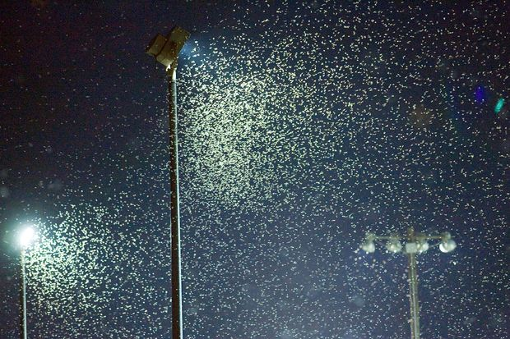
Are you ready
for these
questions
about
TERMITES?

Slide 2
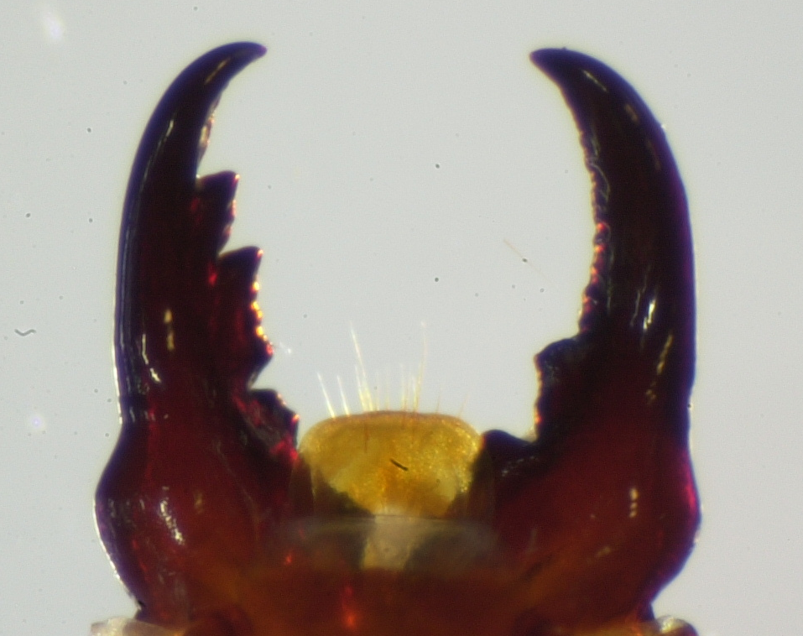
What type of termite soldier is this?
Native subterranean termite (genus Reticulitermes)
Drywood termite
Dampwood termite
Formosan subterranean termite (genus Coptotermes)
Found in Georgia

Slide 3
1. What type of termite soldier is this?
Native subterranean termite (genus Reticulitermes)
Drywood termite
Dampwood termite
Formosan subterranean termite (genus Coptotermes)
Drywood termites have teeth
on the inside of their mandibles.
They have more teeth on their
left mandible. All subterranean
termites have no teeth on the
inside of their mandibles.
Dampwood termites are not
found in GA.
Found in Georgia

Slide 4
2. What type of termite is this swarming in GA?
Native subterranean termite (Reticulitermes spp.)
Formosan subterranean termite (Coptotermes formosanus)
Drywood termite
Dampwood termite

Slide 5
2. What type of termite is this swarming in GA?
Native subterranean termite (Reticulitermes spp.)
Formosan subterranean termite (Coptotermes formosanus)
Drywood termite
Dampwood termite
Formosan termites swarm at dusk and a few hours later in large numbers during May and June in Georgia.
The other types of termites that swarm at night generally do not swarm in such high numbers.

Slide 6
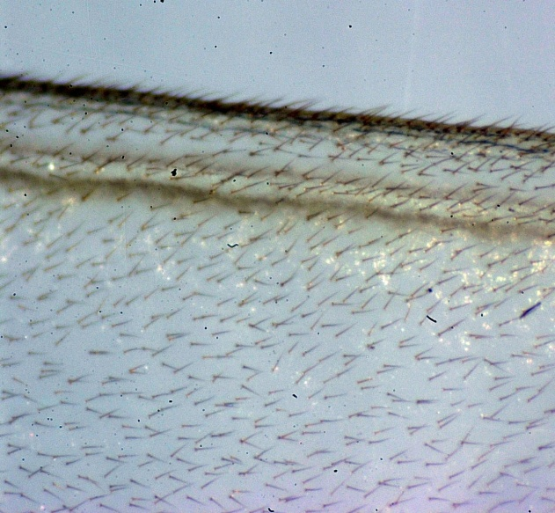
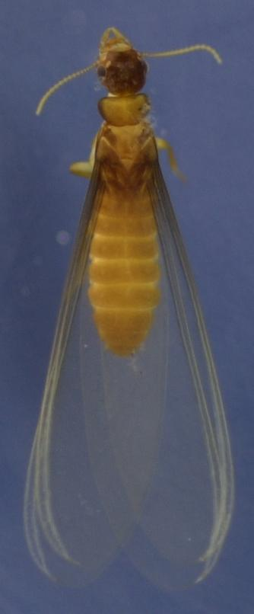
3. What type of termite has this type of wing?
Native subterranean termite (Reticulitermes spp.)
Formosan subterranean termite (Coptotermes formosanus)
Drywood termite
Dampwood termite
Found in Georgia Enlarged portion of front wings

Slide 7
3. What type of termite has this type of wing?
Native subterranean termite (Reticulitermes spp.)
Formosan subterranean termite (Coptotermes formosanus)
Drywood termite
Dampwood termite
All subterranean termites have only 2 dark veins at the front border of its wings. Formosan subterranean termites are the only subterranean termites that have fine hairs all over its wings.
Found in Georgia Enlarged portion of front wings

Slide 8
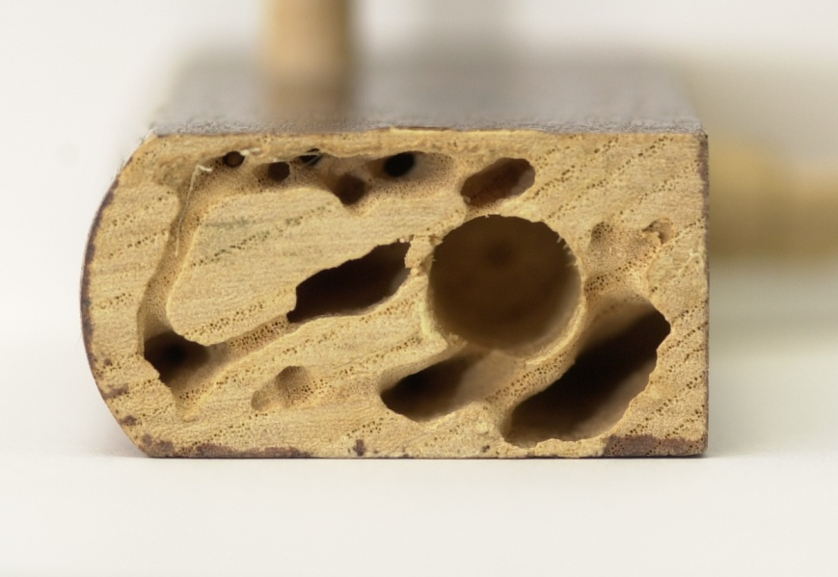
4. What type of termite caused this damage?
Native subterranean termite (Reticulitermes spp.)
Formosan subterranean termite (Coptotermes formosanus)
Drywood termite
Dampwood termite

Slide 9
4. What type of termite caused this damage?
Native subterranean termite (Reticulitermes spp.)
Formosan subterranean termite (Coptotermes formosanus)
Drywood termite
Dampwood termite
Drywood termite galleries are smooth and sandpapered in appearance and they make galleries across the grain of wood. Generally, they kick their 1 mm long fecal pellets out of “kickout” holes which they make in wood and the pellets pile up below.

Slide 10
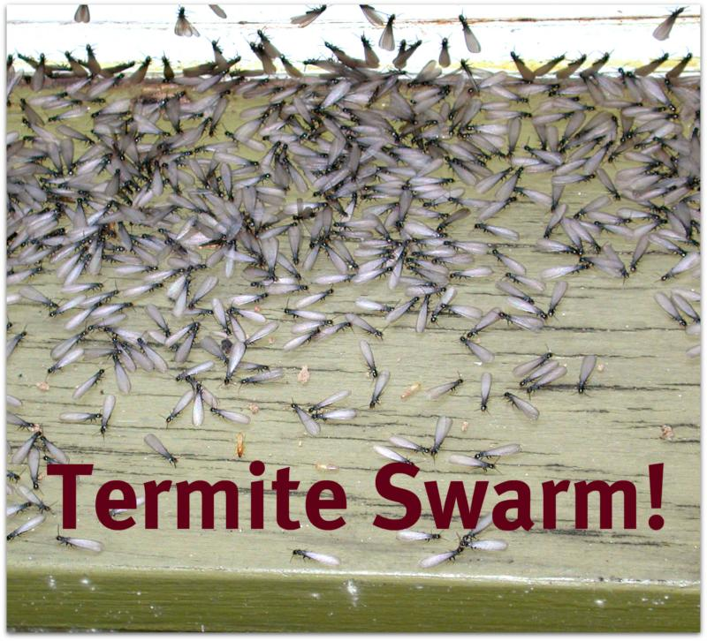
5. What type of termite swarms in the day in GA?
Native subterranean termite (Reticulitermes spp.)
Formosan subterranean termite (Coptotermes formosanus)
Drywood termite
Dampwood termite
Found in Georgia, swarming to a window in the day

Slide 11
5. What type of termite swarms in the day in GA?
Native subterranean termite (Reticulitermes spp.)
Formosan subterranean termite (Coptotermes formosanus)
Drywood termite
Dampwood termite
These Eastern subterranean termites are swarming to a window during the day. Formosan termites swarm at dusk and a few hours later. Most drywood termites swarm in the evening. The Western drywood termite swarms during the day, but its head is reddish-brown and has smoky wings, not a black head with transparent wings, like the Eastern subterranean termite.
Found in Georgia, swarming to a window in the day

Slide 12
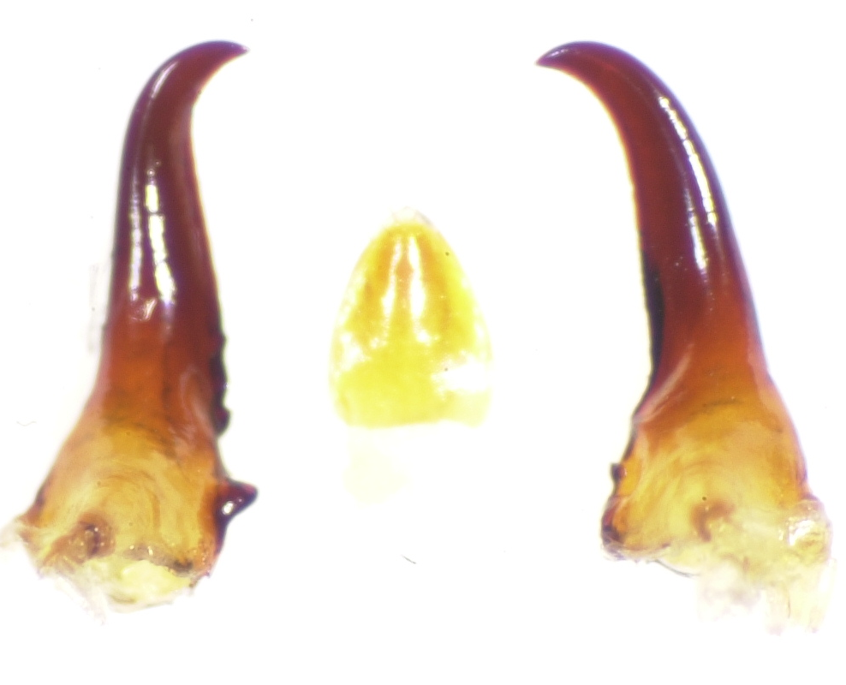
What type of termite is this based on its
mandibles?
Subterranean termite
Drywood termite
Found in Georgia

Slide 13
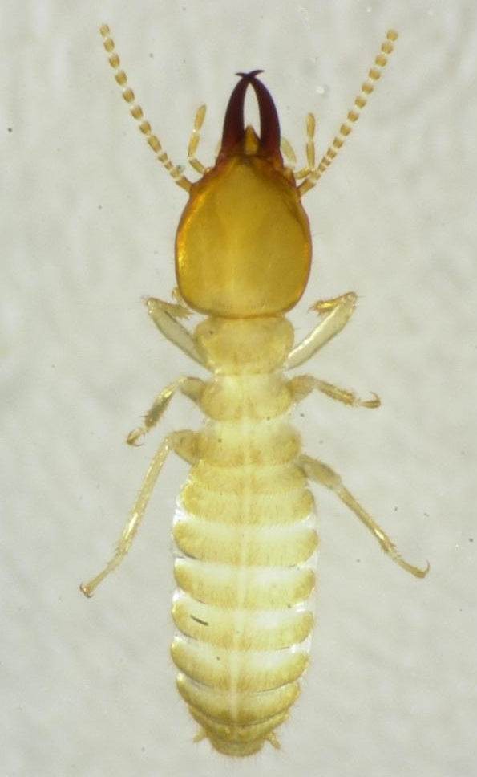
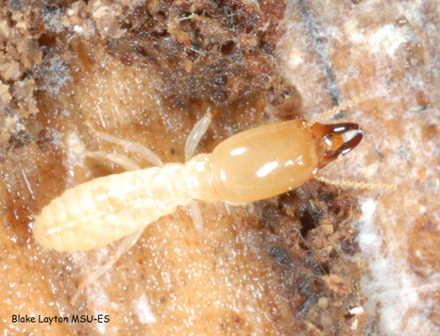
What type of termite is this based on its
mandibles?
Subterranean termites have no
teeth on the inside of their
mandibles that can be seen when
viewing the termite from above.
Subterranean termite
B. Drywood termite
Reticulitermes flavipes Coptotermes formosanus
Found in Georgia
Eastern subterranean Formosan subterranean
termite termite

Slide 14
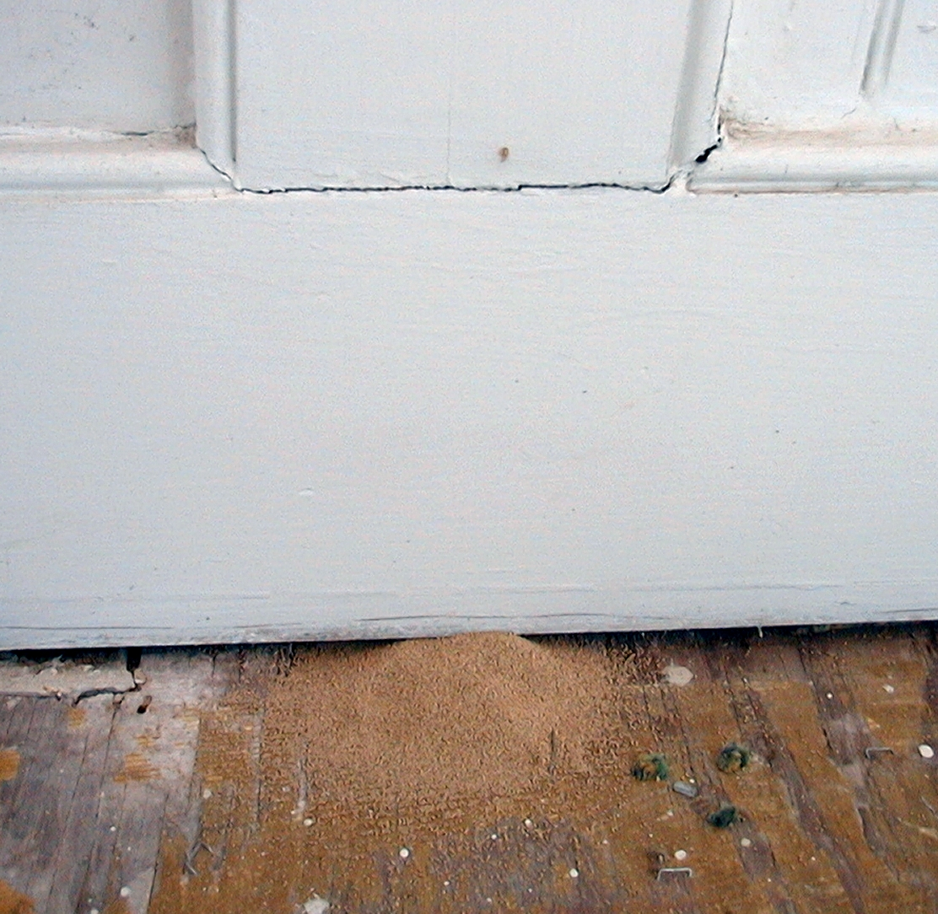
7. What type of termite in GA left this evidence?
Native subterranean termite (Reticulitermes spp.)
Formosan subterranean termite (Coptotermes formosanus)
Drywood termite
Dampwood termite

Slide 15
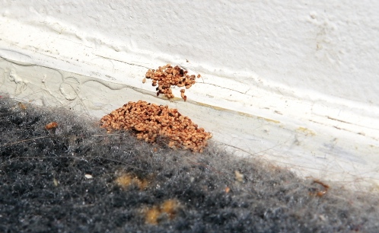
7. What type of termite in GA left this evidence?
Native subterranean termite (Reticulitermes spp.)
Formosan subterranean termite (Coptotermes formosanus)
Drywood termite
Dampwood termite
Drywood termites kick 1 mm,
6-sided concave fecal pellets
with blunt ends out of their
galleries in wood through
“kickout” holes that they
make, where they pile up
directly below.
Kick-out hole
Pile of drywood termite
pellets on floor below

Slide 16
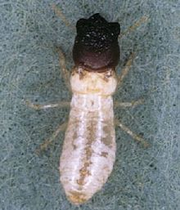
8. What type of termite found in GA is this?
Native subterranean termite (Reticulitermes spp.)
Formosan subterranean termite (Coptotermes formosanus)
Drywood termite
Dampwood termite
Found in Georgia

Slide 17
8. What type of termite found in GA is this?
Native subterranean termite (Reticulitermes spp.)
Formosan subterranean termite (Coptotermes formosanus)
Drywood termite
Dampwood termite
This termite is the West Indian
powder post drywood termite. It
is a widely distributed termite
throughout the world and is not
native to GA. It is not found
living outside in nature except in
Chile. It is a domestic pest in the
US, brought into structures in
infested wood such as in pianos,
furniture, baskets, organs, and in
wood that is already infested.
Found in Georgia

Slide 18
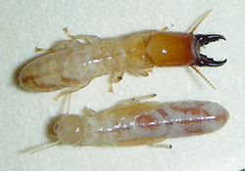
9. What type of termite is this?
Native subterranean termite (Reticulitermes spp.)
Formosan subterranean termite (Coptotermes formosanus)
Drywood termite
Dampwood termite
Found in Savannah, GA

Slide 19
9. What type of termite is this?
Native subterranean termite (Reticulitermes spp.)
Formosan subterranean termite (Coptotermes formosanus)
Drywood termite
Dampwood termite
Notice that the soldier has teeth
that are visible on the inside of
its mandibles. Both drywood
and dampwood termites have
teeth on the inside of their
mandibles, but dampwood
termites are not found in
Georgia. These termites are
drywood termites, Incisitermes
snyderi. They are native to the
southeastern U.S. and are more
commonly found near the coast.
Found in Savannah, GA

Slide 20
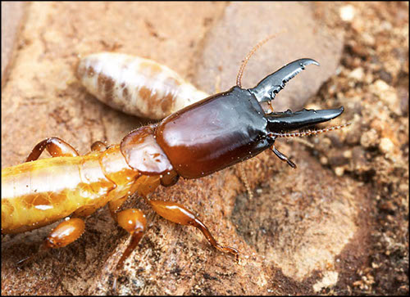
10. What type of termite is this?
Native subterranean termite (Genus Reticulitermes)
Formosan subterranean termite (Coptotermes formosanus)
Drywood termite
Dampwood termite
Not found in Georgia

Slide 21
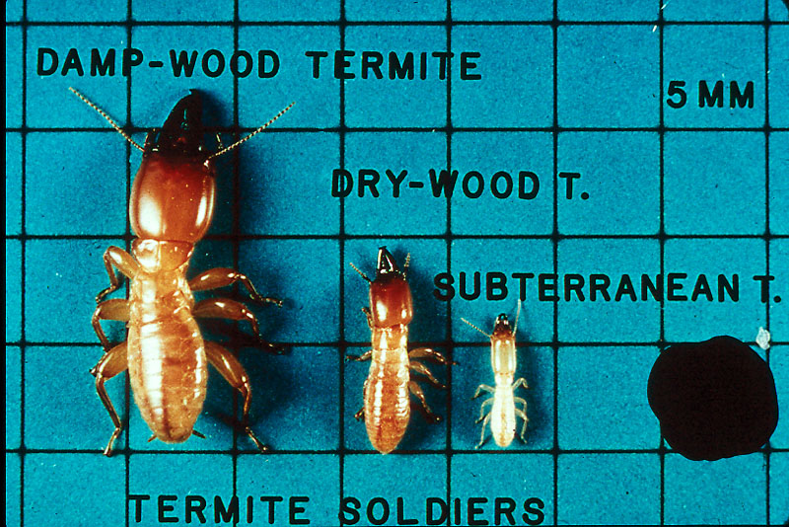
10. What type of termite is this?
Native subterranean termite (Genus Reticulitermes)
Formosan subterranean termite (Coptotermes formosanus)
Drywood termite
Dampwood termite
This is a dampwood termite.
It is the only termite listed
above that is not found in
Georgia. Dampwood termite
soldiers are much larger and
longer than subterranean or
drywood termite soldiers.
Not found in Georgia

Slide 22
11. What type of soldier termite is this?
Native subterranean termite (Genus Reticulitermes)
Formosan subterranean termite (Coptotermes formosanus)
Drywood termite
Dampwood termite
Found in Columbus, GA

Slide 23
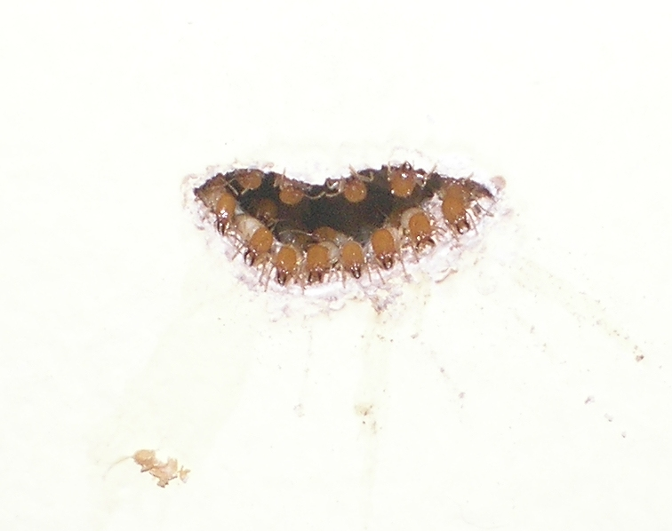
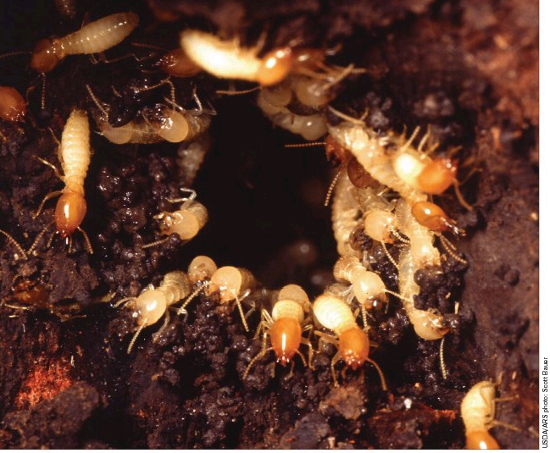
11. What type of soldier termite is this?
Native subterranean termite (Genus Reticulitermes)
Formosan subterranean termite (Coptotermes formosanus)
Drywood termite
Dampwood termite
It is the only soldier termite in Georgia that has
a tear-dropped shaped head. Formosan
subterranean termite soldiers are very
aggressive! 10% to 15% of the caste members
in a Formosan subterranean termite colony are
soldiers. If you probe wood, you will almost
immediately see Formosan soldiers amass at
the area probed. Formosan termite colonies,
on an average, are much larger than native
subterranean termite colonies…therefore, they
do significantly more damage to any one
structure than native subterranean termites do.
Found in Columbus, GA

Slide 24
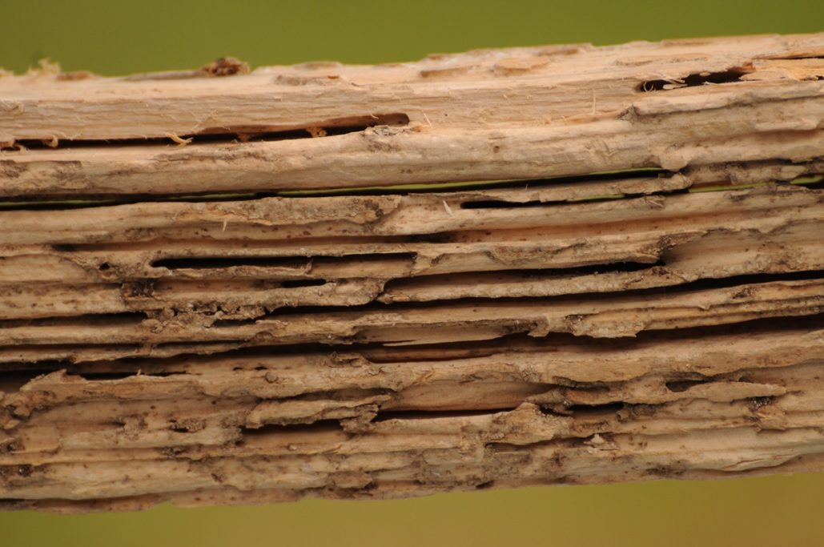

12. What type of termite caused this damage?
Native subterranean termite (Reticulitermes spp.)
Formosan subterranean termite (Coptotermes formosanus)
Drywood termite

Slide 25
12. What type of termite caused this damage?
Native subterranean termite (Reticulitermes spp.)
Formosan subterranean termite (Coptotermes formosanus)
Drywood termite
Dampwood termite
It is difficult to tell the difference between wood that is damaged by
native subterranean termites and by Formosan subterranean
termites without finding any soldiers. All subterranean termites eat
the soft, spring wood along the grain of the wood, so it often has
the appearance of being laminated. There may also be some mud
in the galleries. Drywood and dampwood termites eat across the
grain of wood and have no mud in their galleries.

Slide 26
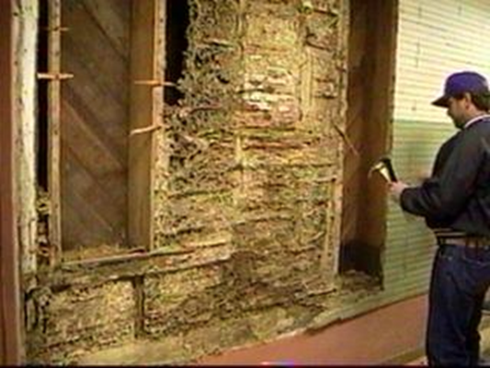
13. What type of termite caused this damage?
Native subterranean termite (Reticulitermes spp.)
Formosan subterranean termite (Coptotermes formosanus)
Drywood termite
Dampwood termite

Slide 27
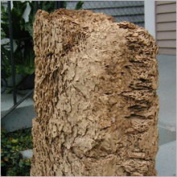
13. What type of termite caused this damage?
Native subterranean termite (Reticulitermes spp.)
Formosan subterranean termite (Coptotermes formosanus)
Drywood termite
Dampwood termite
Formosan carton is made of soil and chewed-up bits & pieces of wood that these termites cement together by saliva and feces to form a hard nest, usually within walls. Large carton nests can
actually cause walls to bulge.
These carton nests house thousands of termites as well as hold moisture. Once the carton nest is established, Formosan termites can live indefinitely in them without soil contact.

Slide 28
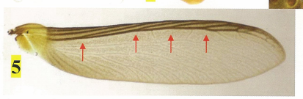
14. This type of termite is primarily found in
coastal states. Which is it?
Native subterranean termite (Reticulitermes spp.)
Formosan subterranean termite (Coptotermes formosanus)
Drywood termite

Slide 29
14. This type of termite is primarily found in
coastal states. Which is it?
Native subterranean termite (Reticulitermes spp.)
Formosan subterranean termite (Coptotermes formosanus)
Drywood termite
Drywood termite wings have 3 or more dark veins
at their base where they join their thorax. Further
away from their body on the wings, dark diagonal
cross-veins can be observed. Subterranean
termites only have 2 dark veins at their base and
have no dark cross-veins.

Slide 30
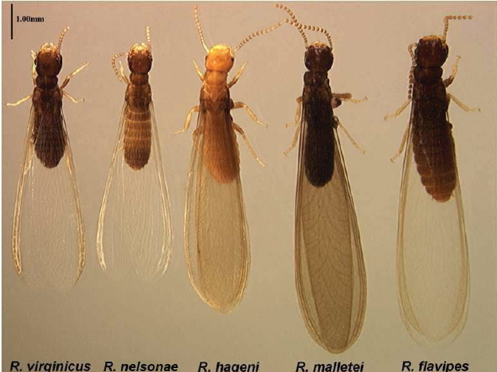
15. What type of swarmer termite is this?
Native subterranean termite (Reticulitermes spp.)
Formosan subterranean termite (Coptotermes formosanus)
Drywood termite
Dampwood termite
10 mm

Slide 31
15. What type of swarmer termite is this?
Native subterranean termite (Reticulitermes spp.)
Formosan subterranean termite (Coptotermes formosanus)
Drywood termite
Dampwood termite
Native subterranean termite swarmers are about 7 mm to
10 mm in length, from the tip of their heads to the tip of
their wings.
Formosan subterranean termite swarmers are between 13
and 15 mm in length, from the tip of their heads to the tip
of their wings.
Drywood termite swarmers are generally 10 mm to 13 mm
in length, from the tip of their heads to the tip of their
wings.
Dampwood termite swarmers are from 15 mm to 25 mm in
length, from the tip of their heads to the tip of their wings.
10 mm

Slide 32
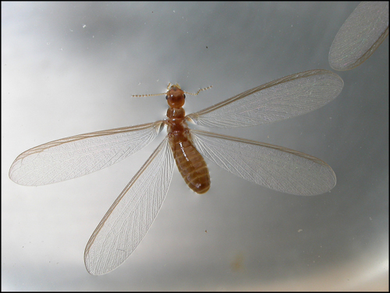
What type of termite is this?
It’s a subterranean termite, of course!
Just because it has a light brown body does not mean it can’t be
a subterranean termite swarmer. Remember, subterranean
termite swarmers have only 2 dark veins at the front of its wings.
Drywood and dampwood termites have 3 or more dark veins at
the front of its wings…and also have dark diagonal cross-veins.

Slide 33
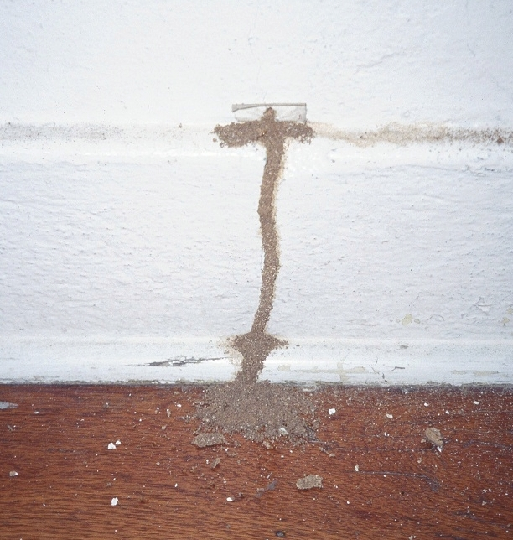
16. What type of termite left this evidence?
Native subterranean termite (Reticulitermes spp.)
Drywood termite
Dampwood termite

Slide 34
16. What type of termite left this evidence?
Native subterranean termite (Reticulitermes spp.)
Drywood termite
Dampwood termite
All the subterranean termite species found
in Georgia build mud tubes (tunnels) with
soil particles and bits of pieces of wood that
are cemented together with saliva and fecal
material. They use these mud tubes to
travel from the soil to areas above ground
to find wood and other cellulose materials
for food. These tunnels absorb moisture
from the air (providing them with the
moisture needed to survive above ground
for short periods of time), protect them
from the desiccating effects of air) and
provide them protection from some of their
natural enemies, predators such as ants.

Slide 35
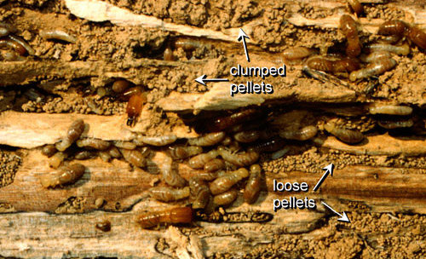
17. What type of termite is this?
Native subterranean termite (Reticulitermes spp.)
Drywood termite
Dampwood termite

Slide 36
17. What type of termite is this?
Native subterranean termite (Reticulitermes spp.)
Drywood termite
Dampwood termite
moist pellets,
“clumped together”
Dampwood termites produce fecal pellets that are moist and are “clumped together”
inside their galleries, not kicked out of the galleries of the wood they are feeding on,
like drywood termites. Their fecal pellets are 3 mm size and lack longitudinal lines.
Drywood termite fecal pellets are much smaller (1 mm) and are 6 sided concave
pellets with blunt ends. Subterranean termites do not produce fecal pellets.

Slide 37
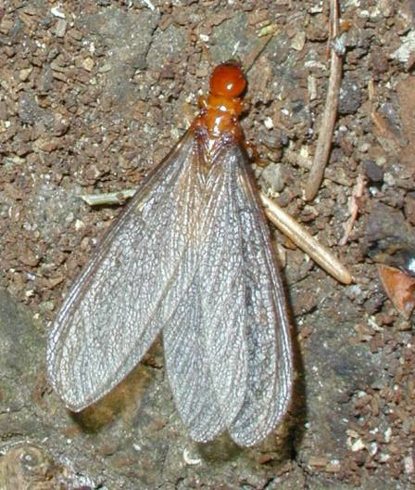
18. What type of swarmer termite is this?
Native subterranean termite (Reticulitermes spp.)
Formosan subterranean termite (Coptotermes formosanus)
Drywood termite
Dampwood termite
15 to 25 mm
in length

Slide 38
18. What type of swarmer termite is this?
Native subterranean termite (Reticulitermes spp.)
Formosan subterranean termite (Coptotermes formosanus)
Drywood termite
Dampwood termite
Dampwood termites are not found in
Georgia. They are found in Florida,
Montana, Idaho, Northern Nevada,
Oregon, Northern California and
Washington. They are often found
infesting wood that is in contact with
the ground and has excess moisture.
They nest in wet wood found above
the ground. In nature, they nest
inside the trees. They do not build
mud tunnels, but they do produce
moist, 3 mm long fecal pellets that are
clumped together inside their nests
and in the wood on which they are
feeding.
15 to 25 mm
in length

Slide 39
19. What type of swarmer termite is this?
Native subterranean termite (Reticulitermes spp.)
Formosan subterranean termite (Coptotermes formosanus)
Drywood termite
Dampwood termite
8 mm in
length

Slide 40
19. What type of swarmer termite is this?
Native subterranean termite (Reticulitermes spp.)
Formosan subterranean termite (Coptotermes formosanus)
Drywood termite
Dampwood termite
Even though this termite is yellowish brown in color, it is
one of the five native subterranean termites of the genus
Reticulitermes that is found in Georgia, which range from
about 7 mm to 10 mm in length, from the tip of their
heads to the tip of their wings.
8 mm in
length
These are the 5
Reticulitermes
species that are
found in Georgia
R. virginicus R. nelsonae R. hageni R. malletei R. flavipes

Slide 41
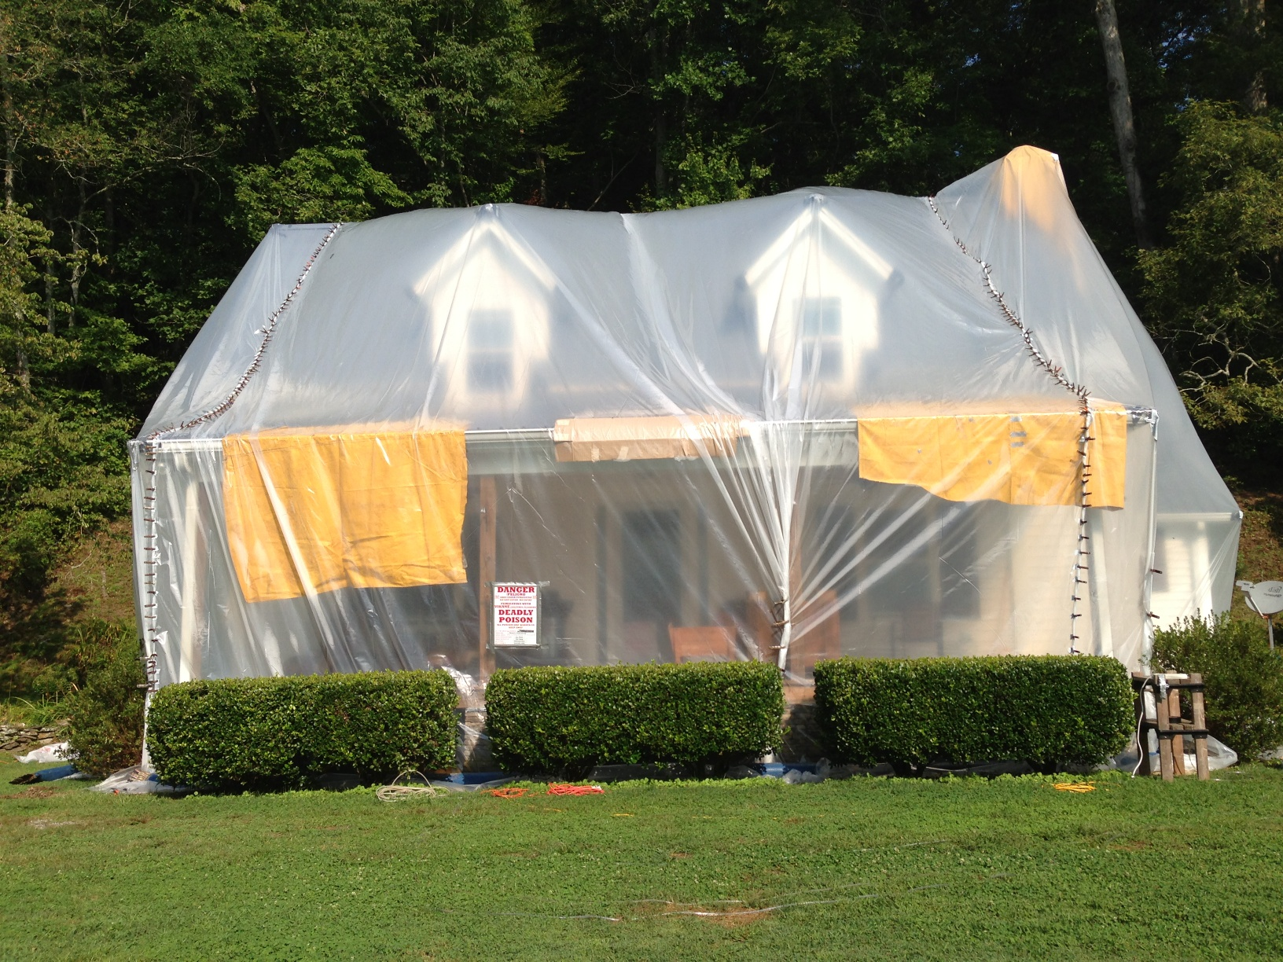
20. For what type of termite is this house in GA
being treated?
Native subterranean termite (Reticulitermes spp.)
Drywood termite
Dampwood termite

Slide 42
20. For what type of termite is this house in GA
being treated?
Native subterranean termite (Reticulitermes spp.)
Drywood termite
Dampwood termite
Drywood termites stay
up in wood without the
need to go the soil for
moisture. The most
effective method of
controlling drywood
termites in a structure is
to fumigate it with
sulfuryl fluoride. It is
the only fumigant that is
currently registered for
the control of drywood
termites in structures in
the U.S.

Slide 43
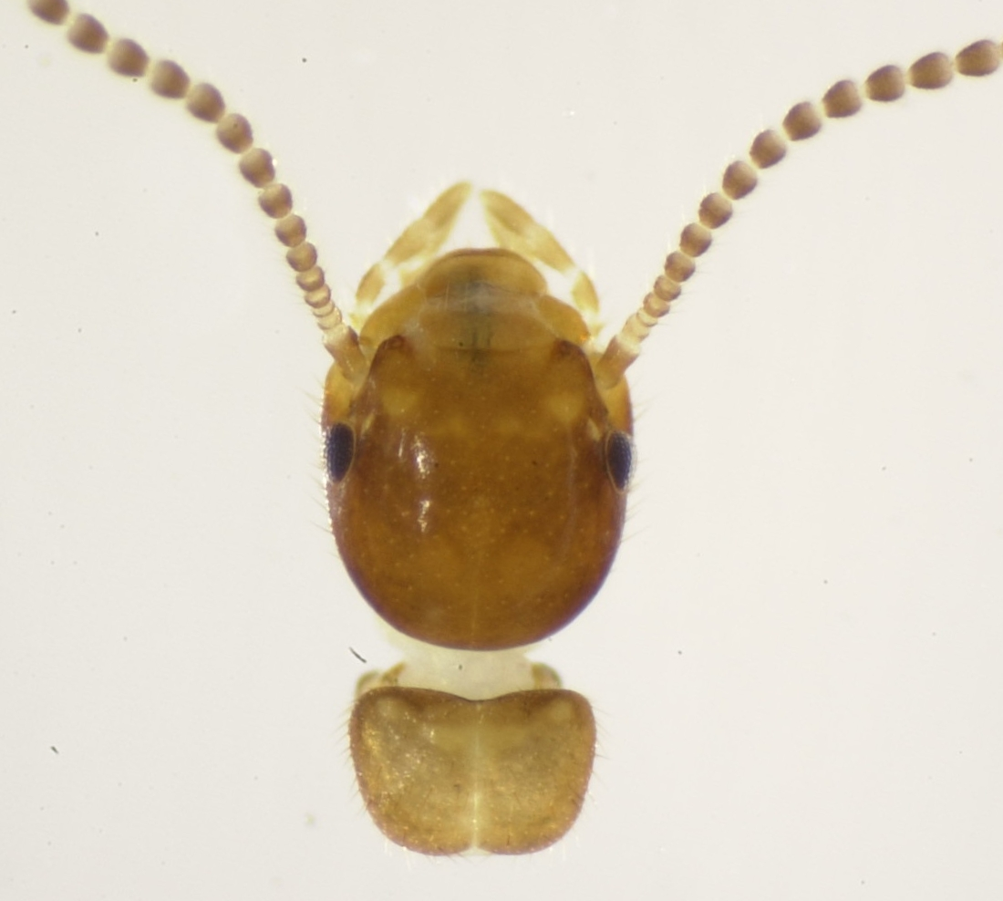
21. What type of swarmer termite is this?
Native subterranean termite (Reticulitermes spp.)
Drywood termite
Dampwood termite

Slide 44
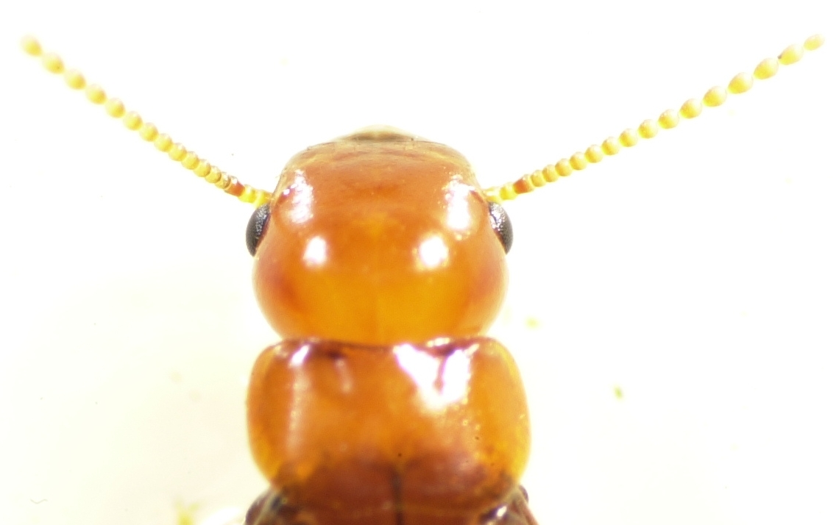
21. What type of swarmer termite is this?
Native subterranean termite (Reticulitermes spp.)
Drywood termite
Dampwood termite
The pronotum of this swarmer
termite is not as wide as its head.
It is a native subterranean termite.
The pronotums of drywood and
dampwood swarmer termites are
slightly wider than their heads and
much larger than the pronotum of
a subterranean termite.

Slide 45
22. What type of swarmer termite is this?
Native subterranean termite (Reticulitermes spp.)
Formosan subterranean termite (Coptotermes formosanus)
Drywood termite

Slide 46
22. What type of swarmer termite is this?
Native subterranean termite (Reticulitermes spp.)
Formosan subterranean termite (Coptotermes formosanus)
Drywood termite
The pronotum of the drywood
termite swarmer is wider than its
head. Yes, it’s a drywood termite
swarmer.

Slide 47
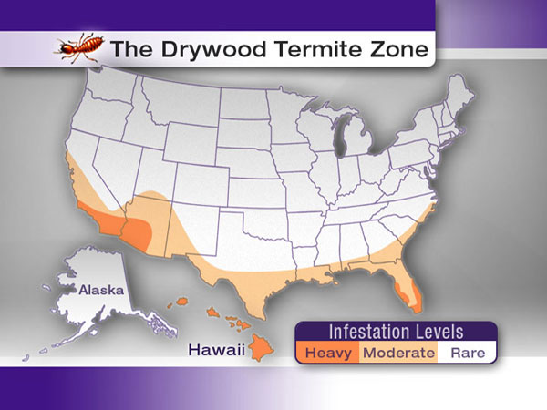
Drywood termites are most often found in coastal
states of the southern U.S. They are much more
common near the coast than the interior of these
coastal states.

Slide 48
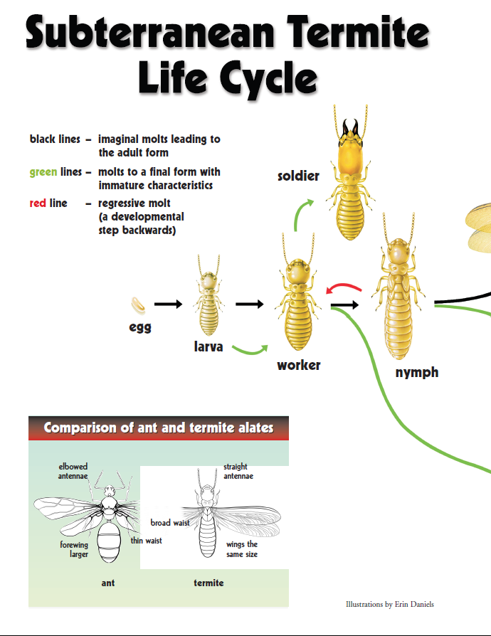
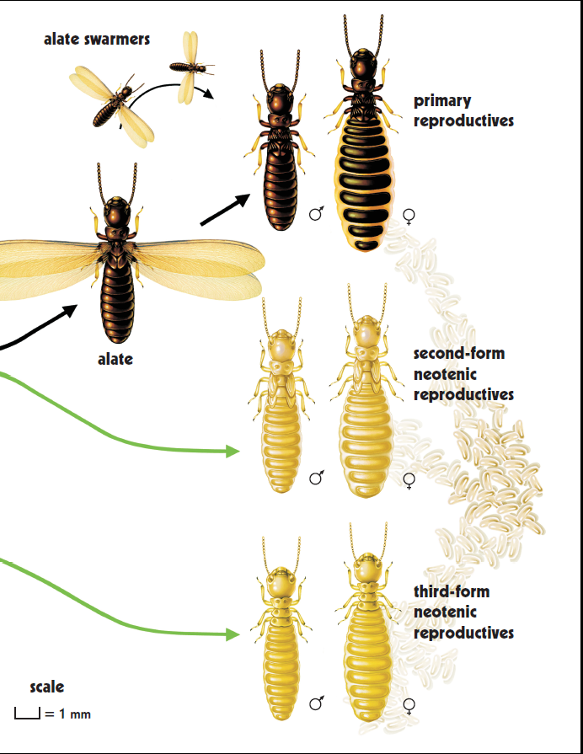

Slide 49
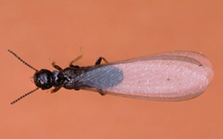
23. What is the caste member of this termite?
Worker
Soldier
Primary reproductive
Supplementary reproductive

Slide 50
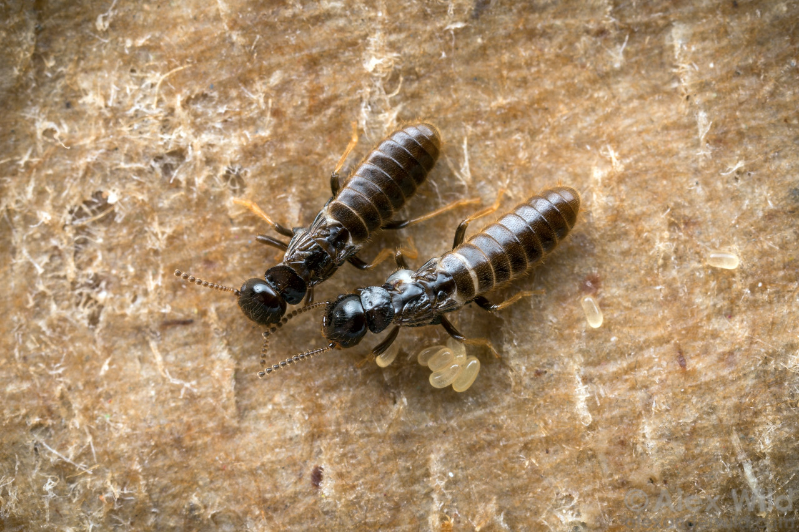
23. What is the caste member of this termite?
Worker
Soldier
Primary reproductive
Supplementary reproductive
If it has wings, it is called a primary reproductive, swarmer or alate.
If it has lost its wings after flight, it is called a de-alate.

Slide 51
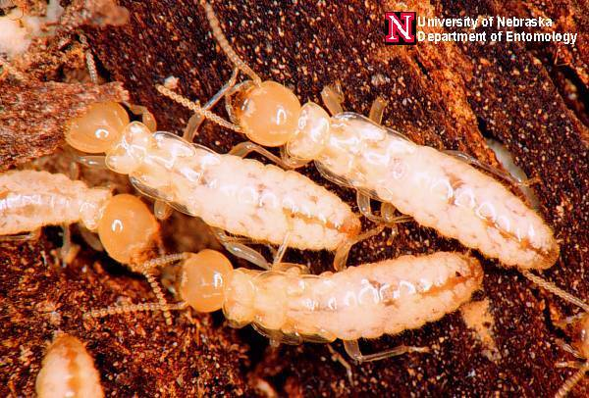
24. What caste member of termite is this?
Worker
Soldier
Primary reproductive
Supplementary reproductive

Slide 52
24. What caste member of termite is this?
Supplementary reproductives (both
secondary and tertiary) are longer than
the worker caste.
Secondary reproductives develop from
nymphs and have functional eyes and
wing bugs, but lack functional wings.
When the queen dies, the secondary
reproductives take over egg laying of
the termite colony in the soil.
Tertiary reproductives develop from
workers and lack eyes and wing buds.
They develop when workers are
isolated from the queen and are no
longer influenced by the queen’s
pheromones, such as when they are in
moist wood above ground and no
longer need to return to the soil. They
can reproduce and form an above
ground satellite colony.
Worker
Soldier
Primary reproductive
Supplementary reproductive

Slide 53
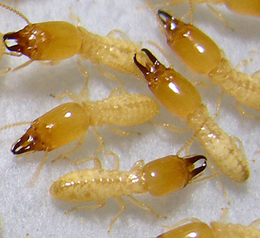
25. What caste member of termite are these?
Worker
Soldier
Primary reproductive
Supplementary reproductive

Slide 54
25. What caste member of termite are these?
Worker
Soldier
Primary reproductive
Supplementary reproductive
Soldier termites defend
the termite colony
against their enemies,
mainly ants. Their long
mandibles are for
fighting, not for eating!
Soldier termites are fed
by workers and nymphs.

Slide 55
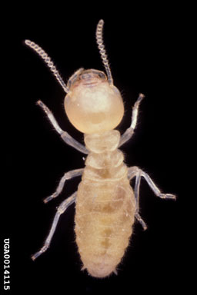
26. What caste member of termite is this?
Worker
Soldier
Queen
Swarmer
Supplementary reproductive

Slide 56
26. What caste member of termite is this?
Worker
Soldier
Queen
Swarmer
Supplementary reproductive
Workers take only a couple of months to
develop from an egg. Workers are
usually light in color and do not have
eyes, wings or any specialized structures.
Workers perform most of the work of
the colony. They build mud tunnels,
build the nest, gather food, feed the
other members of the termite colony
(soldiers and reproductives), groom the
Queen and damage wooden structures
(feeding on the cellulose in wood).

Slide 57
27. What caste member is the most numerous
in a subterranean termite colony?
Worker
Soldier
Queen
Primary reproductive
Supplementary reproductive

Slide 58
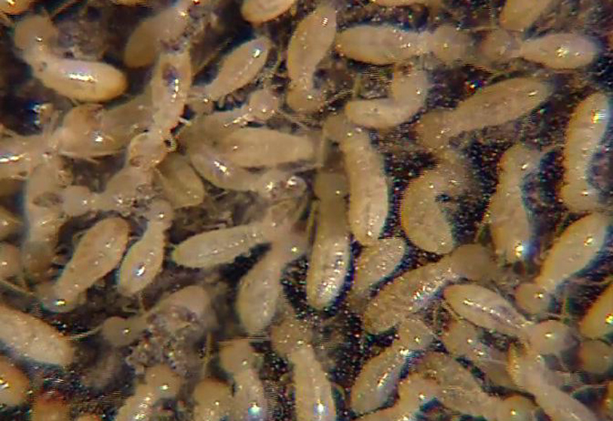
27. What caste member is the most numerous
in a subterranean termite colony?
Worker
Soldier
Queen
Primary reproductive
Supplementary reproductive
Workers are the most numerous individual of a termite colony.

Slide 59
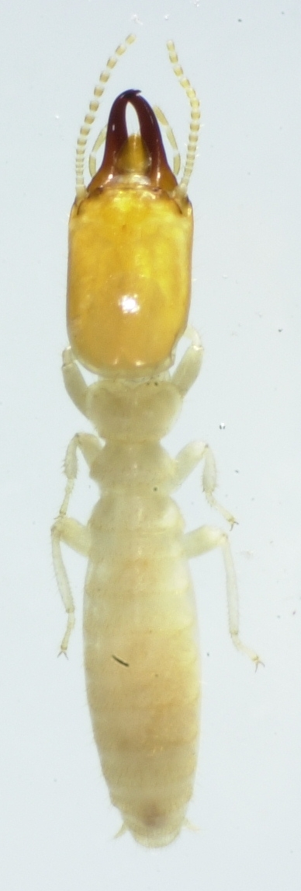
28. Which caste member’s only duty is to defend the colony from ants and other predators?
Worker
Soldier
Queen
Primary reproductive
Supplementary reproductive

Slide 60
28. Which caste member’s only duty is to defend the colony from ants and other predators?
Soldiers have enlarged
mandibles, built to
defend the colony
against its enemies,
especially ants. It is
amazing that soldiers
have no eyes and yet
they are able to kill
ants entering their
galleries in wood, their
tunnels or their nest.
Can you imagine a blind
boxer winning a boxing
match?
Worker
Soldier
Queen
Primary reproductive
Supplementary reproductive

Slide 61
29. Which caste members are responsible for swarming from an established colony in order to start a new colonies?
Workers
Soldiers
Queens
Primary reproductives
Supplementary reproductives

Slide 62
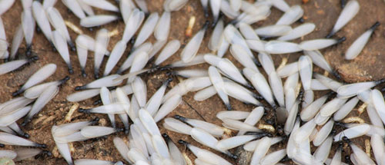
29. Which caste members are responsible for swarming from an established colony in order to start a new colonies?
Workers
Soldiers
Queens
Primary reproductives
Supplementary reproductives
Primary reproductives are called swarmers or alates. They have wings.
A new subterranean termite colony matures in about six to seven years.
It is at this time, alates are produced. Alates take 12 months to develop
before they leave their nest in a swarm (usually on a sunny day after a
rain shower during March, April or May). Male and female swarmers
pair up, find a crack in the ground, enter it and build a nest. There they
mate and start a new colony.

Slide 63
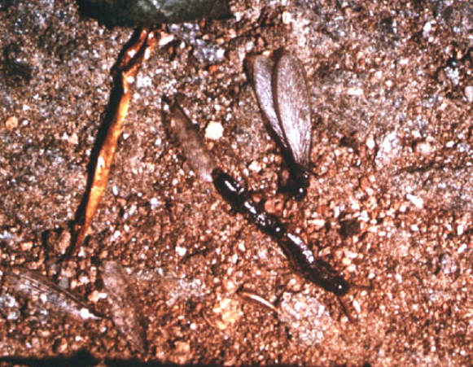
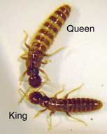
Swarming
Soon after swarming, male and female
alates lose their wings and form pairs
A pair that successfully establishes a
new colony is called the king (male)
and queen (female) of the colony
They are also referred to as the primary
(first form) reproductives because they
have attained the adult stage and are
physically and sexually mature
Within the first few days or weeks after
pairing, the queen lays the first clutch
several dozen eggs; small numbers of
eggs are laid intermittently thereafter

Slide 64
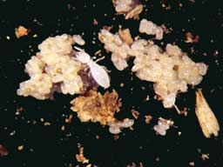
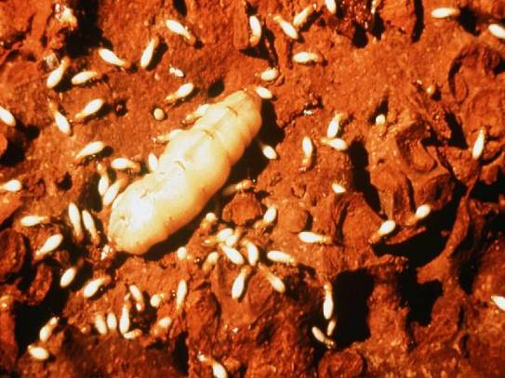
Swarming
The king and queen take care of the
first batch(es) of eggs and young
When a number of workers are
present, they begin caring for
their younger nestmates, eggs,
and the primary reproductives
Initial colony growth is slow,
but as the queen ages her egg-
laying capacity increases and
colony growth rate accelerates

Slide 65
30. Which caste members are responsible for building mud tunnels, foraging for food, feeding other caste members and grooming the queen?
Workers
Soldiers
Primary reproductives
Supplementary reproductives

Slide 66
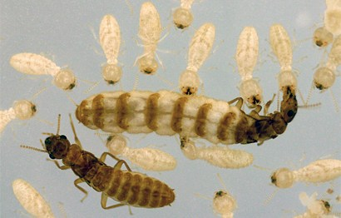
30. Which caste members are responsible for building mud tunnels, foraging for food, feeding other caste members and grooming the queen?
Workers
Soldiers
Primary reproductives
Supplementary reproductives
You can see the creamy-white
colored workers surrounding the
queen while they groom her.

Slide 67
31. Which caste member’s duty is to take over the queen’s duties once she has died?
Workers
Soldiers
Queens
Primary reproductives
Supplementary reproductives

Slide 68
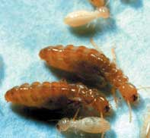
31. Which caste member’s duty is to take over the queen’s duties once she has died?
Workers
Soldiers
Queens
Primary reproductives
Supplementary reproductives
The Queen may only be responsible
for producing as few as 10,000
members of a colony with 1,000,000
individuals. Once the Queen termite
dies, the supplemental reproductives
(secondary reproductives) take over
the egg laying responsibility of the
colony.

Slide 69
32. Subterranean termites belong to the Order:
Dermaptera
Orthoptera
Isoptera
Hemiptera

Slide 70
32. Subterranean termites belong to the Order:
Dermaptera
Orthoptera
Isoptera
D. Hemiptera
ISOPTERA
Isoptera means equal wings…and a termite has 2 equal size and
shape pairs of wings. ISO means “equal” and PTERA means “wings.”
This would be the answer if you were taking the Certification exam.
Recently, termites have been added to the Order Blattodea, the
order that contains cockroaches. This would be the answer if you
were taking the Employee Registration exam.

Slide 71
33. All wasps, bees, hornets, yellow jackets
and termites are social insects.
True
False

Slide 72
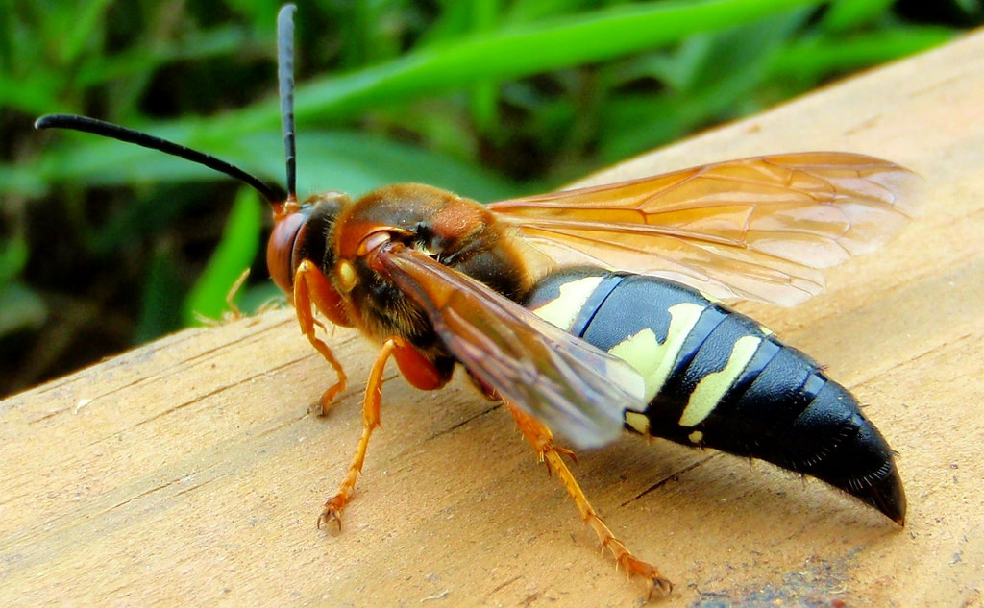
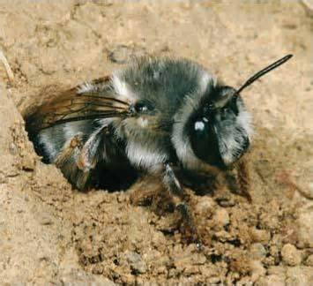
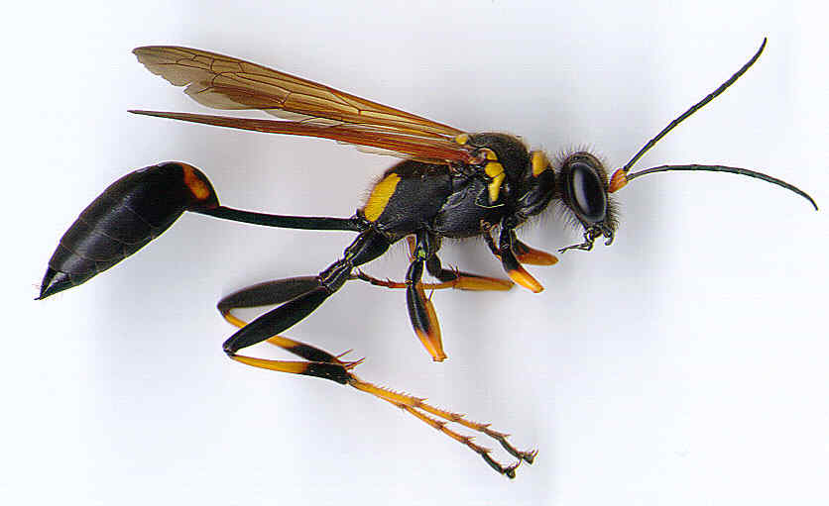
33. All wasps, bees, hornets, yellow jackets
and termites are social insects.
True
False
Some wasps and bees are solitary insects.
However, all termites are social insects.

Slide 73
34. Termites can digest cellulose because they
have symbiotic microorganisms in their gut
that can break down cellulose into
usable nutrients that termites can digest.
True
False

Slide 74

34. Termites can digest cellulose because they
have symbiotic microorganisms in their gut
that can break down cellulose into
usable nutrients that termites can digest.
True
False

Slide 75
35. Termites are the only insects that can
digest cellulose.
True
False

Slide 76
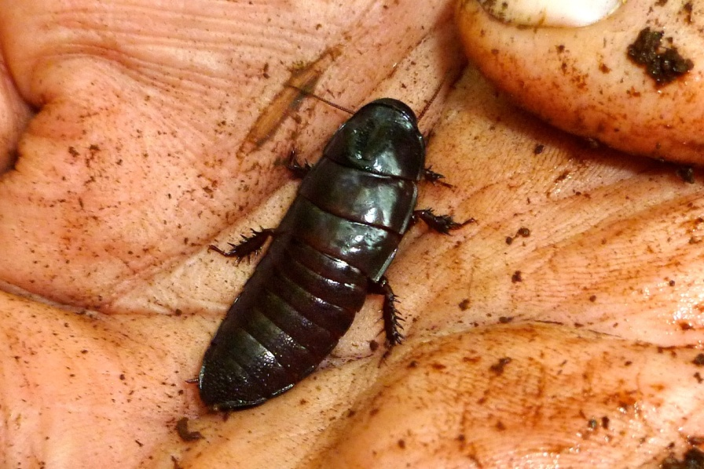


35. Termites are the only insects that can
digest cellulose.
True
False
Anobiid beetles, the Old House Borer and primitive cockroaches of the genus
Cryptocercus can all eat wood and digest cellulose because of they have
microorganisms in their digestive system that can break down cellulose to
nutrients that they can digest.

Slide 77
36. Workers and soldiers are the only caste
members that are blind.
True
False

Slide 78
36. Workers and soldiers are the only caste
members that are blind.
True
False
Workers, soldiers and tertiary reproductives are blind and all lack wings
or wing buds.

Slide 79
37. A subterranean termite colony may forage
for distances up to 200 yards from the nest.
True
False

Slide 80
37. A subterranean termite colony may forage
for distances up to 200 yards from the nest.
True
False
The foraging territory of Reticulitermes species may cover up to a half
(½) acre, and workers may forage 260 lin. ft. (87 lin. yds.) from one
spot to the next while foraging.
Formosan termites have been shown to forage over 1½ acres and
worker may forage a linear distance that approaches 330 ft. (110 yds.)

Slide 81
38. An average Eastern subterranean termite
colony is made up of from 1 to 5 million
worker termites in size.
True
False

Slide 82
38. An average Eastern subterranean termite
colony is made up of from 1 to 5 million
worker termites in size.
True
False
The average, single subterranean termite colony of
Reticulitermes flavipes, the Eastern subterranean
termite, contains about 60,000 to 1,000,000 workers.
The average, single Formosan subterranean termite
(Coptotermes formosanus) colony contains about
350,000 to 2,000,000 workers.

Slide 83
39. Temperature, moisture and other
environmental factors influence termite
swarming?
True
False

Slide 84


39. Temperature, moisture and other
environmental factors influence termite
swarming?
True
False
Subterranean termites "swarm" as the weather begins to warm,
usually at the beginning of Spring, after a rain event.

Slide 85
40. Swarmer termites retain their wings until
after they mate. Then they break them off.
True
False

Slide 86
40. Swarmer termites retain their wings until
after they mate. Then they break them off.
True
False
After a brief flight, the wings are broken
off, and males and females pair and
attempt to establish a new colony in the
soil.
They are particularly defenseless at this
time, and most die or are killed by their
natural enemies (birds, ants, etc.).
They may also succumb to desiccation
and other environmental factors.
Each surviving pair makes a small cell in
the ground which they mate and lay eggs.

Slide 87
41. Subterranean termite swarmers are strong
fliers, often flying distances of ½ mile or
more.
True
False

Slide 88
41. Subterranean termite swarmers are strong
fliers, often flying distances of ½ mile or
more.
True
False
Termites are not strong fliers. However, wind may
carry them further distances.

Slide 89
42. Swarmers are generally produced about
two years after a new colony is started.
True
False

Slide 90
42. Swarmers are generally produced about
two years after a new colony is started.
True
False
A new subterranean termite colony matures in about
six to seven years. It is at this time, swarmers are
produced. They take 12 months to develop before
they leave their nest in a swarm (usually on a sunny
day after a rain shower during March, April or May).

Slide 91
43. In a new subterranean termite colony that
is established in Spring after a swarm, the
first eggs laid by the Queen become
soldiers in order to protect the Queen.
Later, the Queen produces eggs that
become workers.
True
False

Slide 92
43. In a new subterranean termite colony that
is established in Spring after a swarm, the
first eggs laid by the Queen become
soldiers in order to protect the Queen.
Later, the Queen produces eggs that
become workers.
True
False
In new colonies, larvae from the first small batch of
eggs usually all become workers. Nymphs and soldiers
are not normally produced until later egg-laying.

Slide 93
44. Drywood termites have no soldier caste.
True
False

Slide 94

44. Drywood termites have no soldier caste.
True
False

Slide 95
45. Drywood termites have no worker caste.
True
False

Slide 96
45. Drywood termites have no worker caste.
True
False

Slide 97
46. Each Formosan subterranean termite eats
about 6 times more wood per day than
does an Eastern subterranean termite.
True
False

Slide 98
46. Each Formosan subterranean termite eats
about 6 times more wood per day than
does an Eastern subterranean termite.
True
False
They eat about the same amount of wood. If the estimated number of
termites in an average Eastern subterranean termite colony is 60,000
and is 350,000 in an average Formosan subterranean termite colony. An
average Formosan subterranean termite colony eats about 6 times more
wood per day than each Eastern subterranean termite colony because it
is 6 times the size.
Formosan subterranean Eastern subterranean
termite colony termite colony
Average # of workers per colony 350,000 60,000
Wood consumption per colony/day (g) 31.04 4.98
Days to consume a board foot of wood 38 236
Days to consume a 2X4 board 1’ long 19 118

Slide 99
47. When do Formosan subterranean termites
swarm in Georgia?
During the mid-day, from March through April
During the mid-day, from May through June
At dusk and about 2 hours later, from March through April
At dusk and about 2 hours later, from May through June
In the late evening, from March through April
F. In the late evening, from May through June

Slide 100
47. When do Formosan subterranean termites
swarm in Georgia?
During the mid-day, from March through April
During the mid-day, from May through June
At dusk and about 2 hours later, from March through April
At dusk and about 2 hours later, from May through June
In the late evening, from March through April
F. In the late evening, from May through June

Slide 101
48. Swarmer subterranean termites and
swarmer ants are often misidentified by
homeowners.
True
False

Slide 102

48. Swarmer subterranean termites and
swarmer ants are often misidentified by
homeowners.
True
False

Slide 103
49. Which termites do the most amount of
damage to structures each year in the U.S.?
Eastern subterranean termites
Formosan subterranean termites
Drywood termites
Dampwood termites

Slide 104
49. Which termites do the most amount of
damage to structures each year in the U.S.?
Eastern subterranean termites
Formosan subterranean termites
Drywood termites
D. Dampwood termites
Even though Formosan subterranean termites do more damage to any
one home, the Eastern subterranean termite are significantly more
common…so they do more damage to structures each year in the U.S.

Slide 105
50. Are drywood termites attracted to lights?
Yes
No

Slide 106

50. Are drywood termites attracted to lights?
Yes
No
Drywood termites attracted to light at a window sill

Slide 107
51. Are subterranean termites attracted to
lights?
Yes
No

Slide 108

51. Are subterranean termites attracted to
lights?
These subterranean
termites, on a sunny
day, have swarmed
to a window sill.
Yes
No
These Formosan
subterranean
termites have
swarmed to
stadium lights
outside at night

Slide 109
52. How far can supplemental reproductives fly?
They can’t fly
About 10 feet
About 100 feet
Greater than 100 feet

Slide 110
52. How far can supplemental reproductives fly?
They can’t fly
About 10 feet
About 100 feet
Greater than 100 feet
There are 2 kinds of supplemental reproductives in a subterranean
termite colony: secondary reproductives and tertiary reproductives.
Secondary reproductives have eyes and wing pads, but never
develop wings, therefore, they cannot fly.
Tertiary reproductives do not have eyes (are blind) and do not have
wing buds or wings, therefore, they cannot fly.

Slide 111
53. Repellant termiticides are the most effective
termiticides. They form an impenetrable
barrier through the soil that subterranean
termites cannot cross.
True
False

Slide 112
53. Repellant termiticides are the most effective
termiticides. They form an impenetrable
barrier through the soil that subterranean
termites cannot cross.
True
False
Repellant termiticide treatments do form a barrier around a structure being treated for subterranean termites, but the treatments are not always perfect, as they may not spread uniformly under the soil due to obstructions. Therefore, they may not form a perfect barrier and termite damage may continue to occur.
Non-repellent termiticide treatments form an invisible, undetectable, slow-acting death zone and are able to be transferred to other colony members through trophallaxis and are more effective than repellent products. US Forest Service Termiticide Efficacy Reports document that Termidor SC (a non-repellent termiticide) out performs any of the repellent synthetic pyrethroid termiticides.

Slide 113
54. Subterranean termite baiting systems use
IGR-based baits that rely on the worker
termite randomly and continuously foraging
to find the bait. They take the bait back to
the colony and feed others, and recruit other
workers to the bait site/s. The IGR bait is
exchanged to other colony members by
trophallaxis and it prevents molting of the
developing termites that feed on it. It very
quickly eliminates all termite colonies in less
than 6 months.
True
False

Slide 114
54. Subterranean termite baiting systems use
IGR-based baits that rely on the worker
termite randomly and continuously foraging
to find the bait. They take the bait back to
the colony and feed others, and recruit other
workers to the bait site/s. The IGR bait is
exchanged to other colony members by
trophallaxis and it prevents molting of the
developing termites that feed on it. It very
quickly eliminates all termite colonies in less
than 6 months.
True
False
If you failed to answer this question correctly, obviously,
you have never inspected termite baiting systems.

Slide 115
55. In Georgia, there are 3 types of termite
pretreatments that may be performed.
True
False – only one type
False – only two types

Slide 116
55. In Georgia, there are 3 types of termite
pretreatments that may be performed.
True
False – only one type
False – only two types
The 3 types of pretreatments that can be performed are:
Soil treatments
Bait treatments
Wood treatments

Slide 117
56. How many inches of clearance must there
be between wood and soil in a crawl space
for a subterranean termite treatment in GA?
At least 6 inches
At least 12 inches
At least 16 inches
At least 18 inches

Slide 118
56. How many inches of clearance must there
be between wood and soil in a crawl space
for a subterranean termite treatment in GA?
At least 6 inches
At least 12 inches
At least 16 inches
At least 18 inches

Slide 119
57. How many inches of clearance must there
be between wood and soil on the outside
of a structure for a subterranean termite
treatment in GA?
At least 6 inches
At least 12 inches
At least 16 inches
At least 18 inches

Slide 120
57. How many inches of clearance must there
be between wood and soil on the outside
of a structure for a subterranean termite
treatment in GA?
At least 6 inches
At least 12 inches
At least 16 inches
At least 18 inches

Slide 121
58. What is the highest level above the soil or
slab that is adjacent to a foundation wall
that you can drill a void and treat it with a
termiticide and be in compliance with the
Rules of the Structural Pest Control
Commission in GA?
6 inches
At least 12 inches
At least 16 inches
At least 18 inches

Slide 122
58. What is the highest level above the soil or
slab that is adjacent to a foundation wall
that you can drill a void and treat it with a
termiticide and be in compliance with the
Rules of the Structural Pest Control
Commission in GA?
6 inches
At least 12 inches
At least 16 inches
At least 18 inches

Slide 123
59. What rate of application of a termiticide is
required to treat all the voids of a foundation
wall of a structure for a Comprehensive soil
treatment?
1 gallon per 10 linear feet of foundation wall
2 gallons per 10 linear feet of foundation wall
2 gallons per 10 linear feet of foundation wall per foot of depth from the grade to the footer
4 gallons per 10 linear feet of foundation wall

Slide 124
59. What rate of application of a termiticide is
required to treat all the voids of a foundation
wall of a structure for a Comprehensive soil
treatment?
1 gallon per 10 linear feet of foundation wall
2 gallons per 10 linear feet of foundation wall
2 gallons per 10 linear feet of foundation wall per foot of depth from the grade to the footer
4 gallons per 10 linear feet of foundation wall

Slide 125
60. What rate of application of a termiticide is
required to treat the soil on either side of
the foundation wall of a crawl space
structure for a Comprehensive soil
treatment on a new job in GA?
2 gallons per 10 linear feet of foundation wall
2 gallons per 10 linear feet of foundation wall per foot of depth from the grade to the footer
4 gallons per 10 linear feet of foundation wall
4 gallons per 10 linear feet of foundation wall per foot of depth from the
grade to the footer or at least 4 feet deep when the footer is deeper.

Slide 126
60. What rate of application of a termiticide is
required to treat the soil on either side of
the foundation wall of a crawl space
structure for a Comprehensive soil
treatment on a new job in GA?
2 gallons per 10 linear feet of foundation wall
2 gallons per 10 linear feet of foundation wall per foot of depth from the grade to the footer
4 gallons per 10 linear feet of foundation wall
D. 4 gallons per 10 linear feet of foundation wall per foot of depth from the
grade to the footer or at least 4 feet deep when the footer is deeper.

Slide 127
61. Are voids of a structure required to be
treated for subterranean termite control
when performing a Defined soil treatment
in GA?
Yes, all voids must be treated with all types of soil treatments.
No, only voids that are infested by subterranean termites must be treated according to the “Defined soil treatment” section of the Rules of the Structural Pest Control Commission and of the label of the termiticide that you are using.
No, voids are not required to be treated when performing a Defined soil treatment.

Slide 128
61. Are voids of a structure required to be
treated for subterranean termite control
when performing a Defined soil treatment
in GA?
Yes, all voids must be treated with all types of soil treatments.
No, only voids that are infested by subterranean termites must be
treated according to the “Defined soil treatment” section of the
Rules of the Structural Pest Control Commission and of the label
of the termiticide that you are using.
No, voids are never required to be treated when performing a
Defined soil treatment.

Slide 129
62. May all the foundation walls of a dirt-filled porch be
horizontally drilled at level up to 1” to 2” below the
slab and at 12” intervals or less along those
foundation walls and the soil under the slab treated
by short-rodding where it is adjacent to the entire
interior perimeter walls of the dirt-filled porch on a
Comprehensive soil treatment?
No. It may only be vertically drilled within 12” of the interior foundation walls at
12” or less intervals along those walls and treated adjacent to the interior of the
foundation wall of a dirt-filled porch on a Comprehensive soil treatment
Yes. The slab of a dirt-filled porch may also be vertically drilled within 12” of its
interior foundation walls at 12” or less intervals along those walls and the soil
underneath the slab in those areas treated or the foundation walls may be
horizontally drilled at 1” to 2” below the slab level and long-rodded to treat those
same areas of soil under the slab and adjacent to all the interior walls of the dirt-
filled porch..

Slide 130
62. May all the foundation walls of a dirt-filled porch be
horizontally drilled at level up to 1” to 2” below the
slab and at 12” intervals or less along those
foundation walls and the soil under the slab treated
by short-rodding where it is adjacent to the entire
interior perimeter walls of the dirt-filled porch on a
Comprehensive soil treatment?
No. It may only be vertically drilled within 12” of the interior foundation walls at
12” or less intervals along those walls and treated adjacent to the interior of the
foundation wall of a dirt-filled porch on a Comprehensive soil treatment
Yes. The slab of a dirt-filled porch may also be vertically drilled within 12” of its
interior foundation walls at 12” or less intervals along those walls and the soil
underneath the slab in those areas treated or the foundation walls may be
horizontally drilled at 1” to 2” below the slab level and long-rodded to treat those
same areas of soil under the slab and adjacent to all the interior walls of the dirt-
filled porch.

Slide 131
63. Can a dirt-filled porch be drilled and short-
rodded from the side to treat the soil under
the slab where it joins the structure on a
Defined soil treatment?
Yes. A dirt-filled porch may be horizontally drilled through the foundation wall at up to 1” to 2” below the level of the slab of the dirt-filled porch slab at 12” intervals or less and the soil treated by short-rodding.
No. The slab of a dirt-filled porch may only be vertically drilled at a maximum of 12” away from and at a maximum of 12” intervals along all the interior walls of the dirt-filled porch.
No. The slab of the dirt-filled porch is only required to be vertically drilled at a maximum of 12” away from the foundation wall and at no greater than 12” intervals along where the slab joins the structure.

Slide 132
63. Can a dirt-filled porch be drilled and short-
rodded from the side to treat the soil under
the slab where it joins the structure on a
Defined soil treatment?
Yes. A dirt-filled porch may be horizontally drilled through the foundation wall at up to 1” to 2” below the level of the slab of the dirt-filled porch slab at 12” intervals or less and the soil treated by short-rodding.
No. The slab of a dirt-filled porch may only be vertically drilled at a maximum of 12” away from and at a maximum of 12” intervals along all the interior walls of the dirt-filled porch.
No. The slab of the dirt-filled porch is required to be vertically drilled at a maximum of 12” away from the foundation wall and at no greater than 12” intervals along where the slab joins the structure and the soil beneath treated. No other treatment method of a dirt-filled porch is acceptable in a Defined soil treatment.

Slide 133
64. How many gallons of a diluted termiticide
would be needed to treat the voids of a 45
foot long section of triple-brick wall for a
Comprehensive soil treatment on a
structure where the depth of the footer
was 2 feet from grade?
9 gallons
18 gallons
24 gallons
D. 36 gallons

Slide 134
64. How many gallons of a diluted termiticide
would be needed to treat the voids of a 45
foot long section of triple-brick wall for a
Comprehensive soil treatment on a
structure where the depth of the footer
was 2 feet from grade?
There are 2 voids in a triple-brick wall.
The application rate for each void is .2 gals./lin. ft.
.2 gals./lin. ft. + .2 gals./lin. ft. = .4 gals./lin. ft.
The foundation wall is 45 ft. long. To treat it:
45’ X .4 gals./lin. ft. = 18 gals.
You never consider the foot of depth from grade
to the footer for void treatment.
9 gallons
18 gallons
24 gallons
D. 36 gallons

Slide 135
65. How many gallons of a diluted termiticide
would be needed to treat the voids of a 45
foot long section of double-brick wall for a
Comprehensive soil treatment on a
structure where the depth of the footer
was 1 foot from grade?
9 gallons
18 gallons
24 gallons
D. 36 gallons

Slide 136
65. How many gallons of a diluted termiticide
would be needed to treat the voids of a 45
foot long section of double-brick wall for a
Comprehensive soil treatment on a
structure where the depth of the footer
was 1 foot from grade?
9 gallons
18 gallons
24 gallons
D. 36 gallons
There is one void in a double-brick wall.
The application rate for each void is .2 gals./lin. ft.
The foundation wall is 45 ft. long. To treat the void:
45’ X .2 gals./lin. ft. = 9 gals.
You never consider the foot of depth from
grade to the footer for void treatment.

Slide 137
66. How many gallons of a diluted termiticide
would be needed to treat the voids of a 70
foot long section of brick veneer, hollow
block wall for a Comprehensive soil
treatment on a structure where the depth
of the footer was 1 foot from grade?
14 gallons
22 gallons
28 gallons
D. 36 gallons

Slide 138
66. How many gallons of a diluted termiticide
would be needed to treat the voids of a 70
foot long section of brick veneer, hollow
block wall for a Comprehensive soil
treatment on a structure where the depth
of the footer was 1 foot from grade?
There are 2 voids in a brick-veneer, hollow block wall.
The application rate for each void is .2 gals./lin. ft.
The application rate for both voids is 2 X .2 gals./lin. ft.
2 X .2 gals./lin. ft. = .4 gals./lin. ft.
The foundation wall is 70 ft. long. To treat the voids:
70 lin. ft. X .4 gals./lin. ft. = 28 gals.
You never consider the foot of depth from grade
to the footer for void treatment.
14 gallons
22 gallons
28 gallons
D. 36 gallons

Slide 139
67. How many gallons of a diluted termiticide
would be needed to treat the soil adjacent
to the outside of an 85 foot long section of
hollow block wall for a Comprehensive soil
treatment on a structure where the depth
of the footer was 2 feet from grade?
17 gallons
34 gallons
48 gallons
D. 68 gallons

Slide 140
67. How many gallons of a diluted termiticide
would be needed to treat the soil adjacent
to the outside of an 85 foot long section of
hollow block wall for a Comprehensive soil
treatment on a structure where the depth
of the footer was 2 feet from grade?
The rate of application for treating the soil is:
4 gals./10 lin. ft./ft. depth = .4 gals./lin. ft./ft. depth
The footer is 2 feet deep
.4 gals./lin. ft. X 2 ft. depth = .8 gals./lin. ft.
To treat the 85’ section of wall:
.8 gals./lin. ft. X 85 lin. ft. of wall = 68 gallons
17 gallons
34 gallons
48 gallons
D. 68 gallons

Slide 141
68. How many gallons of a diluted termiticide
would be needed to treat the soil adjacent
to both sides of a 65 foot long section of a
single brick wall for a Comprehensive soil
treatment on a crawl space structure
where the depth of the footer was 1 foot
deep?
34 gallons
43 gallons
52 gallons
68 gallons

Slide 142
68. How many gallons of a diluted termiticide
would be needed to treat the soil adjacent
to both sides of a 65 foot long section of a
single brick wall for a Comprehensive soil
treatment on a crawl space structure
where the depth of the footer was 1 foot
deep?
The application rate of each side = 4 gals./10 lin. ft./ft. depth
or .4 gals./lin. ft./ft. depth
.4 gals./lin. ft./ft. depth X 1 ft. depth = .4 gals./lin. ft.
There are 2 sides of a foundation wall to be treated.
.4 gals./lin. ft. + .4 gals./in. ft. = .8 gals./lin. ft.
The soil is to be treated for 65 feet.
.8 gals./lin. ft. X 65 lin. ft. = 52 gallons
34 gallons
43 gallons
52 gallons
68 gallons

Slide 143
69. How many gallons of a diluted termiticide would be
needed to treat the soil adjacent to both sides of a
80 foot long section of a triple brick foundation wall
and the voids of the wall for a Comprehensive soil
treatment on a supported slab structure where the
depth of the footer on the outside was 1 foot deep
and on the inside was 3 feet deep?
144 gallons
160 gallons
240 gallons
D. 320 gallons

Slide 144
69. How many gallons of a diluted termiticide would be
needed to treat the soil adjacent to both sides of a
80 foot long section of a triple brick foundation wall
and the voids of the wall for a Comprehensive soil
treatment on a supported slab structure where the
depth of the footer on the outside was 1 foot deep
and on the inside was 3 feet deep?
The application rate to the soil adjacent to a foundation wall is:
4 gals./10 lin. ft./ft. depth from grade to the footer
The soil adjacent to the exterior foundation wall:
.4 gals./lin. ft./1 ft. depth = .4 gals./lin. ft.
The soil adjacent to the interior of the foundation wall:
.4 gals./lin. ft./3 ft. depth = .4 gals./lin. ft. X 3 = 1.2 gals./lin. ft.
There are 2 voids in a triple brick foundation wall:
.2 gals./lin. ft. + .2 gals./lin. ft. = .4 gals. lin. ft.
.4 gals/lin. ft. + 1.2 gals./lin. ft. + .4 gals./lin. ft. = 2.0 gals./lin. ft.
2.0 gals./lin. ft. X 80 lin. ft. = 160 gallons
144 gallons
160 gallons
240 gallons
D. 320 gallons

Slide 145
70. How many gallons of a diluted termiticide would be
needed to treat the soil adjacent to the outside of a
155 foot long hollow block foundation wall and the
voids of that wall for a Comprehensive soil
treatment on a basement slab structure where the
depth of the footer on the outside was 6½ feet deep?
119 gallons
219 gallons
279 gallons
D. 379 gallons

Slide 146
How many gallons of a diluted termiticide would be
needed to treat the soil adjacent to the outside of a
155 foot long hollow block foundation wall and the
voids of that wall for a Comprehensive soil
treatment on a basement slab structure where the
depth of the footer on the outside was 6½ feet deep?
The application rate to treat the soil adjacent to the exterior of a
foundation wall is: 4 gals./10 lin. ft./ft. depth or:
.4 gals./lin. ft./ft. depth to a maximum of a 4’ depth
.4 gals./lin. ft. x 4 ft. depth = 1.6 gals./lin. ft.
The application to treat a void is 2 gals./10 lin. ft. or .2 gals./lin. ft.
.2 gals./lin. ft. X 1 void = .2 gals./lin ft.
The total application rate along the wall is:
1.6 gals./lin. ft. + .2 gals./lin. ft. = 1.8 gals./lin. ft.
To treat the 155 lin. ft. wall:
1.8 gals./lin. ft. X 155 lin. ft. = 279 gallons
119 gallons
219 gallons
279 gallons
D. 379 gallons

Slide 147
71. Termites are social insects that live in
colonies that cooperate in raising their
young and share their resources (food,
water, etc.).
True
False

Slide 148
71. Termites are social insects that live in
colonies that cooperate in raising their
young and share their resources (food,
water, etc.).
True
False

Slide 149
72. Termites, like ants, have a colony structure
where the majority of members are females
concentrated in a single, centralized, immobile
nest from which workers forage in search of
food and water.
True
False

Slide 150
72. Termites, like ants, have a colony structure
where the majority of members are females
concentrated in a single, centralized, immobile
nest from which workers forage in search of
food and water.
True
False
Subterranean termite social groups are composed of both males and
females and have a mobile nest site usually located near food, most
often some form of dead wood that they excavate and inhabit.

Slide 151
73. This soldier termite secretes a defensive
secretion through a fontanelle, a hole that is
connected to a gland on the front of its head.
Native subterranean termite (Reticulitermes spp.)
Formosan subterranean termite (Coptotermes formosanus)
Drywood termite

Slide 152


73. This soldier termite secretes a defensive
secretion through a fontanelle, a hole that is
connected to a gland on the front of its head.
Native subterranean termite (Reticulitermes spp.)
Formosan subterranean termite (Coptotermes formosanus)
Drywood termite

Slide 153
74. Subterranean termites communicate by:
Pheromones
Sound
Trophallaxis
All the above

Slide 154
74. Subterranean termites communicate by:
Pheromones
Sound
Trophallaxis
All the above

Slide 155
Can a subterranean termite worker develop
into a soldier?
Yes
No

Slide 156
Can a subterranean termite worker develop
into a soldier?
Yes
No

Slide 157
Can a subterranean termite soldier develop
into a worker?
Yes
No

Slide 158
Can a subterranean termite soldier develop
into a worker?
Yes
No…once a worker has turned into a soldier, it can’t turn back into a worker

Slide 159
Can a subterranean termite worker develop
into a Tertiary reproductive?
Yes
No

Slide 160
Can a subterranean termite worker develop
into a Tertiary reproductive?
Yes
No
Yes
No

Slide 161
Which insects are most closely related to a
termite?
Silverfish
Cockroaches
Beetles
Bees

Slide 162
Which insects are most closely related to a
termite?
Silverfish
Cockroaches
Beetles
Bees

Slide 163
Which stage/stages and/or caste/castes
perform all of the work of a termite
colony and do all the damage to
structures?
Worker
Soldier
Worker & Soldier
Nymph & Worker
Nymph & Soldier

Slide 164
Which stage/stages and/or caste/castes
perform all of the work of a termite
colony and do all the damage to
structures?
Worker
Soldier
Worker & Soldier
Nymph & Worker
Nymph & Soldier

Slide 165
Termites develop by:
No metamorphosis
Gradual metamorphosis
Incomplete metamorphosis
Complete metamorphosis

Slide 166
Termites develop by:
No metamorphosis
Gradual metamorphosis
Incomplete metamorphosis
Complete metamorphosis
For those taking the Certification exam:
Questions for the certification exam are taken from the Scientific Guide to Pest Control Operations, which uses an older version to classify insect development.
For those taking the Employee Registration exam:
Questions for the Employee Registration exam are taken from the Employee Registration Manual. It uses a newer version to classify insect metamorphosis that entomologists use to classify the type of insect development an insect has.
Now, termites are considered to have Incomplete metamorphosis. They are considered Paurometabolous insects, living on land in the immature stage.
Hemimetabolous insects, like dragonflies and damselflies, have an immature stage which lives in water, called a naiad.

Slide 167
Which caste of the subterranean termite is
most often the first to be noticed by the
customer?
Worker
Soldier
Primary reproductive
Secondary reproductive

Slide 168
Which caste of the subterranean termite is
most often the first to be noticed by the
customer?
Worker
Soldier
Primary reproductive (most often called swarmers)
Secondary reproductive
Our customers often overlook mud tunnels of subterranean
termites or fecal pellets of drywood termites. Swarm season is
when we get the majority of our calls from our customers
regarding termites. Swarm season is that time of the year,
usually Spring, when termites swarm from their home in large
numbers. It’s hard to overlook a termite swarm!

Slide 169
The Eastern subterranean termite prefers:
Loblolly and slash pine
Sugar maple
Black cherry
Redwood

Slide 170
The Eastern subterranean termite prefers:
Loblolly and slash pine
Sugar maple
Black cherry
Redwood

Slide 171
83. The Formosan subterranean termite prefers:
Loblolly and slash pine
Sugar maple
Black cherry
Redwood

Slide 172
83. The Formosan subterranean termite prefers:
Loblolly and slash pine
Sugar maple
Black cherry
Redwood

Slide 173
Subterranean termites are often associated
with fungi in their nests, which serves as a
source of protein.
Yes
No

Slide 174
Subterranean termites are often associated
with fungi in their nests, which serves as a
source of protein.
Yes
No

Slide 175
Subterranean termites consume wood at
the rate of ______ of their body weight
each day.
1%
2½%
5½%
10%

Slide 176
Subterranean termites consume wood at
the rate of ______ of their body weight
each day.
1%
2½%
5½%
10%

Slide 177
May you perform a soil treatment within
100’ of a well?
A. Yes, there are no labels of termiticides that prohibit treatment
within 100’. However, the Termidor labels do not permit
treatment of the soil within 5’ of a well by any means…not even by
excavation and treatment of the backfill away from the well.
B. No, it is illegal to treat soil within 100 feet of a well by any termiticide

Slide 178
May you perform a soil treatment within
100’ of a well?
A. Yes, there are no labels of termiticides that prohibit treatment
within 100’. However, the Termidor labels do not permit
treatment of the soil within 5’ of a well by any means…not even by
excavation and treatment of the backfill away from the well.
B. No, it is illegal to treat soil within 100 feet of a well by any termiticide

Slide 179
What is the standard for adequate
ventilation for a Comprehensive soil
treatment for the control of
subterranean termites?
8” X 16” vents need to be placed at 15’ intervals or less along the exterior foundation walls of a crawl space and at least 70% of the soil of the crawl space needs to be covered with a vapor barrier.
8” X 16” vents need to be placed at 25’ intervals or less along the exterior foundation walls of a crawl space and at least 70% of the soil of the crawl space needs to be covered with a vapor barrier.
There is no standard for adequate ventilation for a Comprehensive soil treatment for the control of subterranean termites.

Slide 180
What is the standard for adequate
ventilation for a Comprehensive soil
treatment for the control of
subterranean termites?
8” X 16” vents need to be placed at 15’ intervals or less along the exterior foundation walls of a crawl space and at least 70% of the soil of the crawl space needs to be covered with a vapor barrier.
8” X 16” vents need to be placed at 25’ intervals or less along the exterior foundation walls of a crawl space and at least 70% of the soil of the crawl space needs to be covered with a vapor barrier.
There is no standard for adequate ventilation for a Comprehensive soil treatment for the control of subterranean termites.

Slide 181
Do visible cracks in a garage slab need to
be treated for a Comprehensive soil
treatment of a home?
Yes
No
Only if they are infested

Slide 182
Do visible cracks in a garage slab need to
be treated for a Comprehensive soil
treatment of a home?
Yes
No
Only if they are infested

Slide 183
Do visible cracks in a garage slab need to
be treated for a Defined soil treatment?
Yes
No
Only if they are infested

Slide 184
Do visible cracks in a garage slab need to
be treated for a Defined soil treatment?
Yes
No
Only if they are infested

Slide 185
Are bath traps required to be treated for
Comprehensive soil treatments performed
for the control of subterranean termites?
Yes
No
Only if they are infested

Slide 186
Are bath traps required to be treated for
Comprehensive soil treatments performed
for the control of subterranean termites?
Yes
No
Only if they are infested

Slide 187
Are bath traps required to be treated for
Defined soil treatments performed for the
control of subterranean termites?
Yes
No
Only if they are infested

Slide 188
Are bath traps required to be treated for
Defined soil treatments performed for the
control of subterranean termites?
Yes
No
Only if they are infested

Slide 189
An inspector who is a representative of
the GA DOA may take soil samples at
a structure which has been treated for
subterranean termite control:
Any time within 6 months of the treatment
Any time within 1 year of the treatment
Any time within 2 years of the treatment
Any time that the contract is in force and up to 2 years after the contract has cancelled.

Slide 190
An inspector who is a representative of
the GA DOA may take soil samples at
a structure which has been treated for
subterranean termite control:
Any time within 6 months of the treatment
Any time within 1 year of the treatment
Any time within 2 years of the treatment
Any time that the contract is in force and up to 2 years after the contract has cancelled.

Slide 191
After soil samples are taken at a structure
that was treated for subterranean termite
control and the composite sample is
analyzed for the proper amount of
termiticide, the GA DOA expects it to have
1 ppm of active ingredients per:
1% of product applied
0.1% of product applied
0.01% of product applied
0.001% of product applied

Slide 192
After soil samples are taken at a structure
that was treated for subterranean termite
control and the composite sample is
analyzed for the proper amount of
termiticide, the GA DOA expects it to have
1 ppm of active ingredients per:
1% of product applied
0.1% of product applied
0.01% of product applied
0.001% of product applied

Slide 193
The GA DOA inspector takes soil samples at
approximately:
5 foot intervals if the structure is 300’ or less
10 foot intervals if the structure is 300’ or less
15 foot intervals if the structure is 300’ or less
20 foot intervals if the structure is 300’ or less

Slide 194
The GA DOA inspector takes soil samples at
approximately:
5 foot intervals if the structure is 300’ or less
10 foot intervals if the structure is 300’ or less
15 foot intervals if the structure is 300’ or less
20 foot intervals if the structure is 300’ or less

Slide 195
The GA DOA inspector removes _____ of
soil before taking each soil sample.
1”
2”
3”
4”

Slide 196
The GA DOA inspector removes _____ of
soil before taking each soil sample.
1”
2”
3”
4”

Slide 197
The GA DOA inspector takes soil samples
that are:
½” X 4”
½” X 6”
¾” X 4”
¾” X 6”

Slide 198
The GA DOA inspector takes soil samples
that are:
½” X 4”
½” X 6”
¾” X 4”
D. ¾” X 6”

Slide 199
Do the locations of the bait stations that
are installed for the control of subterranean
termites need to be graphed?
Yes
No

Slide 200
Do the locations of the bait stations that
are installed for the control of subterranean
termites need to be graphed?
Yes
No

Slide 201
How long are termiticide application
records required to be kept by a PCO?
Two years after the date of application.
Five years after the date of application.
As long as the contract is active.
As long as the contract is active and 2 years after the contract has cancelled.

Slide 202
How long are termiticide application
records required to be kept by a PCO?
Two years after the date of application.
Five years after the date of application.
As long as the contract is active.
As long as the contract is active and 2 years after the contract has cancelled.

Slide 203
What are 3 non-chemical standards for
installing a baiting system in compliance
with the Rules?
At least 6” clearance between wood and soil on the outside of the structure, at least 18” clearance between wood and soil on the inside of the crawl space and adequate ventilation.
At least 6” clearance between wood and soil on the outside of the structure, at least 16” clearance between wood and soil on the inside of the crawl space and no cellulose debris in the crawl space.
At least 6” clearance between wood and soil on the outside of the structure, at least 18” clearance between wood and soil on the inside of the crawl space and no cellulose debris in the crawl space.
At least 8” clearance between wood and soil on the outside of the structure, at least 18” clearance between wood and soil on the inside of the crawl space and no cellulose debris in the crawl space.

Slide 204
What are 3 non-chemical standards for
installing a baiting system in compliance
with the Rules?
At least 6” clearance between wood and soil on the outside of the structure, at least 18” clearance between wood and soil on the inside of the crawl space and adequate ventilation.
At least 6” clearance between wood and soil on the outside of the structure, at least 16” clearance between wood and soil on the inside of the crawl space and no cellulose debris in the crawl space.
At least 6” clearance between wood and soil on the outside of the structure, at least 18” clearance between wood and soil on the inside of the crawl space and no cellulose debris in the crawl space.
At least 8” clearance between wood and soil on the outside of the structure, at least 18” clearance between wood and soil on the inside of the crawl space and no cellulose debris in the crawl space.

Slide 205
What is the rate of application to treat
the soil that is covered with gravel before
a slab is poured on a residential pretreat?
One gallon per 10 square feet of soil
One gallon per 15 square feet of soil
One and one-half gallons per 10 linear feet of soil
One and one-half gallons per 10 square feet of soil

Slide 206
What is the rate of application to treat
the soil that is covered with gravel before
a slab is poured on a residential pretreat?
One gallon per 10 square feet of soil
One gallon per 15 square feet of soil
One and one-half gallons per 10 linear feet of soil
One and one-half gallons per 10 square feet of soil (0.15 gals./sq. ft.)
200’ X 80’ = 16,000 sq. ft.
16,000 sq. ft.
X 0.15 gals./sq. ft.
2,400 gals.
80’
Soil covered by gravel
200’

Slide 207
How did you do?
If you answered 80 or more of the 100 questions with the
correct answer, you did well…and scored 80% or better.
70% passes most tests!
If you answered less than 80 of the 100 questions with the
correct answer, you may need to review this power point
presentation a few more times to “brush-up” on termites and
their control methods…but, I’ll bet you learned a few new
things about termites today.

