Slide 1
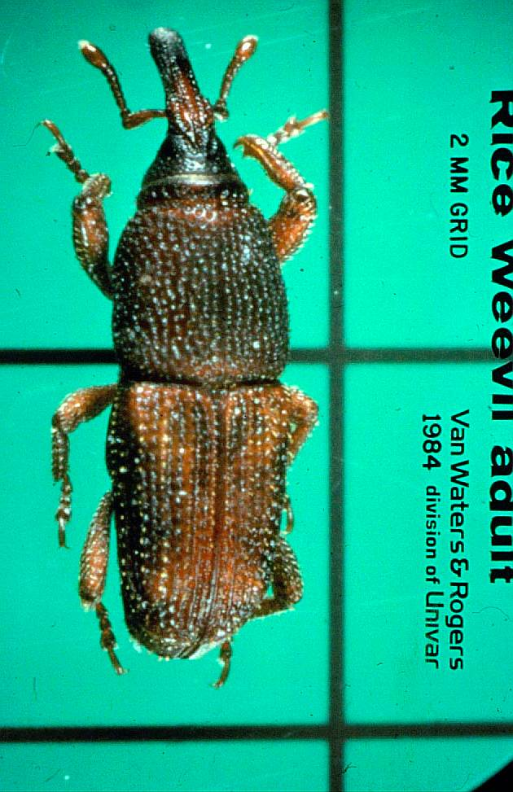
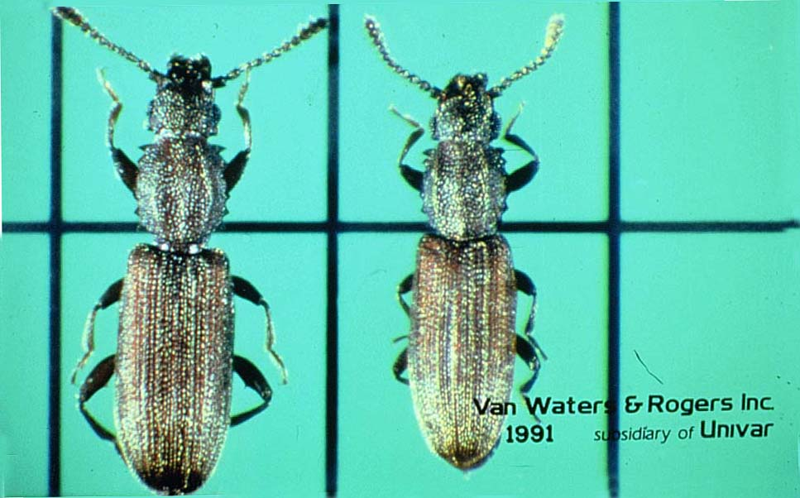
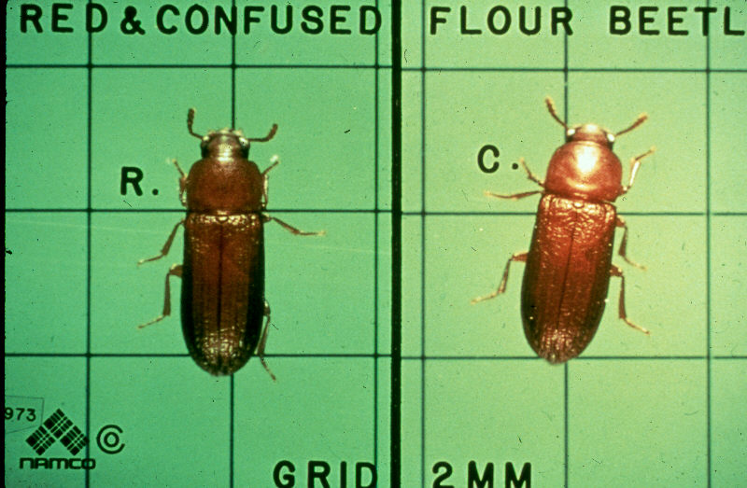
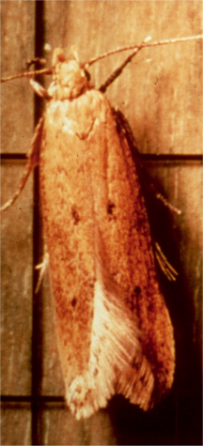
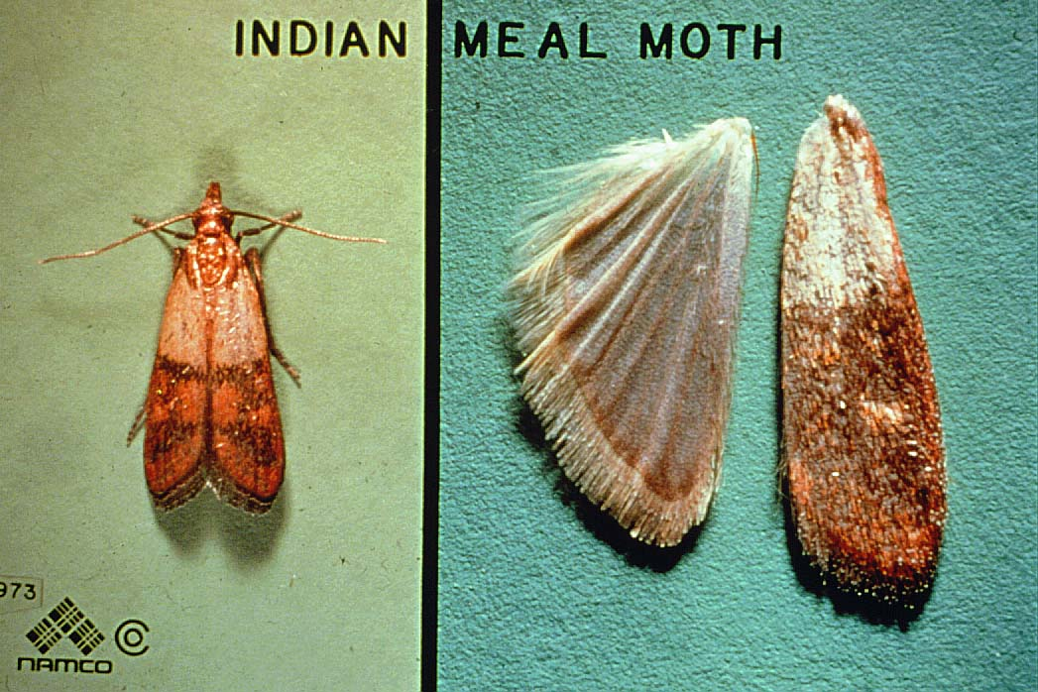
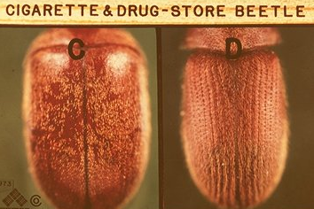
Stored Product Pests

Slide 2
Stored Product Pests
80% of human food is from grains and legumes
Stored product pests compete with humans for
this food both pre- and post-harvest
It is estimated these pests destroy 10% of
world’s grain production each year
Equivalent to 100% loss every tenth year

Slide 3
Stored Product Pests
Most of the stored product pests are:
- Beetles (Order Coleoptera)
- Moths (Order Lepidoptera).

Slide 4
Stored Product Pests
There are four types of stored product
pest feeders:
Internal Feeders
Scavengers
External Feeders
Secondary Feeders

Slide 5
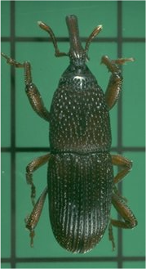
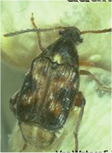
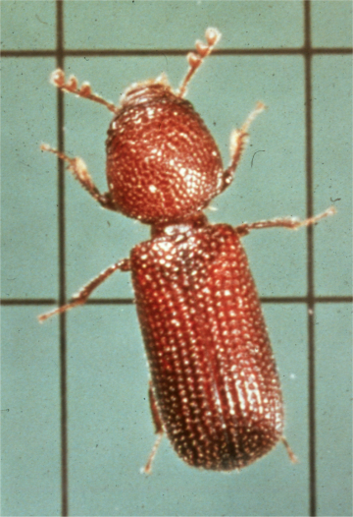
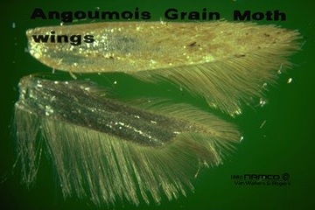
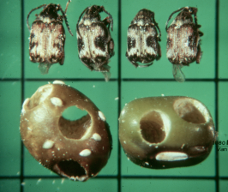
Internal Feeders
Internal feeders feed entirely within
the seed coat or grain

Slide 6
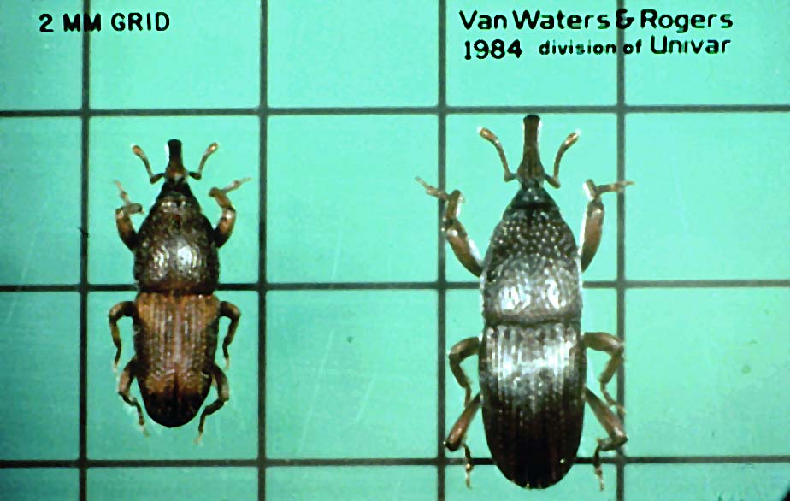
Internal Feeders
Rice Weevil – 3mm
have a snout
can fly
found in the south
identified by four
orange spots on the
elytra (front wings)
Granary Weevil – 4mm
have a snout
can’t fly
found in the north
larger than the
Rice Weevil and
solid dark brown

Slide 7
Internal Feeders
Lesser Grain Borer:
3mm in length
Head hidden under
pronotum
depressions on the
prothorax and the
elytra (front wings)

Slide 8
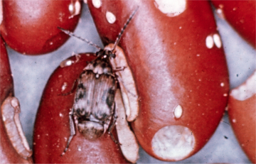
Internal Feeders
Both the Bean Weevil and the Cowpea Weevil are similar

Slide 9
Internal Feeders
Angoumois Grain Moth:
2/3” wingspan
rear wings are pointed
and fringed

Slide 10
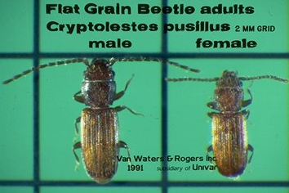
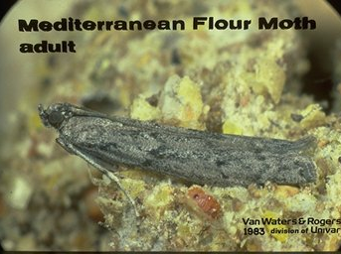
Scavengers
Scavengers feed on the broken-up bits and pieces of grain

Slide 11
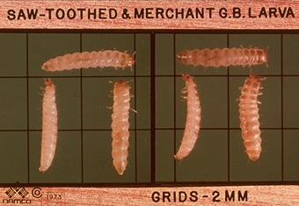
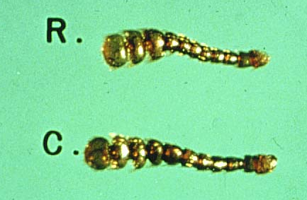
Scavengers
Merchant Grain Beetle
can fly
found mainly
in the North
Saw-toothed
Grain Beetle
can’t fly
found mainly
in the South
Red flour beetle
can fly
found in South
3 seg. clubbed
antennae
Confused flour beetle
can’t fly
found in North
clubbed antennae
gradually enlarged
These are all approximately 1/8” in length

Slide 12
Scavengers
Flat Grain Beetle:
One of the smallest stored product beetles
(< 2mm in length)
Can fly and jump
Feeds on stored corn in the South

Slide 13
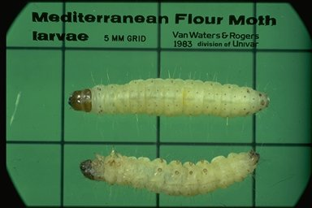
Scavengers
Mediterranean Flour Moth:
Pale grey wings with wavy black lines running across
Characteristic pose when resting - front of the body
is raised & pushed away from the wall giving the
wings a distinct downward slope with the tip of the
abdomen protruding up between them
Note the
two rows
spots on
the top
of the
larvae

Slide 14
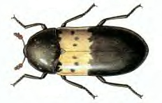
Scavengers
The Larder Beetle adult has a yellow stripe across the front of its
elytra with 6 dark spots.

Slide 15
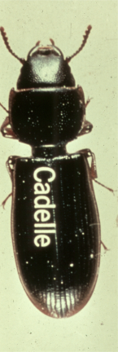
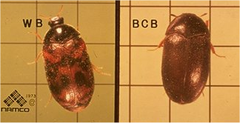
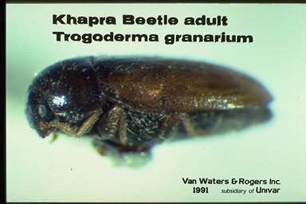
External Feeders
External feeders feed on the outside of the seed coat

Slide 16
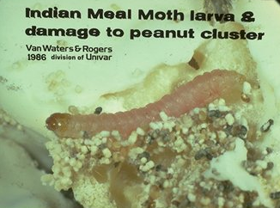
External Feeders
Indian Meal Moth:
1/3 of front wing
at the base is tan
and the outer 2/3
of the front wing
is reddish-brown
with a copper
luster
attracted to lights
major pest of dog
food, bird seed
and cereal
rests flat against
the wall
¾” wingspan
The larva of the Indian Meal Moth is
dirty white, but may range from pink to
brown to a greenish tinge. It is 9 mm
to 19 mm in length. The larva feeds in
or near a tunnel-like case of frass and
silk it webs together.

Slide 17
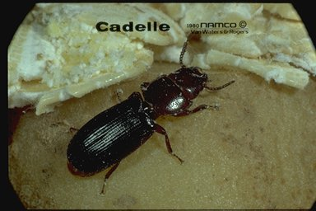
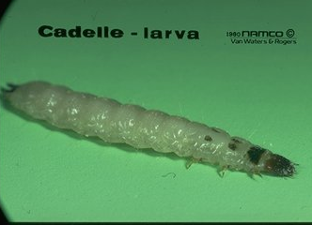
External Feeders
Cadelle:
Adult is 1/3” (8 mm) in length
Flattened body and pinched
waist (gap between prothorax
and front of elytra (front wings)
major pest of rice and flour
mills as well as in grain stored
in farms.
Cadelle larvae:
strikingly marked – pronotum
with dark spot and second and
third segments of the thorax each
have two small brown spots – the
last segment of the abdomen has
two distinct projections
larvae and adults are cold tolerant

Slide 18
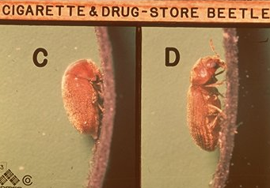
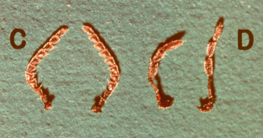
External Feeders
Humpbacked
Cigarette Beetle
(1/8”)
elytra smooth
antennae serrated
#1 pest of tobacco
pest of pet food,
cereals, spices,
drugs, raisins,
pasta and peppers
Drugstore Beetle
(1/8”)
elytra lined (rows
of deep pits)
3 segmented
clubbed antennae
major pest of dog
food & biscuits,
spices & drugs
serrated
3 segmented club

Slide 19
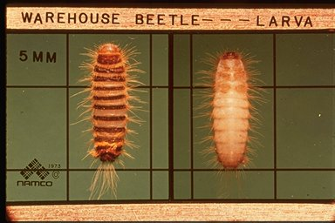
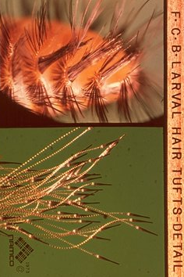
External Feeders
Warehouse Beetles:
3 mm in length
can fly
attracted to lights
feeds on animal
hair and skins,
dead insects, fish
meats, drugs, nuts,
dried fruits, pasta
The larvae of the
warehouse beetle
have numerous
hairs on all sides
of their body and
have slightly
longer hair at
the end of
their abdomen.

Slide 20
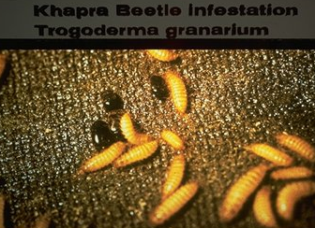
External Feeders
Khapra Beetle:
adult beetle is 3 mm in length
Genus Trogoderma
prefers grains such as wheat,
barley and rice
extremely important pest in
granaries and warehouses in
India
The hairs of the larvae
and those of their cast
skins pose a health risk
because of the allergic
responses they can
trigger in some persons
following accidental
ingestion. The larvae are highly resistant to
starvation and are
repelled by light.

Slide 21
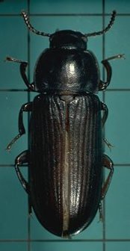
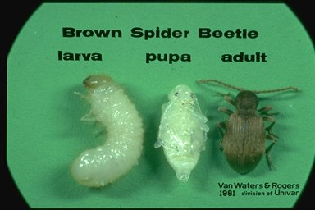
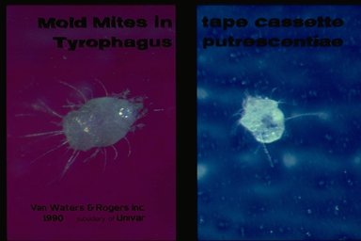
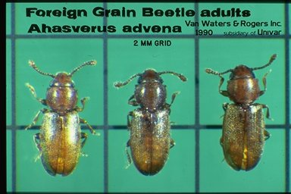
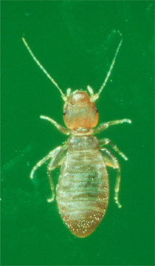
Secondary Feeders
Secondary Feeders
feed on materials
that are damp,
deteriorating, and
have mold growth
present. Some feed
on the molds rather
than the food.

Slide 22
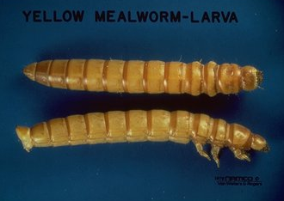
Secondary Feeders
Yellow Mealworm:
Adults are more than ½” in length
Adult is shiny black in color
Larva is golden-yellow in color and called the
“golden grub” and sold as fish bait.
Found in cooler climates of the North
It can fly and is attracted to lights

Slide 23
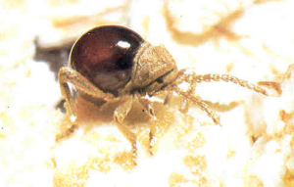
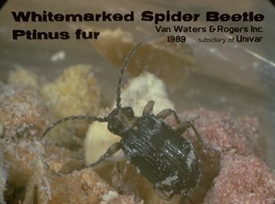
Secondary Feeders
Spider Beetles:
Adult beetle is 2.2 to 4 mm in length
Resembles small spiders – have 6 legs
Feed on dried animal and plant matter
Found in the nests of animals
Feed on wool, hair, textiles fabrics
and feathers.

Slide 24
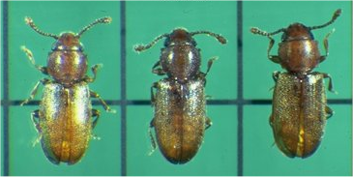
Secondary Feeders
The Foreign Grain Beetle:
The adult beetle is about 2 mm in length
The adult beetle has 3 segmented clubbed antennae
The adult beetle has two rounded projections at the front of the thorax

Slide 25
Secondary Feeders
Psocids or Booklice:
Found on moldy cereal products
Adult psocids are 1 to 2 mm in length
Feed on microscopic molds and on
starchy foods.

Slide 26
Secondary Feeders
They’re so small, they may be difficult to see
without the use of a microscope or hand lens
Grain Mites, mushroom mites, cheese mites, and sugar mites feed on
microscopic molds that are found on damp, deteriorating foods

Slide 27
Stored Product Pests
Control of Stored Product Pests
  Perform a thorough inspection
  Remove infested material & clean
  Treat infested areas
  Educate the customer

Slide 28
Stored Product Pests
Perform a thorough inspection
Find infested foods - keep the pest in mind
  Many species are carried into homes in pet food (usually dog food or cat food) & birdseed
  Internal feeders are found in whole grains
  Secondary pests are associated with old grain
  Species that fly are harder to track down

Slide 29
Stored Product Pests
Perform a thorough inspection
Start in the kitchen, but check other rooms
  Look in the garage – birdseed & pet food
  Look in the bathrooms & bedrooms –
  potpourri, dried peppers
  Look in the living room – dried flowers
  Look in the attic, chimney, or crawlspace –
  nuts or seeds stored by rodents like rats &
  squirrels

Slide 30
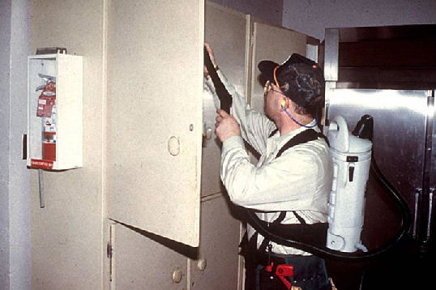
Stored Product Pests
Remove infested material & clean
Discard infested foods in the trash outside
Vacuum & clean the
area where food is
stored

Slide 31
Stored Product Pests
Treat infested areas
Pheromone Monitoring Traps
Usually have pitfall trap baited with grain oil
for other grain beetles
Crack & crevice treatments with a residual
aerosol or dessicant dust
C & C treatments can be helpful controlling
sawtoothed grain beetles

Slide 32
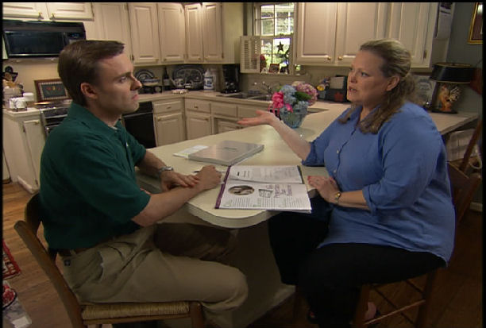
Stored Product Pests
Educate the customer
Key to control is sanitation!
  - Clean up spilled foods
  - Rotate stored foods
  - Place stored foods in homes inside glass
  or plastic containers or store in the
  refrigerator

Slide 33

Stored Product Pests
The Quiz
Please complete the Stored Product Pests Quiz
on page 35 in your quiz book

