Slide 1
Rodents

Slide 2
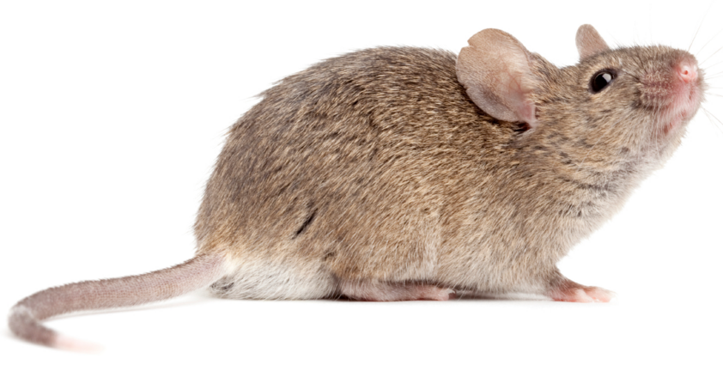
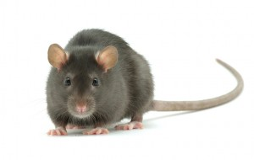
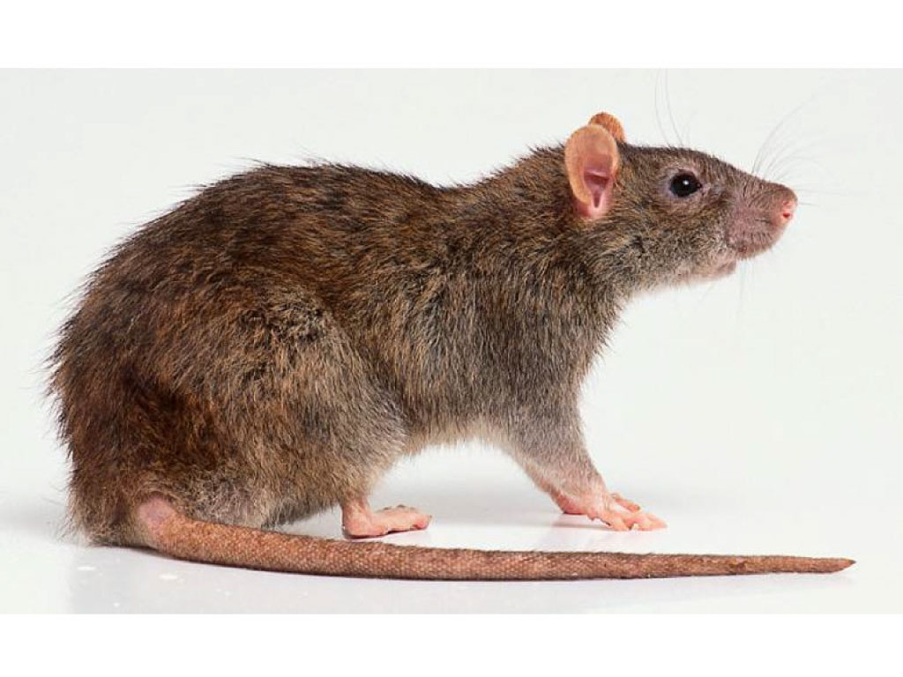
House Mouse
Roof Rat
Norway Rat

Slide 3
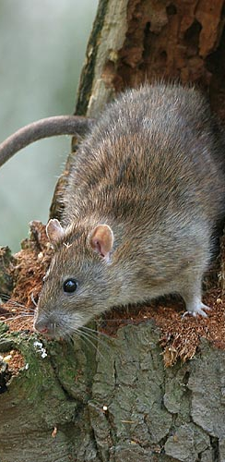
Norway Rat
Body – thick
Color – gray/brown, belly is light colored
Tail – shorter than the body and the head
Ears – tiny, close to the body
Eyes – small, poor eye sight, color blind
Droppings – blunt ends, ¾ inch long or less

Slide 4
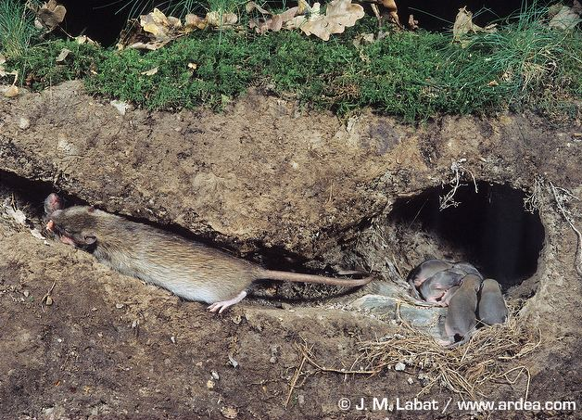
Norway Rat Biology
Primarily ground nesters
Build extensive burrows for harborage and shelter from predators
Food preferences
  Nuts, berries, plant seeds
  Insects, birds, mammals, reptiles
  Carrion

Slide 5
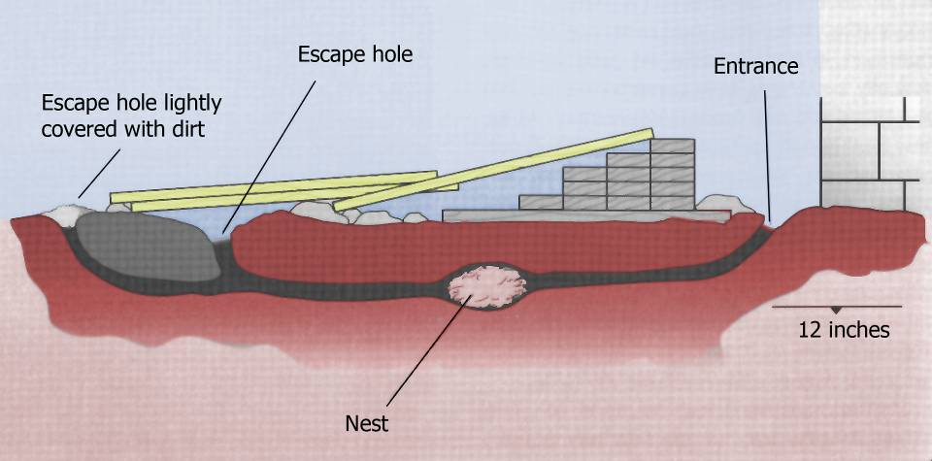
Norway Rat Burrow

Slide 6
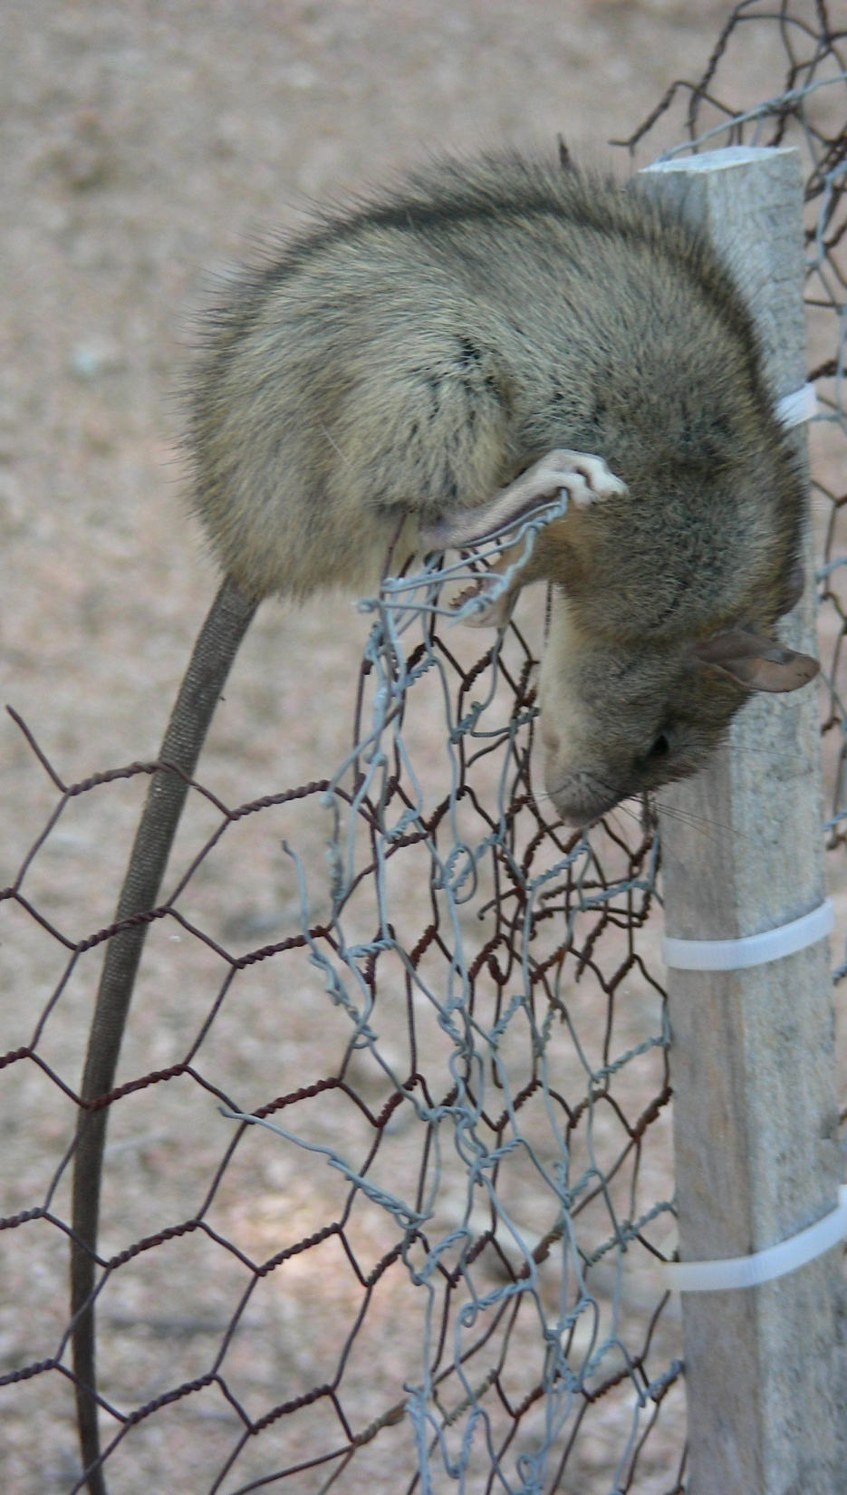
Roof Rat
Body – slender
Color – black to grey/brown, belly is grey to white
Tail – hairless and longer than body
Ears – large, will cover eyes when bent forward
Eyes – large, poor eye sight, color blind,
Droppings – pointed ends, ½ inch long or less

Slide 7
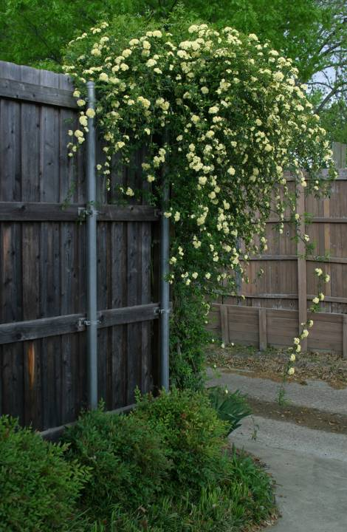
Roof Rat Biology
Prefer mature vegetation, vines, trees for harborage
Most frequently nests above ground
Opportunistic, self-sufficient
  seeds, nuts, fruits, berries
  slugs, snails
  insects
  fish, shellfish
  pet food, bird seed, etc.
Excellent climbers

Slide 8
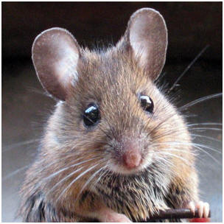
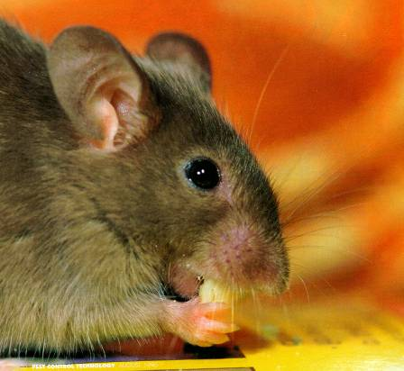
House Mouse
Body – small and slender
Color – gray/brown, light belly
Tail – 3-4 inches long, longer than head and body
Ears – large for body size
Eyes – small, can recognize objects up to 10 feet away
Droppings – pointed ends, ¼ inch long or less

Slide 9
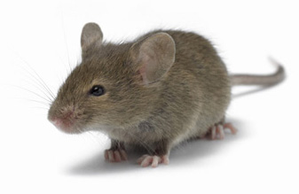
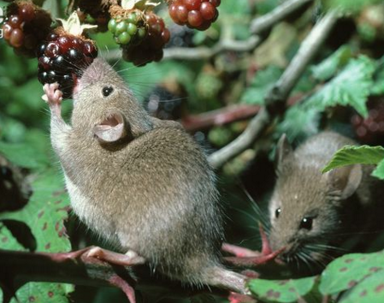
House Mouse Biology
Burrow under tree roots and other solid structures to create shelter
Feed primarily on seeds, cereal grains, berries
Will nibble small amounts from several locations
Excellent climbers

Slide 10
 | House Mouse | Roof Rat | Norway Rat
Sexual Maturity | 1 month | 2-3 months | 2-3 months
Gestation Period | 19 days | 22 days | 23 days
Number per Litter | 5-6/litter | 6-8/litter | 6-12/litter
Number of Litters | 8/year | 4-6/year | 4-7/year
Daily Food | 1/10th oz | 1 oz | 1 oz
Water Consumption | 1/20th oz | 1 oz | 1 oz
Life Span | 15-18 months | 18 months | 18 months

Slide 11
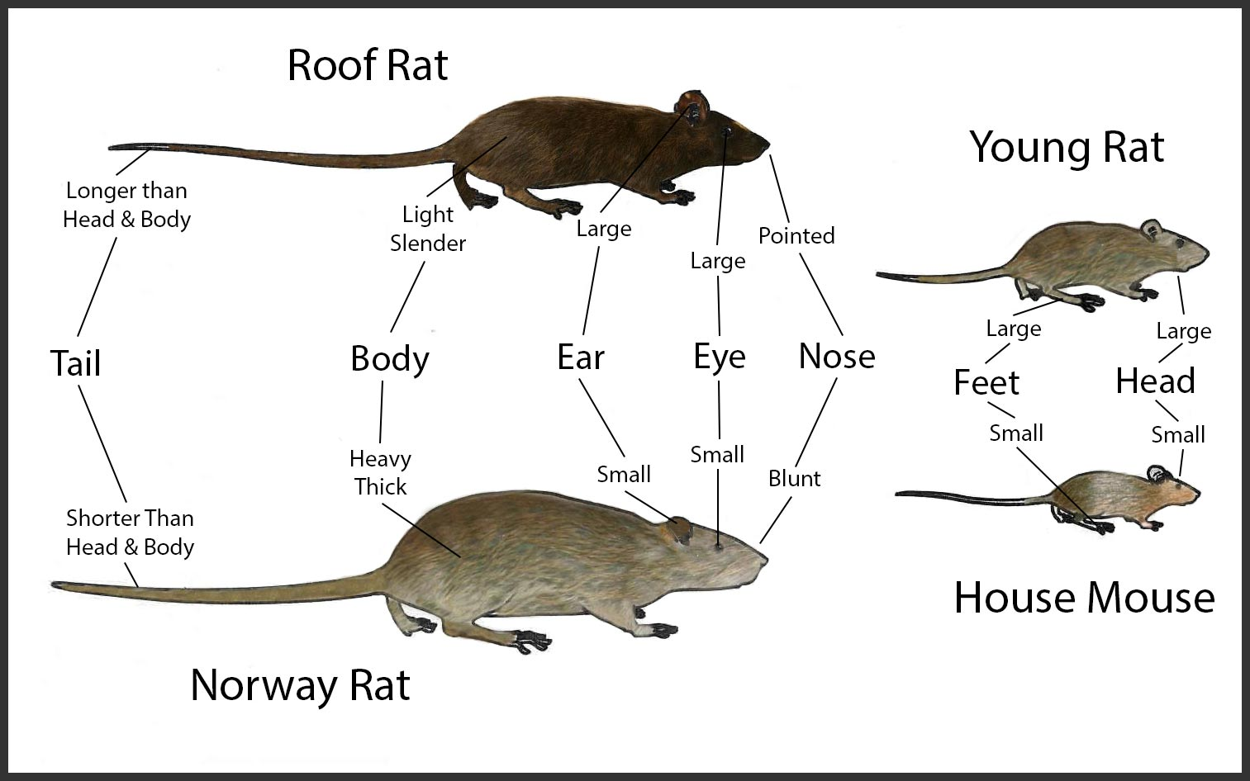

Slide 12
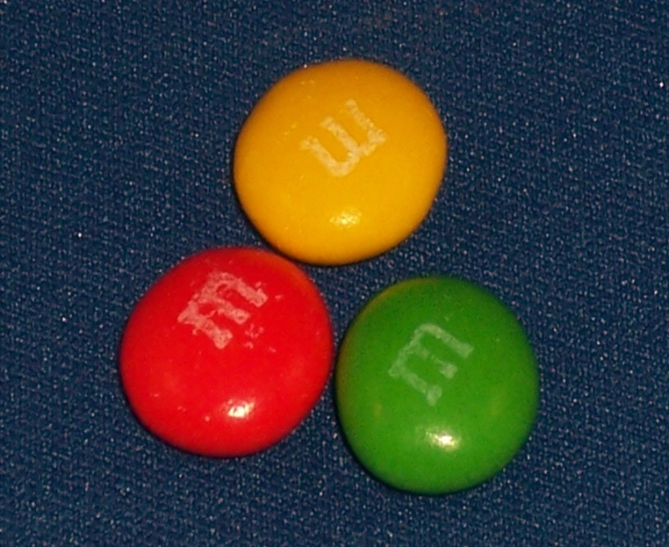
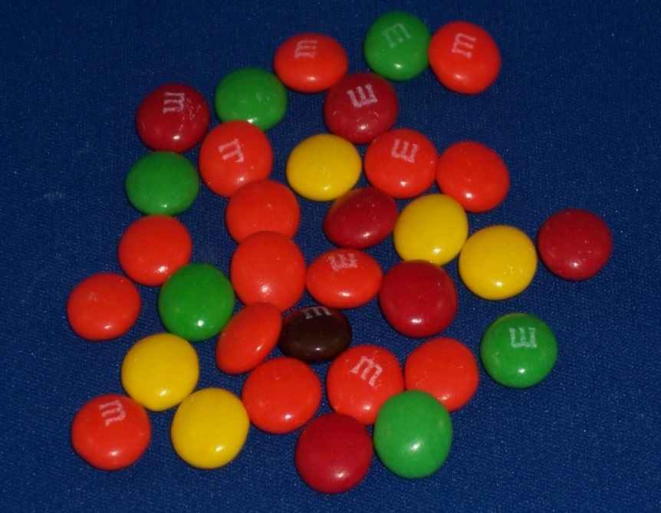
How Much Do They Eat?
House Mice
1/10th oz per day
equivalent to 3 M&Ms
Rats
1 oz per day
equivalent to 33 M&Ms

Slide 13
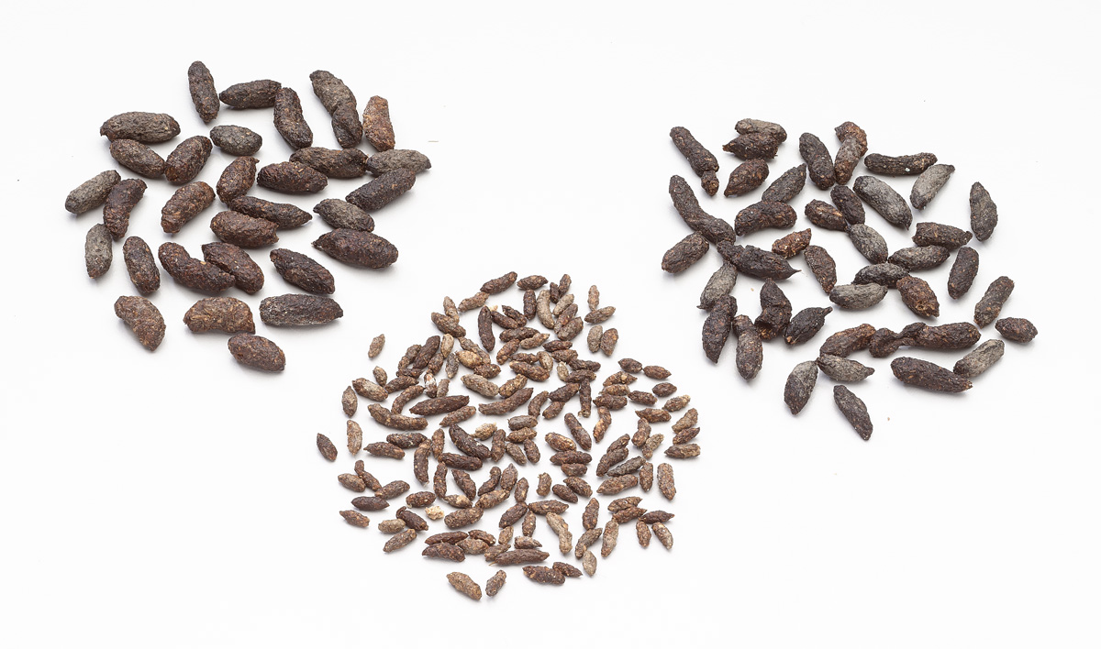
Who Left What Behind?
Norway Rat
  Rounded/blunt ends
  ¾ inch long
Roof Rat
  Pointed ends
  ½ inch long
House Mouse
  Pointed ends
  ¼ inch long
Norway rat
Roof rat
House mouse

Slide 14
What Do the Droppings Tell You
Age
  New: Shiny & putty-like texture
  Old: Hard & crumbly
Size of infestation
  Varying sizes indicate adult and young are present - large infestation
  Many droppings suggest large infestation
Distinguish between rodent, reptile and roach dropping
  Rodent: larger, has hair present due to grooming
  Reptile: white on one end or will have insect parts present
  Roach: small and will have ridges on surface

Slide 15
Distribution of Rodents
House Mouse
Norway Rat
Roof Rat
Notes:
Norway Rat:
Norway rat, also known as the brown rat and sewer rat.
The Norway rats tend to be reddish brown in color.
Norway rat has a fairly blunt nose, and small eyes and ears.
It also has a very thick body

Slide 16
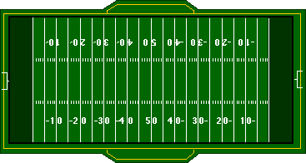
Rodent’s Range of Travel
House Mouse
Roof Rat
30 ft.
100 ft.
300 ft.
Norway Rat
Notes:
Cupboard Indoor:
Look In dark shadowy areas where rodents frequently travel it is important that you use a flashlight when investigating.
This is a slide of a technician looking for infestations in a home, he is checking all the wires and pipes that go from the outside and lead into the house.
Looking for entry points.
Look for rodent signs

Slide 17
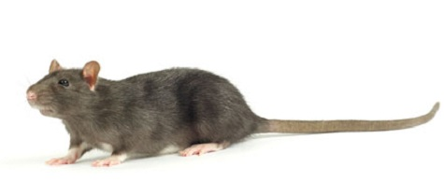
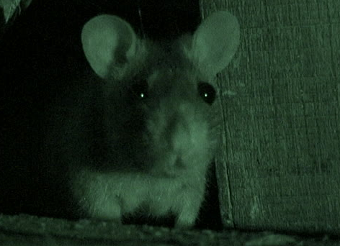
Rodent Behavior
Rodents are nocturnal
Mode of self defense for rodents as most of their enemies are inactive during night hours
Most dominant rodents feed at night, daytime activity is a sign of a large infestation

Slide 18
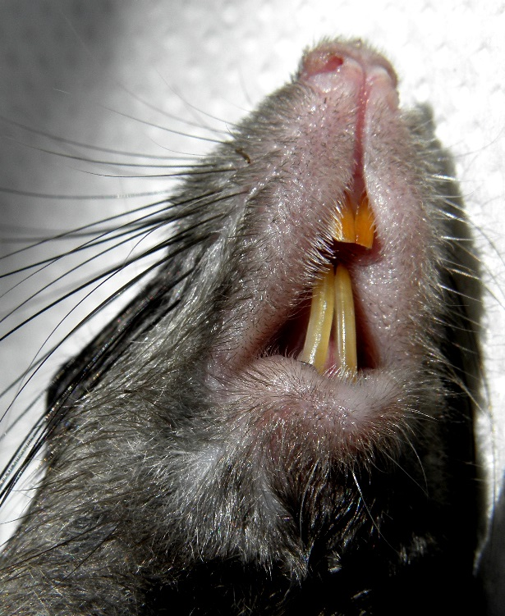
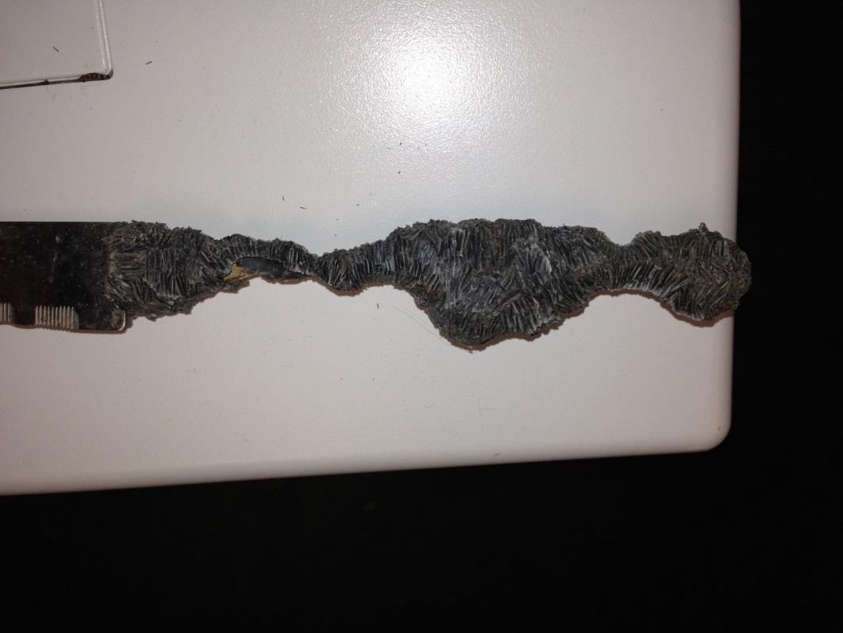
Rodent Behavior
Gnawing
2% of daily activity is gnawing
  Teeth grow at rate of 5 in/yr
  Tooth hardness is greater than iron
  Up to 7000 PSI biting pressure
Notes:
Bottom picture: knife handle that has been gnawed

Slide 19
Rodent Behavior
Rats
  Neophobic
  Will consume a lot of food once they are comfortable in an environment
Mice
  Curious about new things
  Nervous nibblers
Rats & Mice
  Prefer corners for eating, nesting & grooming

Slide 20


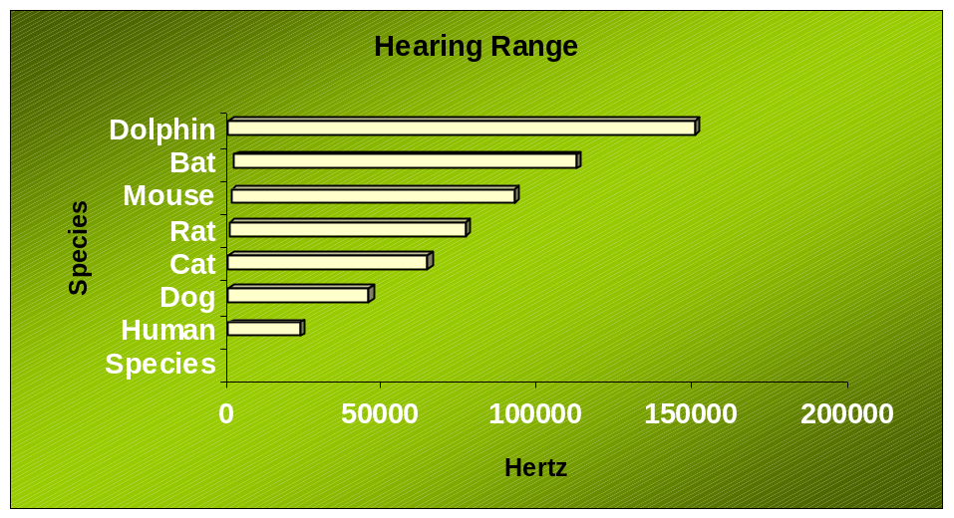
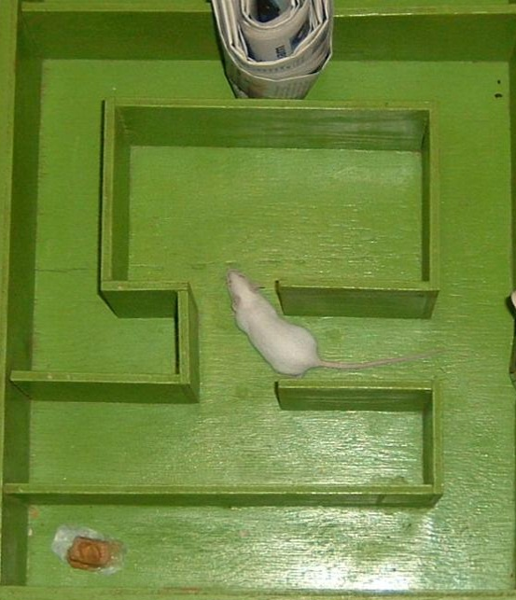
Rodent Senses
Human Perspective
Rodent Perspective
Vision: Very poor
Hearing is well developed
Kinesthetic Sense: muscle memory, develops as they become comfortable in environment

Slide 21
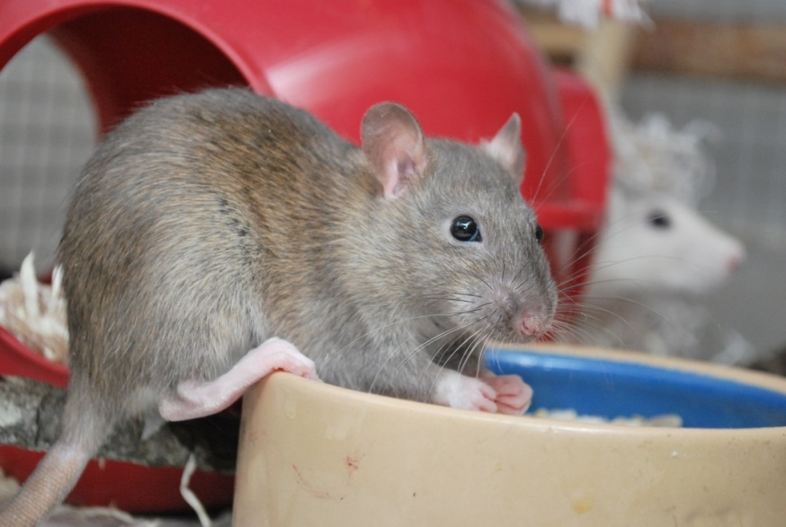
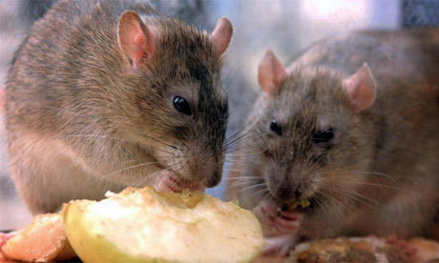
Rodent Senses
Taste
  Quality check
Food preference
  Newborns taste mother’s diet through her milk
  Prefer the food she ate when they grow up
Taste Aversions
  React negatively to foods that made them feel ill.
  Single occurrence
Dietary Needs
  If deprived of a certain nutrient, they learn which foods fill that need
  Will prefer those until need is met

Slide 22
Why is Rodent Control Necessary?

Slide 23
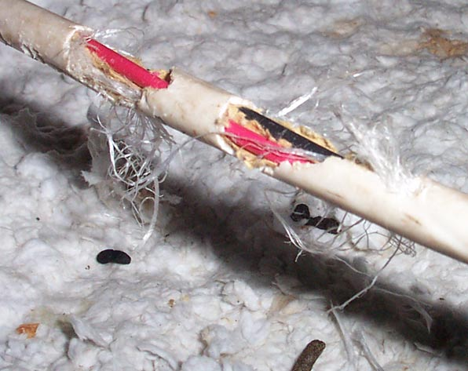
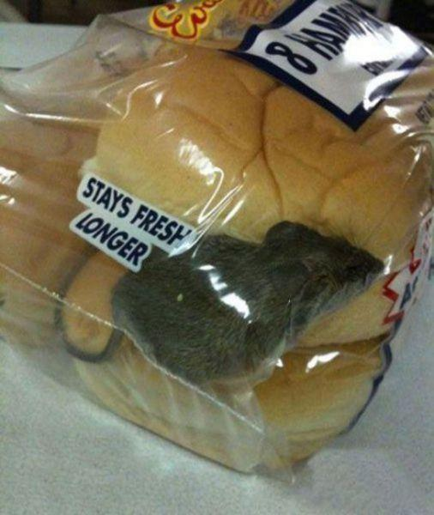
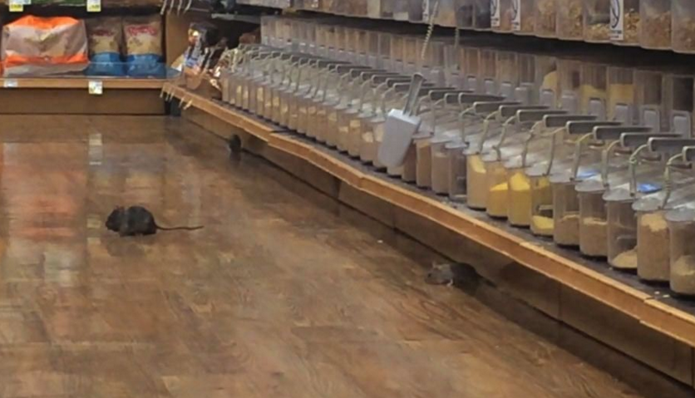
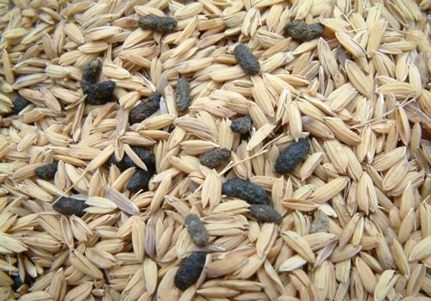
Damage
  Stored food in silos, restaurants, grocery stores, homes, etc
  Wire within structures that can potentially cause fires
Spread disease with urine and fecal contamination

Slide 24
Inspection

Slide 25
Inspection
Before the inspection
  Interview the customer
  Where have rodents been observed?
  Any damaged food containers?
  Have droppings, gnaw marks, rub marks, etc. been observed?
During the inspection, determine:
  The rodent species you are dealing with
  The severity of the infestation
  Unsanitary areas? Recommend clean-up…
  The avenues of entry into the structure
  The high traffic areas
  What will be the best tools for elimination

Slide 26
Inspection
To ensure that you are not exposed to airborne pathogens from rodent urine and droppings, the following should be used
  HEPA filter vacuum
  Respirator
  Gloves
  Protective outerwear
  Hand sanitizer

Slide 27
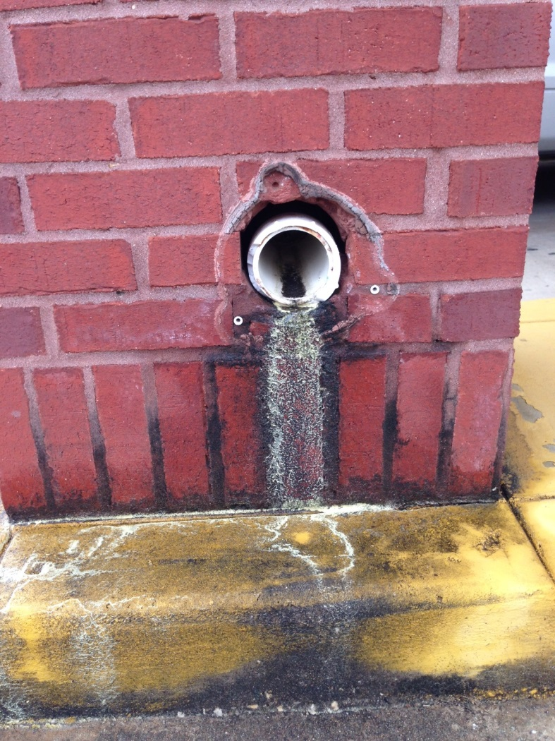
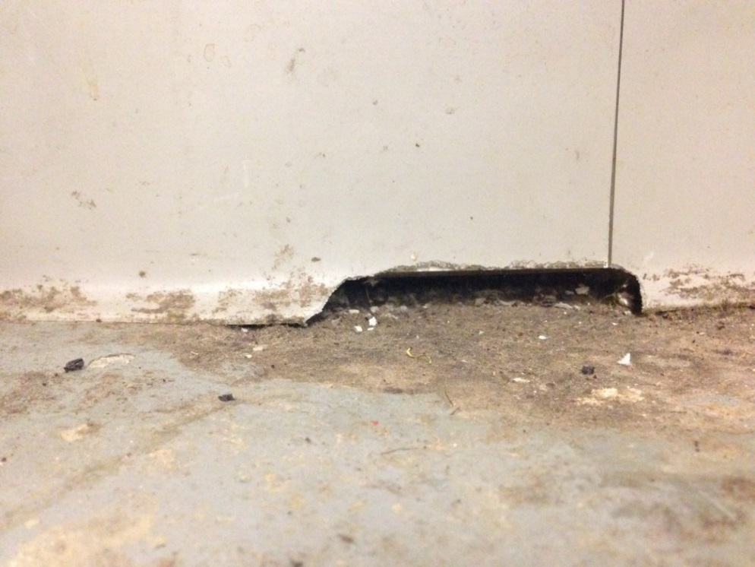
Avenues of Entry
Mice: ¼ inch or larger space
Rats: ½ inch or larger space

Slide 28
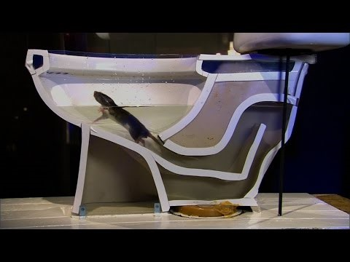
Notes:
Must have internet connection to watch this video

Slide 29
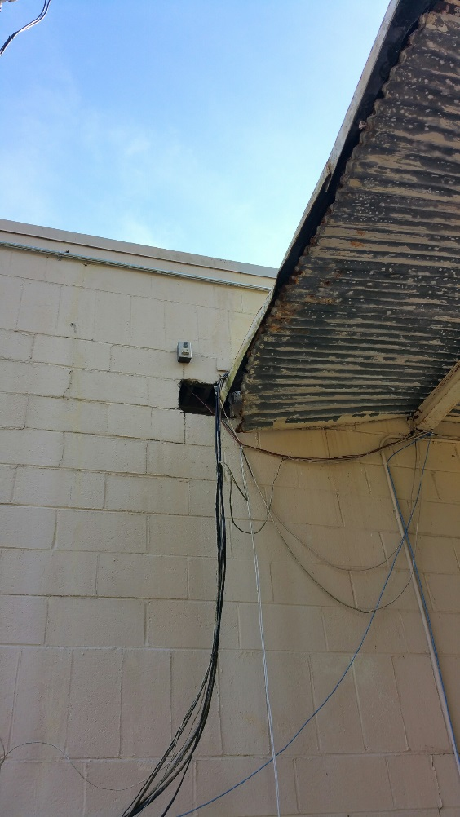
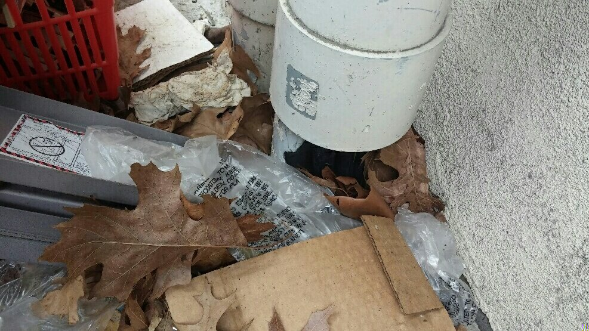
Avenues of Entry

Slide 30
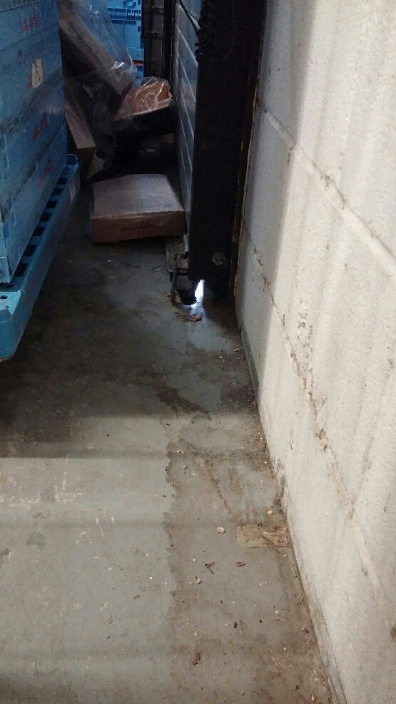
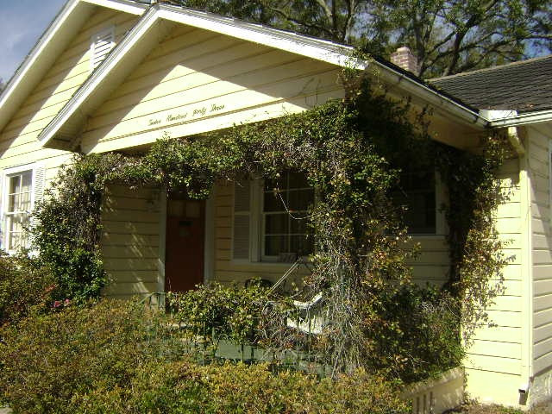
Avenues of Entry

Slide 31
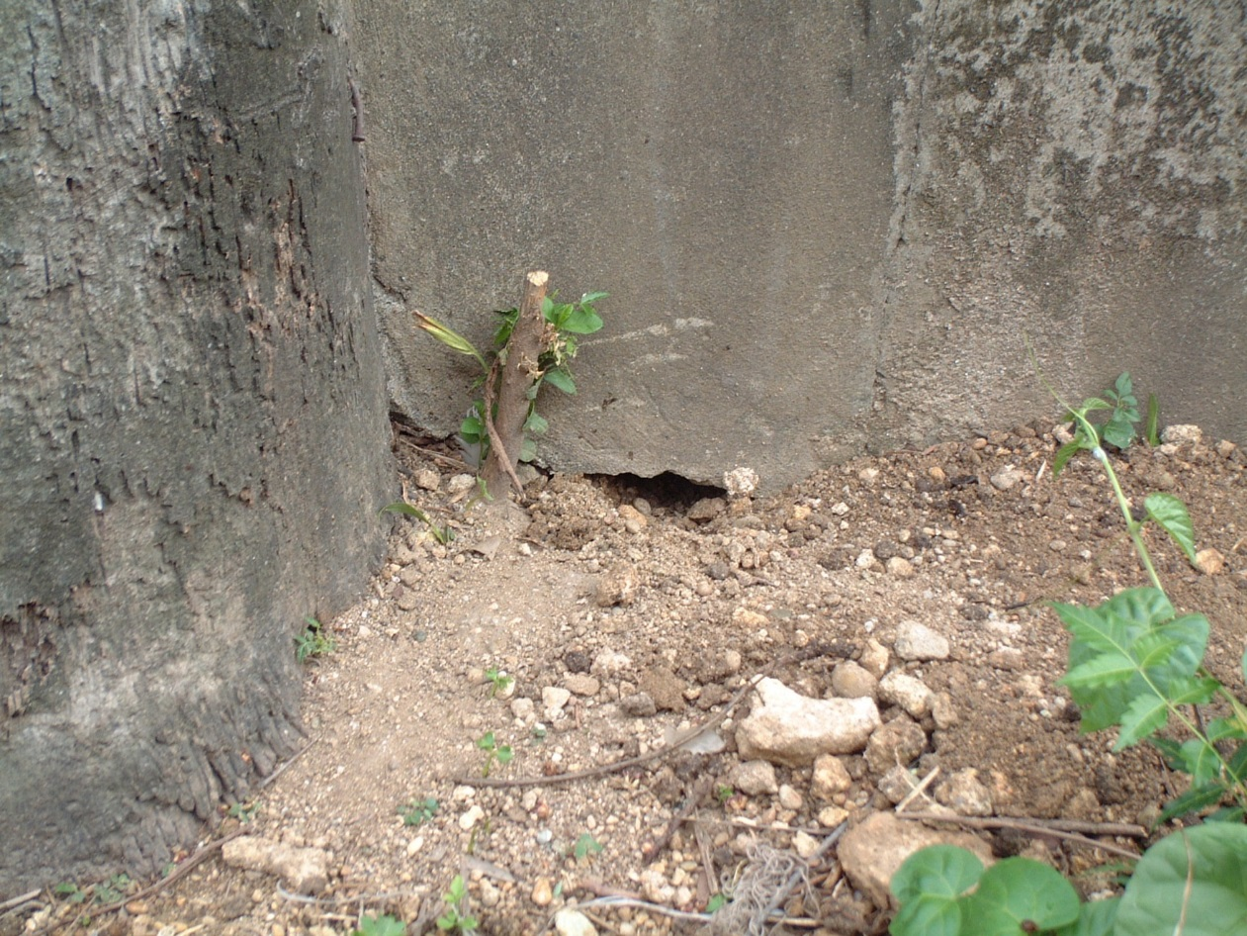
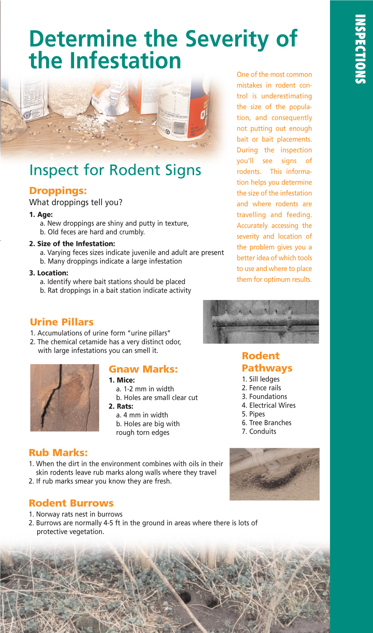
Identify Nesting Areas

Slide 32
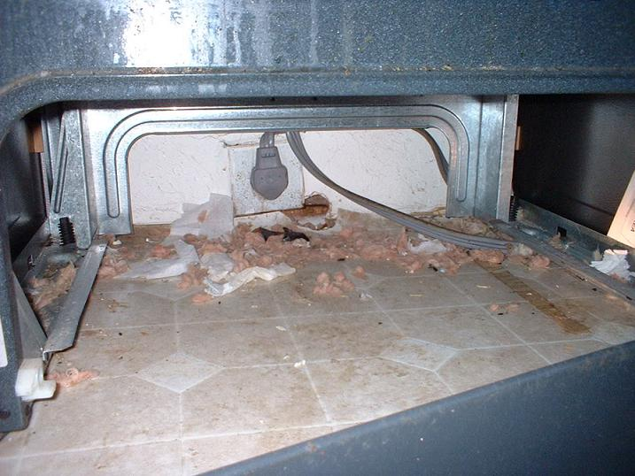
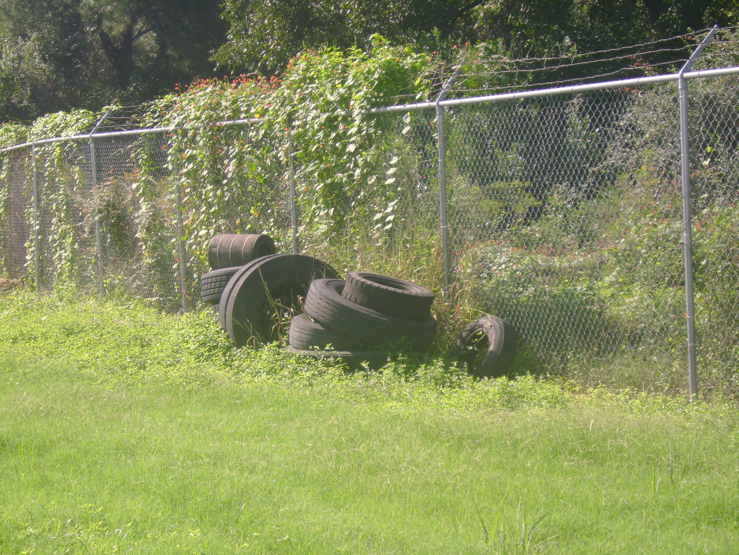
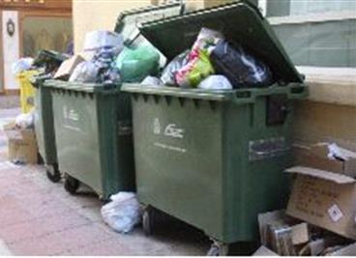
Identify Nesting Areas

Slide 33
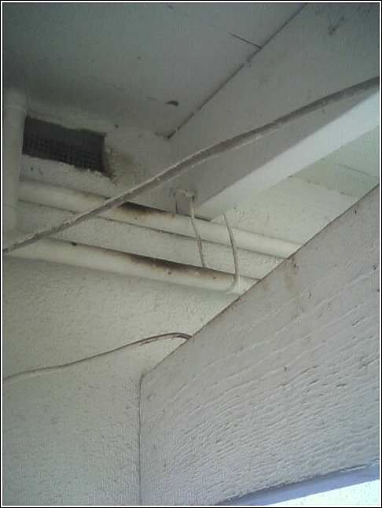
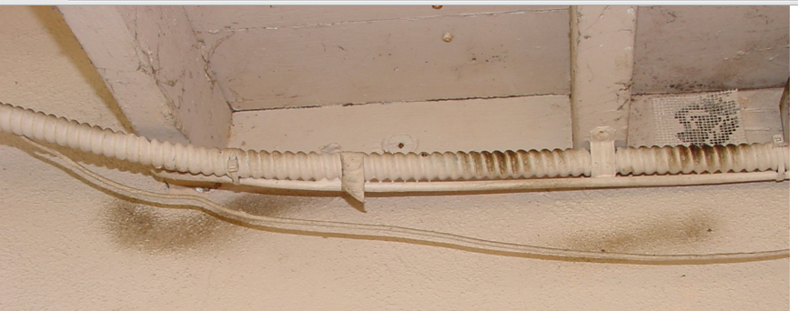
Identify Travel Paths/Locate Rub Marks
When dirt in the environment combines with the oils on the skin and hair of a rodent, rub marks are left on entry points and areas of travel
Fresh rub marks will smear
Notes:
Rub marks are called sebum.

Slide 34
Rodents

