Slide 1
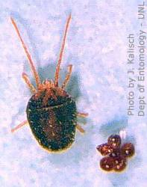
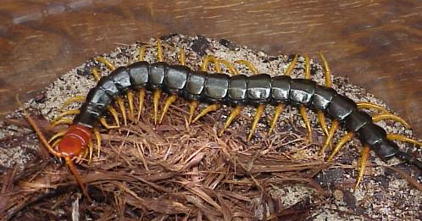
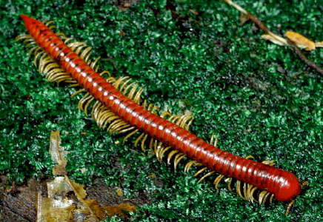
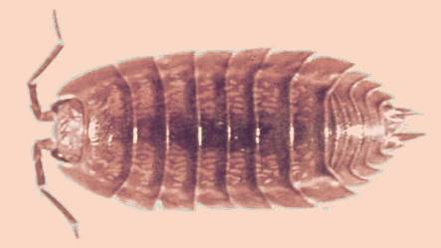
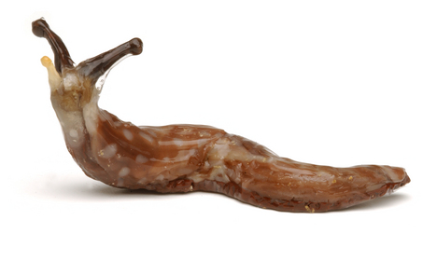
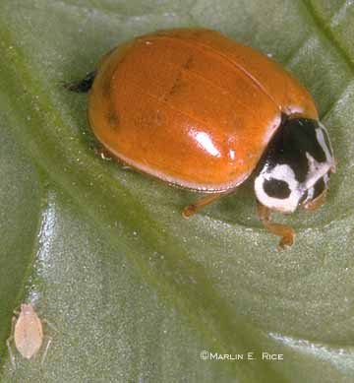
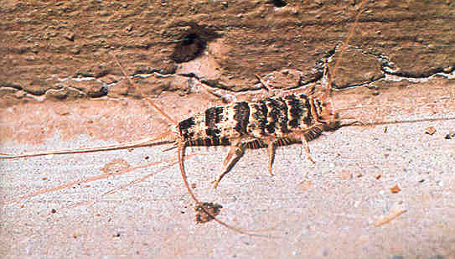
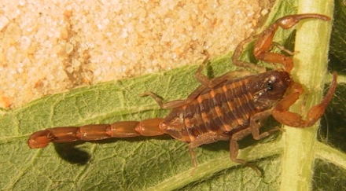
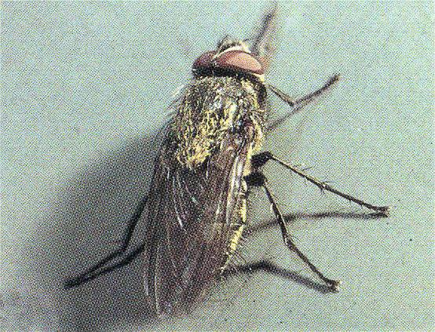
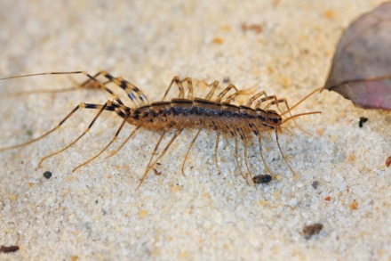
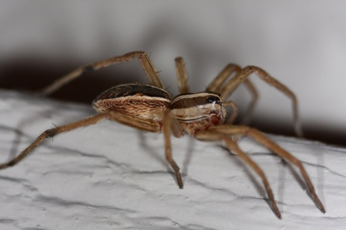
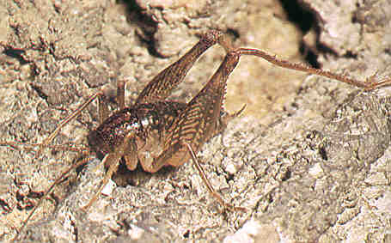
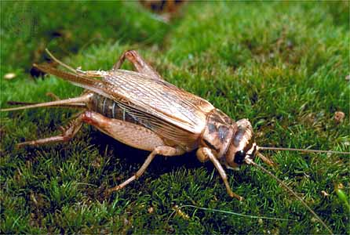
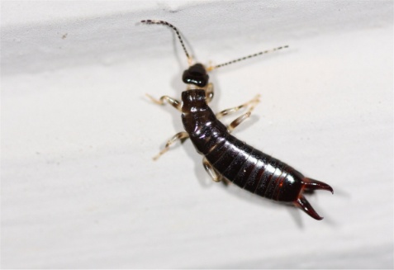
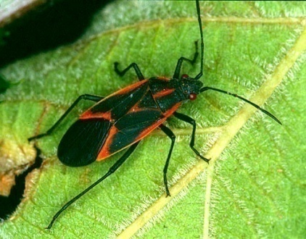
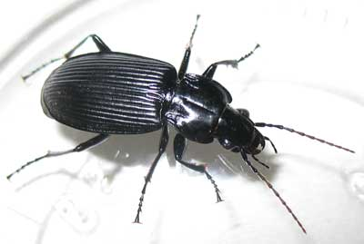
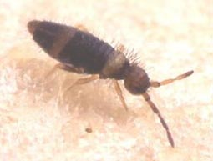
Occasional Invaders and
Miscellaneous Pests
September 2008

Slide 2
What is an Occasional Invader?
A pest that often occurs in buildings at some stage in its life, but
that does not usually complete its entire life cycle inside the
building.
Most live outside and come indoors only on occasion.
Although occasional invaders may enter the structure in large
numbers, they usually do little damage and are considered a
nuisance pest simply because of their presence.

Slide 3
Some Occasional Invaders Are:
Clover mites
Centipedes
Millipedes
Pillbugs and Sowbugs
Slugs and Snails
Crickets (House & Field)
Earwigs
Boxelder Bugs
Ground Beetles
Lady Bugs (Ladybird beetles)

Slide 4
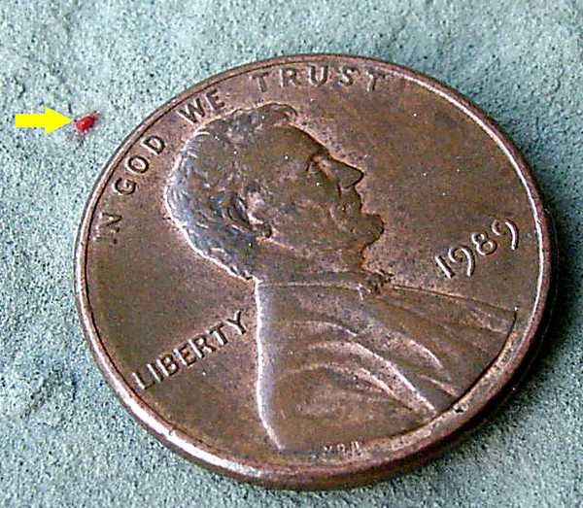
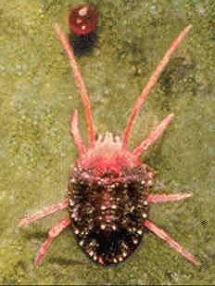
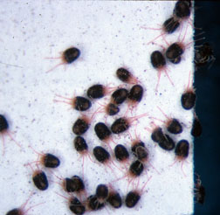
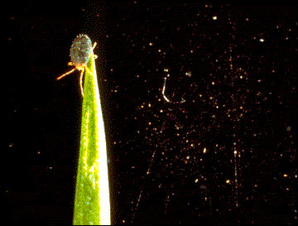
Clover Mites

Slide 5

Clover Mites
Are arachnids (not insects) & don’t bite people or pets
or do damage to structures.
Are red, smaller than the size of a pinhead.
Have 4 pairs of legs. The front pair are pink in color,
are much longer than the other three pair, and extend
forward.
Feed on the juices of plants such as clover and
grasses

Slide 6
Clover Mites
Migration into homes is often triggered by the
overpopulation or by the onset of unfavorable
feeding conditions, which may occur during
periods of drought or by the onset of cold
weather.

Slide 7
Clover Mites
Adult Clover mites lay eggs in cracks inside
foundations, inside exterior walls of structures,
and on the underside of the bark at the base of
trees…where they overwinter.
They are inactive in cold weather as well as
very hot weather.
During brief periods of warm weather in late
winter or early spring, they migrate both to the
outside and inside walls of the house.

Slide 8
Clover Mites
They often enter homes in large numbers
when they migrate to the south & west
walls of structures due to the warming
effect of bright sunshine on the building.
Clover mites often have heavy migrations
into houses in early summer and fall.

Slide 9
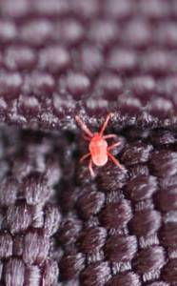
Clover Mites
They often enter homes in large
numbers through cracks and
around windows and doors.
They are soft-bodied and are
easily crushed.
It is extremely annoying to
homeowners who try to brush
them off light-colored drapery or
walls, resulting in red stains.

Slide 10
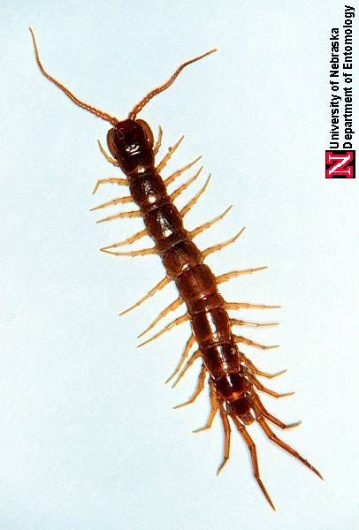
Centipedes
They are beneficial, feeding on insects & spiders

Slide 11
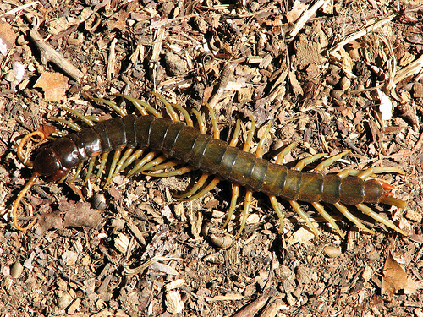
Centipedes
Belong to the Class Chilopoda
They have many segments,
each with one pair of legs
Their body is flattened and
they have long antennae

Slide 12
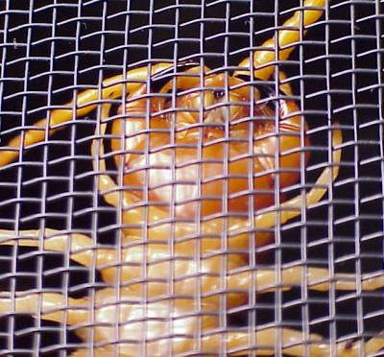
Centipedes
fangs
They are predators
and feed on insects
and spiders at night
(nocturnal).
Their front legs have
fangs and their bite
injects venom that
can cause pain and
swelling

Slide 13
Centipedes
Centipedes live outdoors in damp areas
such as under leaves, stones, boards,
or tree bark or in mulch around outdoor
plantings.
They may be found in moist voids such
as under attached slabs and in the voids
of exterior walls (ie. - weep holes)

Slide 14
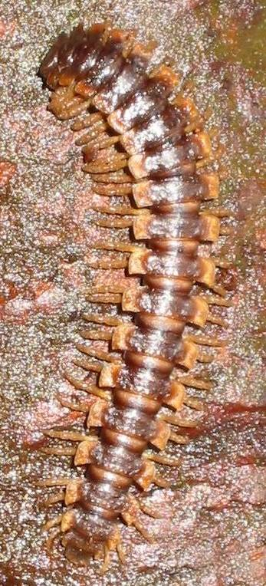
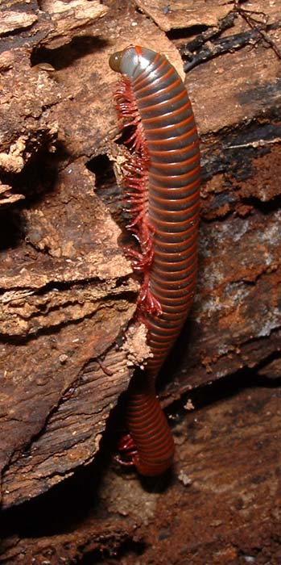
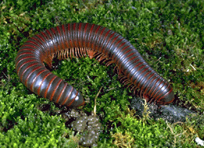
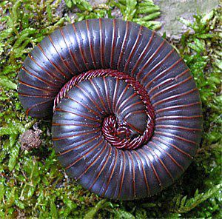
Millipedes

Slide 15
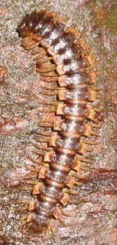
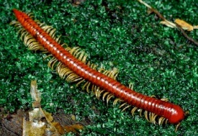

Millipedes
They belong to the Class Diplopoda.
They have many segments, each of which has two
pairs of legs.
Their body is cylindrical and they have short
antennae.
They feed on decaying organic matter.
In dry weather, they migrate out of
piles of leaf litter and may enter
homes in large numbers.

Slide 16

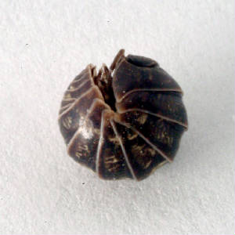
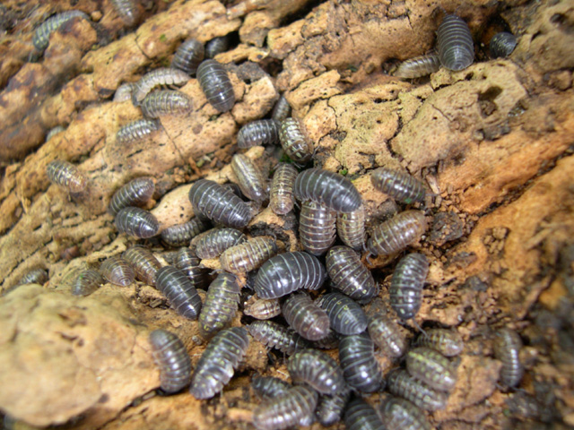
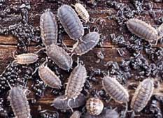
Pillbugs & Sowbugs

Slide 17

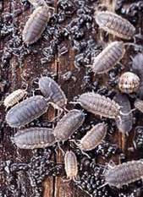
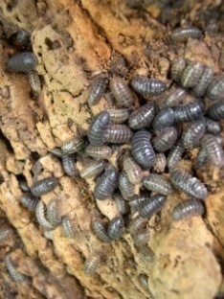
Pillbugs & Sowbugs
They belong to the Class Crustacea
They are the only land forms of Crustaceans
Water forms of Crustaceans are lobster, shrimp,
crab, crawfish, etc.
They have at least five (5) pair of legs
Pillbugs do not have any appendages at the end
of their abdomen and can roll into a tight ball
Sowbugs have two (2) pair of appendages at the
end of their abdomen, but cannot roll into a tight
ball

Slide 18
Pillbugs & Sowbugs
Pillbugs & sowbugs feed on decaying vegetable
matter
They live outside under mulch, vegetable debris,
and under other objects that are on damp ground
(firewood piles, trash cans, and potted plants &
planters)
They may invade damp basements and
crawlspaces, and may infest potted plants
A heavy infestation inside generally indicates that
there is a large population living immediately
outside the building

Slide 19
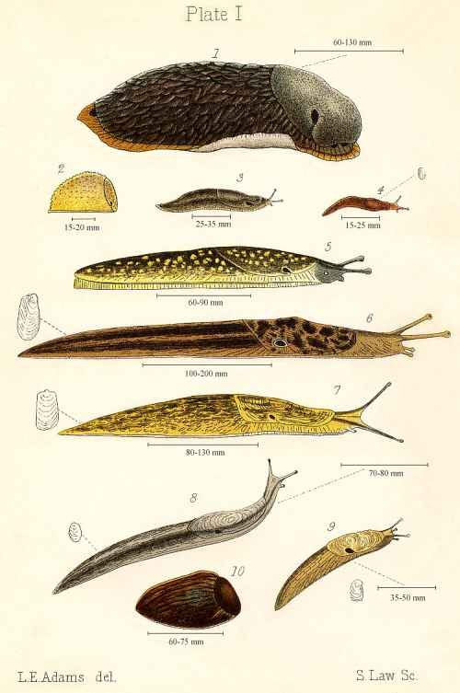
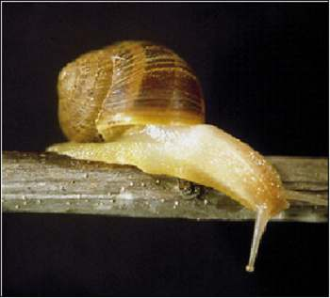
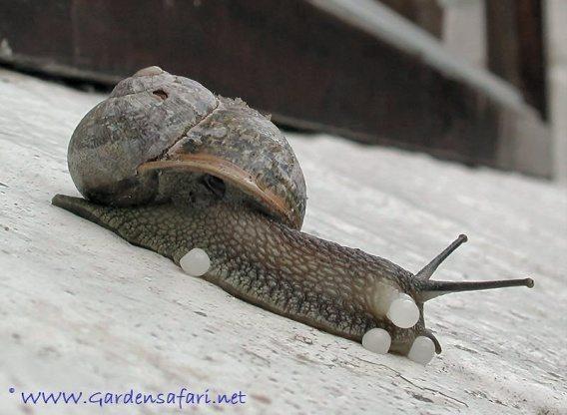
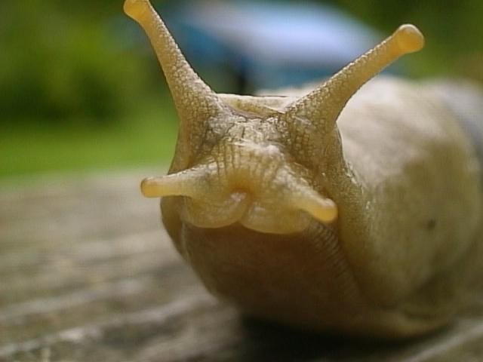
Slugs & Snails

Slide 20




Slugs & Snails
They belong to the Phylum Mollusca (Class
Gastropoda) that is related to oysters
Slugs are soft-bodied, slimy creatures without a
a shell. Snails are soft-bodied, slimy creatures
with a shell
They require a large amount of moisture
They are nocturnal
They are plant feeders, but often deface buildings
with their fecal material
They leave glistening mucous trails as they walk
at night

Slide 21
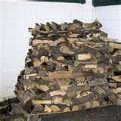
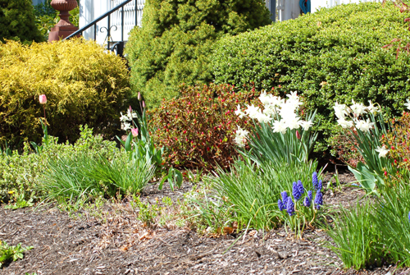
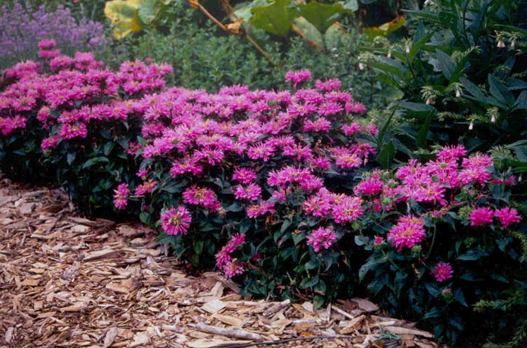
Slugs & Snails
They are often found under boards
and in firewood piles on the ground
and in wet areas (under shrubbery,
in landscape areas, and in
crawlspaces)

Slide 22
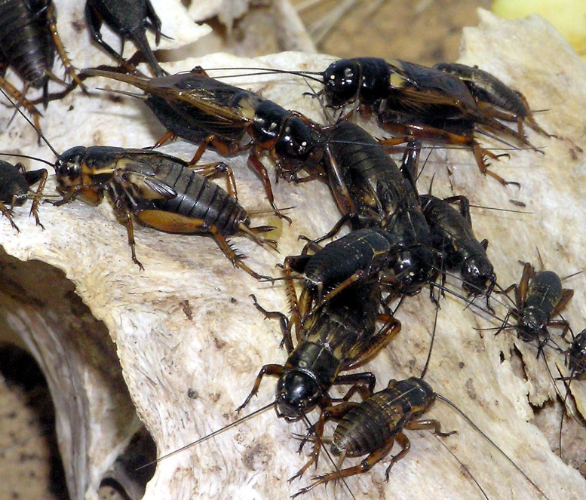
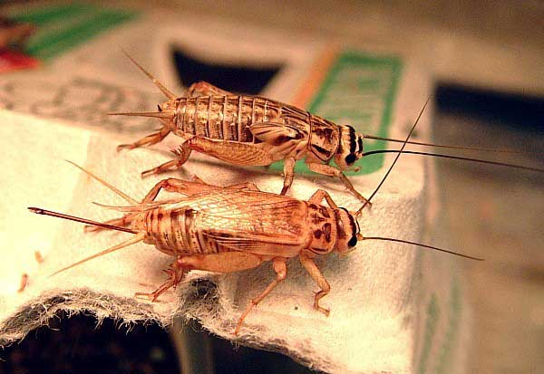
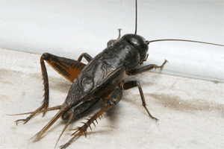
Crickets (House & Field)

Slide 23
Crickets (House & Field)
Are insects related to cockroaches
They feed on both plant and animal
material
Can be a considerable annoyance
inside and can cause damage to
some fabrics such as linens, furs,
silk, woolens, and rayon
Field crickets are often attracted to
lights at night

Slide 24
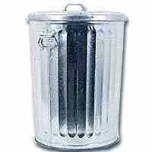
Crickets (House & Field)
Crickets are found outdoors almost
anywhere around a building…in
flower beds, under garbage cans, in
mulch surrounding shrubbery that
is adjacent to the exterior foundation
walls of the building, in firewood
piles, in ground cover, etc.

Slide 25
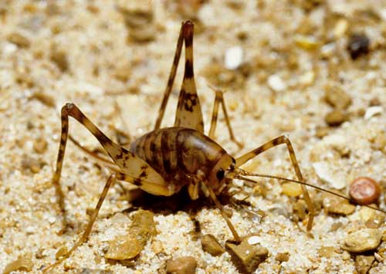
Cave/Camel Crickets

Slide 26
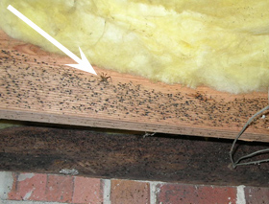
Cave/Camel Crickets
They often are found on
wood and on the exterior
foundation walls within
3’ to 5’ of the junction of
the exterior foundation
wall and the flooring
inside moist crawl spaces.
Infestations of cave/camel crickets are often obvious because
of fecal stains that they leave on surfaces on which they rest.

Slide 27
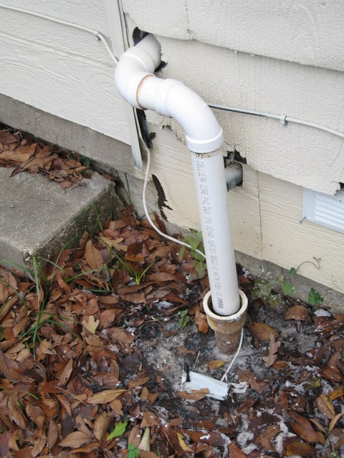

Cave/Camel Crickets
They become pest problems when
they enter homes around openings
surrounding pipes entering the
house from the crawl space or
from outside the house.
They may be found outside in
firewood piles that are resting
on the ground and are placed
next to the house.

Slide 28


Cave/Camel Crickets
Cave/camel crickets can hop
quite well and readily become
a nuisance pest once inside
the house. However, they
can be more than a nuisance.
They can chew and stain
fabrics…although they are
not considered a fabric pest,
as they do not digest keratin.

Slide 29




Earwigs

Slide 30


Earwigs
Earwigs belong to the Order Dermaptera
They have two pair of wings, the front
pair are shortened and the rear pair are
membranous and folded under the 1st
pair
They have a pair of forceps-like
appendages at the rear of their abdomen
They are scavengers on dead animal
and plant material, or are predators

Slide 31



Earwigs
Earwigs are nocturnal
(active at night)
Some are attracted to lights
Some can fly
They are found outside under rocks,
stones, boards, and debris.
They are found under garbage cans and
in and under firewood piles on the ground

Slide 32

Earwigs
Earwigs often build-up in large numbers in voids under
slabs that are adjacent to buildings.

Slide 33



Boxelder Bugs

Slide 34



Boxelder Bugs
Belong to the insect Order Hemiptera
Related to Bed bugs and chinch bugs
Are plant-feeders, primarily sucking the
juices of boxelder trees and maple trees
They have piercing-sucking mouthparts,
that can puncture the skin, but generally
do not bite man
They can stain curtains and other fabrics
with their fecal spots and can produce a
foul odor.

Slide 35

Boxelder Bugs
.

Slide 36



Boxelder Bugs
They build up to large populations and are
found crawling on the south and the west
walls of buildings in the fall, where they
often enter the building through cracks &
crevices and overwinter in the voids of
walls, between floors, and in the attic.
They emerge in the spring
to seek out new host trees
on which to feed and lay eggs
They are primarily a nuisance pest
in homes
Boxelder tree

Slide 37





Boxelder Bugs
t
They accumulate in large numbers outside homes
and in the walls and attics of homes

Slide 38



Boxelder Bugs
They accumulate in large numbers outside homes
and in the walls and attics of homes

Slide 39

Boxelder Bugs
They accumulate in large numbers outside homes
and in the walls and attics of homes

Slide 40

Boxelder Bugs
They accumulate in large numbers outside homes
and in the walls and attics of homes

Slide 41




Ground Beetles

Slide 42
Ground Beetles
Ground beetles are one of the largest
families of beetles
Beetles have 2 pairs of wings, the front
pair of wings are hardened and meet in
a line down the middle of its abdomen.
The rear wings are membranous and
fold underneath the front pair
Beetles are predators and live on the
ground under leaves, stones, logs,
firewood, and other debris

Slide 43
Ground Beetles
Ground beetles are mostly active at
night when they feed on other insects
and arthropods
Only a few species of ground beetles
are attracted to lights or fly
Most ground beetles are dark in color,
although some are brightly colored
Inside a home, they become primarily a
nuisance pest

Slide 44

The Asian multi-colored lady beetle is the most common lady beetle that overwinters inside buildings

Slide 45



Adult Lady Bugs/Beetles are predators
Farmers release them in their fields to kill the bad bugs attacking their crops.

Slide 46


Lady Beetle larvae are predators
They’re the good guys!
They eat soft-bodied insects
such as aphids, mealybugs,
and scale insects.

Slide 47



…but Lady beetles may also be:
a nuisance when they overwinter in the voids of homes

Slide 48
Lady Beetles
Lady beetles are predators of many plant-feeding
pests such as aphids, mealybugs, scale insects and
many other insects that attack trees, shrubs, flowers,
or vegetables in the garden.
They build up in large numbers in the summer and
enter the south and west sides of homes where they
overwinter in wall voids and attics.
In spring, lady beetles emerge from those voids and
become nuisance pests in homes.

Slide 49
What is a Miscellaneous Pest?
A pest that occasionally enters structures, but is able to
complete its life cycle inside the structure and maintain
a continuous infestation inside the structure is referred to
as a miscellaneous pest.
Some miscellaneous pests are:
springtails
scorpions
House centipedes
spiders
silverfish/bristletails
cave/camel crickets

Slide 50




Springtails

Slide 51


Springtails
These primitive insects are wingless
They have a forked appendage, called a
furcula, that is attached to the underside
of the abdomen and extends underneath
the thorax. When released, the furcula
moves suddenly away from the body
against the ground and it makes the
insect jump…giving this insect its name.
They are very small, generally less than
1/12th of an inch in length

Slide 52

Springtails
Springtails feed on algae, fungi
and decaying organic material.
They develop outside in large
numbers in mulched areas in
the thatch of surrounding lawns.
Indoors, springtails are often
found in damp places such as
in bathrooms and kitchens,
around drains, in potted plants
and around the baseboards of
exterior walls and around
window moldings.

Slide 53
Springtails
Springtails do no damage to structures.
Homeowners sometimes think that springtails
are fleas because they jump like fleas.
Homeowners generally consider them as
nuisance pests because they are enter homes
in large numbers inside.
Extremes in weather often stimulate large
numbers of springtails to move indoors.

Slide 54

House Centipedes
fang
fang
The front legs
of centipedes
have been
modified into
fangs and are
connected to
a poison gland.
They are
predators of
insects and
other arthropods

Slide 55

House Centipedes
House centipedes are centipedes with long legs that are
brown and yellow-striped.

Slide 56



House Centipedes
Like other centipedes, they are also
nocturnal and are predators, feeding
on other arthropods at night.
They may build-up in large numbers
inside…often in the basement where
there is more moisture.

Slide 57

House Centipedes
They often forage for prey at night along the walls

Slide 58

House Centipedes
They often forage for prey at night along the walls

Slide 59

Spiders
Because of its size, when a two-inch Wolf spider like this one gets inside, customers get a bit concerned.

Slide 60

Spiders
The Jumping spider’s movements are nothing to be afraid of, but
most homeowners get concerned when they see these spiders inside

Slide 61





Spiders
Jumping spider
Wolf spider
Brown recluse spider
Yellow sac spider
Cellar spider
Black widow spider

Slide 62
Spiders
Spiders are arachnids. They have 4 pairs of legs and
have two body regions with no wings or antennae.
Spiders have fangs connected to poison glands and
use their poison as predators to secure their food…
insects and other arthropods.
Although poisonous, most spiders do not normally
bite man and should be of no serious concern to our
customers. However, there are three spiders in
Georgia that homeowners are concerned about:
Black Widow spiders
Brown Widow spiders
Brown Recluse spiders

Slide 63

Scorpions
pedipalp stinger (telson)

Slide 64


Scorpions
Scorpions are arachnids
that have two very large
pedipalps for grasping
their prey, eight (8) legs,
and a stinger on the end
of their abdomen which
is connected to a poison
gland.
They are predators that
search for their food at
night (nocturnal).

Slide 65

Scorpions
Scorpions are fluorescent
at night under an ultraviolet
light.

Slide 66

Scorpions
Scorpions are often
found under rocks
and in rock piles,
under leaf litter and
mulch piles, and in
firewood piles.

Slide 67

Scorpions
Scorpions taste pretty good when
they’re barbequed on a stick

Slide 68


The next time your mother makes you eat broccoli…just be happy it’s only broccoli!
Scorpions on a stick
A plate full of
insect “goodies”

Slide 69







Why do these outdoor pests become indoor pests?

Slide 70
How do they become indoor pests?
Conditions allow them to build up and harbor in great numbers
close to the building
Lighting attracts them to the building
Other factors stimulate pest movement into structures
Environmental extremes (excessive dry spells or
excessive rainfall)
Onset of winter
Some unusual food source inside the structure

Slide 71
What can customers do to help us help them?
Exclusion
Seal cracks & crevices in the exterior of the building
lead into the structure to prevent pest entry
Seal cracks and crevices (weather-strip) around and
under doors and windows to prevent pest entry
Maintain tight-fitting soffit, gable and foundation
vents to prevent pest entry to the attic and
crawlspace areas
Weather-strip the sides and bottom of the garage
door

Slide 72
What can customers do to help us help them?
Remove harborage
Remove mulch, leaf litter and ground cover from areas adjacent to the structure
De-thatch the lawn
Move firewood piles up off of the ground and away from the house
Remove piles of bricks, rubbish, and improperly stored items which might provide harborage for pets

Slide 73
What can customers do to help us help them?
Environmental alteration
Reduce moisture in the house by use of a dehumidifier or air-conditioning
Add ventilation +/or a vapor barrier to the crawlspace
Cut back shrubbery and tree branches away from the structure so that they don’t touch the structure

Slide 74
What can customers do to help us help them?
Sanitation
Keep the lid of the garbage can sealed
Clean-up trash
Only leave out the amount of pet food that the pet will eat that day
Lighting
Change lighting from white bulbs to yellow bulbs (bug lights) or
mercury vapor to sodium vapor lamps of low wattage.

Slide 75


Slide 76
What can homeowners do to help control Scorpions?
Make sure that foundation vents, gable vents and
soffit vents are properly screened to prevent scorpion
entry.
Make sure that weep holes are properly proofed to
prevent scorpion entry.
Caulk up any cracks in your foundation or siding so
scorpions cannot gain easy access to the home
Make sure screens do not have any holes in them and
fit tightly so the scorpions can not enter through an
open window

Slide 77
What can homeowners do to help control Scorpions?
Remove and dispose of rubbish, rock piles, etc.
from their property that may provide harborage
for scorpions
Move firewood piles away from the structure and
store firewood off the ground
Keep the grass short and landscaping trimmed
and make sure that there are no branches
overhanging above the house
Insects are attracted to lights and scorpions feed
on insects. Change “white” lights that attract
insects to “bug” (yellow) lights that attract fewer
insects.

Slide 78

Control of Scorpions
What can we do to control Scorpions?
Scorpions prey on insects. If you can eliminate an insect
problems around and in the house, the scorpions will have
nothing to prey on
Treat areas adjacent to a building in
a band up to 10’ wide with a
microencapsulated synthetic pyrethroid
pesticide product labeled for such use.
With the same type of product, treat
the building foundation to a height of 2’
or 3’ in areas where scorpions are
active or where they can find entrance
to the structure.

Slide 79



Control of Scorpions
What can we do to control scorpions?
Seal up the cracks and crevices
around windows and doors.
Treat the cracks around windows
and doors and in exterior walls
with a dessicant dust that contains
silica aerogel or diatomaceous earth.
Make directed contact treatments
with synergized pyrethrins for rapid
knockdown of any scorpions that
you see crawling around outdoors
or indoors.

Slide 80




Control of Scorpions
What can we do to control scorpions?
Treat the cracks between the bottom of
the siding that is closest to the grade
and the exterior foundation walls
with a dessicant dust that contains
silica aerogel or diatomaceous earth.
Use monitoring traps adjacent to the
walls of a garage, unfinished
basements and any other areas that
are likely infested with scorpions.
.

Slide 81

Control of Scorpions
What can we do to control scorpions?
Make spot treatments (about 3”
wide by 6’ long) on the concrete
floors along the walls in garages
and in unfinished basements
where crickets crawl with a
microencapsulated formulation
of a synthetic pyrethroid pesticide
product that is labeled for that
application.
Use insect monitoring traps along
walls in areas where there has been
cricket activity to monitor your
control of the cricket infestation.

Slide 82


Control of Clover Mites
What can the homeowner do to help?
Close mowing of grasses and clovers or other ground
covers that support clover mite poplulations.
Avoid excessive watering or fertilization so that the
lush growth of host plants is not encouraged.
The use of bark around shrubbery will discourage
mite populations around buildings.
Seal up cracks and crevices around windows
and doors.

Slide 83

Control of Clover Mites
What can we do to control Clover mites?
Treatment of the cracks around windows
and doors with a dessicant dust containing
silica aerogel or diatomaceous earth.
Seal us cracks and crevices around
windows and doors.
Spot treatments of the area between screens and
storm windows, along baseboards, and other entry
points with a microencapsulated formulation of a
synthetic pyrethroid pesticide product.

Slide 84
Control of Clover Mites
What can we do to control Clover mites?
Treat areas adjacent to a building in
a band up to 10’ wide with a
microencapsulated synthetic pyrethroid
pesticide product labeled for such use.
With the same type of product, treat
the building foundation to a height of 2’
or 3’ in areas where clover mites are
active or where they can find entrance
to the structure.
Make directed contact treatments
with synergized pyrethrins for rapid
knockdown of clover mites crawling
around indoors.

Slide 85



Control of Centipedes
What can the homeowner do to help?
Reduce the outdoor habitat that
encourages the presence of centipedes
by removing the trash, boards, rocks,
poorly maintained compost piles, leaf
litter and leaf piles, thick thatch, mulch,
firewood piles that are on the ground,
and other moist areas around the
structure.
Caulking cracks & crevices and other
openings that permit centipedes to gain
entrance to the structure.

Slide 86

Control of Centipedes
What can we do to control centipedes?
Treat the areas adjacent to a building in a band up to 10’ wide.
Rake the mulch back, and using a microencapsulated formulation
of a synthetic pyrethroid pesticide product, treat the soil and the treat
the top of the mulch after raking the mulch back.
Also treat the building foundation to a height of 2’ or 3’ in areas
where centipedes are active or where they can find entrance to
the structure.

Slide 87

Control of Centipedes
What can we do to control centipedes?
Seal up the cracks and crevices around
windows and doors.
Treat in the cracks around windows and
doors with a dessicant dust that contains
silica aerogel or diatomaceous earth.
Make directed contact treatments
with synergized pyrethrins for rapid
knockdown of centipedes that are
crawling around indoors…or simply
vacuum them up.

Slide 88
Control of Centipedes
What can we do to control centipedes?
Make spot treatments (about 3”
wide by 6’ long) on the concrete
floors along the walls in garages
and in unfinished basements
where centipedes crawl with a
microencapsulated formulation
of a synthetic pyrethroid pesticide
product that is labeled for that
application.
Use insect monitoring traps along
walls in areas where there has been
cricket activity to monitor your
control of the centipede infestation.

Slide 89

Control of Millipedes
What can the homeowner do to help?
Reduce the outdoor habitat that
encourages the presence of
millipedes by removing the trash,
boards, rocks, poorly maintained
compost piles, leaf litter and leaf
piles, thick thatch, mulch, firewood
piles that are on the ground, and
other moist areas around the structure.
Seal or caulk cracks & crevices and
other openings that permit millipedes
to gain entrance to the structure.

Slide 90

Control of Millipedes
What can we do to control millipedes?
Make spot treatments (about 3” wide by
6’ long) on the concrete floors along the
walls in garages and in unfinished
basements where millipedes crawl with
a microencapsulated formulation of a
synthetic pyrethroid that is labeled for
such applications.
Use insect monitoring traps along walls
in areas where there has been millipede
activity to monitor your control of the
millipede infestation.

Slide 91

Control of Millipedes
What can we do to control millipedes?
Treat the areas adjacent to the building in a band up to 10’ wide.
Rake the mulch back, and using a microencapsulated formulation
of a synthetic pyrethroid pesticide product that is labeled for such use,
treat the soil and the top of the mulch after raking the mulch back.
Treat the foundation walls of the building with the same type of product,
up to a height of 2’ or 3’ from grade in areas where millipedes are active
or where they can find entrance to the structure.

Slide 92

Control of Millipedes
What can we do to control millipedes?
Treat the cracks around windows
and doors and in exterior walls
with a dessicant dust containing
silica aerogel or diatomaceous
earth.
Seal up the cracks and crevices
around windows and doors.
Make directed contact treatments with
synergized pyrethrins for rapid
knockdown of the millipedes that are
crawling around indoors…or simply
vacuum them up.

Slide 93

Control of Pillbugs & Sowbugs
What can we do to control pillbugs & sowbugs?
The behavior and feeding habits of both
pillbugs and sowbugs are very similar to
those of millipedes…therefore, the
management and pest control methods
will be similar.
Don’t forget to lift-up potted plants, trash
cans, and other items that might trap
moisture underneath…and treat under
those areas with a microencapsulated
formulation of a synthetic pyrethroid
product that is labeled for that application.

Slide 94
Control of Pillbugs & Sowbugs
What can the homeowner do to help?
Reduce the outdoor habitat that
encourages the presence of pillbugs
and sowbugs by removing the trash,
boards, rocks, poorly maintained
compost piles and other damp
hiding spots around the structure.
Caulk the cracks & crevices and seal up
other openings to the building that permit
pillbugs and sowbugs to enter the structure.

Slide 95




Control of Pillbugs & Sowbugs
What can the homeowner do to help?
Don’t over-water potted plants outdoors or
indoors.
Place firewood up off the ground (so it will
stay dry) and store it away from the house.
Use dehumidifier to dry-out a damp basement.

Slide 96
Control of Slugs & Snails
What can the homeowner do to help?
Remove all rotting boards, firewood stored
on the ground, and other clutter or debris
that provide hiding and breeding sites for
slugs and snails.
Reduce watering around shrubbery,
potted plants, flower beds, and
landscaping to reduce or eliminate
damp conditions that favor snails and
slugs.

Slide 97

Control of Slugs & Snails
What can we do to control slugs & snails?
Use bait formulations to control slugs and
snails (Mesurol or metaldehyde) in areas
where activity is seen…in damp crawlspaces,
under shrubs, around rotten stumps, etc.
Take care to make sure that the bait is placed
in areas inaccessible to children & pets.
Make sure that the homeowner does not use
an irrigation system or water the area in
which you have placed the bait.

Slide 98
Control of Crickets (House & Field)
What can the homeowner do to help?
Switching white lights to yellow
(bug) lights that will not attract
crickets
Turning lights off outside when
crickets are numerous
Using tight-fitting screens and doors

Slide 99
Control of Crickets (House & Field)
What can the homeowner do to help?
Reduce the outdoor habitat that
encourages the presence of
crickets by removing thick mulch,
trash, boards, rocks, firewood
stored on the ground and other
hiding spots around the structure.
Caulking cracks & crevices and
other openings that permit crickets
to enter the structure.

Slide 100
Control of Crickets (House & Field)
What can we do to control house & field crickets?
Seal up the cracks and crevices
around windows and doors.
Treat the cracks around windows
and doors and in exterior walls
with a dessicant dust that contains
silica aerogel or diatomaceous earth.
Make directed contact treatments
with synergized pyrethrins for rapid
knockdown of the millipedes that
are crawling around indoors…or
simply vacuum them up.

Slide 101

Control of Crickets (House & Field)
What can we do to control house & field crickets?
Rake the mulch away from the
foundation wall and shrubs, and using
a microencapsulated formulation
of a synthetic pyrethriod pesticide,
lightly treat the top of the soil, through
the mulch. After raking the mulch back,
lightly treat the top of the mulch.
Using the same type of formulation, treat the building foundation to a
height of 2’ or 3’ in areas where crickets are active or where they can
find entrance to the structure.

Slide 102


Control of Crickets (House & Field)
What can we do to control house & field crickets?
Apply a granular bait around the
foundation walls of the house in
flower beds, in ground cover,
around shrubbery, in and around
firewood piles, and in other areas
where crickets may find harborage
Granular bait should be scattered
outside in areas not accessible
to children and pets

Slide 103
Control of Crickets (House & Field)
What can we do to control house & field crickets?
Make spot treatments (about 3”
wide by 6’ long) on the concrete
floors along the walls in garages
and in unfinished basements
where crickets crawl with a
microencapsulated formulation
of a synthetic pyrethroid pesticide
product that is labeled for that
application.
Use insect monitoring traps along
walls in areas where there has been
cricket activity to monitor your
control of the cricket infestation.

Slide 104

Control of Cave/Camel Crickets
What can the homeowner do to help?
Reduce the outdoor habitat that
encourages the presence of
crickets by removing thick mulch,
trash, boards, rocks, poorly
maintained compost piles and
other hiding spots such as
firewood piles around the structure.
Caulking cracks & crevices and other
openings that permit crickets to enter
the structure.

Slide 105
Control of Cave/Camel Crickets
What can the homeowner do to help?
Install a dehumidifier in the
basement to lower the moisture
content of the basement. Cave
and camel crickets need a
moist environment in which to
live. Eliminating the moisture
that is found along a basement
wall will eliminate this site as a
harborage area inside.

Slide 106


Control of Cave/Camel Crickets
What can the homeowner do to help?
Keep the door to the crawlspace
closed to prevent cricket entry.
Insure that the foundation vents
are screened to prevent cricket
entry to the crawlspace.
Keep the crawlspace dry (keep
the foundation vents open in warm
weather and install a vapor barrier
over 70% to 80% of the soil in the
crawlspace)

Slide 107

Control of Cave/Camel Crickets
What can we do to control cave/camel crickets?
Install a vapor barrier over 70% to
80% of the soil in the crawlspace
Install Temp Vents to
provide for the proper
ventilation of the
crawlspace
Scatter granular bait in and
around firewood piles, around
shrubbery, in ivy and other
ground cover, and around
other harborage areas outside

Slide 108
Control of Cave/Camel Crickets
What can we do to control cave/camel crickets?
Treat the wooden joists,
headers, subflooring and
sills within 3 feet of the
exterior foundation walls
and along the top 2 to 3
feet of the exterior
foundation walls inside
the crawlspace with a
microencapsulated
formulation of a synthetic
pyrethroid labeled for such
an application.
a crawlspace

Slide 109
Control of Cave/Camel Crickets
What can we do to control cave/camel crickets?
In an unfinished basement
Treat the wooden joists,
headers, subflooring and
sills within 3 feet of the
unfinished basement
foundation wall and along
the top 2 or 3 feet of the
unfinished basement
foundation wall with either
a wettable powder or a
microencapsulated
formulation of a synthetic pyrethroid pesticide product that is
labeled for such use.

Slide 110


Control of Earwigs
What can the homeowner do to help?
Switching white lights to yellow
(bug) lights that will not attract
earwigs
Turning lights off outside when
earwigs are numerous
Using tight-fitting screens and
doors

Slide 111
Control of Earwigs
What can the homeowner do to help?
Reduce the outdoor habitat that
encourages the presence of
crickets by removing thick mulch,
trash, boards, rocks, poorly
maintained compost piles and
other hiding spots around the
structure.
Caulking cracks & crevices and
other openings that permit crickets
to enter the structure.

Slide 112
Control of Earwigs
What can we do to control earwigs?
Treat the cracks around windows
and doors and in exterior walls
with a dessicant dust containing
silica aerogel or diatomaceous
earth.
Seal up the cracks and crevices
around windows and doors.
Make directed contact treatments
with synergized pyrethrins for rapid
knockdown of the earwigs that
are crawling around indoors…or
simply vacuum them up.

Slide 113

Control of Earwigs
What can we do to control earwigs?
Treat the areas under mulch and
objects that are adjacent to the
foundation walls of a building.
Rake the mulch back, and using
a microencapsulated formulation
of a synthetic pyrethroid pesticide,
lightly treat the soil, through the
mulch and the top of the mulch
after raking the mulch back.
Also treat the building foundation
to a height of 2’ or 3’ in areas where
earwigs are active or where they
can find entrance to the structure.

Slide 114
Control of Earwigs
What can we do to control earwigs?
Apply a granular bait around the
foundation walls of the house in
flower beds, in ground cover,
around shrubbery, in and around
firewood piles, and in other areas
where earwigs may find harborage
A granular bait should be
scattered outside in areas not
accessible to children and pets

Slide 115


Control of Earwigs
What can we do to control earwigs?
Earwigs often find harborage
under things…under potted plants,
under garbage cans, under splash
blocks, firewood, under stepping
stones, and under concrete slabs
that are attached to the building.
Lift items up and treat beneath and
treat the cracks between attached
concrete slabs and the building with
a microencapsulated formulation of
a synthetic pyrethroid product.

Slide 116

Control of Earwigs
What can we do to control earwigs?
Lift up stepping stones,
trash cans, rocks, boards,
splash blocks under
downspouts, and rubbish
and treat underneath them
with a microencapsulated
formulation of a synthetic
pyrethroid pesticide product.

Slide 117


Control of Springtails
What can the homeowner can do to control springtails?
Springtails need moisture under thatch and leaf litter. Eliminating
excess thatch eliminates the moisture that springtails need to
survive. Homeowners need to dethatch the grass with excess
thatch!

Slide 118

Control of Springtails
What can the homeowner can do to control springtails?
Springtails need moisture under thatch and leaf litter. The
homeowner can eliminate the moisture by raking up leaf litter.
Springtails can gain entrance through very small
cracks in the foundation wall, around windows,
around and under doors, around pipes going
through walls, etc. The homeowner should
caulk cracks & crevices and other openings that
permit springtails to gain entrance to the structure.

Slide 119

Control of Springtails
What can we do to control springtails?
Treat the areas adjacent to the building in
a band up to 10’ wide. Rake the mulch
back and using a microencapsulated
formulation of a synthetic pyrethroid
pesticide product that is labeled for such
use, treat the soil and the top of the mulch
after raking the mulch back.
Treat the foundation walls of the building with the same type of
product, up to a height of 2’ or 3’ from grade in areas where
springtails are active or where they can find entrance to the
structure.

Slide 120

Control of Springtails
What can we do to control springtails?
Seal up the cracks and crevices
around windows and doors.
Treat the cracks around windows
and doors and in exterior walls
with a dessicant dust containing
silica aerogel or diatomaceous
earth.
Make directed contact treatments
with synergized pyrethrins for rapid
knockdown of the springtails that are
crawling around indoors…or simply
vacuum them up.

Slide 121



Control of Asian Lady Beetles & Cluster Flies
What can the homeowner can do?
Mechanical exclusion seems to be the best method of control to keep
lady beetles, as well as all other overwintering pests, from entering
homes and buildings. Cracks around windows, doors, siding, utility pipes,
behind chimneys, and underneath the wood fascia and other openings
should be sealed with good quality silicone or silicone-latex caulk.
Damaged screens on doors and windows should be repaired or replaced.
Attics, fireplace chimneys, and exhaust vents should be covered with
number 20 (or smaller) screen mesh.

Slide 122
Control of Asian Lady Beetles & Cluster Flies
What can we do?
Communication with the customer is
essential to create the proper expectation!
We cannot stop overwintering pests from trying to invade a structure…so
mechanical exclusion is the only way that their entry…and that must be
done either by the homeowner or the PCO to limit entry.
Mechanical exclusion (if we choose to)
Light traps in an attic
Vacuum up lady beetles & cluster flies that are overwintering in the attic.

