Slide 1
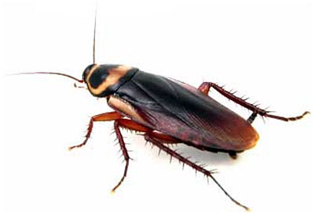
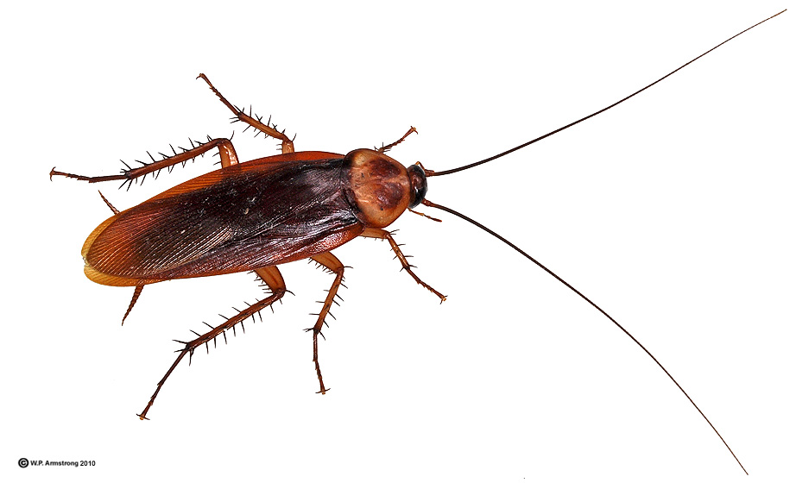
Cockroaches of GA & the Carolinas

Slide 2
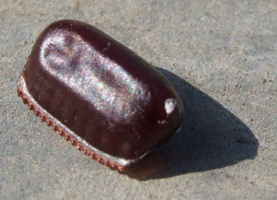
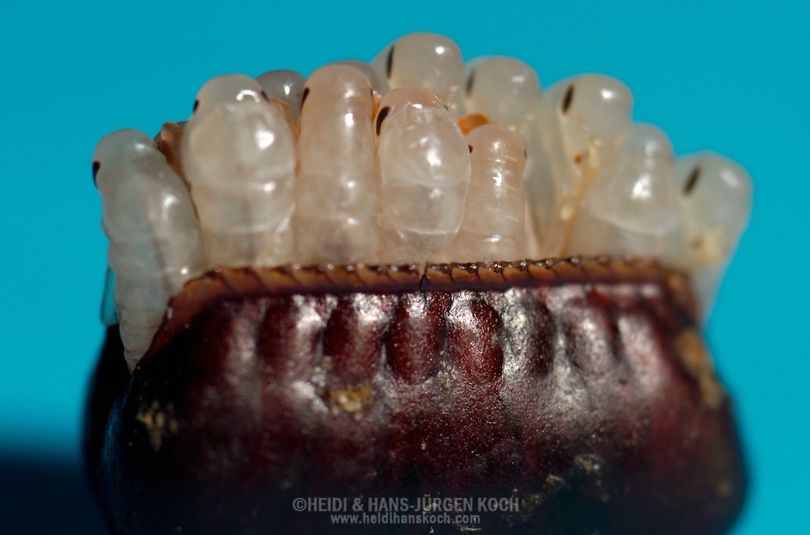
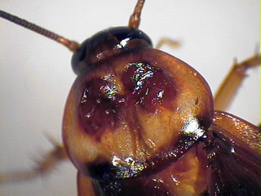
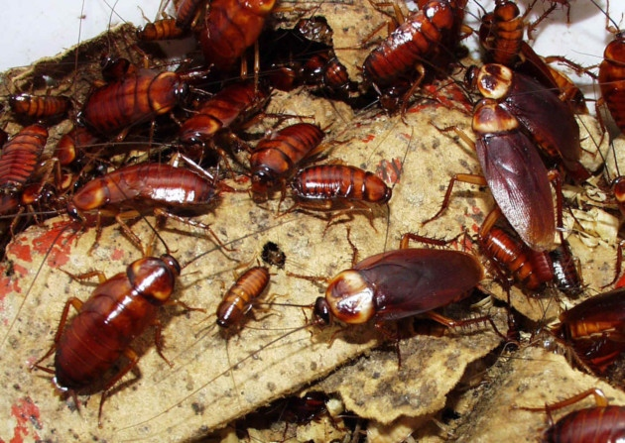
Cockroach Biology
Undergo gradual metamorphosis
Lay eggs within an ootheca which protects them from predators, pesticides, heat, etc.
Pronotum which covers the thorax and part of the head helps in identifying the species of insect you are dealing with
Prefer a moist environment near/in cracks & crevices
Most active at night
Daytime sightings mean high population

Slide 3
Common Cockroaches
Peridomestic cockroaches: main habitat is outdoors, but can be found indoors if conditions permit
Domestic cockroaches: main habitat is indoors: German & Brown-Banded
Species of common peridomestic cockroaches
  American
  Smoky-brown
  Oriental
  Australian
  Asian

Slide 4
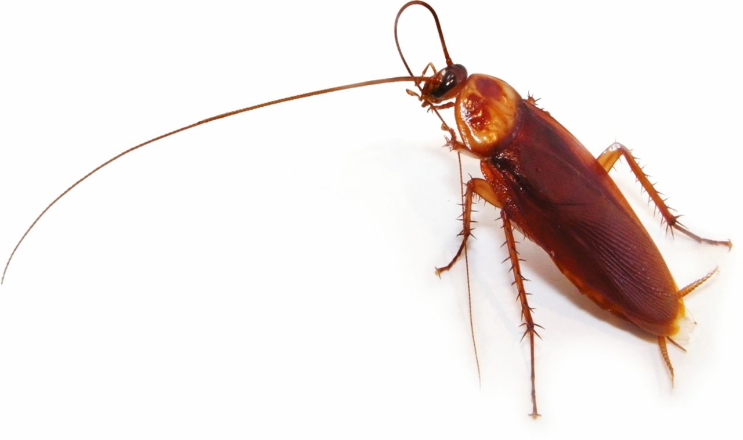
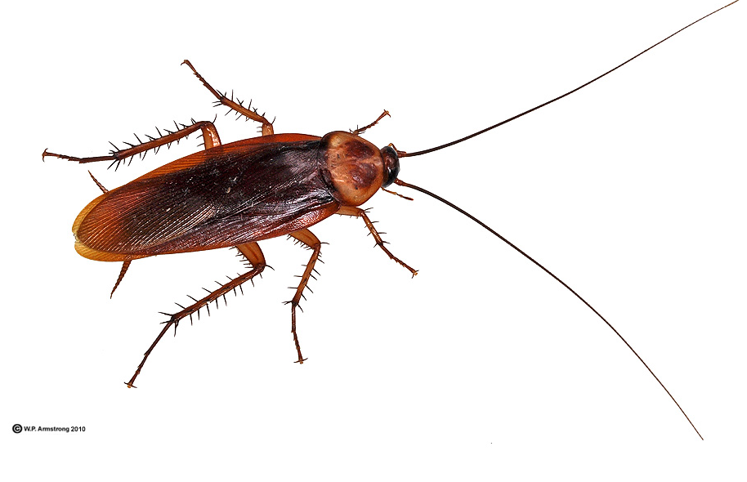
American Cockroach
Largest of the common roach species: 1 ½” or longer
Reddish brown with pale yellow border around pronotum
Strong fliers; well developed wings, longer than body
Living Environment
  Dark, moist areas
  Mulched areas around trees/shrubs/plants
  Leaf piles/clogged gutters
  Common in sewers
  Indoors: bathrooms, floor drains, pipe chases

Slide 5
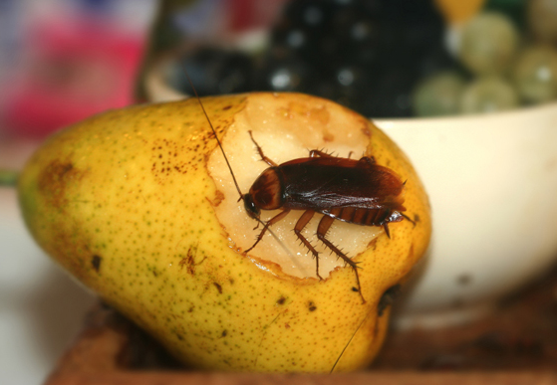
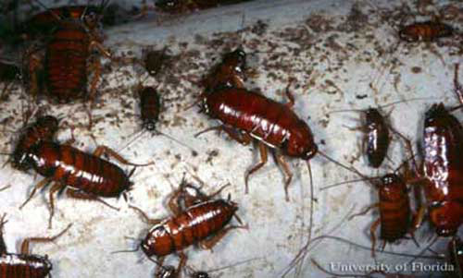
American Cockroach
Will feed on almost anything, prefer decaying organic matter
Public health problem due to association with human waste and disease
Aesthetically displeasing because they can soil items with their excrement and regurgitation

Slide 6
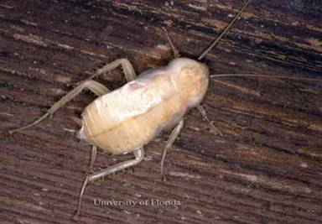
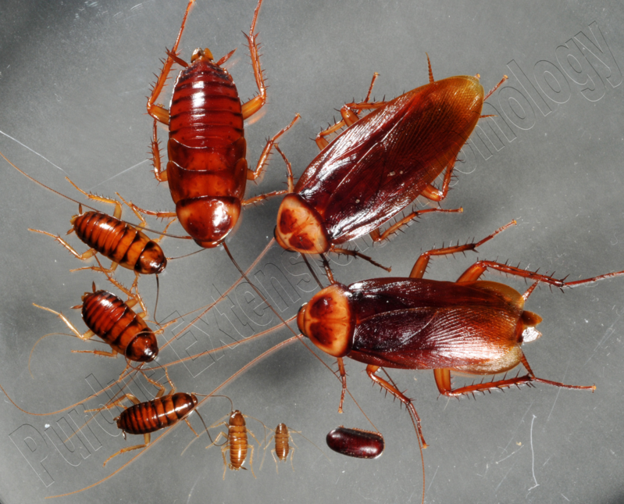
American Cockroach
Female will produce 9-10 oothecas in her lifetime
14-16 eggs/ootheca
Life cycle requires ~600 days from egg to adult
Notes:
White cockroach: all insects are white immediately after molting. They exoskeleton as not sclerotized (hardened) or tanned (gained its color). Since their exoskeleton is a main barrier of defense, they are not protected from predators prior to sclerotization. They are rarely seen out in the open. If they are it is due to a disturbance in the area/harborage area. (movement of items during inspection, flushing with PI, etc.

Slide 7
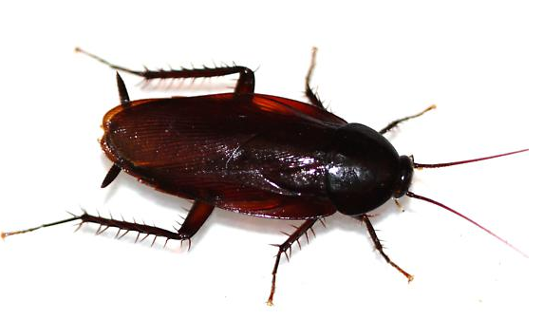
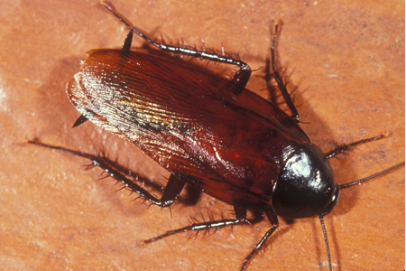
Smoky-Brown Cockroach
Slightly longer than 1”
Uniform mahogany color
Wings longer than body
Usually feed on plant material; leaf litter, around shrubs, wood piles, etc
Can be found indoors in garages, attics, crawlspaces

Slide 8
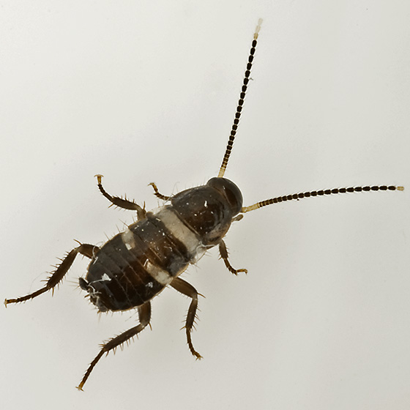
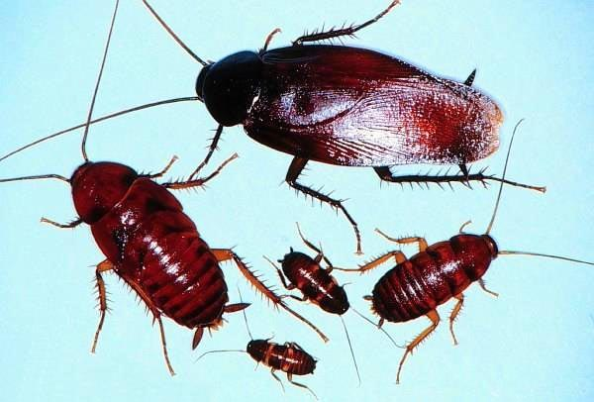
Smoky-Brown Cockroach
Female will produce ~17 oothecas in a lifetime
~20 eggs/ootheca
Life cycle requires 320 days from egg to adult
Younger nymphs are black with white stripe across body and white tip on antennae

Slide 9
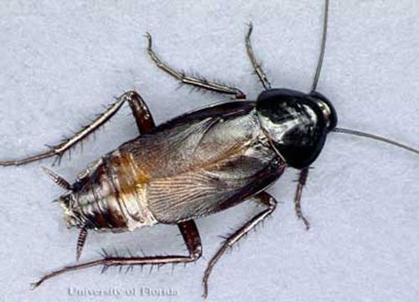
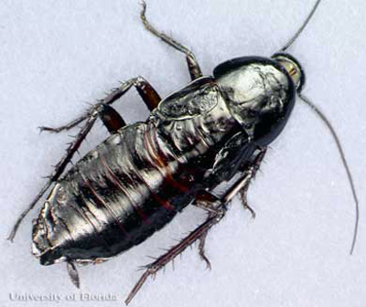
Oriental Cockroach
1 inch long
Dark brown, nearly black bodies with greasy sheen
Small functionless wings
Feed on decaying organic matter
Can be found in dark, damp places
  Mulched areas, leaf litter
  Crawlspaces, garbage and trash dumps
  Sewers
  Floor drains, around indoor plumbing areas

Slide 10
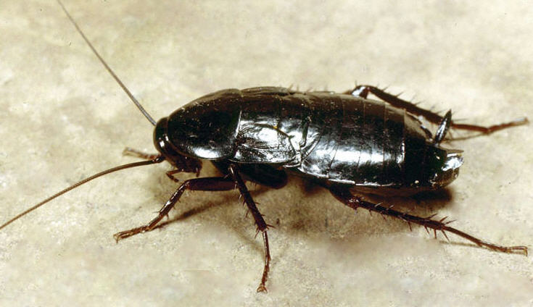
Oriental Cockroach
Female will produce ~8 ootheca in her lifetime
Each ootheca will have ~16 eggs
Life cycle takes approximately one year from egg to adult

Slide 11
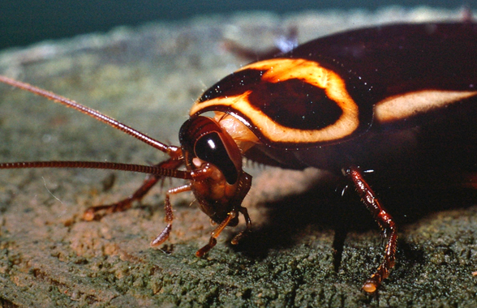
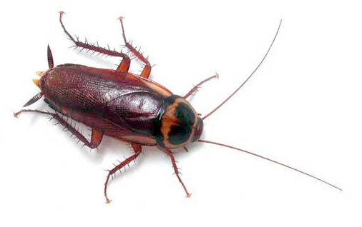
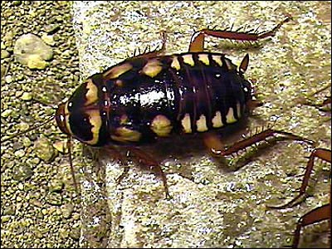
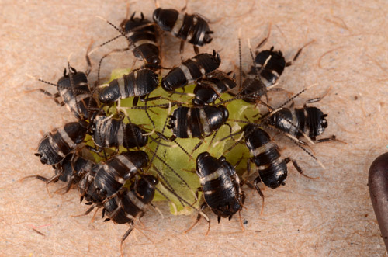
Australian Cockroach
About 1 ¼” long
Reddish brown body, long wing; strong fliers
Prominent yellow stripes on forward edge of forewing
Dark spot in middle of pronotum
Older nymphs marked with distinct splotches of yellow on dorsal sides of thorax and abdomen
Younger nymphs are black with white stripe in middle of the body and white tips on the antennae

Slide 12
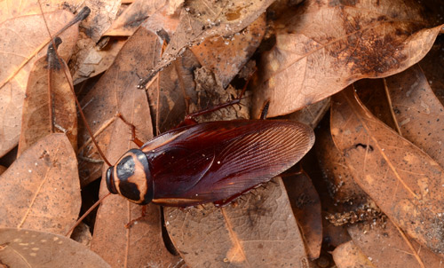
Australian Cockroach
Outdoors, they can be found
  under the bark of trees
  leaf litter
  in firewood piles
  in locations with moisture
Indoor habitats include
  Around water pipes, sinks, toilets
  Cabinets
  Warm, dark areas in the structure

Slide 13
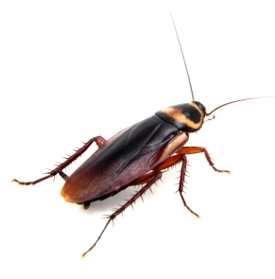
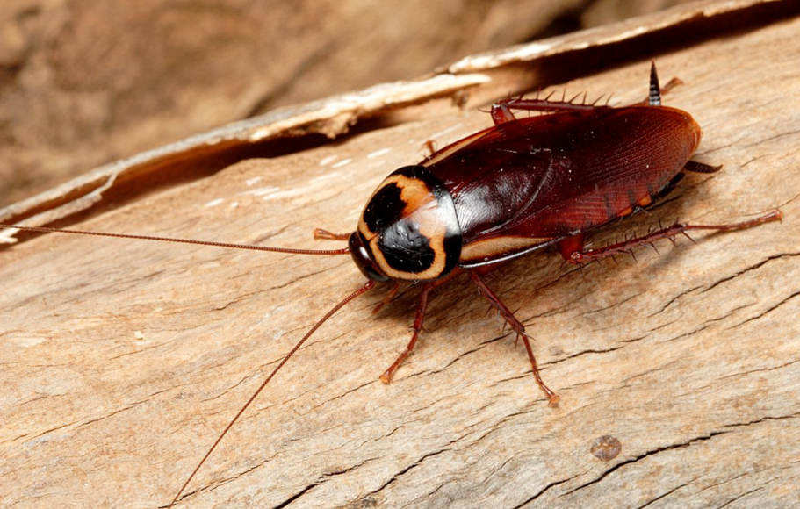
Australian Cockroach
Female produces 20-30 ootheca in her lifetime
Each ootheca contains ~24 eggs
Life cycle requires ~1 year from egg to adult

Slide 14
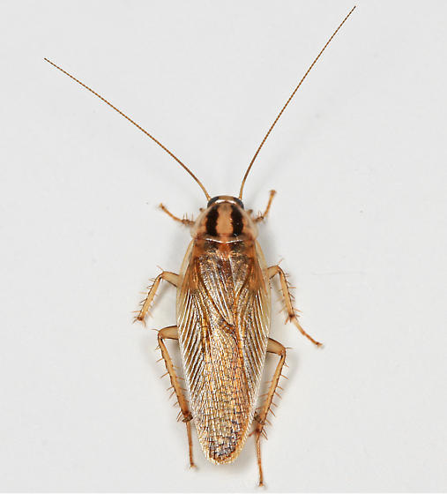
Asian Cockroach
Identical to German roach in size and color
Asian roach adults have wings that cover well past the end of the abdomen
German roaches have wings that just cover to the tip of the abdomen
Infests thatch in lawns, leaf litter and ground covers
Strong fliers
Attracted to light

Slide 15
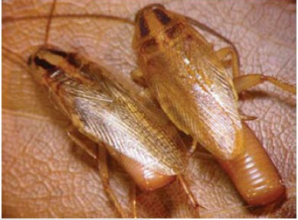
Asian Cockroach
Female will produce 5-6 ootheca in her lifetime
~38 eggs/ootheca
Deposits ootheca in ground cover
Egg capsule carried by Asian roach covered by wings, but not in the German roach

Slide 16
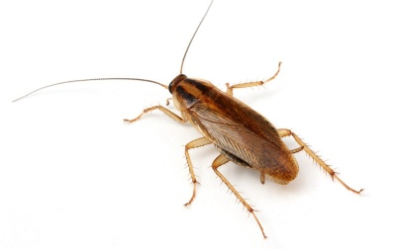
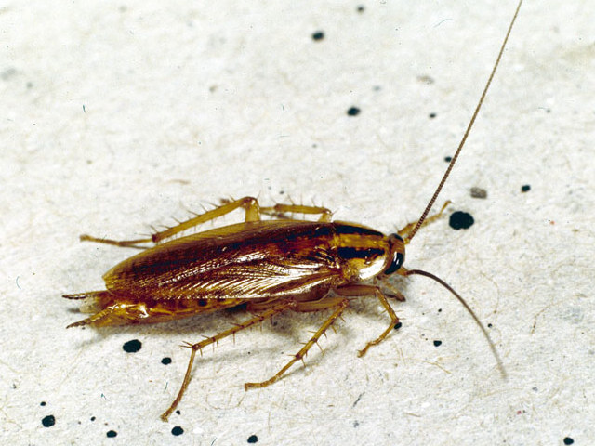
German Cockroaches
1/2 - 5/8” long
Light tan to light brown color
Two distinct parallel lines the length of the pronotum; “racing stripes”
Wings longer than abdomen
Do not fly
Will live in areas that provide them with humidity, food, and water source
All developmental stages live together in same area (they are not social insects)
Mainly active at night
During the day, they remain concealed in cracks and crevices unless they are over-crowded

Slide 17
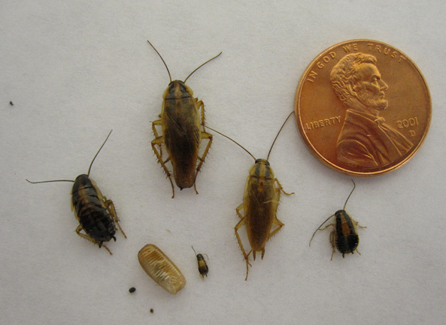
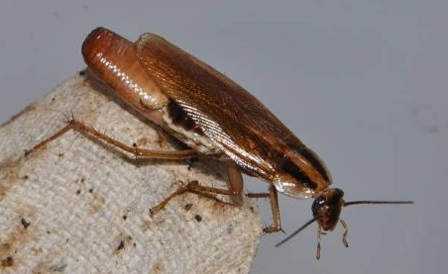
German Cockroaches
First and second instars feed on fecal matter, dead insects and regurgitated material found in their harborages-risky to leave
Older nymphs and adults forage and feed regularly
Females who are pregnant (gravid) do not feed; they seek harborage while the ootheca is attached. Once the ootheca is dropped, she will engorge herself on food available
Notes:
German roaches cluster together in very tight cracks and crevices (cryptophagic) and eat their own feces (coprophagic), and are also cannibalistic.

Slide 18
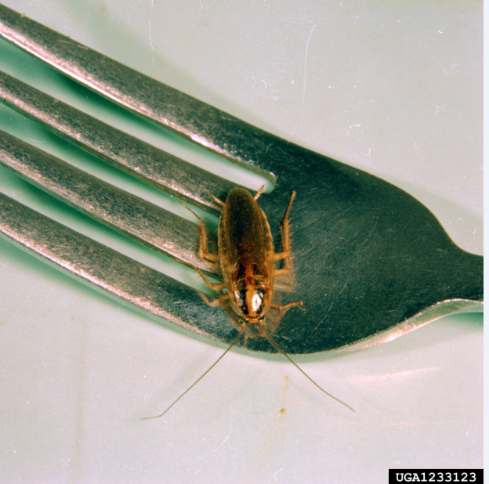
German Cockroaches
Contaminate food and food products with feces and defensive secretions
Physically transport and often harbor pathogenic organisms
Studies have shown they can cause severe allergic responses in children

Slide 19
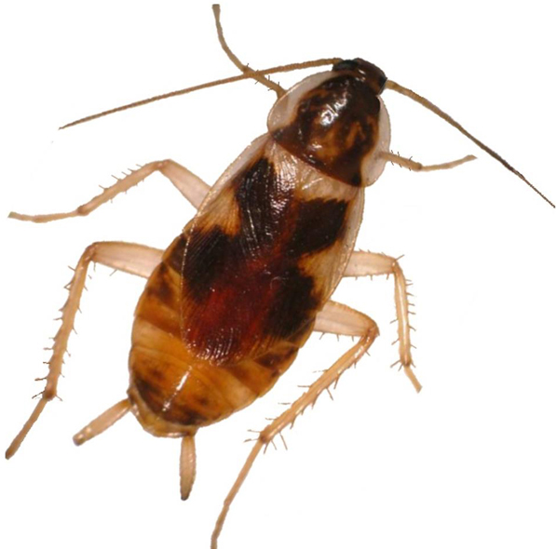
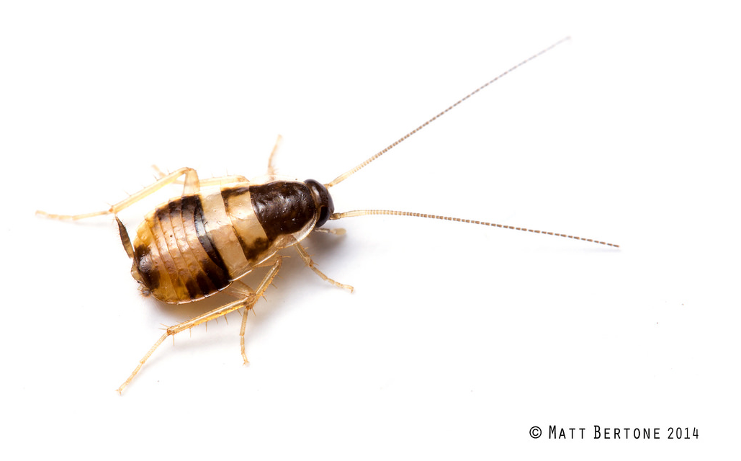
Brown Banded Cockroach
½ inch or slightly shorter
Fully developed wings
  Females: do not cover abdomen
  Males: cover abdomen
2 brownish bands across the mid and lower abdomen
Nymphs do not have wings but bands are noticeable
Edges of pronotum are clear
Prefer warm, dry locations
  Refrigerator motor
  Dressers, closets, pantries
  Light switch plates
  In areas away from water sources

Slide 20
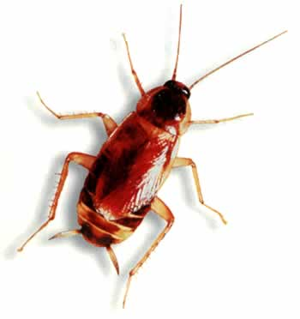
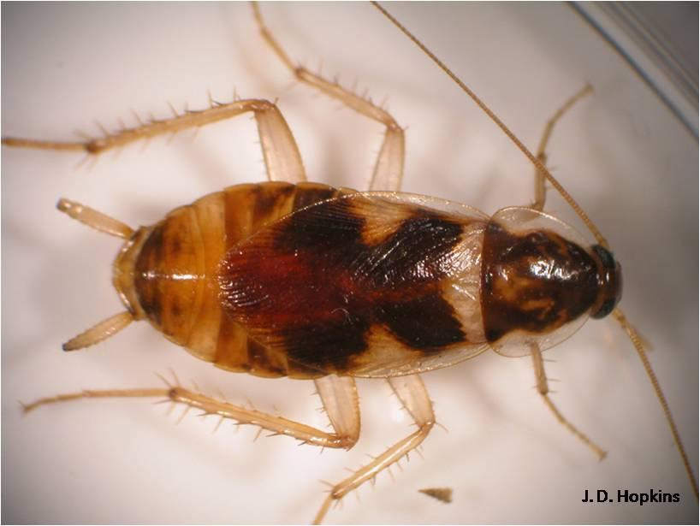
Brown Banded Cockroach
Female will produce ~14 oothecas in her lifetime
14-18 eggs per ootheca
Once nymphs hatch from eggs, it will take ~ 2 months to reach sexual maturity

Slide 21
Cockroaches of GA & the Carolinas

