Slide 1
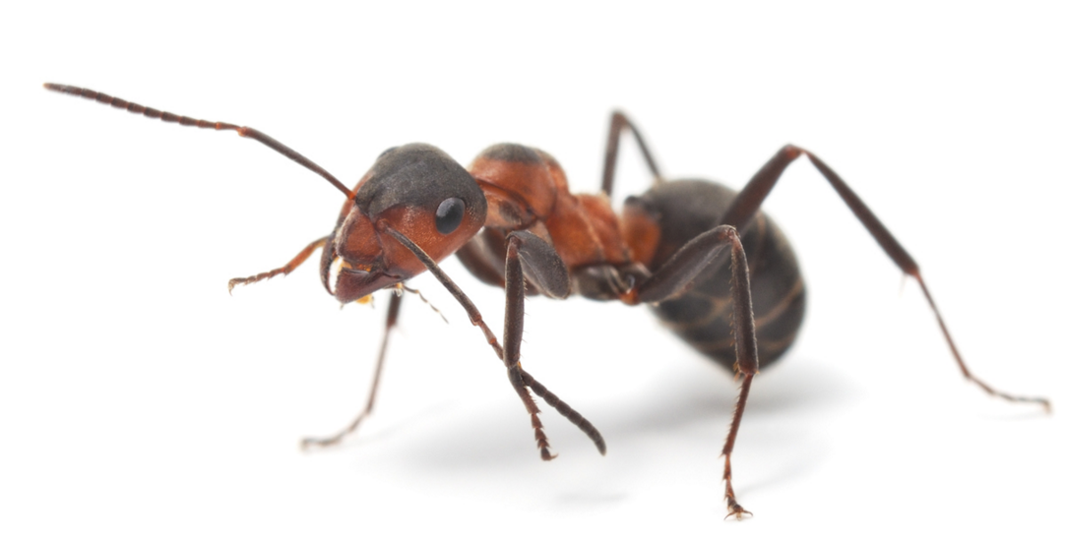
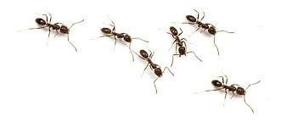
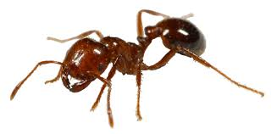
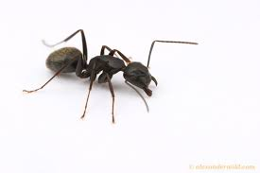
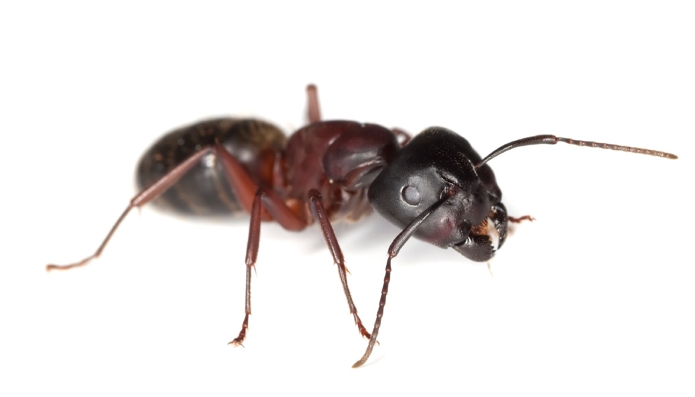
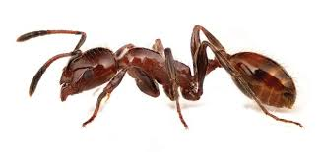
Ants

Slide 2
Ant Facts
Ants can lift 20X their body weight
In just a few days, some ant queens can lay 30,000+ eggs
Ants never sleep, they work 24/7 and 365 days a year
Notes:
Video embedded

Slide 3
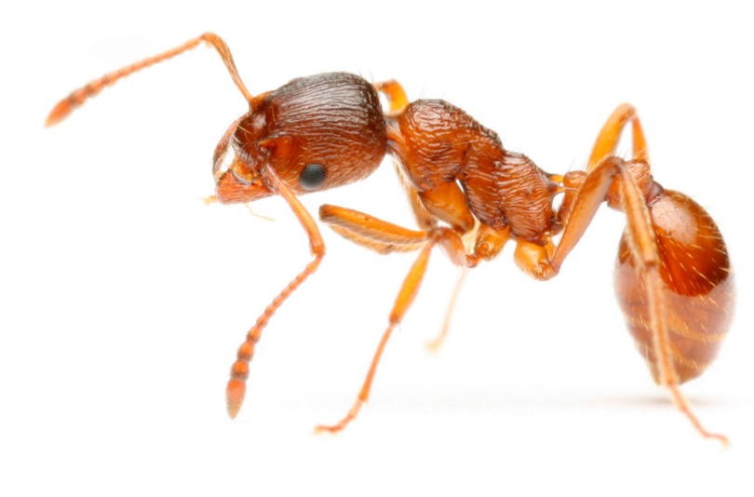
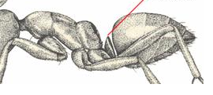
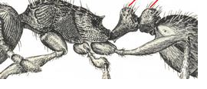
Characteristics of an Ant
Social insects
  Caste system
    Queen/Alates
    Workers
    Males
  Live in colonies with large number of nest mates
  Division of labor: each caste member has its only job
  Queen is responsible for reproduction
Elbowed antennae
Strongly constricted petiole (waist) with 1 or 2 nodes present
Workers are wingless
Some species have stinger on end of abdomen
One node
Two nodes

Slide 4
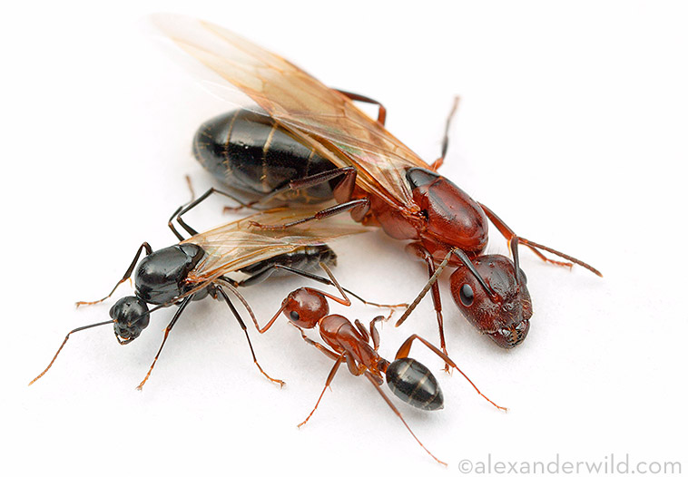
Meet the Caste
Female Alate
  Large in size
  Strongly elbowed antennae
  Wings present
Male Alate
  Smaller compared to female alate
  Slightly elbowed antennae
  Wings present
Worker
  All sterile females
  No wings present
Female Alate/Future Queen
Male Alate
Female Worker

Slide 5
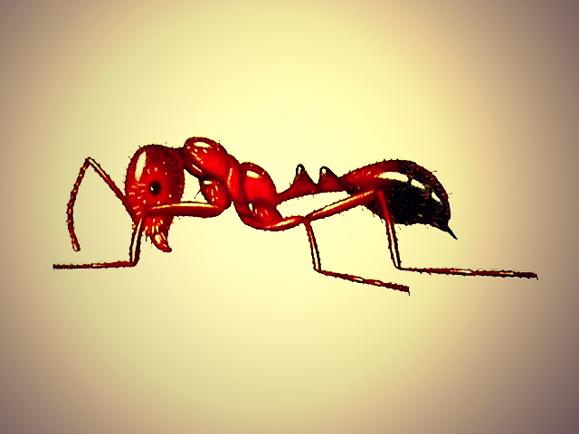
Ant Anatomy
Petiole
(1 or 2 node)
Scape
Gaster
Antenna
tip of
abdomen
Head
Thorax
Abdomen

Slide 6
Ant Behavior: Trophallaxis
Feed each other via trophallaxis
Transfer, by regurgitation, of food among nest mates through mouth to mouth feeding
Notes:
Video embedded

Slide 7
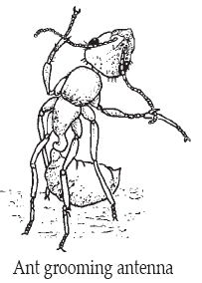
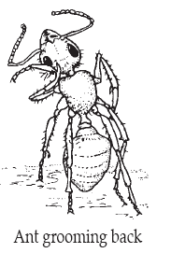
Ant Behavior: Grooming
Use antimicrobial secretions from glands on underside of petiole to disinfect themselves from unwanted, dangerous pathogens
Transfer secretions to the foreleg then to the mouthparts and other parts of the body
Through trophallaxis and nest mate grooming, antimicrobial secretions are distributed throughout the colony
How can we use this behavior against them? What part does trophallaxis play?
Notes:
Video embedded
How can we use this grooming behavior against them? How is it related to trophallaxis?
If a trail of ants is treated with Termidor, those ants walking thru it will pick Termidor up on their feet. While they groom themselves, they will then ingest the Termidor. Thru the behavior of trophallaxis they will regurgitate food in liquid form, which will also contain Termidor. That ant will them pass the Termidor along via trophallaxis to other ants. Even tho the majority of ants did not come in direct contact with Termidor, they will get it passed along to them.

Slide 8
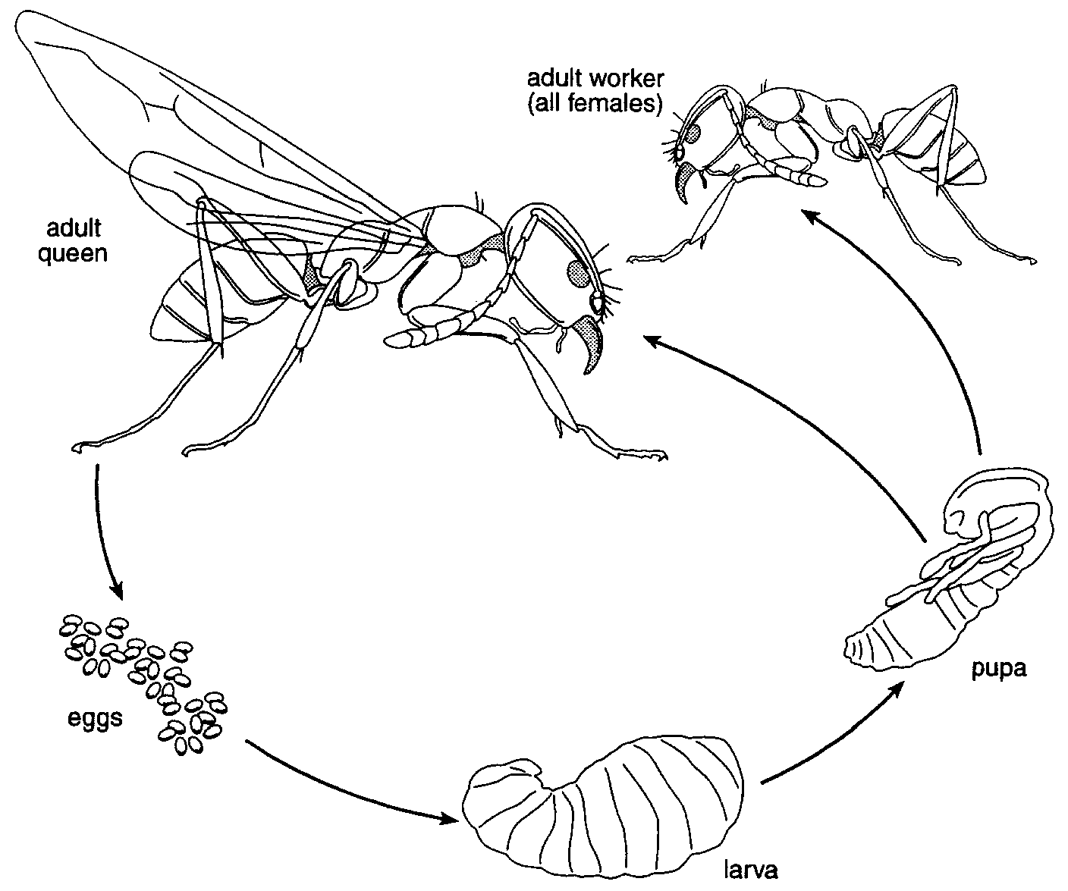
Ant Biology
Undergo complete metamorphosis
Queen determines the needs to the colony
  She determines if alates or workers will be produced
  Through the release of pheromones

Slide 9
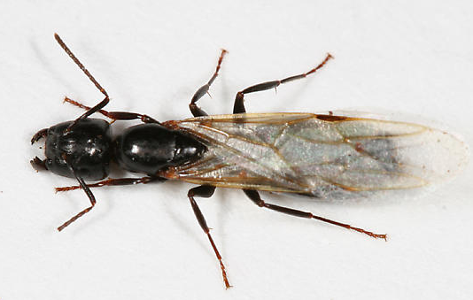
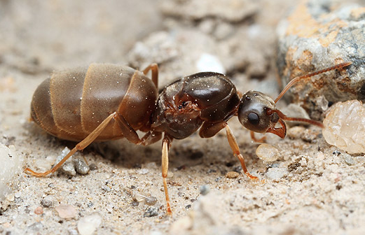
Ant Alates & Queens
Male and female alate mate to start new colony
Female becomes the queen of the colony
First brood is tended alone, feeding from liquefied tissue that was wing muscle
Young become the foragers for future broods

Slide 10
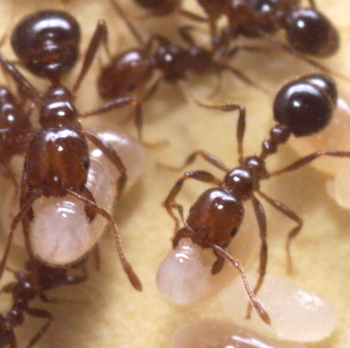
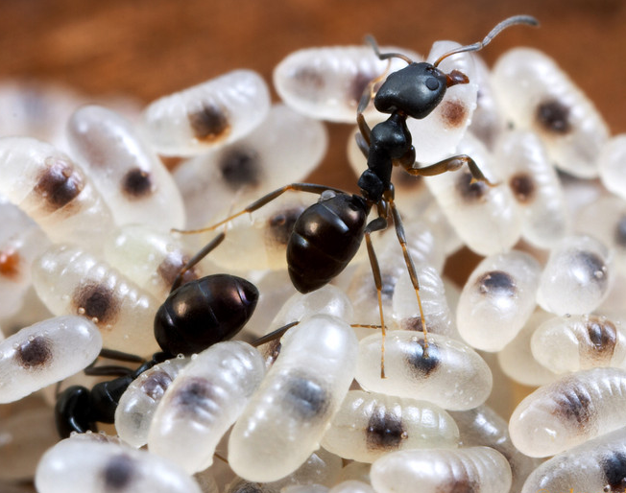
Ant Eggs
Life of the colony
Kept well protected by workers
  Cleaned with antimicrobial secretions to prevent fungal & mold growth
  Moved when danger is presented

Slide 11
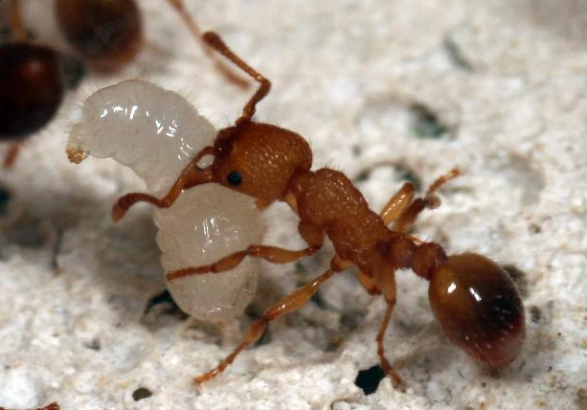
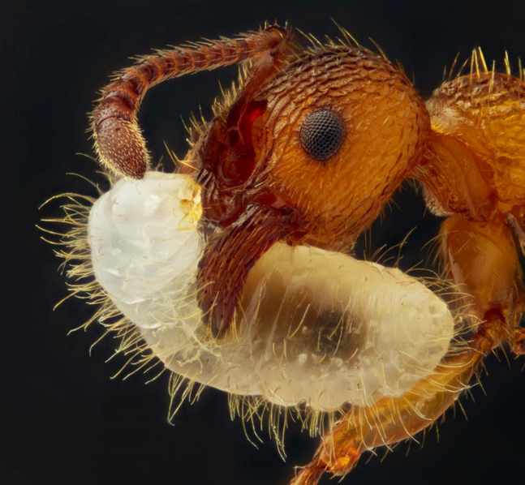
Ant Larvae
Tended to and moved by the workers
Digest solid foods and regurgitate liquid back to workers
Workers feed other nest mates and queen

Slide 12
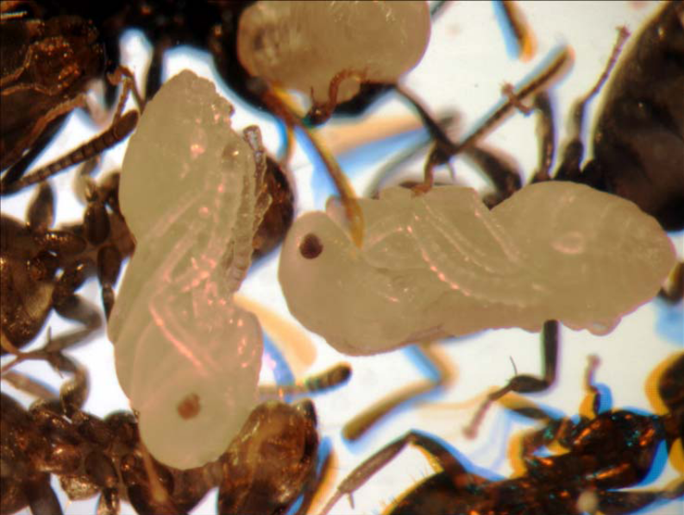
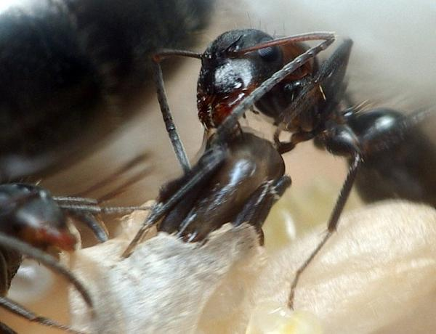
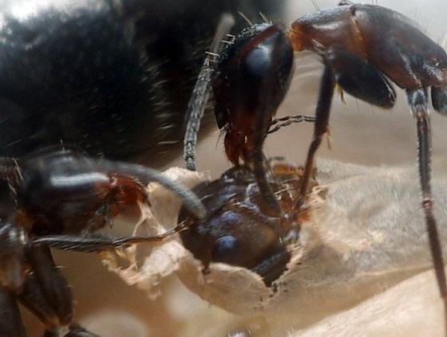
Ant Pupae
Tended to, moved and cared for by workers
Last stage of development before worker or alate emerges from casing
When ready to emerge from casing, workers help it to exit

Slide 13
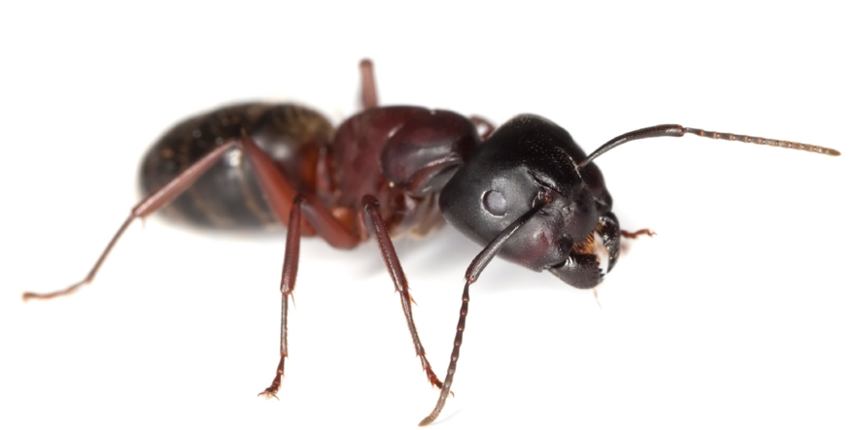
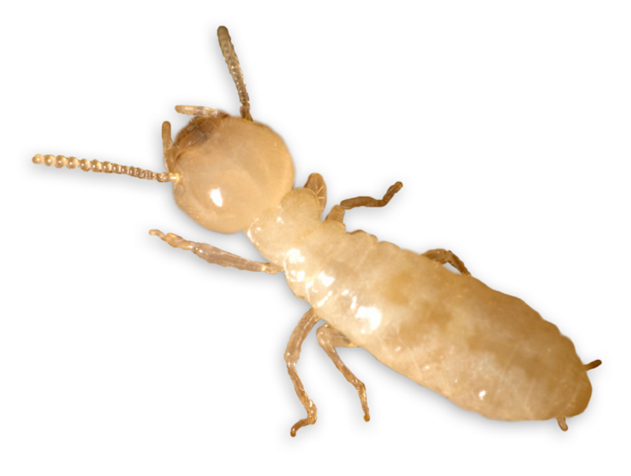
Ants or Termites?
During the year, ants and termites can swarm at the same time
While it may be easy to identify workers of each species, ant alates and termite alates are often misidentified
It will be up to you to identify what pest you are dealing with

Slide 14
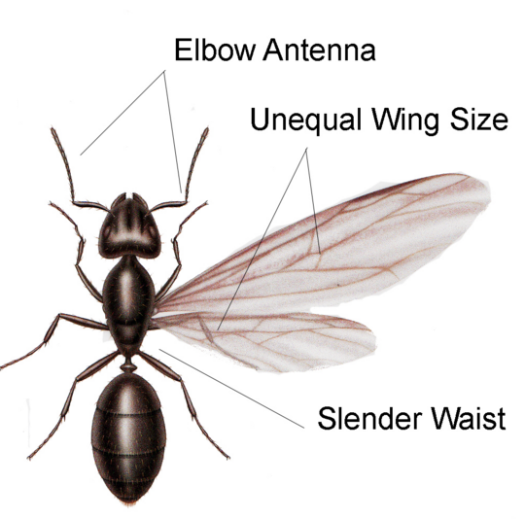
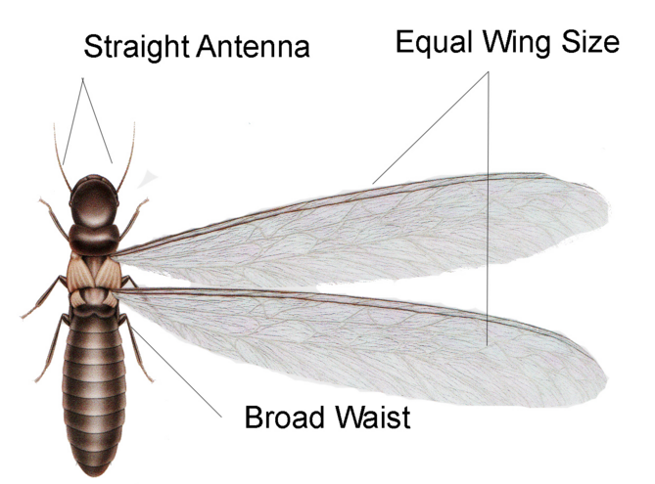
Ant Alate
Termite Alate
Elbowed antennae
Slender “waist”
Forewings are larger than hind wings
Few veins in wings
Straight, beaded antennae
Broad “waist”
Equal sized wings, longer than body
Numerous veins in wings

Slide 15
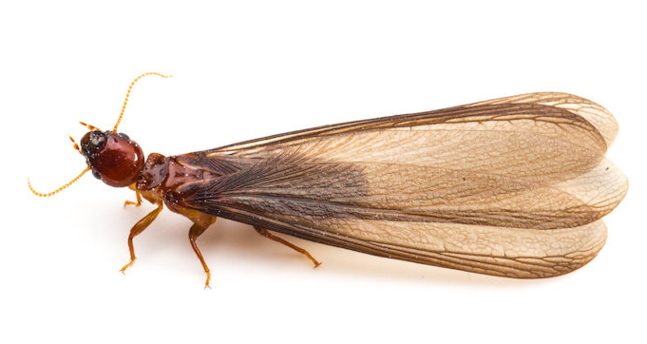
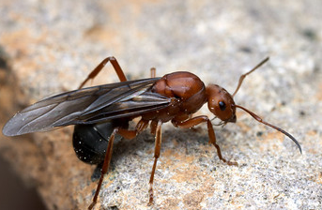
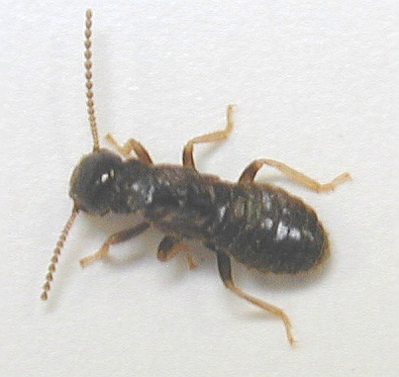
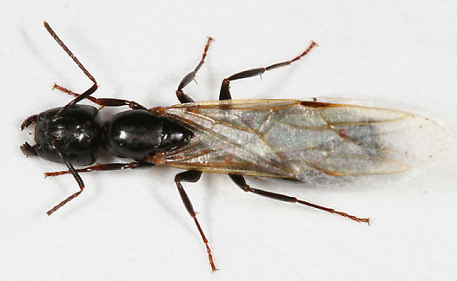
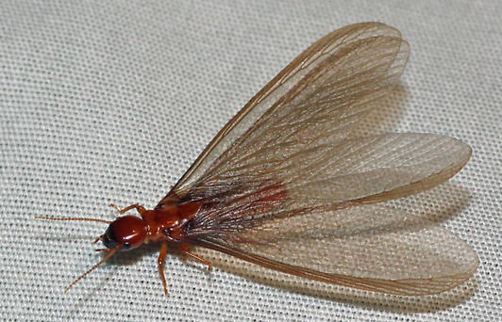
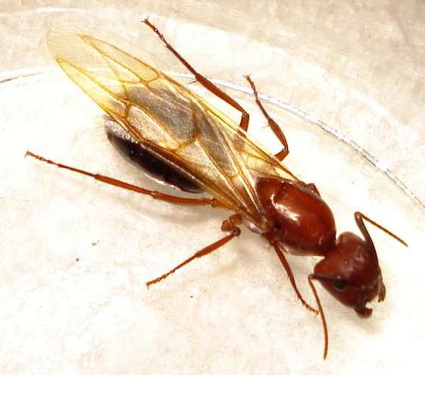
Ant Alate or Termite Alate?
Notes:
Top L to R Ant Termite that has lost its wings termite
Bottom L to R Termite ant ant

Slide 16
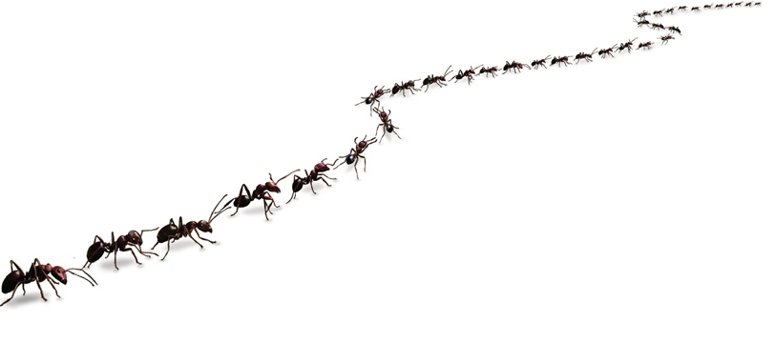
Ant Identification
Most accurate way to identify is to have expert view the specimen with microscope and scientific key
Other ways to identify include observing
  Physical characteristics
  Trailing behavior
  Feeding behavior
  Nesting behavior

Slide 17
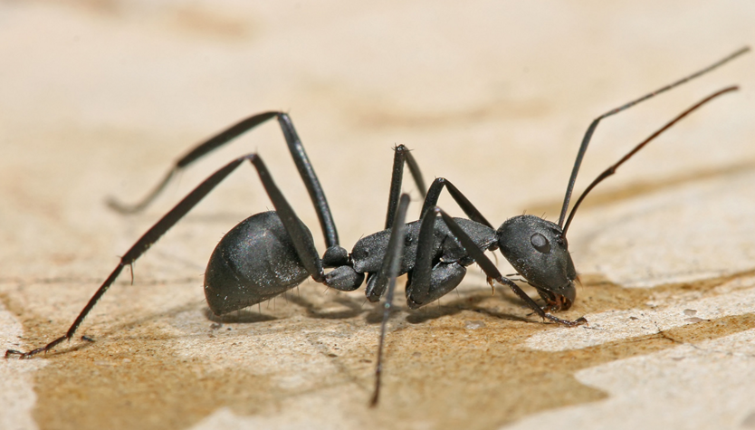
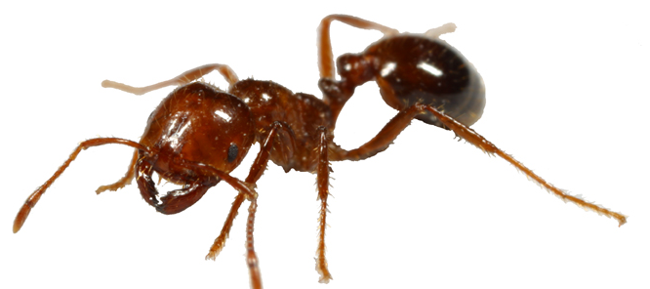
Ant Identification
1 Node or 2
  1 node: Sweet baits
  2 nodes: Protein baits
Size of workers
Color
Other identifying characteristics
  Antennae
  Hair
  Stinger
  Spines on thorax

Slide 18
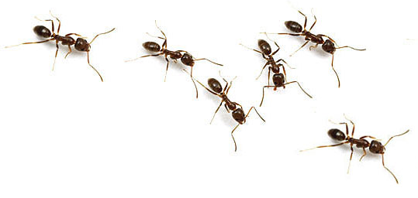
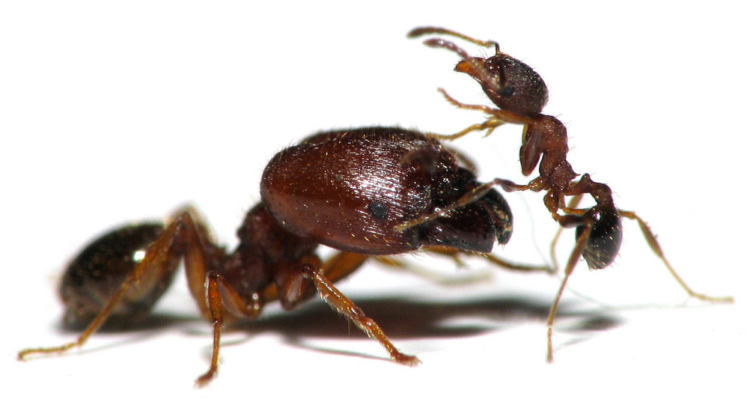
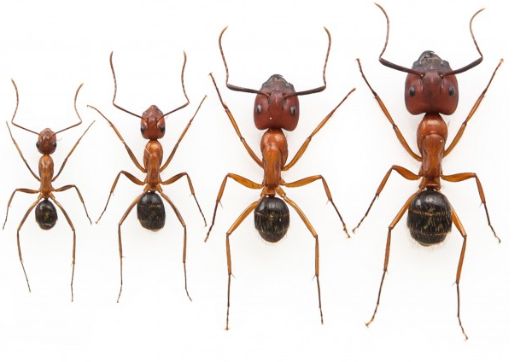
Ant Worker Identification
Monomorphic Argentine Ant
Observing worker ant size can help to identify the species.
  Monomorphic: One size worker; all are the same size
  Dimorphic: Two sizes of workers
  Polymorphic: more than 2 sizes of workers
Dimorphic Big Headed Ant
Polymorphic Florida Carpenter Ant

Slide 19
Mono, Di or Polymorphic?
Monomorphic Ants
Dimorphic Ants
Rover
Crazy
Acrobat
Argentine
Pharaoh
Pyramid
Elongate Twig
Big Headed
Polymorphic Ants
Carpenter
Red Imported Fire
Harvester

Slide 20
1 Noded Ants

Slide 21
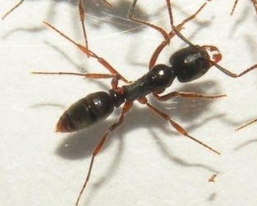
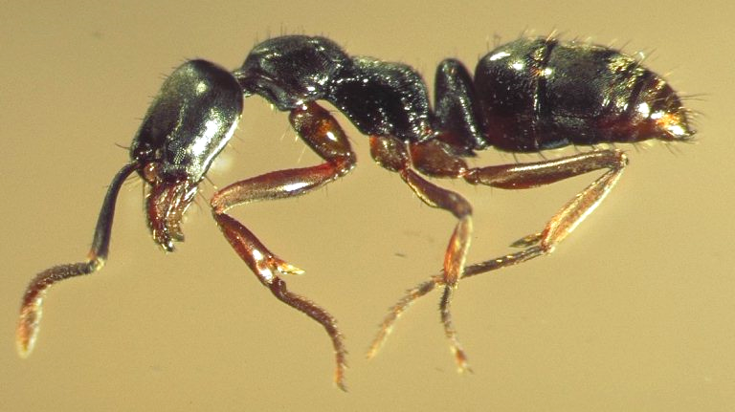
Asian Needle Ant
Very intense sting, so be
careful around this ant
Introduced
Spreading slowly
Mainly soil nesting
Not an indoor threat
I-------------------------¼ inch -----------------------------I

Slide 22
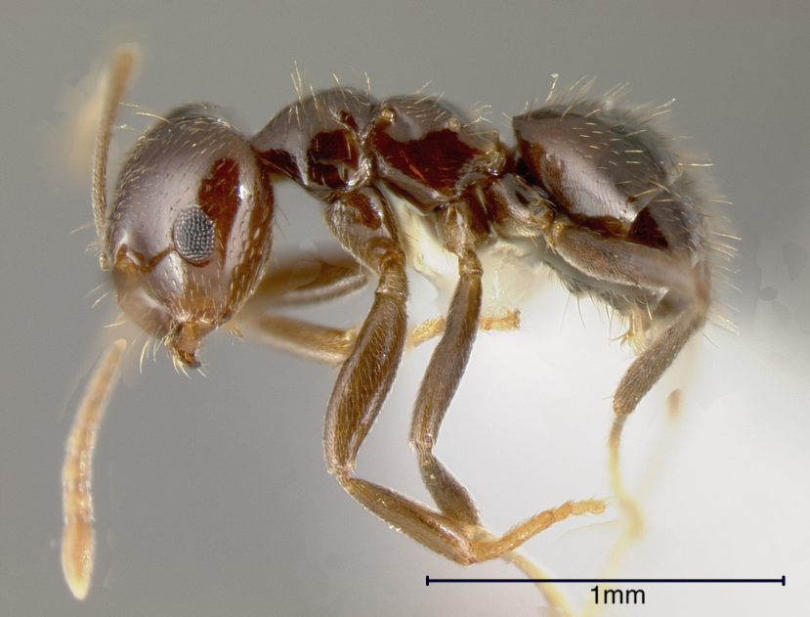
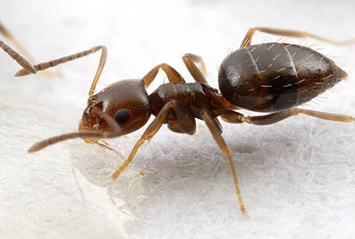
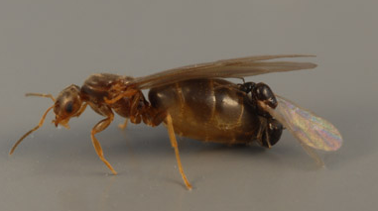
Rover Ants
Small, stubby and brown in color
Node is hidden under gaster
No stinger
Due to small size, alates can easily enter homes through window screens
Female alates are 3x the size of male alates

Slide 23
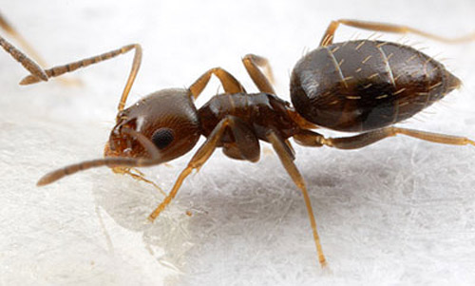
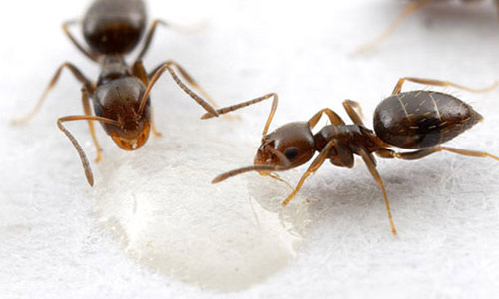
Rover Ants
Commonly nest in soil below or next to slabs
Can rarely be followed back to their nest
Often trail in and out of various voids
Often trail up or down to or from a tree
Often trail around the base or the eaves of structures, following structural guidelines
Always attempt to follow them back to where they are exiting or entering

Slide 24
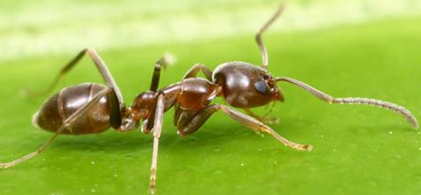
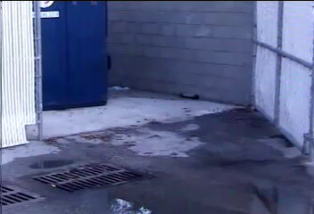
Argentine Ants
1/8” inch in length
Dark brown/black and slender body
Forage in multiple rows
No stinger
Nests may contain hundreds of queens and millions of worker
  Supercolony: 2 or more colonies come together to create a larger colony
Prefer to feed on sweets like honeydew and nectar. Can feed on proteins if needed
Notes:
Video embedded

Slide 25
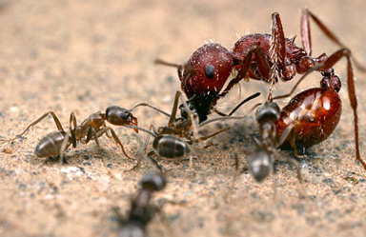
Argentine Ants
Argentine ants are aggressive, often eliminating other types of ants in the same area
Seek out all colonies
Numerous nests in mulch and soil, under objects, or near tree roots, on trees, in rotten wood, garbage, near or below slabs
Will trail up trees and along branches
Nests can be on neighboring properties
Notes:
Video embedded

Slide 26
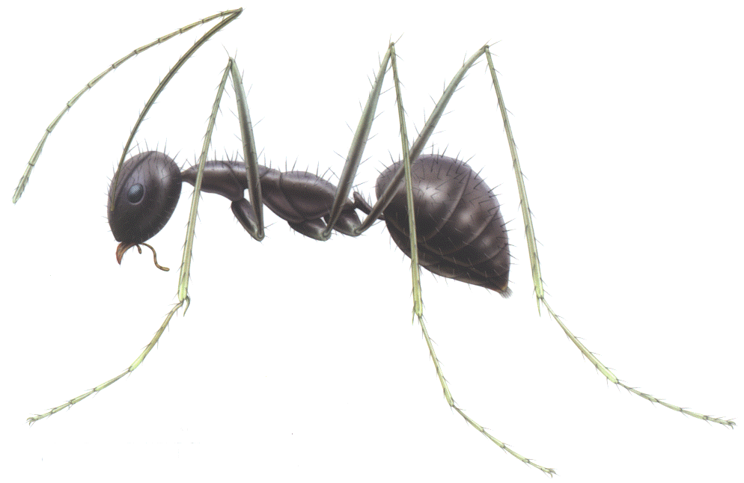
Crazy Ants
1/8” long and black in color
Scape of antennae (1st segment) as long as head and thorax
Long legs
No stinger
Erratic foraging pattern
Multiple nests along foundations, under objects on ground (potted plants, trash piles, toys, etc)
Prefer sweets but will feed on proteins
Notes:
Video embedded

Slide 27


Tawny Crazy Ants
Presently located in the Houston/SE Texas area
1/8” in length
Golden to reddish brown in color
Body surface is smooth, glossy, and covered with dense hairs
The antennal scape is nearly twice the width of the head
Prefer sweets, but will feed on proteins
No stinger

Slide 28


Slide 29


Tawny Crazy Ants
Thick, erratic foraging trails with thousands of ants occur along sidewalks, around buildings, and on trees and shrubs
After feeding, the gaster will appear to be striped due to stretching of the light-colored membrane connecting segments of the gaster
Because of large number, when they die from treatments, bodies will pile up in areas around a structure

Slide 30


Odorous House Ants
Range in color from dark brown to shiny black
Node is hidden by pedicel
Primarily sweet feeds, preferring honeydew from aphids and scale insects. Will also feed on insects
When disturbed, become erratic with their abdomens raised in the air, similar to acrobat ant
Smell like coconut when crushed

Slide 31


Odorous House Ants
Large colonies, with up to 10,000 workers and multiple queens
Outside
Live in shallow nests in the soil and potted plants
Under stones, wood and debris
Inside
Wall voids
Under floors
Around water pipes and heaters
Potted plants

Slide 32



Pyramid Ants
Pale orange to dark brown
Pyramid projection on thorax
Does not sting or act aggressively
Nest out of a single-hole volcano-type mound

Slide 33



Carpenter Ants
Large in size
Numerous species in Texas/Oklahoma area
  Solid black
  Black with brownish/orange head and thorax
  Black with reddish thorax
No stinger
Covered in yellowish/white hairs

Slide 34

Carpenter Ants
Nest in wood, dead stumps, lumber piles, rotting logs, wall voids
Main colony and satellites
Swarm mainly in spring
Forage mainly at night
Nests can be located by the presence of small piles of sawdust, or frass
Frass consists of wood shavings or other material excavated from the ant’s nests, as well as tiny fragments of dead ants and other insects
Notes:
Video embedded

Slide 35
Carpenter Ants
Single queen per nest
Colonies of carpenter ants will not combine
Colonies show aggression towards each other
What does this mean for you when you are treating for carpenter ants?
Notes:
Video embedded
Unlike some ants that will combine colony A and colony B to become one larger colony, Carpenter ants do not do this. They will show aggression towards members of other colonies. This is to be kept in mind when treating for Carpenter ants. If you located and treat one colony and a few days later still have activity, it is unlikely that the treatment didn’t work and likely you have a 2nd colony of Carpenter ants.

Slide 36
2 Noded Ants

Slide 37


Elongate Twig Ant
Elongate body
Stinger present
  Very painful when stung
Wasp like in appearance
Forage individually
Found mainly outdoors on fences, eaves, and trees

Slide 38


Pharaoh Ants
Yellow, honey colored, or orange
Thorax uneven when viewed from the side
Head, thorax & petiole densely sculptured
Gaster is smooth & shiny
Stinger present
Single file foraging
Colony will “bud” if foragers removed

Slide 39
Pharaoh Ants
Slow moving with foraging
Single file trail
Not easily disturbed when foraging or feeding
Notes:
Video embedded
Because of the sensitivity of this ant to many products, it is imperative that this ant is ID’ed correctly. One way to determine that pharaoh ants are the issue is to attempt to disturb them while they are foraging/walking in a trail. If the trail of ants is easily disturbed, it is not pharaoh ants. If they are not easily disturbed, you are dealing with pharaoh ants.
Do not treat with dusts or liquid residuals.

Slide 40


Acrobat Ants
2 main species in TX and OK area
  Solid black
  Red head and thorax/black abdomen
Abdomen is heart shaped
Pair of spines on thorax
Will hold abdomen up with threatened

Slide 41



Harvester Ants
Large bodied ant; ¼ to 3/8 inch in length
Red, brown or black in color
Square shaped heads
Beard or fringe of hairs present on the underside of head
1 pair of spines on thorax
Monomorphic species
Not aggressive, rarely sting but when they do, it is painful

Slide 42


Harvester Ants
Common in arid regions with sandy soil
Can colonize lawns, playgrounds and turf, but will not invade homes
Depending on the species they can build large exposed, flattened mounds or small mounds with cones of primarily sand
Workers will clear the area of all vegetation around nests creating a bare area of fully exposed soil

Slide 43


Fire Ants
Head and thorax are varied red, brown or black
Gaster is shiny black with stinger present
No spines on thorax
Protein feeders

Slide 44


Fire Ants
Mound forming,
  Approximately 10% of colony located here
  Older workers
Ground nesting
  Underground network of tunnels
  Young workers, queen(s), egg, larvae, and pupae
Will forage/nest inside structures

Slide 45
Ants

