Slide 1
Orders of Class Insecta/Hexapoda
Order Thysanura – Silverfish, Bristletails, and Firebrats
Order Orthoptera – Grasshoppers & Crickets
Order Blattoidea/Dictyoptera– Cockroaches
Order Dermaptera - Earwigs
Order Isoptera – Termites
Order Hemiptera – True bugs, bed bugs, boxelder bugs
Order Siphonaptera – Fleas
Order Diptera – Flies & mosquitoes
Order Coleoptera – Beetles
Order Hymenoptera – Bees, wasps, hornets, yellow jackets
Order Lepidoptera – Moths & butterflies

Slide 2
1. The Order of Cockroaches is:
Hemiptera
Hymenoptera
Isoptera
Dictyoptera - Blattoidea

Slide 3
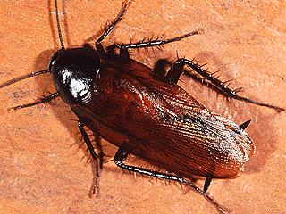
1. The Order of Cockroaches is:
Dictyoptera - Blattoidea

Slide 4
2. The Order of Bedbugs is:
Hemiptera
Hymenoptera
Lepidoptera
Coleoptera

Slide 5
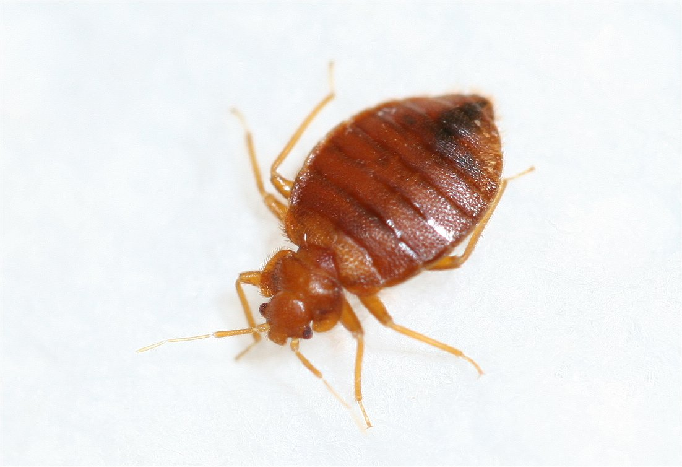
2. The Order of Bedbugs is:
a. Hemiptera (True bugs)

Slide 6
The Order of Fleas is:
Lepidoptera
Hymenoptera
Siphonaptera
Isoptera

Slide 7
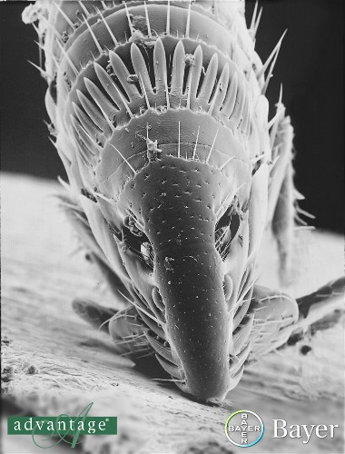
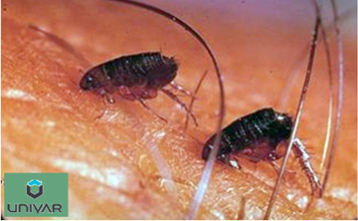
The Order of Fleas is:
c. Siphonaptera
Fleas feeding
on man

Slide 8
4. The Order of Termites is:
Orthoptera
Dictyoptera
Diptera
Isoptera

Slide 9
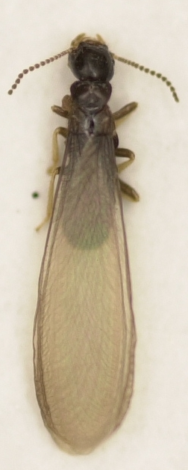
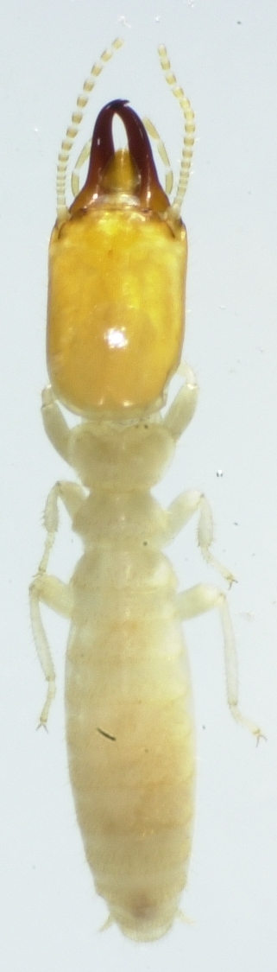
4. The Order of Termites is:
d. Isoptera

Slide 10
5. The Order of Ants, Bees & Wasps is:
Lepidoptera
Hemiptera
Hymenoptera
Siphonaptera

Slide 11
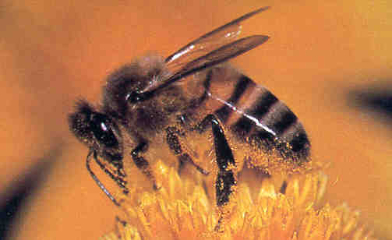
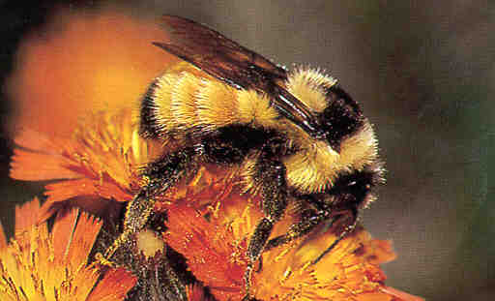
5. The Order of Ants, Bees & Wasps is:
c. Hymenoptera
And don’t forget Horntails, non-reinfesting wood wasps that develop in wet wood

Slide 12
6. The Order of Flies and Mosquitoes is:
Diptera
Lepidoptera
Hemiptera
Isoptera

Slide 13
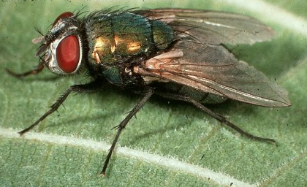
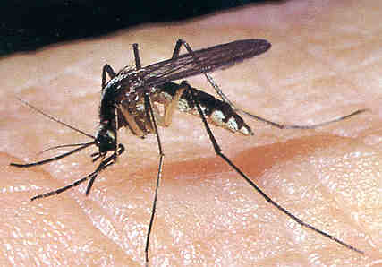
6. The Order of Flies and Mosquitoes is:
Diptera
It’s the only group of insects with one pair of wings

Slide 14
7. The Order of Butterflies and Moths is:
Diptera
Siphonaptera
Hymenoptera
Lepidoptera

Slide 15
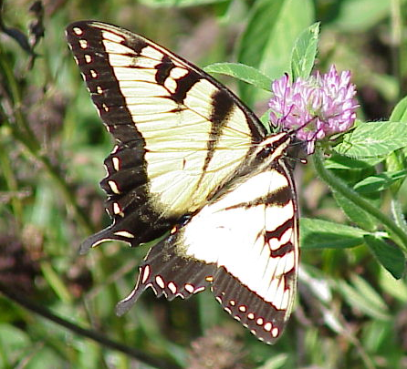
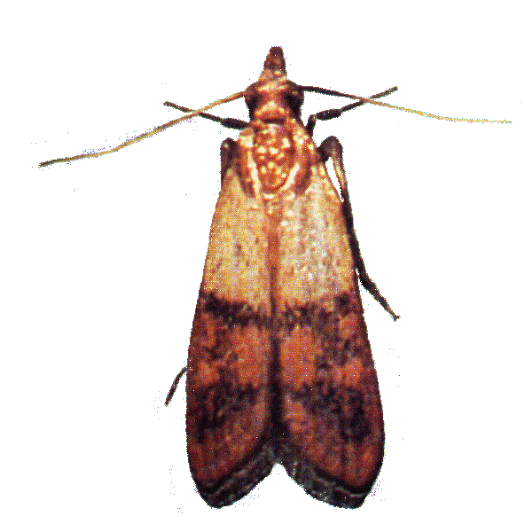
7. The Order of Butterflies and Moths is:
d. Lepidoptera (scale-like wings)

Slide 16
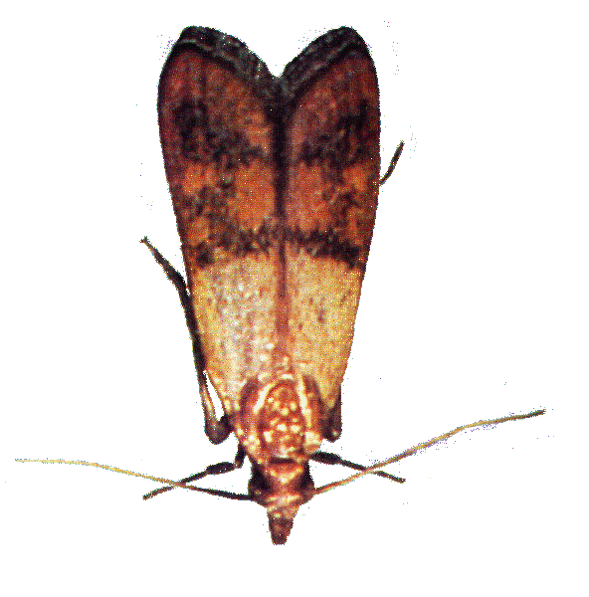
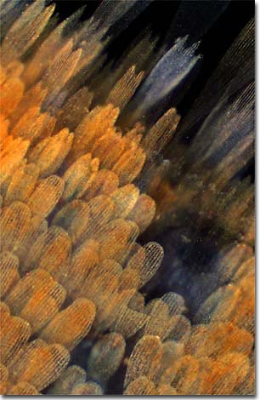
Lepidoptera - Butterflies and Moths
(scale-like wings)

Slide 17
The change in shape, size and form that insects go through during growth and development is called:
Trophallaxis
Metamorphosis
Molting
Pheromones

Slide 18
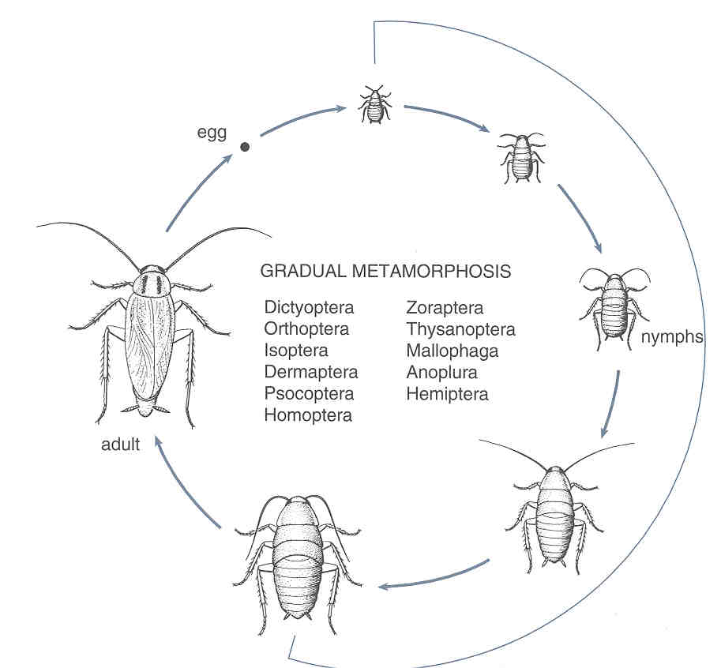
The change in shape, size and form that insects go through during growth and development is called:
b. Metamorphosis
It means “change in form”

Slide 19
Which two characteristics are used most often identify insects?
Antennae & wings
Wings & legs
Mouthparts & wings
Mouthparts & legs

Slide 20
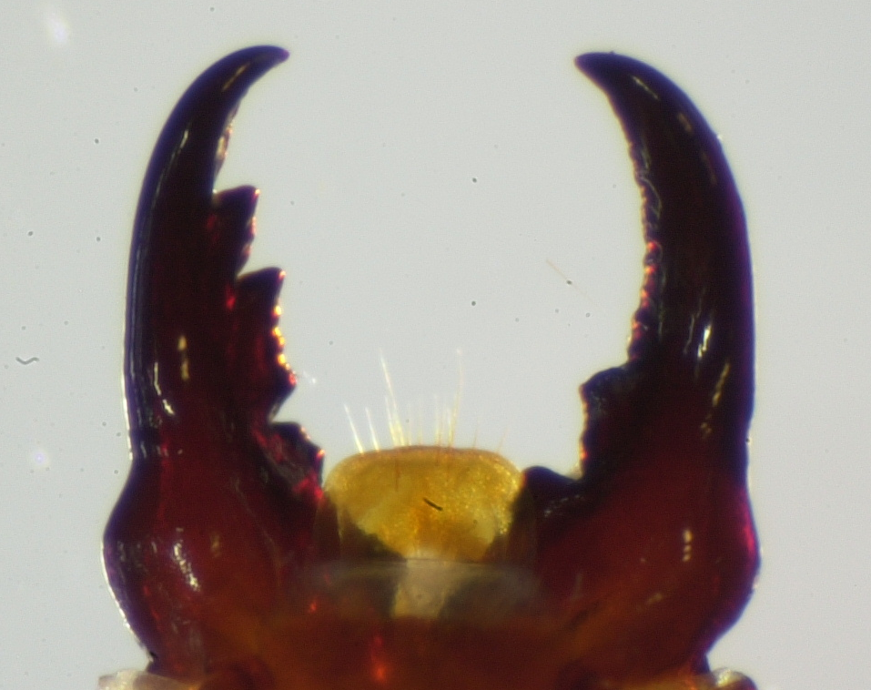
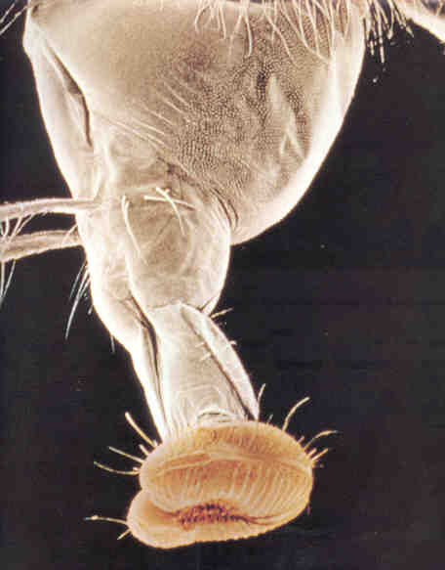
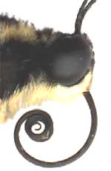
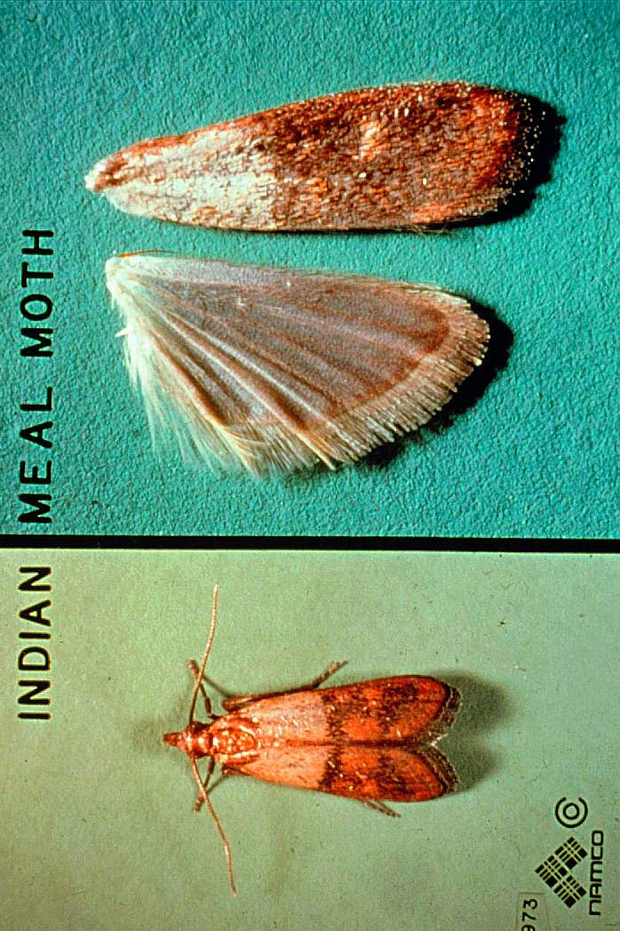
9. Which two characteristics are used most often identify insects?
c. Mouthparts & wings

Slide 21
What two characteristics do insects have that no other organisms have?
Two pair of wings and three body regions
Three body regions and three pair of legs
Four body regions and three pair of legs
One pair of legs on each body segment and
one pair of wings

Slide 22
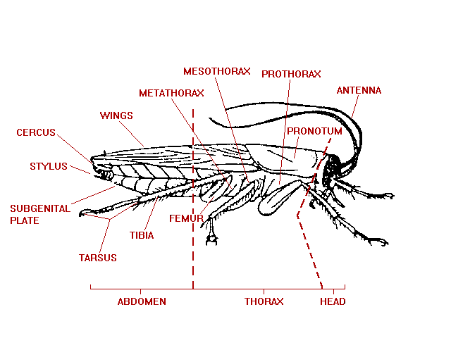
What two characteristics do insects have that no other organisms have?
b. Three body regions and three pair of legs

Slide 23
What is the shedding of the insect “skin” called?
Photosynthesis
Synergy
Thigmotaxis
Molting

Slide 24
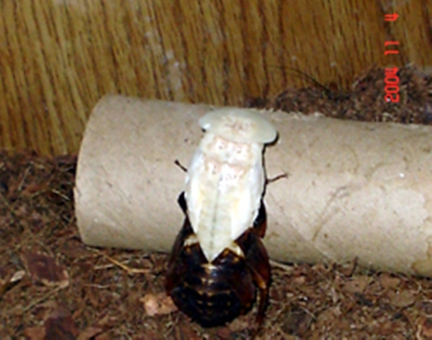
What is the shedding of the insect “skin” called?
d. Molting
Insects have a hard exoskeleton that does not grow. For an
insect to grow, it must split its exoskeleton along its back, and
it must crawl out of it. Its new exoskeleton, accordion-like in
nature, becomes larger once it is extended, and it usually
becomes pigmented within a few hours.

Slide 25
What is the name of the stage between each molt called?
Larva
Instar
Pupa
Naiad

Slide 26
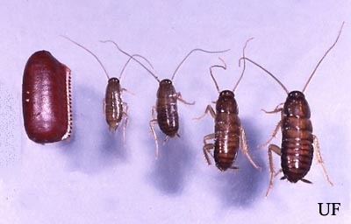
What is the name of the stage between each molt called?
b. Instar
1st 2nd 3rd 4th
1st through the 4th instars of 7 American
Cockroach instars

Slide 27
What kind of metamorphosis do ants have?
No metamorphosis
Gradual metamorphosis
Incomplete metamorphosis
Complete metamorphosis

Slide 28
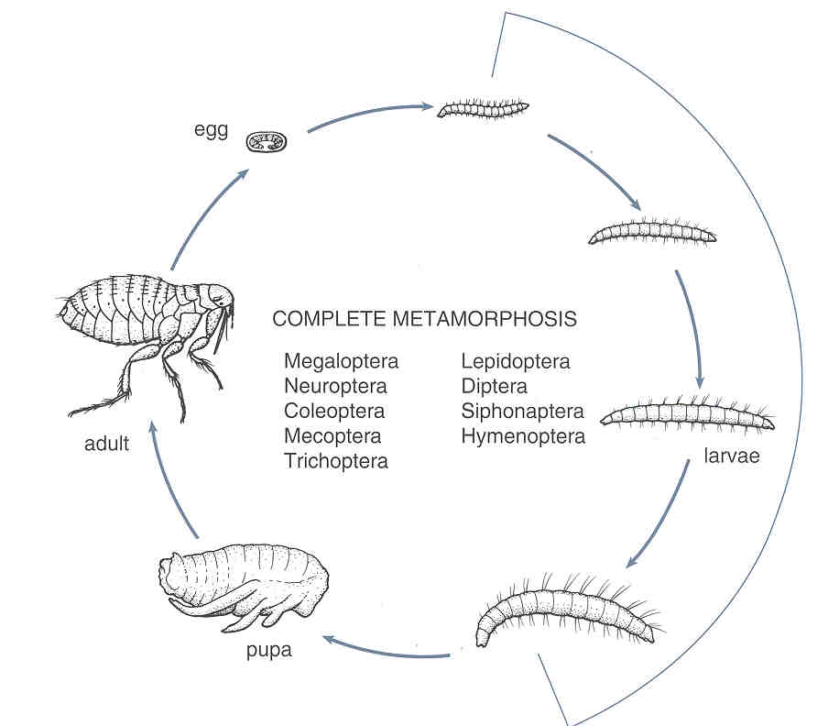
What kind of metamorphosis do ants have?
Egg
Larva
Pupa
Adult
d. Complete metamorphosis
“a complete change”
Notice how different the larva and adult are!
They both have different types of mouthparts.

Slide 29
What kind of metamorphosis do fleas have?
No metamorphosis
Gradual metamorphosis
Incomplete metamorphosis
Complete metamorphosis

Slide 30
What kind of metamorphosis do fleas have?
The Larval
stage looks
completely
different
from the
Adult stage
d. Complete metamorphosis
Egg
Larva
Pupa
Adult
The Pupal stage is
called the “resting
stage” because it
does not generally
move and does not
eat

Slide 31
What kind of metamorphosis do cockroaches have?
No metamorphosis
b. Gradual metamorphosis
Incomplete metamorphosis
d. Complete metamorphosis

Slide 32
What kind of metamorphosis do cockroaches have?
b. Gradual metamorphosis
Nymphs don’t
have wings,
but the Adults
do have wings
Egg
Nymph
Adult

Slide 33
What kind of metamorphosis do silverfish and firebrats have?
No metamorphosis
Gradual metamorphosis
Incomplete metamorphosis
Complete metamorphosis

Slide 34
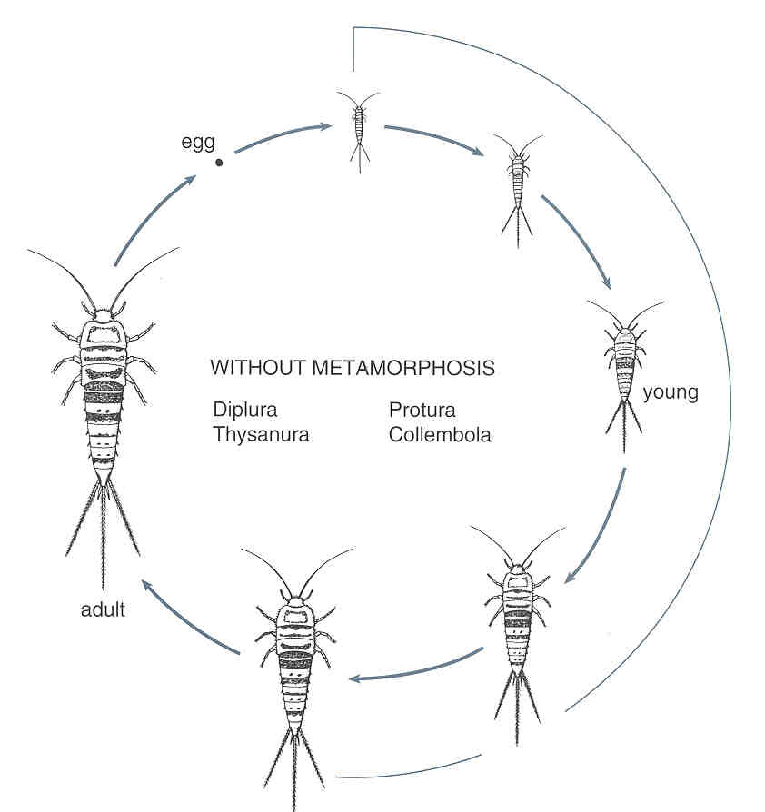
What kind of metamorphosis do silverfish and firebrats have?
a. No metamorphosis
(Ametamorphosis or Without Metamorphosis)
Both young
and adults do not have wings
egg
young
adult

Slide 35
What kind of metamorphosis do dragonflies and damselflies have?
No metamorphosis
Gradual metamorphosis
Incomplete metamorphosis
Complete metamorphosis

Slide 36
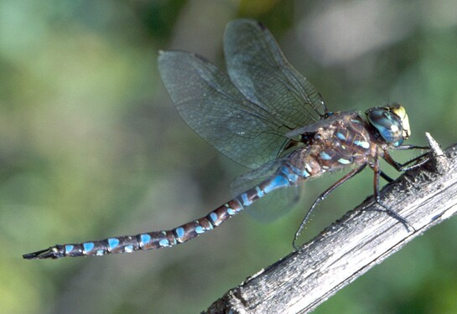

What kind of metamorphosis do dragonflies and damselflies have?
adult
c. Incomplete metamorphosis
naiad
It’s an immature form that lives in
the H2O and breathes by means of gills
egg

Slide 37
What kind of metamorphosis do termites have?
No metamorphosis
Gradual metamorphosis
Incomplete metamorphosis
Complete metamorphosis

Slide 38
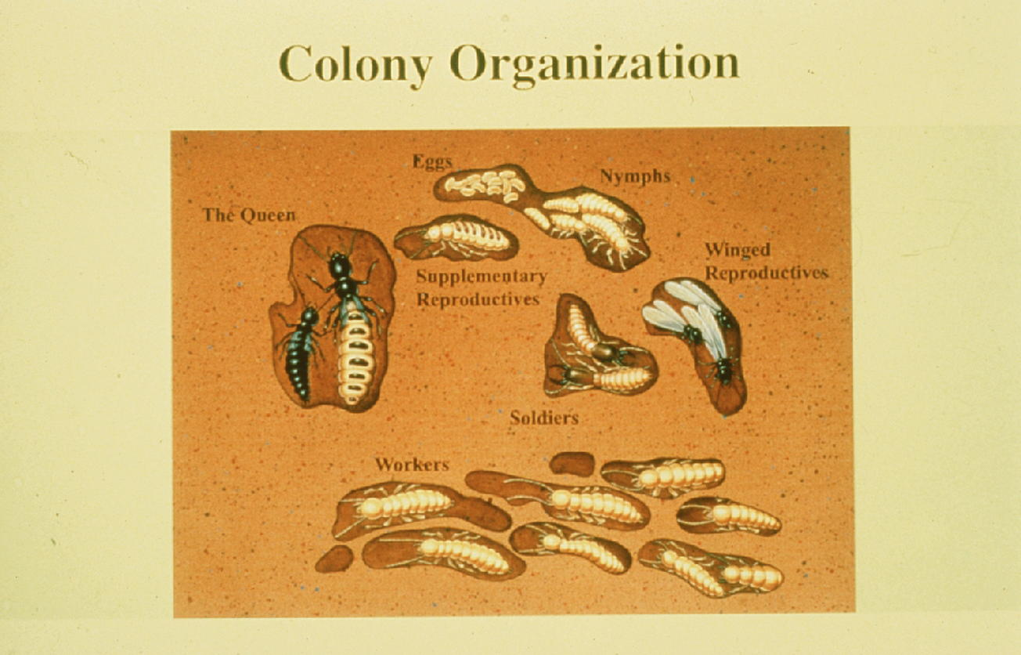
What kind of metamorphosis do termites have?
eggs
nymphs
adults
b. Gradual metamorphosis

Slide 39
What kind of metamorphosis do flies have?
No metamorphosis
Gradual metamorphosis
Incomplete metamorphosis
Complete metamorphosis

Slide 40
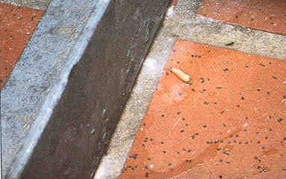
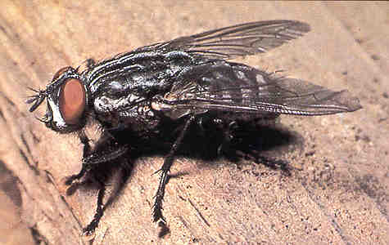
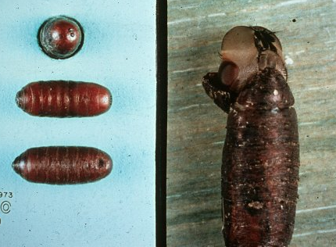
What kind of metamorphosis do flies have?
Egg
Complete
Metamorphosis
Larva
Adult
Pupa

Slide 41


Slide 42
What stages of insects are present in gradual metamorphosis?
Egg, young, adult
Egg, naiad, adult
Egg, nymph, adult
Egg, larva, pupa, adult

Slide 43
What stages of insects are present in gradual metamorphosis?
c. Egg, nymph, adult
The adult stage usually has wings

Slide 44
What stages of insects are present in complete metamorphosis?
Egg, young, adult
Egg, naiad, adult
Egg, nymph, adult
Egg, larva, pupa, adult

Slide 45
What stages of insects are present in complete metamorphosis?
d. Egg, larva, pupa, adult
If it has a larval
or a pupal stage,
it must have
Complete
Metamorphosis

Slide 46
What stages of insects are present in no metamorphosis?
Egg, young, adult
Egg, naiad, adult
Egg, nymph, adult
Egg, larva, pupa, adult

Slide 47
What stages of insects are present in no metamorphosis?
Both the young and the adult stages do
not have wings
a. Egg, young, adult

Slide 48
What stages of insects are present in incomplete metamorphosis?
Egg, young, adult
Egg, naiad, adult
Egg, nymph, adult
Egg, larva, pupa, adult

Slide 49
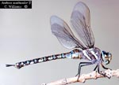
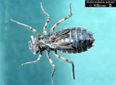
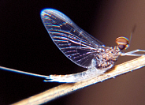
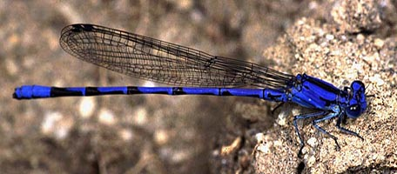
What stages of insects are present in incomplete metamorphosis?
b. Egg, naiad, adult
Dragonfly
The immature
stage (naiad)
lives in water
and breathes with gills
Damselfly
Mayfly

Slide 50
24. Insects have an __________ skeleton.
Internal
External

Slide 51
24. Insects have an __________ skeleton.
External
b. External (exoskeleton)

Slide 52
Which segment of an insect’s legs is attached to the body?
Femur
Tibia
Tarsus
Coxa
Pretarsus
Trochanter

Slide 53
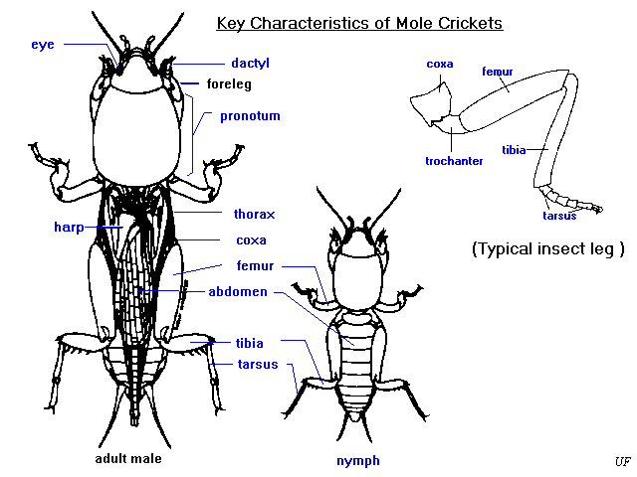
Which segment of an insect’s legs is attached to the body?
d. Coxa
d. Coxa

Slide 54
What part of an insect’s leg is furthest away from the insect’s body?
Femur
Tibia
Tarsus
Coxa
Pretarsus
Trochanter

Slide 55
What part of an insect’s leg is furthest away from the insect’s body?
away from the insect’s body?
e. Pretarus
(tarsal claw)

Slide 56
27. An insect’s antennae are used to detect:
Odors
Touch
Hearing
All of the above
None of the above

Slide 57
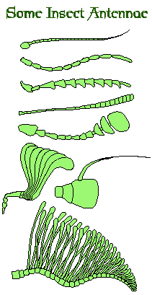
27. An insect’s antennae are used to detect:
d. All of the above
Including: Touch
Air
Motion
Heat
Vibration (sound)
Olfaction (smell or taste)

Slide 58
The circulatory system of an insect is a
__________ system.
Open
Closed

Slide 59
The circulatory system of an insect is a
__________ system.
a. Open

Slide 60
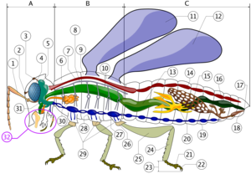
Insect blood flows
forward from the chambers of the hearts to the dorsal aorta and onto the brain and then flows throughout the body through
systolic movements
Dorsal aorta
Chambers of insect heart

Slide 61
29. Insect blood is _____________.
Transparent
Yellow
Red
Green

Slide 62
29. Insect blood is _____________.
a. Transparent

Slide 63
30. The nervous system is __________.
Dorsal
Ventral

Slide 64
30. The nervous system is __________.
Ventral
Insect brain
Ventral nerve cord (including ganglia)

Slide 65
Insects excrete wastes through:
Spiracles
Ostia
Malpighian tubules
Ocelli

Slide 66
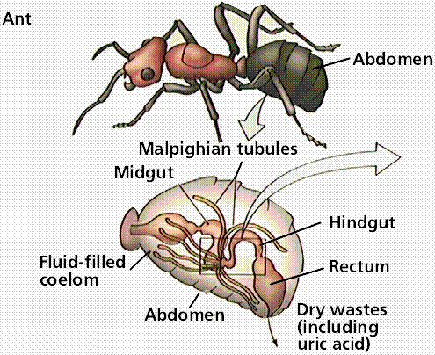
Insects excrete wastes through:
c. Malpighian tubules

Slide 67
Malpighian tubules absorb wastes from the blood
The wastes are then excreted through the alimentary
canal and out the anus

Slide 68
The valves that open and close the insect’s respiratory system are called:
Ocelli
Cerci
Ostia
Spiracles

Slide 69
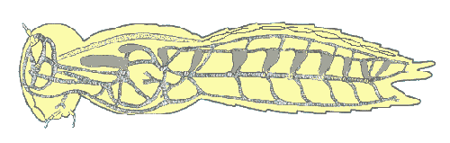
The valves that open and close the insect’s respiratory system are called:
d. Spiracles
(They connect with trachea)

Slide 70
How many pairs of wings do flies & mosquitoes have?
None
One
Two
Three

Slide 71
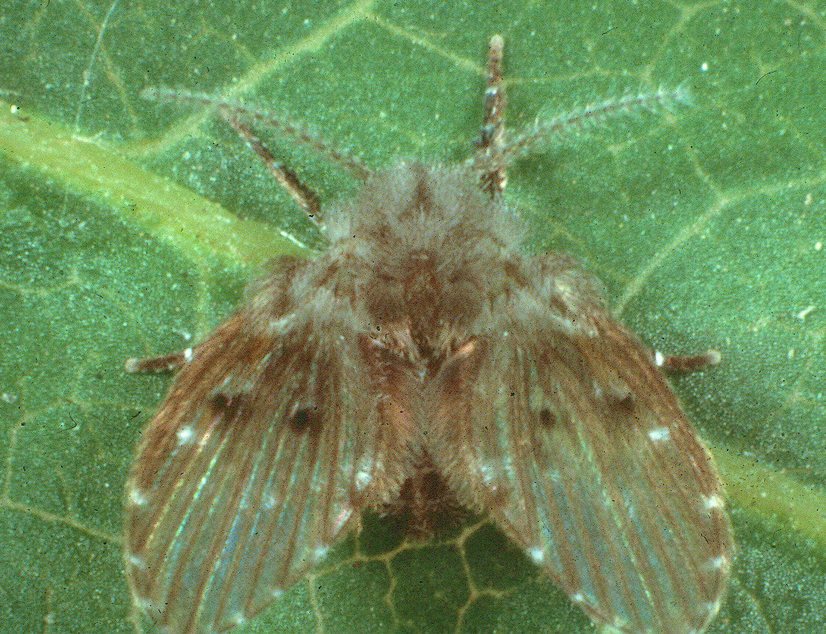
How many pairs of wings do flies & mosquitoes have?
b. One pair

Slide 72
Flies have a pair of balancing organs called ____________.
Ocelli
Cerci
Halteres
Spiracles

Slide 73

Flies have a pair of balancing organs called
____________.
c. Halteres

Slide 74
35. Ants have a slim waist between their thorax and abdomen which is called a ____.
Funicle
Gaster
Furcula
Pedicle

Slide 75
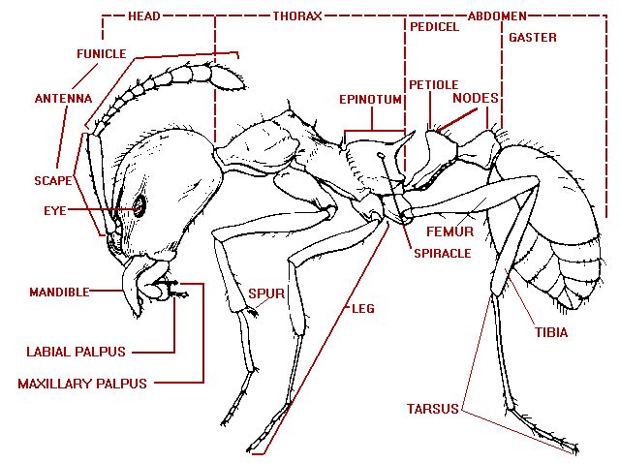
35. Ants have a slim waist between their thorax and abdomen which is called a ____.
Pedicle
d. Pedicle
It has 1 or 2 nodes

Slide 76
36. Springtails have a structure attached to their abdomen that is shaped like a fork, is used to propel the insect when disturbed and is called a ________.
Ocellus
Cerci
Furcula
Ostia

Slide 77
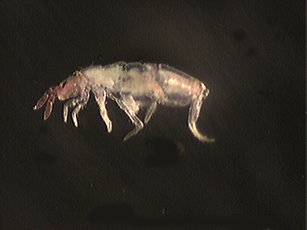
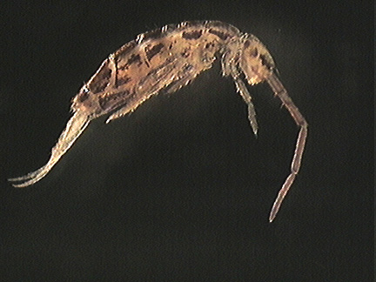
36. Springtails have a structure attached to their abdomen that is shaped like a fork, is used to propel the insect when disturbed and is called a ________.
c. Furcula

Slide 78
Earwigs have have a pair of pinchers at the end of their abdomen called:
Ocelli
Cerci
Furcula
Ostia

Slide 79
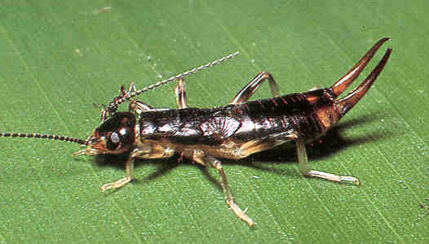
Earwigs have have a pair of pinchers at the end of their abdomen called:
b. Cerci

Slide 80
A ____________ enhances the activity of a pesticide.
Synergist
Thigmotaxis
Hormone
Viagra

Slide 81
A ____________ enhances the activity of a pesticide.
a. Synergist
Piperonyl butoxide
and MGK264 are
two synergists that
are always used with
Pyrethrum

Slide 82
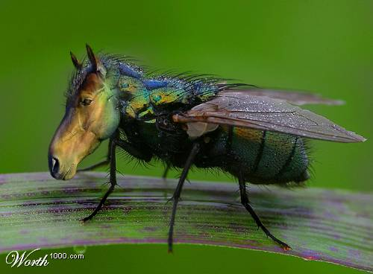
What kind of mouthparts do horseflies have?
Chewing
Biting/piercing-sucking
Siphoning
Sponging-lapping
Rasping

Slide 83
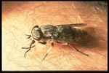
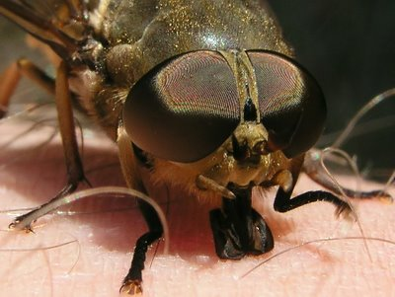
What kind of mouthparts do horseflies have?
b. Biting/piercing-sucking

Slide 84
What kind of mouthparts do cockroaches have?
Chewing
Biting/piercing-sucking
Siphoning
Sponging-lapping
Rasping

Slide 85
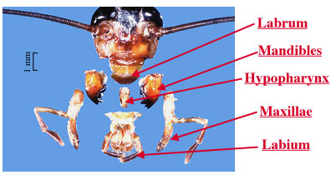
What kind of mouthparts do cockroaches have?
a. Chewing

Slide 86
What kind of mouthparts do mosquitoes have?
Chewing
Biting/piercing-sucking
Siphoning
Sponging-lapping
Rasping

Slide 87
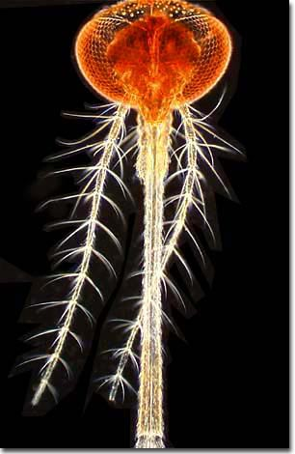
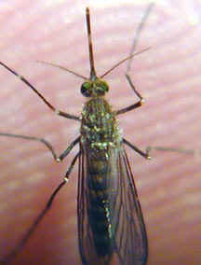
What kind of mouthparts do mosquitoes have?
b. Biting/piercing-sucking

Slide 88
What kind of mouthparts do butterflies and moths have?
Chewing
Biting/piercing-sucking
Siphoning
Sponging-lapping
Rasping

Slide 89
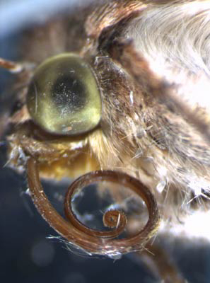
What kind of mouthparts do butterflies and moths have?
Clothes moths
have siphoning mouthparts
but do not feed
Moths & Butterflies
suck-up nectar from
plants and flowers.
c. Siphoning

Slide 90
What kind of mouthparts do termites have?
Chewing
Biting/piercing-sucking
Siphoning
Sponging-lapping
Rasping

Slide 91
What kind of mouthparts do termites have?
a. Chewing
The mandibles
of this soldier
termite are for
fighting rather
than for
feeding.

Slide 92
What kind of mouthparts do beetles have?
Chewing
Biting/piercing-sucking
Siphoning
Sponging-lapping
Rasping

Slide 93

What kind of mouthparts do beetles have?
a. Chewing

Slide 94
What kind of mouthparts do house flies have?
Chewing
Biting/piercing-sucking
Siphoning
Sponging-lapping
Rasping

Slide 95
What kind of mouthparts do house flies have?
d. Sponging-lapping
Houseflies vomit up
an enzyme that
dissolves solid food
to a liquid and then sponges it up.

Slide 96
Which part of the chewing mouthparts tears and rips food apart?
Labrum
Labium
Mandible
Maxillae

Slide 97
Which part of the chewing mouthparts tears and rips food apart?
c. Mandible
Mandible

Slide 98
Insects have simple eyes called:
Ocelli
Cerci
Ostia
Nodes

Slide 99

Insects have simple eyes called:
a. Ocelli
An ocellus is probably used by insects to view the horizon and to adapt to changes in
light

Slide 100
Insects have a pair of compound eyes, each which contain many lenses or ____________.
Ostia
Ommatidia
Spiracles
Malpighian tubules

Slide 101


Insects have a pair of compound eyes, each which contain many lenses or ____________.
b. Ommatidia

Slide 102

Ommatidia of Compound Eyes
Dragonflies can
have thousands
of ommatidia in
each compound
eye

Slide 103
The scientific name of the House fly is:
Musca domestica
Musca Domestica or Musca Domestica
c. Musca domestica or Musca domestica
MUSCA DOMESTICA

Slide 104
The scientific name of the House fly is:
c. Musca domestica or
Musca domestica
ie: Blatella germanica

Slide 105
Which of the following Arthropods have four pairs of legs, two body regions, no antennae and no wings?
Insects - Insecta
Centipedes - Chilopoda
Millipedes – Diplopoda
Arachnids - Arachnida
Crustaceans - Crustacea

Slide 106






Which of the following Arthropods have four pairs of legs, two body regions, no antennae and no wings?
d. Arachnids – Class Arachnida

Slide 107
51. Which of the following Arthropods have many segments on them, all with one pair of legs, the first pair of which are modified into fangs and connected to a poison gland?
Insects
Centipedes
Millipedes
Arachnids
Crustaceans

Slide 108

51. Which of the following Arthropods have many segments on them, all with one pair of legs, the first pair of which are modified into fangs and connected to a poison gland?
b. Centipedes
Class Chilopoda
The house centipede is the only centipede with long legs

Slide 109
52. Which of the following Arthropods have many segments on them, all of which contain two pairs of legs…connected to the bottom of its cylindrically-shaped body?
Insects
Centipedes
Millipedes
Arachnids
Crustaceans

Slide 110

52. Which of the following Arthropods have many segments on them, all of which contain two pairs of legs…connected to the bottom of its cylindrically-shaped body?
c. Millipedes – Class Diplopoda

Slide 111
53. Which of the following Arthropods have at least 5 pairs of legs and breathe by means of gills?
Insects
Centipedes
Millipedes
Arachnids
Crustaceans

Slide 112

53. Which of the following Arthropods have at least 5 pairs of legs and breathe by means of gills?
e. Crustaceans

Slide 113
54. Pillbugs:
Are Crustaceans
Roll-up into a ball
Breathe by means of gills
All of the above

Slide 114



54. Pillbugs:
Are Crustaceans
Roll-up into a ball
Breathe by means
of gills
d. All of the above

Slide 115
55. Centipedes (Class Chilopoda):
Feed on organic material
Feed on nectar and pollen
Feed on live insects and spiders
Do not feed

Slide 116

55. Centipedes:
(are predators)
c. Feed on live insects and spiders

Slide 117
56. Millipedes (Class Diplopoda):
Feed on organic material
Feed on nectar and pollen
Feed on live insects and spiders
Do not feed

Slide 118

56. Millipedes:
a. Feed on organic material

Slide 119
57. All insects are pests.
True
False

Slide 120

57. All insects are pests.
Ladybug larvae and adults are predators
of detrimental agricultural & ornamental
pests.
Honey bees pollinate plants and produce
honey.
b. False

Slide 121
Approximately how many different insect species are there?
10,000
100,000
500,000
1,000,000
10,000,000

Slide 122
Approximately how many different insect species are there?
d. 1,000,000

Slide 123
59. The scientific name of the norway rat is:
Rattus norvegicus
Rattus rattus
Mus domesticus
Norvegicus rattus

Slide 124

59. The scientific name of the norway rat is:
a. Rattus norvegicus

Slide 125
The scientific name of the roof rat is:
Rattus norvegicus
Rattus rattus
Mus domesticus
Norvegicus rattus

Slide 126

The scientific name of the roof rat is:
b. Rattus rattus

Slide 127
Botanicals (Plant derived)
Pyrethrum
Abamectin (AVERT)
D-limonene
Rotenone
Red Squill
Capsecium

Slide 128
Inorganic (Minerals)
Silica gel (Amorphous silica)
Diatomaceous earth
Limestone
Boric acid
Borates
Sodium fluoride
Dessicants
Stomach
poisons

Slide 129
Synthetic Pyrethroids
Fenvalerate
Resmethrin
Allethrin
Phenothrin
Permethrin
Cypermethrin
Cyfluthrin
Lambda cyhalathrin
Deltamethrin
Bifenthrin

Slide 130
Organophosphates (OPs)
Diazinon
DDVP (Vapona)
Chloropyrifos (Dursban)
Acephate (Orthene)
Malathion
Propetamphos (Catalyst)
Pryfon
The antidote is ATROPINE
3 Ds
3
Smelly ones
The one that
didn’t work

Slide 131
Carbamates
Bendiocarb (Ficam)
Carbaryl (Sevin)
Propoxur (Baygon)
The antidote is ATROPINE & 2PAM

Slide 132
Chlorinated Hydrocarbons
Chlordane
Heptachlor
Aldrin
Dieldrin
Lindane
BHC
Kelthane
Paradichlorobenzene
DDT
Termiticides
Have a long
residual life

Slide 133
Other Neurotransmitters
Hydramethylnon (Maxforce & Siege)
Sulfuramid (Dual Choice Pro Control)
Imidacloprid (Premise)
Fipronil (Termidor, Maxforce, Frontline)
Chlorfenapyr (Phantom)
Newer
non-
repellent
pesticides

Slide 134
Insect Growth Regulators (IGRs)
Hydroprene (Gentrol)
Methoprene (Precor)
Pyriproxyfen (Nylar, Archer)
Fenoxycarb (Torus)
Hexaflumuron (Sentricon)
Noviflumuron (Sentricon)
Diflubenzuron (Exterra, Advance)
Lufenuron (Program)
Termiticide
baits

Slide 135
Fumigants
Methyl bromide
Sulfuryl fluoride (Vikane)
Phostoxin
Magtoxin
Chloropicrin
Calcium cyanide

Slide 136
Single-feeding Anticoagulant
Second generation anticoagulants
Brodifacoum (Talon)
Bromadiolone (Maki, Contract)
Difethialone (Generation)
The antidote is Vitamin K-1

Slide 137
Multiple-feeding Anticoagulant
First generation anticoagulants
Warfarin
Diphacinone
Chlorophacinone
Pival or Pivalyn
The antidote is Vitamin K-1

Slide 138
Acute Rodenticides
Zinc Phosphide
Bromethalin (Vengeance)
Cholecalciferol (Quintox)
The following acute rodenticides were used in the past:
Strychnine Antu Red Squill
(sodium fluoroacetate) Phosphorus paste

Slide 139
61 – 80. Which classes of pesticides (a. – j.) do the following pesticides belong to?
Botanical (Plant derived) 61. Chlordane 75. Malathion
Synthetic pyrethroid 62. Silica aerogel 76. Ficam
Organophosphate (OP’s) 63. Pyrethrum 77. Nylar
Carbamate 64. Gentrol 78. Quintox
Chlorinated hydrocarbon 65. Diphacinone 79. Orthene
Inorganic (mineral) 66. Vikane 80. Lindane
IGR 67. Diazinon
Fumigant 68. Baygon
Acute rodenticide 69. Hexaflumeron
Anticoagulant rodenticide 70. Demon
71. Vengeance
72. Tempo
73. Avert
74. Boric acid

Slide 140
61 – 80. Which classes of pesticides (a. – j.) do the following pesticides belong to?
Botanical (Plant derived) 61. Chlordane 75. Malathion
Synthetic pyrethroid 62. Silica aerogel 76. Ficam
Organophosphate (OP’s) 63. Pyrethrum 77. Nylar
Carbamate 64. Gentrol 78. Quintox
Chlorinated hydrocarbon 65. Diphacinone 79. Orthene
Inorganic (mineral) 66. Vikane 80. Lindane
IGR 67. Diazinon
Fumigant 68. Baygon
Acute rodenticide 69. Hexaflumeron
Anticoagulant rodenticide 70. Demon
71. Vengeance
72. Tempo
73. Avert
74. Boric acid

Slide 141
61 – 80. Which classes of pesticides (a. – j.) do the following pesticides belong to?
Botanical (Plant derived) 61. Chlordane 75. Malathion
Synthetic pyrethroid 62. Silica aerogel 76. Ficam
Organophosphate (OP’s) 63. Pyrethrum 77. Nylar
Carbamate 64. Gentrol 78. Quintox
Chlorinated hydrocarbon 65. Diphacinone 79. Orthene
Inorganic (mineral) 66. Vikane 80. Lindane
IGR 67. Diazinon
Fumigant 68. Baygon
Acute rodenticide 69. Hexaflumeron
Anticoagulant rodenticide 70. Demon
71. Vengeance
72. Tempo
73. Avert
74. Boric acid

Slide 142
61 – 80. Which classes of pesticides (a. – j.) do the following pesticides belong to?
Botanical (Plant derived) 61. Chlordane 75. Malathion
Synthetic pyrethroid 62. Silica aerogel 76. Ficam
Organophosphate (OP’s) 63. Pyrethrum 77. Nylar
Carbamate 64. Gentrol 78. Quintox
Chlorinated hydrocarbon 65. Diphacinone 79. Orthene
Inorganic (mineral) 66. Vikane 80. Lindane
IGR 67. Diazinon
Fumigant 68. Baygon
Acute rodenticide 69. Hexaflumeron
Anticoagulant rodenticide 70. Demon
71. Vengeance
72. Tempo
73. Avert
74. Boric acid

Slide 143
61 – 80. Which classes of pesticides (a. – j.) do the following pesticides belong to?
Botanical (Plant derived) 61. Chlordane 75. Malathion
Synthetic pyrethroid 62. Silica aerogel 76. Ficam
Organophosphate (OP’s) 63. Pyrethrum 77. Nylar
Carbamate 64. Gentrol 78. Quintox
Chlorinated hydrocarbon 65. Diphacinone 79. Orthene
Inorganic (mineral) 66. Vikane 80. Lindane
IGR 67. Diazinon
Fumigant 68. Baygon
Acute rodenticide 69. Hexaflumeron
Anticoagulant rodenticide 70. Demon
71. Vengeance
72. Tempo
73. Avert
74. Boric acid

Slide 144
61 – 80. Which classes of pesticides (a. – j.) do the following pesticides belong to?
Botanical (Plant derived) 61. Chlordane 75. Malathion
Synthetic pyrethroid 62. Silica aerogel 76. Ficam
Organophosphate (OP’s) 63. Pyrethrum 77. Nylar
Carbamate 64. Gentrol 78. Quintox
Chlorinated hydrocarbon 65. Diphacinone 79. Orthene
Inorganic (mineral) 66. Vikane 80. Lindane
IGR 67. Diazinon
Fumigant 68. Baygon
Acute rodenticide 69. Hexaflumeron
Anticoagulant rodenticide 70. Demon
71. Vengeance
72. Tempo
73. Avert
74. Boric acid

Slide 145
61 – 80. Which classes of pesticides (a. – j.) do the following pesticides belong to?
Botanical (Plant derived) 61. Chlordane 75. Malathion
Synthetic pyrethroid 62. Silica aerogel 76. Ficam
Organophosphate (OP’s) 63. Pyrethrum 77. Nylar
Carbamate 64. Gentrol 78. Quintox
Chlorinated hydrocarbon 65. Diphacinone 79. Orthene
Inorganic (mineral) 66. Vikane 80. Lindane
IGR 67. Diazinon
Fumigant 68. Baygon
Acute rodenticide 69. Hexaflumeron
Anticoagulant rodenticide 70. Demon
71. Vengeance
72. Tempo
73. Avert
74. Boric acid

Slide 146
61 – 80. Which classes of pesticides (a. – j.) do the following pesticides belong to?
Botanical (Plant derived) 61. Chlordane 75. Malathion
Synthetic pyrethroid 62. Silica aerogel 76. Ficam
Organophosphate (OP’s) 63. Pyrethrum 77. Nylar
Carbamate 64. Gentrol 78. Quintox
Chlorinated hydrocarbon 65. Diphacinone 79. Orthene
Inorganic (mineral) 66. Vikane 80. Lindane
IGR 67. Diazinon
Fumigant 68. Baygon
Acute rodenticide 69. Hexaflumeron
Anticoagulant rodenticide 70. Demon
71. Vengeance
72. Tempo
73. Avert
74. Boric acid

Slide 147
61 – 80. Which classes of pesticides (a. – j.) do the following pesticides belong to?
Botanical (Plant derived) 61. Chlordane 75. Malathion
Synthetic pyrethroid 62. Silica aerogel 76. Ficam
Organophosphate (OP’s) 63. Pyrethrum 77. Nylar
Carbamate 64. Gentrol 78. Quintox
Chlorinated hydrocarbon 65. Diphacinone 79. Orthene
Inorganic (mineral) 66. Vikane 80. Lindane
IGR 67. Diazinon
Fumigant 68. Baygon
Acute rodenticide 69. Hexaflumeron
Anticoagulant rodenticide 70. Demon
71. Vengeance
72. Tempo
73. Avert
74. Boric acid

Slide 148
61 – 80. Which classes of pesticides (a. – j.) do the following pesticides belong to?
Botanical (Plant derived) 61. Chlordane 75. Malathion
Synthetic pyrethroid 62. Silica aerogel 76. Ficam
Organophosphate (OP’s) 63. Pyrethrum 77. Nylar
Carbamate 64. Gentrol 78. Quintox
Chlorinated hydrocarbon 65. Diphacinone 79. Orthene
Inorganic (mineral) 66. Vikane 80. Lindane
IGR 67. Diazinon
Fumigant 68. Baygon
Acute rodenticide 69. Hexaflumeron
Anticoagulant rodenticide 70. Demon
71. Vengeance
72. Tempo
73. Avert
74. Boric acid

Slide 149
61 – 80. Which classes of pesticides (a. – j.) do the following pesticides belong to?
Botanical (Plant derived) 61. Chlordane 75. Malathion
Synthetic pyrethroid 62. Silica aerogel 76. Ficam
Organophosphate (OP’s) 63. Pyrethrum 77. Nylar
Carbamate 64. Gentrol 78. Quintox
Chlorinated hydrocarbon 65. Diphacinone 79. Orthene
Inorganic (mineral) 66. Vikane 80. Lindane
IGR 67. Diazinon
Fumigant 68. Baygon
Acute rodenticide 69. Hexaflumeron
Anticoagulant rodenticide 70. Demon
71. Vengeance
72. Tempo
73. Avert
74. Boric acid

Slide 150
61 – 80. Which classes of pesticides (a. – j.) do the following pesticides belong to?
Botanical (Plant derived) 61. Chlordane 75. Malathion
Synthetic pyrethroid 62. Silica aerogel 76. Ficam
Organophosphate (OP’s) 63. Pyrethrum 77. Nylar
Carbamate 64. Gentrol 78. Quintox
Chlorinated hydrocarbon 65. Diphacinone 79. Orthene
Inorganic (mineral) 66. Vikane 80. Lindane
IGR 67. Diazinon
Fumigant 68. Baygon
Acute rodenticide 69. Hexaflumeron
Anticoagulant rodenticide 70. Demon
71. Vengeance
72. Tempo
73. Avert
74. Boric acid

Slide 151
61 – 80. Which classes of pesticides (a. – j.) do the following pesticides belong to?
Botanical (Plant derived) 61. Chlordane 75. Malathion
Synthetic pyrethroid 62. Silica aerogel 76. Ficam
Organophosphate (OP’s) 63. Pyrethrum 77. Nylar
Carbamate 64. Gentrol 78. Quintox
Chlorinated hydrocarbon 65. Diphacinone 79. Orthene
Inorganic (mineral) 66. Vikane 80. Lindane
IGR 67. Diazinon
Fumigant 68. Baygon
Acute rodenticide 69. Hexaflumeron
Anticoagulant rodenticide 70. Demon
71. Vengeance
72. Tempo
73. Avert
74. Boric acid

Slide 152
61 – 80. Which classes of pesticides (a. – j.) do the following pesticides belong to?
Botanical (Plant derived) 61. Chlordane 75. Malathion
Synthetic pyrethroid 62. Silica aerogel 76. Ficam
Organophosphate (OP’s) 63. Pyrethrum 77. Nylar
Carbamate 64. Gentrol 78. Quintox
Chlorinated hydrocarbon 65. Diphacinone 79. Orthene
Inorganic (mineral) 66. Vikane 80. Lindane
IGR 67. Diazinon
Fumigant 68. Baygon
Acute rodenticide 69. Hexaflumeron
Anticoagulant rodenticide 70. Demon
71. Vengeance
72. Tempo
73. Avert
74. Boric acid

Slide 153
61 – 80. Which classes of pesticides (a. – j.) do the following pesticides belong to?
Botanical (Plant derived) 61. Chlordane 75. Malathion
Synthetic pyrethroid 62. Silica aerogel 76. Ficam
Organophosphate (OP’s) 63. Pyrethrum 77. Nylar
Carbamate 64. Gentrol 78. Quintox
Chlorinated hydrocarbon 65. Diphacinone 79. Orthene
Inorganic (mineral) 66. Vikane 80. Lindane
IGR 67. Diazinon
Fumigant 68. Baygon
Acute rodenticide 69. Hexaflumeron
Anticoagulant rodenticide 70. Demon
71. Vengeance
72. Tempo
73. Avert
74. Boric acid

Slide 154
61 – 80. Which classes of pesticides (a. – j.) do the following pesticides belong to?
Botanical (Plant derived) 61. Chlordane 75. Malathion
Synthetic pyrethroid 62. Silica aerogel 76. Ficam
Organophosphate (OP’s) 63. Pyrethrum 77. Nylar
Carbamate 64. Gentrol 78. Quintox
Chlorinated hydrocarbon 65. Diphacinone 79. Orthene
Inorganic (mineral) 66. Vikane 80. Lindane
IGR 67. Diazinon
Fumigant 68. Baygon
Acute rodenticide 69. Hexaflumeron
Anticoagulant rodenticide 70. Demon
71. Vengeance
72. Tempo
73. Avert
74. Boric acid

Slide 155
61 – 80. Which classes of pesticides (a. – j.) do the following pesticides belong to?
Botanical (Plant derived) 61. Chlordane 75. Malathion
Synthetic pyrethroid 62. Silica aerogel 76. Ficam
Organophosphate (OP’s) 63. Pyrethrum 77. Nylar
Carbamate 64. Gentrol 78. Quintox
Chlorinated hydrocarbon 65. Diphacinone 79. Orthene
Inorganic (mineral) 66. Vikane 80. Lindane
IGR 67. Diazinon
Fumigant 68. Baygon
Acute rodenticide 69. Hexaflumeron
Anticoagulant rodenticide 70. Demon
71. Vengeance
72. Tempo
73. Avert
74. Boric acid

Slide 156
61 – 80. Which classes of pesticides (a. – j.) do the following pesticides belong to?
Botanical (Plant derived) 61. Chlordane 75. Malathion
Synthetic pyrethroid 62. Silica aerogel 76. Ficam
Organophosphate (OP’s) 63. Pyrethrum 77. Nylar
Carbamate 64. Gentrol 78. Quintox
Chlorinated hydrocarbon 65. Diphacinone 79. Orthene
Inorganic (mineral) 66. Vikane 80. Lindane
IGR 67. Diazinon
Fumigant 68. Baygon
Acute rodenticide 69. Hexaflumeron
Anticoagulant rodenticide 70. Demon
71. Vengeance
72. Tempo
73. Avert
74. Boric acid

Slide 157
61 – 80. Which classes of pesticides (a. – j.) do the following pesticides belong to?
Botanical (Plant derived) 61. Chlordane 75. Malathion
Synthetic pyrethroid 62. Silica aerogel 76. Ficam
Organophosphate (OP’s) 63. Pyrethrum 77. Nylar
Carbamate 64. Gentrol 78. Quintox
Chlorinated hydrocarbon 65. Diphacinone 79. Orthene
Inorganic (mineral) 66. Vikane 80. Lindane
IGR 67. Diazinon
Fumigant 68. Baygon
Acute rodenticide 69. Hexaflumeron
Anticoagulant rodenticide 70. Demon
71. Vengeance
72. Tempo
73. Avert
74. Boric acid

Slide 158
61 – 80. Which classes of pesticides (a. – j.) do the following pesticides belong to?
Botanical (Plant derived) 61. Chlordane 75. Malathion
Synthetic pyrethroid 62. Silica aerogel 76. Ficam
Organophosphate (OP’s) 63. Pyrethrum 77. Nylar
Carbamate 64. Gentrol 78. Quintox
Chlorinated hydrocarbon 65. Diphacinone 79. Orthene
Inorganic (mineral) 66. Vikane 80. Lindane
IGR 67. Diazinon
Fumigant 68. Baygon
Acute rodenticide 69. Hexaflumeron
Anticoagulant rodenticide 70. Demon
71. Vengeance
72. Tempo
73. Avert
74. Boric acid

Slide 159
61 – 80. Which classes of pesticides (a. – j.) do the following pesticides belong to?
Botanical (Plant derived) 61. Chlordane 75. Malathion
Synthetic pyrethroid 62. Silica aerogel 76. Ficam
Organophosphate (OP’s) 63. Pyrethrum 77. Nylar
Carbamate 64. Gentrol 78. Quintox
Chlorinated hydrocarbon 65. Diphacinone 79. Orthene
Inorganic (mineral) 66. Vikane 80. Lindane
IGR 67. Diazinon
Fumigant 68. Baygon
Acute rodenticide 69. Hexaflumeron
Anticoagulant rodenticide 70. Demon
71. Vengeance
72. Tempo
73. Avert
74. Boric acid

Slide 160
61 – 80. Which classes of pesticides (a. – j.) do the following pesticides belong to?
Botanical (Plant derived) 61. Chlordane 75. Malathion
Synthetic pyrethroid 62. Silica aerogel 76. Ficam
Organophosphate (OP’s) 63. Pyrethrum 77. Nylar
Carbamate 64. Gentrol 78. Quintox
Chlorinated hydrocarbon 65. Diphacinone 79. Orthene
Inorganic (mineral) 66. Vikane 80. Lindane
IGR 67. Diazinon
Fumigant 68. Baygon
Acute rodenticide 69. Hexaflumeron
Anticoagulant rodenticide 70. Demon
71. Vengeance
72. Tempo
73. Avert
74. Boric acid

Slide 161
61 – 80. Which classes of pesticides (a. – j.) do the following pesticides belong to?
Botanical (Plant derived) 61. Chlordane 75. Malathion
Synthetic pyrethroid 62. Silica aerogel 76. Ficam
Organophosphate (OP’s) 63. Pyrethrum 77. Nylar
Carbamate 64. Gentrol 78. Quintox
Chlorinated hydrocarbon 65. Diphacinone 79. Orthene
Inorganic (mineral) 66. Vikane 80. Lindane
IGR 67. Diazinon
Fumigant 68. Baygon
Acute rodenticide 69. Hexaflumeron
Anticoagulant rodenticide 70. Demon
71. Vengeance
72. Tempo
73. Avert
74. Boric acid

Slide 162
61 – 80. Which classes of pesticides (a. – j.) do the following pesticides belong to?
Botanical (Plant derived) 61. Chlordane 75. Malathion
Synthetic pyrethroid 62. Silica aerogel 76. Ficam
Organophosphate (OP’s) 63. Pyrethrum 77. Nylar
Carbamate 64. Gentrol 78. Quintox
Chlorinated hydrocarbon 65. Diphacinone 79. Orthene
Inorganic (mineral) 66. Vikane 80. Lindane
IGR 67. Diazinon
Fumigant 68. Baygon
Acute rodenticide 69. Hexaflumeron
Anticoagulant rodenticide 70. Demon
71. Vengeance
72. Tempo
73. Avert
74. Boric acid

Slide 163
61 – 80. Which classes of pesticides (a. – j.) do the following pesticides belong to?
Botanical (Plant derived) 61. Chlordane 75. Malathion
Synthetic pyrethroid 62. Silica aerogel 76. Ficam
Organophosphate (OP’s) 63. Pyrethrum 77. Nylar
Carbamate 64. Gentrol 78. Quintox
Chlorinated hydrocarbon 65. Diphacinone 79. Orthene
Inorganic (mineral) 66. Vikane 80. Lindane
IGR 67. Diazinon
Fumigant 68. Baygon
Acute rodenticide 69. Hexaflumeron
Anticoagulant rodenticide 70. Demon
71. Vengeance
72. Tempo
73. Avert
74. Boric acid

Slide 164
61 – 80. Which classes of pesticides (a. – j.) do the following pesticides belong to?
Botanical (Plant derived) 61. Chlordane 75. Malathion
Synthetic pyrethroid 62. Silica aerogel 76. Ficam
Organophosphate (OP’s) 63. Pyrethrum 77. Nylar
Carbamate 64. Gentrol 78. Quintox
Chlorinated hydrocarbon 65. Diphacinone 79. Orthene
Inorganic (mineral) 66. Vikane 80. Lindane
IGR 67. Diazinon
Fumigant 68. Baygon
Acute rodenticide 69. Hexaflumeron
Anticoagulant rodenticide 70. Demon
71. Vengeance
72. Tempo
73. Avert
74. Boric acid

Slide 165
61 – 80. Which classes of pesticides (a. – j.) do the following pesticides belong to?
Botanical (Plant derived) 61. Chlordane 75. Malathion
Synthetic pyrethroid 62. Silica aerogel 76. Ficam
Organophosphate (OP’s) 63. Pyrethrum 77. Nylar
Carbamate 64. Gentrol 78. Quintox
Chlorinated hydrocarbon 65. Diphacinone 79. Orthene
Inorganic (mineral) 66. Vikane 80. Lindane
IGR 67. Diazinon
Fumigant 68. Baygon
Acute rodenticide 69. Hexaflumeron
Anticoagulant rodenticide 70. Demon
71. Vengeance
72. Tempo
73. Avert
74. Boric acid

Slide 166
61 – 80. Which classes of pesticides (a. – j.) do the following pesticides belong to?
Botanical (Plant derived) 61. Chlordane 75. Malathion
Synthetic pyrethroid 62. Silica aerogel 76. Ficam
Organophosphate (OP’s) 63. Pyrethrum 77. Nylar
Carbamate 64. Gentrol 78. Quintox
Chlorinated hydrocarbon 65. Diphacinone 79. Orthene
Inorganic (mineral) 66. Vikane 80. Lindane
IGR 67. Diazinon
Fumigant 68. Baygon
Acute rodenticide 69. Hexaflumeron
Anticoagulant rodenticide 70. Demon
71. Vengeance
72. Tempo
73. Avert
74. Boric acid

Slide 167
61 – 80. Which classes of pesticides (a. – j.) do the following pesticides belong to?
Botanical (Plant derived) 61. Chlordane 75. Malathion
Synthetic pyrethroid 62. Silica aerogel 76. Ficam
Organophosphate (OP’s) 63. Pyrethrum 77. Nylar
Carbamate 64. Gentrol 78. Quintox
Chlorinated hydrocarbon 65. Diphacinone 79. Orthene
Inorganic (mineral) 66. Vikane 80. Lindane
IGR 67. Diazinon
Fumigant 68. Baygon
Acute rodenticide 69. Hexaflumeron
Anticoagulant rodenticide 70. Demon
71. Vengeance
72. Tempo
73. Avert
74. Boric acid

Slide 168
61 – 80. Which classes of pesticides (a. – j.) do the following pesticides belong to?
Botanical (Plant derived) 61. Chlordane 75. Malathion
Synthetic pyrethroid 62. Silica aerogel 76. Ficam
Organophosphate (OP’s) 63. Pyrethrum 77. Nylar
Carbamate 64. Gentrol 78. Quintox
Chlorinated hydrocarbon 65. Diphacinone 79. Orthene
Inorganic (mineral) 66. Vikane 80. Lindane
IGR 67. Diazinon
Fumigant 68. Baygon
Acute rodenticide 69. Hexaflumeron
Anticoagulant rodenticide 70. Demon
71. Vengeance
72. Tempo
73. Avert
74. Boric acid

Slide 169
61 – 80. Which classes of pesticides (a. – j.) do the following pesticides belong to?
Botanical (Plant derived) 61. Chlordane 75. Malathion
Synthetic pyrethroid 62. Silica aerogel 76. Ficam
Organophosphate (OP’s) 63. Pyrethrum 77. Nylar
Carbamate 64. Gentrol 78. Quintox
Chlorinated hydrocarbon 65. Diphacinone 79. Orthene
Inorganic (mineral) 66. Vikane 80. Lindane
IGR 67. Diazinon
Fumigant 68. Baygon
Acute rodenticide 69. Hexaflumeron
Anticoagulant rodenticide 70. Demon
71. Vengeance
72. Tempo
73. Avert
74. Boric acid

Slide 170
61 – 80. Which classes of pesticides (a. – j.) do the following pesticides belong to?
Botanical (Plant derived) 61. Chlordane 75. Malathion
Synthetic pyrethroid 62. Silica aerogel 76. Ficam
Organophosphate (OP’s) 63. Pyrethrum 77. Nylar
Carbamate 64. Gentrol 78. Quintox
Chlorinated hydrocarbon 65. Diphacinone 79. Orthene
Inorganic (mineral) 66. Vikane 80. Lindane
IGR 67. Diazinon
Fumigant 68. Baygon
Acute rodenticide 69. Hexaflumeron
Anticoagulant rodenticide 70. Demon
71. Vengeance
72. Tempo
73. Avert
74. Boric acid

Slide 171
61 – 80. Which classes of pesticides (a. – j.) do the following pesticides belong to?
Botanical (Plant derived) 61. Chlordane 75. Malathion
Synthetic pyrethroid 62. Silica aerogel 76. Ficam
Organophosphate (OP’s) 63. Pyrethrum 77. Nylar
Carbamate 64. Gentrol 78. Quintox
Chlorinated hydrocarbon 65. Diphacinone 79. Orthene
Inorganic (mineral) 66. Vikane 80. Lindane
IGR 67. Diazinon
Fumigant 68. Baygon
Acute rodenticide 69. Hexaflumeron
Anticoagulant rodenticide 70. Demon
71. Vengeance
72. Tempo
73. Avert
74. Boric acid

Slide 172
61 – 80. Which classes of pesticides (a. – j.) do the following pesticides belong to?
Botanical (Plant derived) 61. Chlordane 75. Malathion
Synthetic pyrethroid 62. Silica aerogel 76. Ficam
Organophosphate (OP’s) 63. Pyrethrum 77. Nylar
Carbamate 64. Gentrol 78. Quintox
Chlorinated hydrocarbon 65. Diphacinone 79. Orthene
Inorganic (mineral) 66. Vikane 80. Lindane
IGR 67. Diazinon
Fumigant 68. Baygon
Acute rodenticide 69. Hexaflumeron
Anticoagulant rodenticide 70. Demon
71. Vengeance
72. Tempo
73. Avert
74. Boric acid

Slide 173
61 – 80. Which classes of pesticides (a. – j.) do the following pesticides belong to?
Botanical (Plant derived) 61. Chlordane 75. Malathion
Synthetic pyrethroid 62. Silica aerogel 76. Ficam
Organophosphate (OP’s) 63. Pyrethrum 77. Nylar
Carbamate 64. Gentrol 78. Quintox
Chlorinated hydrocarbon 65. Diphacinone 79. Orthene
Inorganic (mineral) 66. Vikane 80. Lindane
IGR 67. Diazinon
Fumigant 68. Baygon
Acute rodenticide 69. Hexaflumeron
Anticoagulant rodenticide 70. Demon
71. Vengeance
72. Tempo
73. Avert
74. Boric acid

Slide 174
61 – 80. Which classes of pesticides (a. – j.) do the following pesticides belong to?
Botanical (Plant derived) 61. Chlordane 75. Malathion
Synthetic pyrethroid 62. Silica aerogel 76. Ficam
Organophosphate (OP’s) 63. Pyrethrum 77. Nylar
Carbamate 64. Gentrol 78. Quintox
Chlorinated hydrocarbon 65. Diphacinone 79. Orthene
Inorganic (mineral) 66. Vikane 80. Lindane
IGR 67. Diazinon
Fumigant 68. Baygon
Acute rodenticide 69. Hexaflumeron
Anticoagulant rodenticide 70. Demon
71. Vengeance
72. Tempo
73. Avert
74. Boric acid

Slide 175
61 – 80. Which classes of pesticides (a. – j.) do the following pesticides belong to?
Botanical (Plant derived) 61. Chlordane 75. Malathion
Synthetic pyrethroid 62. Silica aerogel 76. Ficam
Organophosphate (OP’s) 63. Pyrethrum 77. Nylar
Carbamate 64. Gentrol 78. Quintox
Chlorinated hydrocarbon 65. Diphacinone 79. Orthene
Inorganic (mineral) 66. Vikane 80. Lindane
IGR 67. Diazinon
Fumigant 68. Baygon
Acute rodenticide 69. Hexaflumeron
Anticoagulant rodenticide 70. Demon
71. Vengeance
72. Tempo
73. Avert
74. Boric acid

Slide 176
61 – 80. Which classes of pesticides (a. – j.) do the following pesticides belong to?
Botanical (Plant derived) 61. Chlordane 75. Malathion
Synthetic pyrethroid 62. Silica aerogel 76. Ficam
Organophosphate (OP’s) 63. Pyrethrum 77. Nylar
Carbamate 64. Gentrol 78. Quintox
Chlorinated hydrocarbon 65. Diphacinone 79. Orthene
Inorganic (mineral) 66. Vikane 80. Lindane
IGR 67. Diazinon
Fumigant 68. Baygon
Acute rodenticide 69. Hexaflumeron
Anticoagulant rodenticide 70. Demon
71. Vengeance
72. Tempo
73. Avert
74. Boric acid

Slide 177
61 – 80. Which classes of pesticides (a. – j.) do the following pesticides belong to?
Botanical (Plant derived) 61. Chlordane 75. Malathion
Synthetic pyrethroid 62. Silica aerogel 76. Ficam
Organophosphate (OP’s) 63. Pyrethrum 77. Nylar
Carbamate 64. Gentrol 78. Quintox
Chlorinated hydrocarbon 65. Diphacinone 79. Orthene
Inorganic (mineral) 66. Vikane 80. Lindane
IGR 67. Diazinon
Fumigant 68. Baygon
Acute rodenticide 69. Hexaflumeron
Anticoagulant rodenticide 70. Demon
71. Vengeance
72. Tempo
73. Avert
74. Boric acid

Slide 178
61 – 80. Which classes of pesticides (a. – j.) do the following pesticides belong to?
Botanical (Plant derived) 61. Chlordane 75. Malathion
Synthetic pyrethroid 62. Silica aerogel 76. Ficam
Organophosphate (OP’s) 63. Pyrethrum 77. Nylar
Carbamate 64. Gentrol 78. Quintox
Chlorinated hydrocarbon 65. Diphacinone 79. Orthene
Inorganic (mineral) 66. Vikane 80. Lindane
IGR 67. Diazinon
Fumigant 68. Baygon
Acute rodenticide 69. Hexaflumeron
Anticoagulant rodenticide 70. Demon
71. Vengeance
72. Tempo
73. Avert
74. Boric acid

Slide 179
Which type of formulation is the best to use on a porous surface such as concrete to control ants?
Emulsifiable concentrate
Wettable powder

Slide 180
Which type of formulation is the best to use on a porous surface such as concrete to control ants?
b. Wettable powder

Slide 181
What type of formulation is mixed with water and forms a suspension?
Emulsifiable concentrate
Wettable powder
Soluble powder
Aerosol

Slide 182
What type of formulation is mixed with water and forms a suspension?
b. Wettable powder

Slide 183
What is added to an oil solution of pesticide to allow it to mix with water?
Wetting agent
Emulsifier

Slide 184
What is added to an oil solution of pesticide to allow it to mix with water?
b. Emulsifier
…and now it is called an emulsifiable concentrate.
Emulsifiable concentrates, when mixed with water,
form an emulsion. Emulsions work well on non-
porous surfaces such as stainless steel.

Slide 185
What are two disadvantages of using an emulsion?
Staining and burning plants (phytotoxic)
Phytotoxic and being absorbed into porous surfaces
Phytotoxic and difficult to mix
Stains and is absorbed into porous surfaces

Slide 186
What are two disadvantages of using an emulsion?
b. Phytotoxic and being absorbed into porous surfaces

Slide 187
What are two disadvantages of wettable powders?
Staining of surfaces and difficult to mix
Difficult to mix and can be breathed-in while being mixed without the use of a respirator
Leaves a visible residue on dark surfaces and has a poor residual life
Kills plants easily and leaves a visible residue on dark surfaces

Slide 188
What are two disadvantages of wettable powders?
Difficult to mix and can
be breathed-in while
being mixed without the
use of a respirator

Slide 189
86 – 89. Match the following modes of action of pesticides on insects.
86. Contact a. Phostoxin
87. Stomach b. Silica aerogel
Fumigant c. Demand CS
Dessicant d. Avert gel

Slide 190
86 – 89. Match the following modes of action of pesticides on insects.
86. Contact a. Phostoxin
87. Stomach b. Silica aerogel
Fumigant c. Demand CS
Dessicant d. Avert gel

Slide 191
86 – 89. Match the following modes of action of pesticides on insects.
86. Contact a. Phostoxin
87. Stomach b. Silica aerogel
Fumigant c. Demand CS
Dessicant d. Avert gel

Slide 192
86 – 89. Match the following modes of action of pesticides on insects.
86. Contact a. Phostoxin
87. Stomach b. Silica aerogel
Fumigant c. Demand CS
Dessicant d. Avert gel

Slide 193
86 – 89. Match the following modes of action of pesticides on insects.
86. Contact a. Phostoxin
87. Stomach b. Silica aerogel
Fumigant c. Demand CS
Dessicant d. Avert gel

Slide 194
86 – 89. Match the following modes of action of pesticides on insects.
86. Contact a. Phostoxin
87. Stomach b. Silica aerogel
Fumigant c. Demand CS
Dessicant d. Avert gel

Slide 195
86 – 89. Match the following modes of action of pesticides on insects.
86. Contact a. Phostoxin
87. Stomach b. Silica aerogel
Fumigant c. Demand CS
Dessicant d. Avert gel

Slide 196
86 – 89. Match the following modes of action of pesticides on insects.
86. Contact a. Phostoxin
87. Stomach b. Silica aerogel
Fumigant c. Demand CS
Dessicant d. Avert gel

Slide 197
90 – 100. How much does it cost… a. $10 b. $15 c. $20 d. $25 e. $45 f. $50 g. $70 h. $100
To apply to take the Employee Registration exam?
To apply for an Employee Registration card?
To renew your Certified Applicator card?
To renew your office License?
To renew your sub-office license?
To apply to take the Certification exam per category?
To renew your Employee Registration card?
To replace a lost Employee Registration card or to change an Employee Registration card from another company to Terminix?
To apply to become Certified once you pass the exam?
To renew your Employee Registration Card on July 2, 2009?
For the Research Fee for each office license?

Slide 198
90 – 100. How much does it cost… a. $10 b. $15 c. $20 d. $25 e. $45 f. $50 g. $70 h. $100
To apply to take the Employee Registration exam?
To apply for an Employee Registration card?
To renew your Certified Applicator card?
To renew your office License?
To renew your sub-office license?
To apply to take the Certification exam per category?
To renew your Employee Registration card?
To replace a lost Employee Registration card or to change an Employee Registration card from another company to Terminix?
To apply to become Certified once you pass the exam?
To renew your Employee Registration Card on July 2, 2009?
For the Research Fee for each office license?
$45

Slide 199
90 – 100. How much does it cost… a. $10 b. $15 c. $20 d. $25 e. $45 f. $50 g. $70 h. $100
To apply to take the Employee Registration exam?
To apply for an Employee Registration card?
To renew your Certified Applicator card?
To renew your office License?
To renew your sub-office license?
To apply to take the Certification exam per category?
To renew your Employee Registration card?
To replace a lost Employee Registration card or to change an Employee Registration card from another company to Terminix?
To apply to become Certified once you pass the exam?
To renew your Employee Registration Card on July 2, 2009?
For the Research Fee for each office license?

Slide 200
90 – 100. How much does it cost… a. $10 b. $15 c. $20 d. $25 e. $45 f. $50 g. $70 h. $100
To apply to take the Employee Registration exam?
To apply for an Employee Registration card?
To renew your Certified Applicator card?
To renew your office License?
To renew your sub-office license?
To apply to take the Certification exam per category?
To renew your Employee Registration card?
To replace a lost Employee Registration card or to change an Employee Registration card from another company to Terminix?
To apply to become Certified once you pass the exam?
To renew your Employee Registration Card on July 2, 2009?
For the Research Fee for each office license?
$10

Slide 201
90 – 100. How much does it cost… a. $10 b. $15 c. $20 d. $25 e. $45 f. $50 g. $70 h. $100
To apply to take the Employee Registration exam?
To apply for an Employee Registration card?
To renew your Certified Applicator card?
To renew your office License?
To renew your sub-office license?
To apply to take the Certification exam per category?
To renew your Employee Registration card?
To replace a lost Employee Registration card or to change an Employee Registration card from another company to Terminix?
To apply to become Certified once you pass the exam?
To renew your Employee Registration Card on July 2, 2009?
For the Research Fee for each office license?

Slide 202
90 – 100. How much does it cost… a. $10 b. $15 c. $20 d. $25 e. $45 f. $50 g. $70 h. $100
To apply to take the Employee Registration exam?
To apply for an Employee Registration card?
To renew your Certified Applicator card?
To renew your office License?
To renew your sub-office license?
To apply to take the Certification exam per category?
To renew your Employee Registration card?
To replace a lost Employee Registration card or to change an Employee Registration card from another company to Terminix?
To apply to become Certified once you pass the exam?
To renew your Employee Registration Card on July 2, 2009?
For the Research Fee for each office license?
$100

Slide 203
90 – 100. How much does it cost… a. $10 b. $15 c. $20 d. $25 e. $45 f. $50 g. $70 h. $100
To apply to take the Employee Registration exam?
To apply for an Employee Registration card?
To renew your Certified Applicator card?
To renew your office License?
To renew your sub-office license?
To apply to take the Certification exam per category?
To renew your Employee Registration card?
To replace a lost Employee Registration card or to change an Employee Registration card from another company to Terminix?
To apply to become Certified once you pass the exam?
To renew your Employee Registration Card on July 2, 2009?
For the Research Fee for each office license?

Slide 204
90 – 100. How much does it cost… a. $10 b. $15 c. $20 d. $25 e. $45 f. $50 g. $70 h. $100
To apply to take the Employee Registration exam?
To apply for an Employee Registration card?
To renew your Certified Applicator card?
To renew your office License?
To renew your sub-office license?
To apply to take the Certification exam per category?
To renew your Employee Registration card?
To replace a lost Employee Registration card or to change an Employee Registration card from another company to Terminix?
To apply to become Certified once you pass the exam?
To renew your Employee Registration Card on July 2, 2009?
For the Research Fee for each office license?
$100

Slide 205
90 – 100. How much does it cost… a. $10 b. $15 c. $20 d. $25 e. $45 f. $50 g. $70 h. $100
To apply to take the Employee Registration exam?
To apply for an Employee Registration card?
To renew your Certified Applicator card?
To renew your office License?
To renew your sub-office license?
To apply to take the Certification exam per category?
To renew your Employee Registration card?
To replace a lost Employee Registration card or to change an Employee Registration card from another company to Terminix?
To apply to become Certified once you pass the exam?
To renew your Employee Registration Card on July 2, 2009?
For the Research Fee for each office license?

Slide 206
90 – 100. How much does it cost…
a. $10 b. $15 c. $20 d. $25 e. $45 f. $50 g. $70 h. $100
To apply to take the Employee Registration exam?
To apply for an Employee Registration card?
To renew your Certified Applicator card?
To renew your office License?
To renew your sub-office license?
To apply to take the Certification exam per category?
To renew your Employee Registration card?
To replace a lost Employee Registration card or to change an Employee Registration card from another company to Terminix?
To apply to become Certified once you pass the exam?
To renew your Employee Registration Card on July 2, 2009?
For the Research Fee for each office license?
$10

Slide 207
90 – 100. How much does it cost… a. $10 b. $15 c. $20 d. $25 e. $45 f. $50 g. $70 h. $100
To apply to take the Employee Registration exam?
To apply for an Employee Registration card?
To renew your Certified Applicator card?
To renew your office License?
To renew your sub-office license?
To apply to take the Certification exam per category?
To renew your Employee Registration card?
To replace a lost Employee Registration card or to change an Employee Registration card from another company to Terminix?
To apply to become Certified once you pass the exam?
To renew your Employee Registration Card on July 2, 2009?
For the Research Fee for each office license?

Slide 208
90 – 100. How much does it cost… a. $10 b. $15 c. $20 d. $25 e. $45 f. $50 g. $70 h. $100
To apply to take the Employee Registration exam?
To apply for an Employee Registration card?
To renew your Certified Applicator card?
To renew your office License?
To renew your sub-office license?
To apply to take the Certification exam per category?
To renew your Employee Registration card?
To replace a lost Employee Registration card or to change an Employee Registration card from another company to Terminix?
To apply to become Certified once you pass the exam?
To renew your Employee Registration Card on July 2, 2009?
For the Research Fee for each office license?
$45

Slide 209
90 – 100. How much does it cost… a. $10 b. $15 c. $20 d. $25 e. $45 f. $50 g. $70 h. $100
To apply to take the Employee Registration exam?
To apply for an Employee Registration card?
To renew your Certified Applicator card?
To renew your office License?
To renew your sub-office license?
To apply to take the Certification exam per category?
To renew your Employee Registration card?
To replace a lost Employee Registration card or to change an Employee Registration card from another company to Terminix?
To apply to become Certified once you pass the exam?
To renew your Employee Registration Card on July 2, 2009?
For the Research Fee for each office license?

Slide 210
90 – 100. How much does it cost… a. $10 b. $15 c. $20 d. $25 e. $45 f. $50 g. $70 h. $100
To apply to take the Employee Registration exam?
To apply for an Employee Registration card?
To renew your Certified Applicator card?
To renew your office License?
To renew your sub-office license?
To apply to take the Certification exam per category?
To renew your Employee Registration card?
To replace a lost Employee Registration card or to change an Employee Registration card from another company to Terminix?
To apply to become Certified once you pass the exam?
To renew your Employee Registration Card on July 2, 2009?
For the Research Fee for each office license?
$10

Slide 211
90 – 100. How much does it cost… a. $10 b. $15 c. $20 d. $25 e. $45 f. $50 g. $70 h. $100
To apply to take the Employee Registration exam?
To apply for an Employee Registration card?
To renew your Certified Applicator card?
To renew your office License?
To renew your sub-office license?
To apply to take the Certification exam per category?
To renew your Employee Registration card?
To replace a lost Employee Registration card or to change an Employee Registration card from another company to Terminix?
To apply to become Certified once you pass the exam?
To renew your Employee Registration Card on July 2, 2009?
For the Research Fee for each office license?

Slide 212
90 – 100. How much does it cost… a. $10 b. $15 c. $20 d. $25 e. $45 f. $50 g. $70 h. $100
To apply to take the Employee Registration exam?
To apply for an Employee Registration card?
To renew your Certified Applicator card?
To renew your office License?
To renew your sub-office license?
To apply to take the Certification exam per category?
To renew your Employee Registration card?
To replace a lost Employee Registration card or to change an Employee Registration card from another company to Terminix?
To apply to become Certified once you pass the exam?
To renew your Employee Registration Card on July 2, 2009?
For the Research Fee for each office license?
$10

Slide 213
90 – 100. How much does it cost… a. $10 b. $15 c. $20 d. $25 e. $45 f. $50 g. $70 h. $100
To apply to take the Employee Registration exam?
To apply for an Employee Registration card?
To renew your Certified Applicator card?
To renew your office License?
To renew your sub-office license?
To apply to take the Certification exam per category?
To renew your Employee Registration card?
To replace a lost Employee Registration card or to change an Employee Registration card from another company to Terminix?
To apply to become Certified once you pass the exam?
To renew your Employee Registration Card on July 2, 2009?
For the Research Fee for each office license?

Slide 214
90 – 100. How much does it cost… a. $10 b. $15 c. $20 d. $25 e. $45 f. $50 g. $70 h. $100
To apply to take the Employee Registration exam?
To apply for an Employee Registration card?
To renew your Certified Applicator card?
To renew your office License?
To renew your sub-office license?
To apply to take the Certification exam per category?
To renew your Employee Registration card?
To replace a lost Employee Registration card or to change an Employee Registration card from another company to Terminix?
To apply to become Certified once you pass the exam?
To renew your Employee Registration Card on July 2, 2009?
For the Research Fee for each office license?
$100

Slide 215
90 – 100. How much does it cost… a. $10 b. $15 c. $20 d. $25 e. $45 f. $50 g. $70 h. $100
To apply to take the Employee Registration exam?
To apply for an Employee Registration card?
To renew your Certified Applicator card?
To renew your office License?
To renew your sub-office license?
To apply to take the Certification exam per category?
To renew your Employee Registration card?
To replace a lost Employee Registration card or to change an Employee Registration card from another company to Terminix?
To apply to become Certified once you pass the exam?
To renew your Employee Registration Card on July 2, 2009?
For the Research Fee for each office license?

Slide 216
90 – 100. How much does it cost… a. $10 b. $15 c. $20 d. $25 e. $45 f. $50 g. $70 h. $100
To apply to take the Employee Registration exam?
To apply for an Employee Registration card?
To renew your Certified Applicator card?
To renew your office License?
To renew your sub-office license?
To apply to take the Certification exam per category?
To renew your Employee Registration card?
To replace a lost Employee Registration card or to change an Employee Registration card from another company to Terminix?
To apply to become Certified once you pass the exam?
To renew your Employee Registration Card on July 2, 2009?
For the Research Fee for each office license?
$20

Slide 217
90 – 100. How much does it cost… a. $10 b. $15 c. $20 d. $25 e. $45 f. $50 g. $70 h. $100
To apply to take the Employee Registration exam?
To apply for an Employee Registration card?
To renew your Certified Applicator card?
To renew your office License?
To renew your sub-office license?
To apply to take the Certification exam per category?
To renew your Employee Registration card?
To replace a lost Employee Registration card or to change an Employee Registration card from another company to Terminix?
To apply to become Certified once you pass the exam?
To renew your Employee Registration Card on July 2, 2009?
For the Research Fee for each office license?

Slide 218
90 – 100. How much does it cost… a. $10 b. $15 c. $20 d. $25 e. $45 f. $50 g. $70 h. $100
To apply to take the Employee Registration exam?
To apply for an Employee Registration card?
To renew your Certified Applicator card?
To renew your office License?
To renew your sub-office license?
To apply to take the Certification exam per category?
To renew your Employee Registration card?
To replace a lost Employee Registration card or to change an Employee Registration card from another company to Terminix?
To apply to become Certified once you pass the exam?
To renew your Employee Registration Card on July 2, 2009?
For the Research Fee for each office license?
$70

Slide 219
90 – 100. How much does it cost… a. $10 b. $15 c. $20 d. $25 e. $45 f. $50 g. $70 h. $100
To apply to take the Employee Registration exam?
To apply for an Employee Registration card?
To renew your Certified Applicator card?
To renew your office License?
To renew your sub-office license?
To apply to take the Certification exam per category?
To renew your Employee Registration card?
To replace a lost Employee Registration card or to change an Employee Registration card from another company to Terminix?
To apply to become Certified once you pass the exam?
To renew your Employee Registration Card on July 2, 2009?
For the Research Fee for each office license?
$45
$10
$100
$100
$10
$45
$10
$10
$100
$20
$70

Slide 220
101 –105. Match the following classes of
Arthropods:
Chilopoda a. Booklouse
Diplopoda b. Centipede
Arachnida c. Pillbug
Insecta d. Millipede
Crustacea e. Mite

Slide 221
101 –105. Match the following:
Chilopoda a. Booklouse
Diplopoda b. Centipede
Arachnida c. Pillbug
Insecta d. Millipede
Crustacea e. Mite

Slide 222
Chilopoda b. Centipede

Slide 223
101 –105. Match the following:
Chilopoda a. Booklouse
Diplopoda b. Centipede
Arachnida c. Pillbug
Insecta d. Millipede
Crustacea e. Mite

Slide 224
101 –105. Match the following:
Chilopoda a. Booklouse
Diplopoda b. Centipede
Arachnida c. Pillbug
Insecta d. Millipede
Crustacea e. Mite

Slide 225
102. Diplopoda d. Millipede

Slide 226
101 –105. Match the following:
Chilopoda a. Booklouse
Diplopoda b. Centipede
Arachnida c. Pillbug
Insecta d. Millipede
Crustacea e. Mite

Slide 227
101 –105. Match the following:
Chilopoda a. Booklouse
Diplopoda b. Centipede
Arachnida c. Pillbug
Insecta d. Millipede
Crustacea e. Mite

Slide 228

103. Arachnida e. Mite
Which mite
is this?

Slide 229
101 –105. Match the following:
Chilopoda a. Booklouse
Diplopoda b. Centipede
Arachnida c. Pillbug
Insecta d. Millipede
Crustacea e. Mite

Slide 230
101 –105. Match the following:
Chilopoda a. Booklouse
Diplopoda b. Centipede
Arachnida c. Pillbug
Insecta d. Millipede
Crustacea e. Mite

Slide 231

104. Insecta a. Booklouse

Slide 232
101 –105. Match the following:
Chilopoda a. Booklouse
Diplopoda b. Centipede
Arachnida c. Pillbug
Insecta d. Millipede
Crustacea e. Mite

Slide 233
101 –105. Match the following:
Chilopoda a. Booklouse
Diplopoda b. Centipede
Arachnida c. Pillbug
Insecta d. Millipede
Crustacea e. Mite

Slide 234
105. Crustacea c. Pillbug

Slide 235
The Order of Beetles is:
a. Hymenoptera
b. Coleoptera
c. Lepidoptera
d. Orthoptera

Slide 236

Order Coleoptera = Cleopatra (beetles)
Scarab
beetle

Slide 237


The Order of Beetles is:
b. Coleoptera

Slide 238
107. Which type of metamorphosis do
butterflies and moths have?
a. No metamorphosis
b. Gradual metamorphosis
c. Incomplete metamorphosis
d. Complete metamorphosis

Slide 239
107. Which type of metamorphosis do
butterflies and moths have?
d. Complete metamorphosis

Slide 240
108. Which type of metamorphosis do
Cave Crickets have?
a. No metamorphosis
b. Gradual metamorphosis
c. Incomplete metamorphosis
d. Complete metamorphosis

Slide 241

108. Which type of metamorphosis do
Cave Crickets have?
b. Gradual metamorphosis

Slide 242
109. What type of metamorphosis do
head lice have?
a. No metamorphosis
b. Gradual metamorphosis
c. Incomplete metamorphosis
d. Complete metamorphosis

Slide 243


109. What type of metamorphosis do
head lice have?
b. Gradual metamorphosis

Slide 244

This is the dreaded “kissing cousin”to the head louse.
Can you guess what it is called?
Hint…hint…what does it look like?

Slide 245
110. Insects have what type of
circulatory system?
a. Open
b. Closed
c. Arteries & Veins
d. None

Slide 246

110. Insects have what type of
circulatory system?
a. Open
Dorsal aorta

Slide 247
111. What are the valves in the insect
heart called?
a. Ocelli
b. Ostia
c. Ommatidia
d. Oh…I’m not sure…I forgot

Slide 248
111. What are the valves in the insect
heart called?
b. Ostia
Ostia

Slide 249
112. An insect’s blood is:
a. Yellow
b. Green
c. Red
d. Transparent

Slide 250
112. An insect’s blood is:
d. Transparent

Slide 251
113. How many pairs of wings do wasps
have?
a. One
b. Two
c. Three
d. Four

Slide 252

113. How many pairs of wings do wasps
have?
b. Two
Ants, bees, wasps, hornets, yellow jackets, and horntails have:
2 pairs of wings

Slide 253
114. How many wings do beetles have?
a. One
b. Two
c. Three
d. Four

Slide 254

114. How many wings do beetles have?
d. Four
The front pair are hard, like
a shell and are called elytra.
They meet in the middle of
the back where they form a
line down the middle of the back.
The rear pair are membranous
and are folded underneath the
hard front pair of wings (elytra).

Slide 255
Which of the following pests are nocturnal?
115. Cockroaches Yes No
116. Earwigs Yes No
117. Slugs Yes No
118. Crickets Yes No
119. Boxelder bugs Yes No
120. Millipedes Yes No
121. Centipedes Yes No

Slide 256
Which of the following pests are nocturnal?
115. Cockroaches Yes No
116. Earwigs Yes No
117. Slugs Yes No
118. Crickets Yes No
119. Boxelder bugs Yes No
120. Millipedes Yes No
121. Centipedes Yes No

Slide 257
Which of the following pests are nocturnal?
115. Cockroaches Yes No
116. Earwigs Yes No
117. Slugs Yes No
118. Crickets Yes No
119. Boxelder bugs Yes No
120. Millipedes Yes No
121. Centipedes Yes No

Slide 258
Which of the following pests are nocturnal?
115. Cockroaches Yes No
116. Earwigs Yes No
117. Slugs Yes No
118. Crickets Yes No
119. Boxelder bugs Yes No
120. Millipedes Yes No
121. Centipedes Yes No

Slide 259
Which of the following pests are nocturnal?
115. Cockroaches Yes No
116. Earwigs Yes No
117. Slugs Yes No
118. Crickets Yes No
119. Boxelder bugs Yes No
120. Millipedes Yes No
121. Centipedes Yes No

Slide 260
Which of the following pests are nocturnal?
115. Cockroaches Yes No
116. Earwigs Yes No
117. Slugs Yes No
118. Crickets Yes No
119. Boxelder bugs Yes No
120. Millipedes Yes No
121. Centipedes Yes No

Slide 261
Which of the following pests are nocturnal?
115. Cockroaches Yes No
116. Earwigs Yes No
117. Slugs Yes No
118. Crickets Yes No
119. Boxelder bugs Yes No
120. Millipedes Yes No
121. Centipedes Yes No

Slide 262
Which of the following pests are nocturnal?
115. Cockroaches Yes No
116. Earwigs Yes No
117. Slugs Yes No
118. Crickets Yes No
119. Boxelder bugs Yes No
120. Millipedes Yes No
121. Centipedes Yes No

Slide 263
Which of the following pests are nocturnal?
115. Cockroaches Yes No
116. Earwigs Yes No
117. Slugs Yes No
118. Crickets Yes No
119. Boxelder bugs Yes No
120. Millipedes Yes No
121. Centipedes Yes No

Slide 264
Which of the following pests are nocturnal?
115. Cockroaches Yes No
116. Earwigs Yes No
117. Slugs Yes No
118. Crickets Yes No
119. Boxelder bugs Yes No
120. Millipedes Yes No
121. Centipedes Yes No

Slide 265
Which of the following pests are nocturnal?
115. Cockroaches Yes No
116. Earwigs Yes No
117. Slugs Yes No
118. Crickets Yes No
119. Boxelder bugs Yes No
120. Millipedes Yes No
121. Centipedes Yes No

Slide 266
Which of the following pests are nocturnal?
115. Cockroaches Yes No
116. Earwigs Yes No
117. Slugs Yes No
118. Crickets Yes No
119. Boxelder bugs Yes No
120. Millipedes Yes No
121. Centipedes Yes No

Slide 267
Which of the following pests are nocturnal?
115. Cockroaches Yes No
116. Earwigs Yes No
117. Slugs Yes No
118. Crickets Yes No
119. Boxelder bugs Yes No
120. Millipedes Yes No
121. Centipedes Yes No

Slide 268
Which of the following pests are nocturnal?
115. Cockroaches Yes No
116. Earwigs Yes No
117. Slugs Yes No
118. Crickets Yes No
119. Boxelder bugs Yes No
120. Millipedes Yes No
121. Centipedes Yes No

Slide 269
Which of the following pests are nocturnal?
115. Cockroaches Yes No
116. Earwigs Yes No
117. Slugs Yes No
118. Crickets Yes No
119. Boxelder bugs Yes No
120. Millipedes Yes No
121. Centipedes Yes No

Slide 270
Match with the proper “Time Period”
A. 10 B. 15 C. 30 D. 45 E. 90
The registration fee must be paid within ____
days of notification of passing the exam.
An application for certification must be
postmarked at least ____ days before the exam.
The Licensee shall notify the GA DOA of
employees who fail to become registered within
____ days of employment.

Slide 271
Match with the proper “Time Period”
A. 10 B. 15 C. 30 D. 45 E. 90
The registration fee must be paid within 90
days of notification of passing the exam.
An application for certification must be
postmarked at least __ days before the exam.
The Licensee shall notify the GA DOA of
employees who fail to become registered within
__ days of employment.

Slide 272
Match with the proper “Time Period”
A. 10 B. 15 C. 30 D. 45 E. 90
The registration fee must be paid within 90
days of notification of passing the exam.
An application for certification must be
postmarked at least __ days before the exam.
The Licensee shall notify the GA DOA of
employees who fail to become registered within
__ days of employment.

Slide 273
Match with the proper “Time Period”
A. 10 B. 15 C. 30 D. 45 E. 90
The registration fee must be paid within 90
days of notification of passing the exam.
An application for certification must be
postmarked at least 45 days before the exam.
The Licensee shall notify the GA DOA of
employees who fail to become registered within
__ days of employment.

Slide 274
Match with the proper “Time Period”
A. 10 B. 15 C. 30 D. 45 E. 90
The registration fee must be paid within 90
days of notification of passing the exam.
An application for certification must be
postmarked at least 45 days before the exam.
The Licensee shall notify the GA DOA of
employees who fail to become registered within
__ days of employment.

Slide 275
Match with the proper “Time Period”
A. 10 B. 15 C. 30 D. 45 E. 90
The registration fee must be paid within 90
days of notification of passing the exam.
An application for certification must be
postmarked at least 45 days before the exam.
The Licensee shall notify the GA DOA of
employees who fail to become registered within
30 days of employment.

Slide 276
Match with the proper “Time Period”
A. 10 B. 15 C. 30 D. 45 E. 90
125. A person who has passed the certification exam
must apply for and complete the requirements
for certification within ____ days of passing the
examination…or be re-examined.
126. While waiting for the issuance of a registration
card, applicant may act as a registered employee
for a period not to exceed ____ business days
after notification of a passing grade and until the
registration card is received.

Slide 277
Match with the proper “Time Period”
A. 10 B. 15 C. 30 D. 45 E. 90
125. A person who has passed the certification exam
must apply for and complete the requirements
for certification within 90 days of passing the
examination…or be re-examined.
126. While waiting for the issuance of a registration
card, applicant may act as a registered employee
for a period not to exceed __business days
after notification of a passing grade and until the
registration card is received.

Slide 278
Match with the proper “Time Period”
A. 10 B. 15 C. 30 D. 45 E. 90
125. A person who has passed the certification exam
must apply for and complete the requirements
for certification within 90 days of passing the
examination…or be re-examined.
126. While waiting for the issuance of a registration
card, applicant may act as a registered employee
for a period not to exceed __ business days
after notification of a passing grade and until the
registration card is received.

Slide 279
Match with the proper “Time Period”
A. 10 B. 15 C. 30 D. 45 E. 90
125. A person who has passed the certification exam
must apply for and complete the requirements
for certification within 90 days of passing the
examination…or be re-examined.
126. While waiting for the issuance of a registration
card, applicant may act as a registered employee
for a period not to exceed 15 business days
after notification of a passing grade and until the
registration card is received.

Slide 280
Match with the proper “Time Period”
A. 10 B. 15. C. 30 D. 45 E. 90
If the Certified Operator renewal fee is not
paid by 06/30/07, the certified operator has
only ___ days to pay double the fee or
he/she will have to retake the certification exam.
A Temporary Designated Certified operator
can only serve ____ days as a Dual DCO.
The Licensee shall notify the Secretary in
writing, within ____ days of any change of
address or the opening or closing of any office.

Slide 281
Match with the proper “Time Period”
A. 10 B. 15. C. 30 D. 45 E. 90
If the Certified Operator renewal fee is not
paid by 06/30/07, the certified operator has
only 90 days to pay double the fee or
he/she will have to retake the certification exam.
A Temporary Designated Certified operator
can only serve ____ days as a Dual DCO.
The Licensee shall notify the Secretary in
writing, within ____ days of any change of
address or the opening or closing of any office.

Slide 282
Match with the proper “Time Period”
A. 10 B. 15. C. 30 D. 45 E. 90
If the Certified Operator renewal fee is not
paid by 06/30/07, the certified operator has
only 90 days to pay double the fee or
he/she will have to retake the certification exam.
A Temporary Designated Certified operator
can only serve __ days as a Dual DCO.
The Licensee shall notify the Secretary in
writing, within __ days of any change of
address or the opening or closing of any office.

Slide 283
Match with the proper “Time Period”
A. 10 B. 15. C. 30 D. 45 E. 90
If the Certified Operator renewal fee is not
paid by 06/30/07, the certified operator has
only 90 days to pay double the fee or
he/she will have to retake the certification exam.
A Temporary Designated Certified operator
can only serve 90 days as a Dual DCO.
The Licensee shall notify the Secretary in
writing, within __ days of any change of
address or the opening or closing of any office.

Slide 284
Match with the proper “Time Period”
A. 10 B. 15. C. 30 D. 45 E. 90
If the Certified Operator renewal fee is not
paid by 06/30/07, the certified operator has
only 90 days to pay double the fee or
he/she will have to retake the certification exam.
A Temporary Designated Certified operator
can only serve 90 days as a Dual DCO.
The Licensee shall notify the Secretary in
writing, within __ days of any change of
address or the opening or closing of any office.

Slide 285
Match with the proper “Time Period”
A. 10 B. 15. C. 30 D. 45 E. 90
If the Certified Operator renewal fee is not
paid by 06/30/07, the certified operator has
only 90 days to pay double the fee or
he/she will have to retake the certification exam.
A Temporary Designated Certified operator
can only serve 90 days as a Dual DCO.
The Licensee shall notify the Secretary in
writing, within 10 days of any change of
address or the opening or closing of any office.

Slide 286
Match with the proper “Time Period”
A. one B. two C. five D. ten
Pesticide records must be kept for a
period of ____ year/s.
Licenses and certification are renewed
every ____ year/s.
Employee registration cards are
renewed every ____ year/s.

Slide 287
Match with the proper “Time Period”
A. one B. two C. five D. ten
Pesticide records must be kept for a
period of two year/s.
Licenses and certification are renewed
every ___ year/s.
Employee registration cards are
renewed every ___ year/s.

Slide 288
Match with the proper “Time Period”
A. one B. two C. five D. ten
Pesticide records must be kept for a
period of two year/s.
Licenses and certification are renewed
every year/s.
Employee registration cards are
renewed every ___ year/s.

Slide 289
Match with the proper “Time Period”
A. one B. two C. five D. ten
Pesticide records must be kept for a
period of two year/s.
Licenses and certification are renewed
every two year/s.
Employee registration cards are
renewed every ___ year/s.

Slide 290
Match with the proper “Time Period”
A. one B. two C. five D. ten
Pesticide records must be kept for a
period of two year/s.
Licenses and certification are renewed
every two year/s.
Employee registration cards are
renewed every ___ year/s.

Slide 291
Match with the proper “Time Period”
A. one B. two C. five D. ten
Pesticide records must be kept for a
period of two year/s.
Licenses and certification are renewed
every two year/s.
Employee registration cards are
renewed every two year/s.

Slide 292
Match with the proper number
A. 5 B. 10 C. 15 D. 20 E. 50 F. 70 G. 90
____ hours of on-the-job experience is
required before taking the Employee
Registration exam.
____ hours of classroom training is
required before taking the Employee
Registration exam.
One of the two years of experience required
to apply for the certification exam is needed
in the last ____ years.

Slide 293
Match with the proper number
A. 5 B. 10 C. 15 D. 20 E. 50 F. 70 G. 90
70 hours of on-the-job experience is
required before taking the Employee
Registration exam.
__ hours of classroom training is
required before taking the Employee
Registration exam.
One of the two years of experience required
to apply for the certification exam is needed
in the last __ years.

Slide 294
Match with the proper number
A. 5 B. 10 C. 15 D. 20 E. 50 F. 70 G. 90
70 hours of on-the-job experience is
required before taking the Employee
Registration exam.
__ hours of classroom training is
required before taking the Employee
Registration exam.
One of the two years of experience required
to apply for the certification exam is needed
in the last __ years.

Slide 295
Match with the proper number
A. 5 B. 10 C. 15 D. 20 E. 50 F. 70 G. 90
70 hours of on-the-job experience is
required before taking the Employee
Registration exam.
10 hours of classroom training is
required before taking the Employee
Registration exam.
One of the two years of experience required
to apply for the certification exam is needed
in the last __ years.

Slide 296
Match with the proper number
A. 5 B. 10 C. 15 D. 20 E. 50 F. 70 G. 90
70 hours of on-the-job experience is
required before taking the Employee
Registration exam.
10 hours of classroom training is
required before taking the Employee
Registration exam.
One of the two years of experience required
to apply for the certification exam is needed
in the last _ years.

Slide 297
Match with the proper number
A. 5 B. 10 C. 15 D. 20 E. 50 F. 70 G. 90
70 hours of on-the-job experience is
required before taking the Employee
Registration exam.
10 hours of classroom training is
required before taking the Employee
Registration exam.
One of the two years of experience required
to apply for the certification exam is needed
in the last 5 years.

Slide 298
Match with the following dates
A. Jan. 1st B. May 1st C. May 31st D. June 30th
Reregistration credit hours must be obtained
before ____ of each odd year.
137. The Licensee shall renew Employee Registration
cards by ____ of each odd year.
The Certified Operator must renew his
certification by ____ of each odd year.

Slide 299
Match with the following dates
A. Jan. 1st B. May 1st C. May 31st D. June 30th
Reregistration credit hours must be obtained
before May 1st of each odd year.
137. The Licensee shall renew Employee Registration
cards by _______ of each odd year.
The Certified Operator must renew his
certification by _______ of each odd year.

Slide 300
Match with the following dates
A. Jan. 1st B. May 1st C. May 31st D. June 30th
Reregistration credit hours must be obtained
before May 1st of each odd year.
137. The Licensee shall renew Employee Registration
cards by _______ of each odd year.
The Certified Operator must renew his
certification by _______ of each odd year.

Slide 301
Match with the following dates
A. Jan. 1st B. May 1st C. May 31st D. June 30th
Reregistration credit hours must be obtained
before May 1st of each odd year.
137. The Licensee shall renew Employee Registration
cards by June 30th of each odd year.
The Certified Operator must renew his
certification by _______ of each odd year.

Slide 302
Match with the following dates
A. Jan. 1st B. May 1st C. May 31st D. June 30th
Reregistration credit hours must be obtained
before May 1st of each odd year.
137. The Licensee shall renew Employee Registration
cards by June 30th of each odd year.
The Certified Operator must renew his
certification by _______ of each odd year.

Slide 303
Match with the following dates
A. Jan. 1st B. May 1st C. May 31st D. June 30th
Reregistration credit hours must be obtained
before May 1st of each odd year.
137. The Licensee shall renew Employee Registration
cards by June 30th of each odd year.
The Certified Operator must renew his
certification by June 30th of each odd year.

Slide 304
Posting signs must be at least ______
in size and made of sturdy, weather
resistant material.
A. 2” x 4” B. 3” x 5” C. 4” x 5” D. 5” x 7”

Slide 305

Posting signs must be at least ________
in size and made of sturdy, weather
resistant material.
C. 4”x 5”
4” x 5”

Slide 306
The bottom edge of the posting sign
shall be ___________ inches above
the ground.
A. 4 to 6 B. 6 to 8 C. 8 to 12 D. 12 to 16

Slide 307
The bottom edge of the posting sign
shall be ___________ inches above
the ground.
C. 8” to 12”
Caution signs must be used whenever a pesticide
(other than a bait in a tamper-resistant container)
is applied greater than 10 feet away from the
structure being treated. It should be placed at the
primary point/s of entrance to the property.
8” to 12”

Slide 308
The Order of Silverfish is:
A. Isoptera
B. Thysanura
C. Coleoptera
D. Hemiptera

Slide 309


The Order of Silverfish is:
B. Thysanura
Firebrat
Silverfish

Slide 310
The Order of Earwigs is:
A. Siphonaptera
B. Diptera
C. Dictyoptera
D. Dermaptera

Slide 311
The Order of Earwigs is:
D. Dermaptera

Slide 312
The primary hormone controlling
molting is:
A. Juvenile hormone
B. Ecdysone
C. Hexaflumeron
D. Eclosion hormone

Slide 313

The primary hormone controlling
molting is:
A. Juvenile hormone
B. Ecdysone
C. Hexaflumeron
D. Eclosion hormone
(non living layer)
(living layer)

Slide 314
Appoximately _____% of all known
species of animals are Arthropods.
A. 25%
B. 50%
C. 70%
D. 90%

Slide 315
Appoximately _____% of all known
species of animals are Arthropods.
A. 25%
B. 50%
C. 70%
D. 90%

Slide 316
Approximately _____% of the dry
body weight of an insect is the
exoskeleton.
A. 10%
B. 30%
C. 50%
D. 70%

Slide 317
Approximately _____% of the dry
body weight of an insect is the
exoskeleton.
A. 10%
B. 30%
C. 50%
D. 70%

Slide 318
True or False: The exoskeleton is
composed of sclerotin and chitin. It’s
function is to protect the insect from
damage.
A. True
B. False

Slide 319
True or False: The exoskeleton is
composed of sclerotin and chitin. It’s
function is to protect the insect from
damage.
A. True

Slide 320
The epicuticle, the outer layer of the
exoskeleton, is a thin waxy layer that
protects the insect from:
A. moisture loss
B. other arthropod predators
C. sunburn
D. abrasive damage caused by hard
objects

Slide 321
The epicuticle, the outer layer of the
exoskeleton, is a thin waxy layer that
protects the insect from:
A. moisture loss
That’s why Amorphous
Silica (Silica gel) works.
It abrades the epicuticle,
absorbs water, and causes
dessication.
Some dessicants are Drione, Tri-Die, and Diatomaceous earth

Slide 322
True or False. The insect’s exoskeleton
provides an anchoring point for muscle
attachments and support, and
protection and sensing functions which
explains how insects produce such great
strength in relation to their size.
A. True
B. False

Slide 323

A. True
What an
ant!

Slide 324
Which of the following pesticides is an
organophosphate (OP)?
Pyrethrum
Chlordane
Orthene
Sevin

Slide 325

Which of the following pesticides is an
organophosphate (OP)?
c. Orthene
The 3 D’s: Dursban, Diazinon, and DDVP (Vapona)
The 3 smelly ones: Orthene, Malathion, and Catalyst
And the one that didn’t work: Pryfon

Slide 326
The cuticle is a _______________
layer of cells.
A. living
B. non-living

Slide 327
The cuticle is a _______________
layer of cells.
B. non-living
(non-living)
(living)

Slide 328
What class of pesticide is Sevin?
a. Organophosphate
b. Carbamate
c. Anticoagulant
d. Inorganic

Slide 329

What class of pesticide is Sevin?
b. Carbamate
Ficam
Sevin
Baygon

Slide 330
What is Precor?
a. Contact poison
b. Stomach poison
c. IGR
d. Anticoagulant

Slide 331

What is Precor?
c. IGR (Methoprene)
IGRs affect an insect’s growth, development or reproduction

Slide 332
What does a synergist do?
a. Causes inability to molt
b. Enables a pest to recognize others
c. Penetrates the spiracles and causes
death by inhalation
d. Enhances the activity of another
pesticide

Slide 333
What does a synergist do?
d. Enhances the activity of
another pesticide
Piperonyl butoxide and MGK 264 are synergists of Pyrethrum

Slide 334
What does a dessicant do?
a. Dehydrates the insect and causes
death
b. Kills by ingestion
c. Kills by inhalation
d. Causes death by disrupting energy
within the cells of the insect

Slide 335
What does a dessicant do?
a. Dehydrates the insect and
causes death
Drione, Tri-Die, and Diatomaceous earth are dessicants. They
abrade the insect exoskeleton and cause the insect to lose H20.

Slide 336
The Brown Recluse spider bite is:
a. Neurotoxic b. Rots the flesh
(affects the nervous system) (degenerates tissue)
c. Hemotoxic (affects the blood) d. Trophyllactic
Can you see
the violin?

Slide 337

The Brown Recluse spider bite:
Anyone
care for a
hamburger
for lunch?
Rots the flesh (degenerates tissue)

Slide 338
Which pesticide is least harmful to
humans?
a. Diazinon
b. Dursban
c. Pyrethrum
e. Zinc Phosphide

Slide 339
Which pesticide is least harmful to
humans?
a. Diazinon
b. Dursban
c. Pyrethrum
e. Zinc Phosphide

Slide 340
Which rodenticide is least toxic?
a. 1080
b. Phosphorous paste
c. Zinc phosphide
d. Diphacinone

Slide 341
Which rodenticide is least toxic?
a. 1080
b. Phosphorous paste
c. Zinc phosphide
d. Diphacinone (Liquitox)

Slide 342
Safrotin EC works well on unpainted
surfaces.
a. True
b. False

Slide 343
Safrotin EC works well on unpainted
surfaces.
b. False
Emulsions are absorbed into unpainted wood and into concrete. They work well on stainless steel and ceramic tile.

Slide 344
More people are killed by wasps and
bees than rattlesnakes, spiders, and
scorpions.
a. True
b. False

Slide 345
More people are killed by wasps and
bees than rattlesnakes, spiders, and
scorpions.
a. True (at least 3X as many)

Slide 346
Ficam W can be toxic to bees and
wasps when sprayed on plants,
bushes, and flowers.
a. True
b. False

Slide 347
Ficam W can be toxic to bees and
wasps when sprayed on plants,
bushes, and flowers.
a. True
Wettable powders, suspendible concentrates and microencapsulated pesticide
formulations can be picked up by bees and wasps, but don’t burn plants.

Slide 348
What type of metamorphosis do
beetles have?
No metamorphosis
Gradual metamorphosis
Incomplete metamorphosis
Complete metamorphosis

Slide 349

What type of metamorphosis do beetles
have?
d. Complete metamorphosis
Egg
Larva
Pupa
Adult

Slide 350
Authorized Recertification Training Hours Required For Renewal Of Certification & Registration Cards
Certification Registered Employee
Total Authorized Recertification Training Hours Required
25 hrs. HPC (5 or more IPM) 8 hrs. HPC (3 or more IPM)
25 hrs. WDO (5 or more PTX) 8 hrs. WDO (3 or more PTX)
12 hrs. FUM 3 hrs. FUM
Total Authorized Recertification Training Hours Permitted On Computer
8 hrs. HPC (2 hrs. IPM) 4 hrs. HPC (1 hr. IPM)
8 hrs. WDO (2 hrs. PTX) 4 hrs. WDO (1 hr. PTX)
5 hrs. FUM 1 hr. FUM

Slide 351
How much will it take of a pesticide with a signal word of WARNING to kill an average adult?
A taste to a teaspoonful
A teaspoon to a tablespoonful
One ounce to a pint or more

Slide 352
How much will it take of a pesticide with a signal word of WARNING to kill an average adult?
b. A teaspoon to a tablespoonful
Caution = an ounce to more than a pint
Warning = a teaspoon to a tablespoon
Danger = a taste to a teaspoon

Slide 353
How many members are there on the
Structural Pest Control Commission?
Three
Five
Seven
Nine
I don’t have any idea!

Slide 354
How many members are there on the
Structural Pest Control Commission?
C. Seven (7) members

Slide 355
How many members of the Structural
Pest Control Commission are appointed?
One
Two
Three
Four

Slide 356
How many members of the Structural
Pest Control Commission are appointed?
Four: - 3 pest control operators that are
working in at least one category
- 1 person with an interest in
consumer affairs & protection

Slide 357
165. Who appoints Commission members?
The GPCA
Jim Harron
The Commissioner of Agriculture
The Head of the department of Entomology from the Univ. of Georgia

Slide 358

165. Who appoints Commission members?
C. The Commissioner of Agriculture
I reckon you know
who the Commissioner
of Agriculture is…he’s
the man on the left…
Mr. Tommy Irvin. I’m
not sure who the other
man is.

Slide 359
How many fixed members (state agencies) of the Commission are there?
One
Two
Three
Four
I don’t have any earthly idea

Slide 360
How many fixed members (state agencies) of the Commission are there?
Three (3):
- Commissioner of Agriculture or the representative that is
appointed by the Commissioner
- Commissioner of Human Resources or the representative
that is appointed by the Commissioner
- Head of the Department of Entomology at the Univ. of GA
or the representative that is appointed by him/her

Slide 361
What size lettering must be on decals of vehicles used in pest control?
1”
2”
At least 3”
At least 2”
4”

Slide 362
What size lettering must be on decals of vehicles used in pest control?
D. At least 2”

Slide 363
What one thing has to be on a vehicle decal of a pest control vehicle?
A. The name of the pest control company and the telephone # of the company
B. The name of the pest control company and the PCO # of the company
C. The name of the pest control company and the name of the DCO
D. The name of the pest control company

Slide 364
What two things have to be on a vehicle decal of a pest control vehicle?
D. The name of the pest control company

