Slide 1
Defined soil treatment with Termidor SC of a crawl space construction with a hollow block foundation wall
Rear
Patio
slab
Crawl space construction
Garage
DFP
Driveway
KEY
Trenching/trenching & rodding soil
Vertically drilling slab & treating soil beneath
Horizontally drilling & rodding soil under slab

Slide 2
Defined soil treatment with Termidor SC of a floating slab construction with a hollow block foundation wall
Rear
Patio
slab
Floating slab construction
Garage
DFP
Driveway
KEY
Trenching/trenching & rodding soil
Vertically drilling slab & treating soil beneath
Treating bath trap areas

Slide 3
What is a Post Construction Defined Soil Treatment?
The definition of a Defined Soil Treatment in the Rules of the Structural
Pest Control Commission means the treatment of select areas of a
structure as directed and permitted by a product’s label directions to
protect a structure from attack from termites consistent with the
requirements of Rule 620-6-.04(1)(b).
In all practicality, it is a perimeter treatment and the treatment of limited
areas inside. It is called an “EP/LI” treatment on the labels of termiticides
that permit a Defined soil treatment.

Slide 4
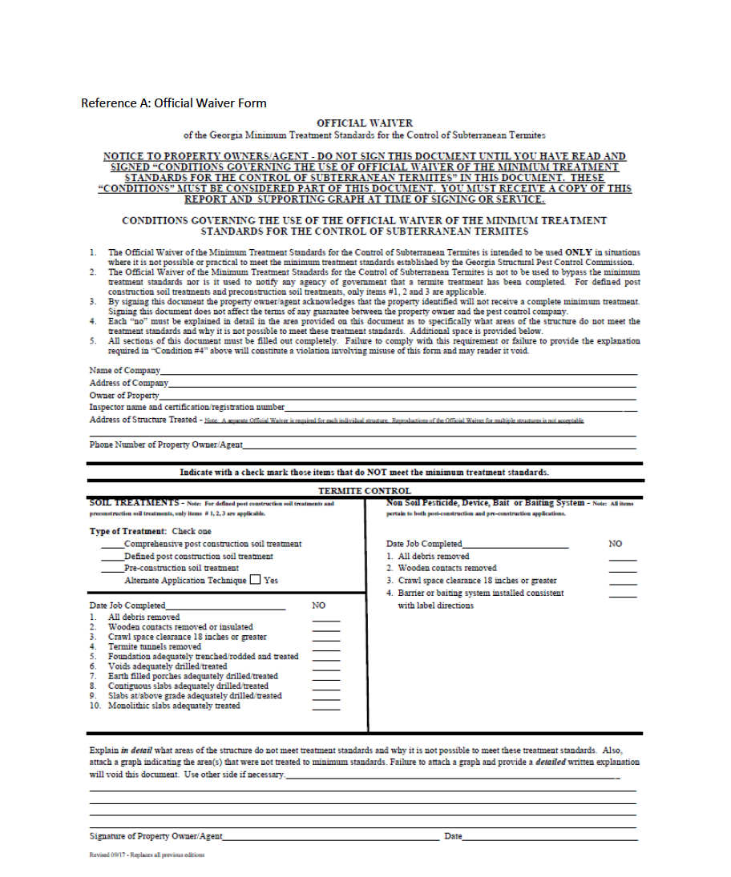
Before we go over the minimum treatment standards for a
Defined soil treatment, remember the following:
For Defined Post Construction Soil
Treatments, only the following
minimum treatment standards can
be waived with an Official Waiver
of the Georgia Minimum Treatment
Standards for the control of
subterranean termites:
Check “x” the type of application to be made
1. All debris removed
2. Wooden contacts removed or insulated
3. Crawl space clearance 18” or greater
X
All three of these treatment standards do
not involve the application of termiticides

Slide 5
If any other minimum treatment standards of a Defined Post
Construction Soil Treatment cannot met (other than those 3
non-chemical treatment standards), a Defined soil treatment
could not be made.
In other words, those treatments standards that involve the
use of a termiticide for a Defined Post Construction Soil
Treatment cannot be waived using the Official Waiver form.
Then, either a Bait system treatment could be made, or if a
Comprehensive Post Construction Soil Treatment was made
instead, the Official Waiver form would be used to waive any
other treatment standards requiring a termiticide treatment
that couldn’t be made in compliance with the RULES.
Slide 5/86

Slide 6
Minimum standards for a Post Construction
Defined soil treatment
620-6-.04 Control Measures. Amended.
(1) Minimum adequate subterranean termite control treatment for
post construction shall include the following:
(b) For pesticide products allowing a defined soil treatment consistent
with individual product registered label directions:

Slide 7
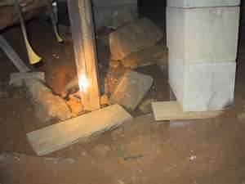
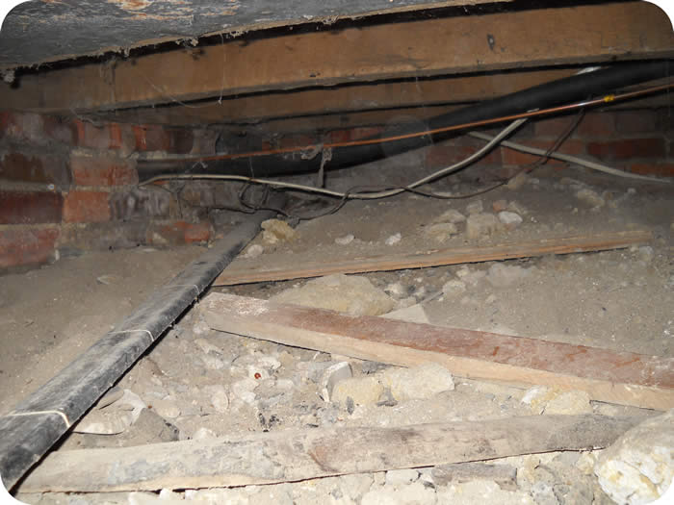
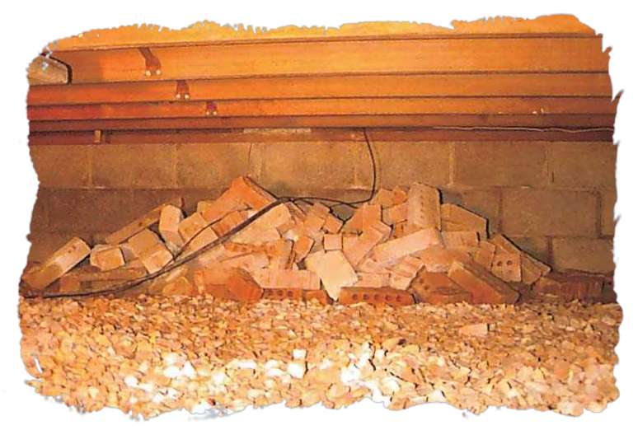
620-6-.04 Control Measures. Amended.
(1) (b) 1. Removal of all cellulosic material from underneath the building
and removal of any other debris which would interfere with
inspection or treatment in such area.
Most often, the debris needs to be removed, not WAIVED.

Slide 8
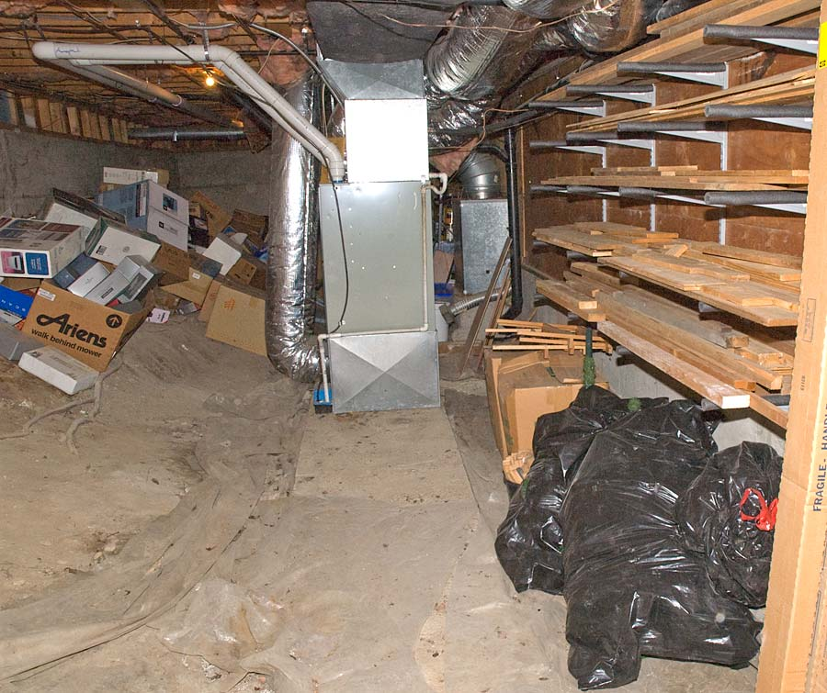
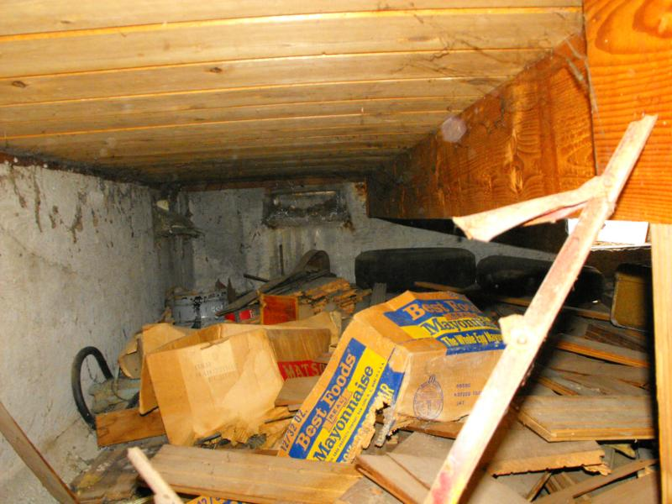
Obviously, this debris needs to be removed, not WAIVED

Slide 9
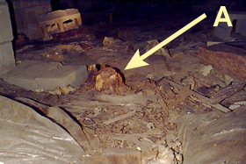
If a stump can’t be
removed from the
crawl space and
there is at least 12”
space between the
top of the stump
and the structural
wood above, it may
be WAIVED…
You should consider treating the stump
with a product labeled for treatment if
it can’t be removed

Slide 10
620-6-.04 (1) (b) 2. Removal of all wooden contacts between buildings
and outside soil, other than wooden supports which have been treated
with preservatives to a minimum preservative retention designed for
ground contact. The top of all supports for untreated wooden members
shall be no closer than six (6) inches to the soil. In no case shall the
minimum clearance between untreated wood and soil be less than six (6)
inches.
Wood siding
Soil
Soil
Hollow block
foundation wall
6”
at least 6” of air is required between wood
& soil unless treated for ground contact
Slide 10/86

Slide 11
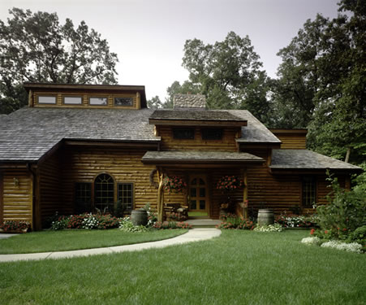
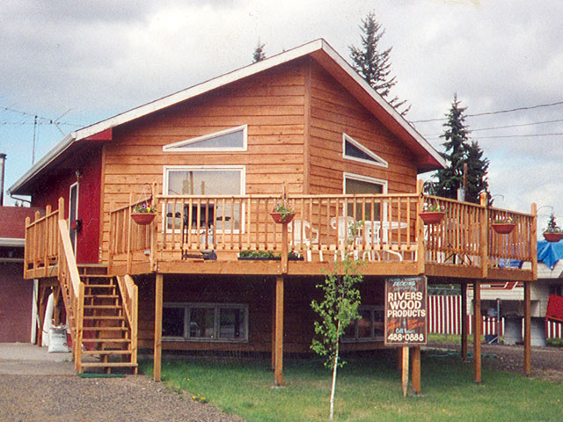
Wood within 6” of the soil
Wooden siding, porch columns, deck posts, and stairs are
touching or are within 6” of soil and must either be removed,
properly insulated from soil, or alternatively WAIVED

Slide 12
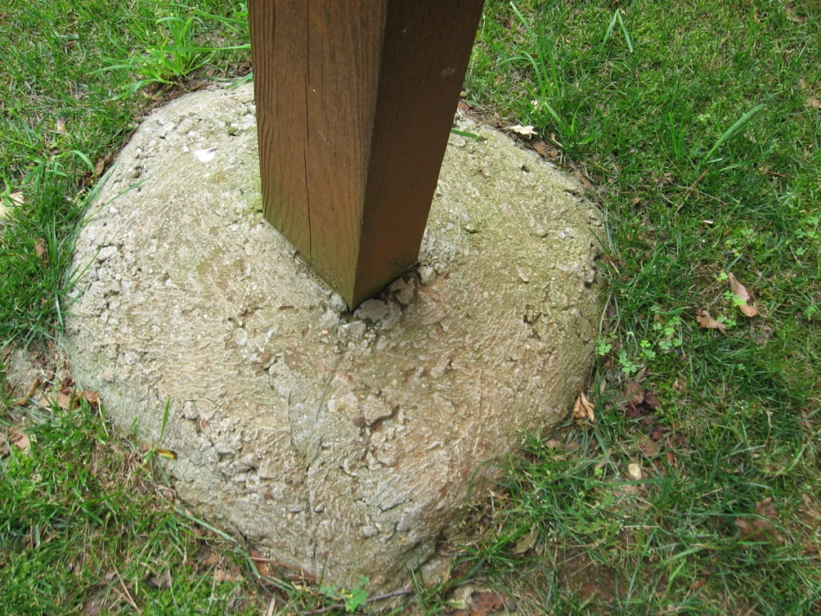
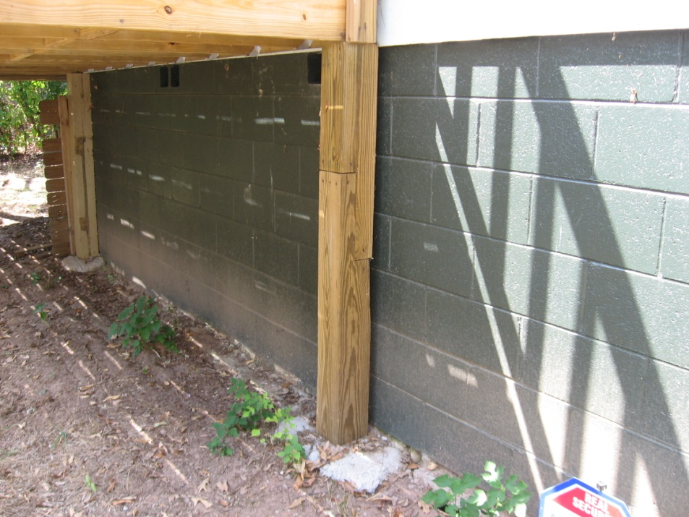
If wooden deck posts are not stamped or plated to show they are treated for ground contact and they are embedded in concrete, they are considered wood-to-earth contacts and need to be either removed, properly insulated from soil, or alternatively WAIVED.
If wooden deck posts are not stamped or plated to show they are treated for ground contact and they are sitting on top of a concrete footer and there is at less than 6” of clearance between the wood and the soil, they need either to be removed, properly insulated from soil, or alternatively WAIVED.

Slide 13
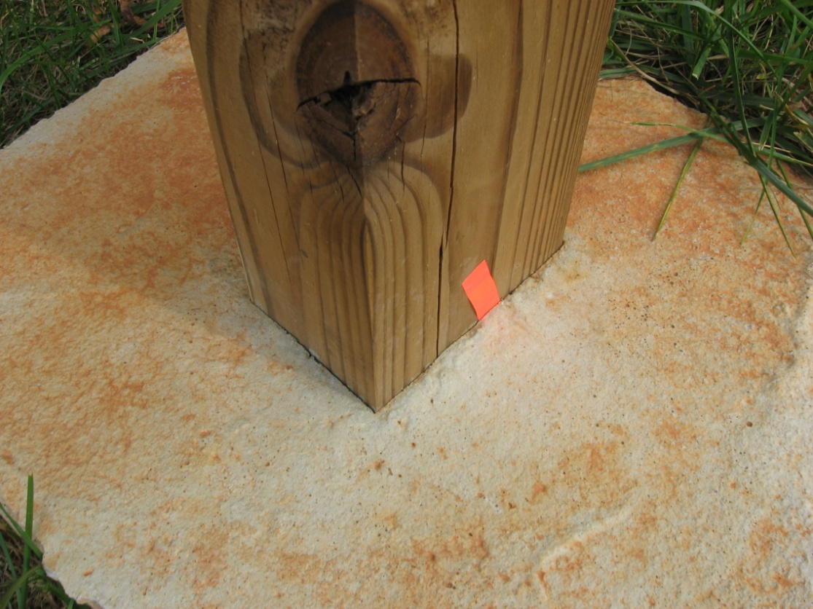
Wood deck post embedded in concrete
This deck post is embedded in concrete and must either be
removed, properly insulated from soil, or alternatively WAIVED

Slide 14
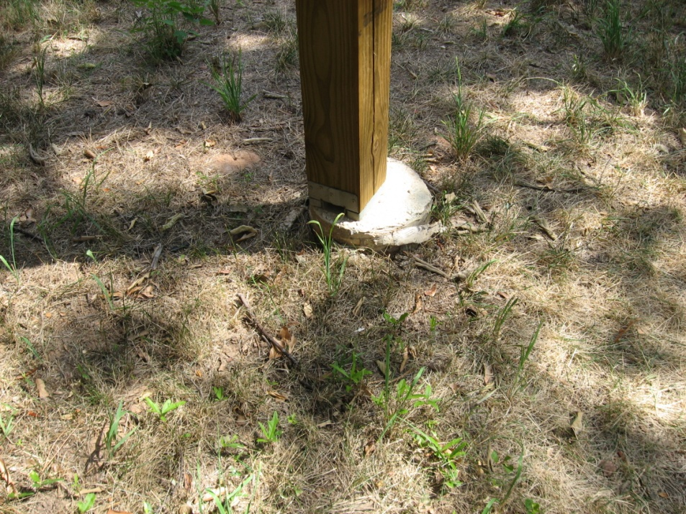
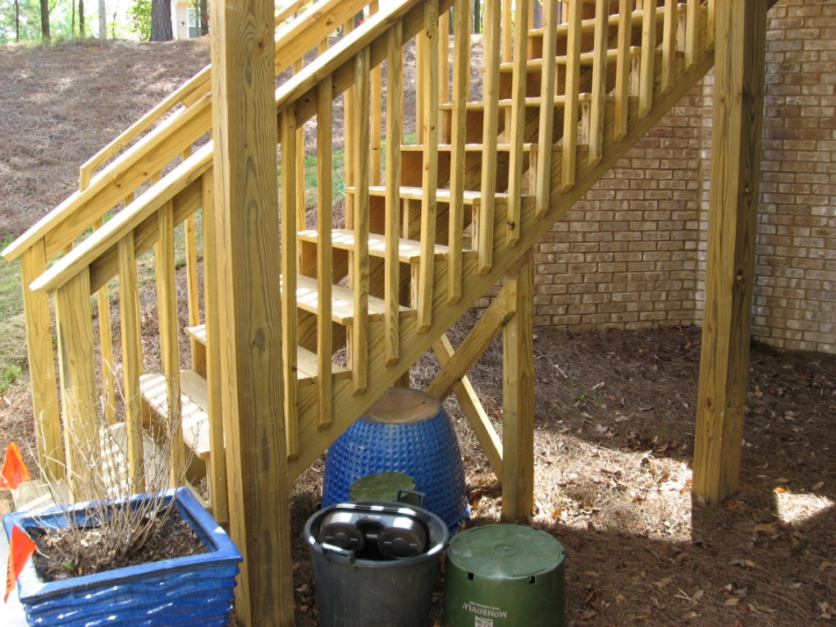
These deck posts and steps and stair stringers are not treated for ground contact and are either resting on top of a footing and within 6” of the soil or are directly contacting the soil.
They must either be removed, properly insulated from soil, or alternatively
be WAIVED

Slide 15
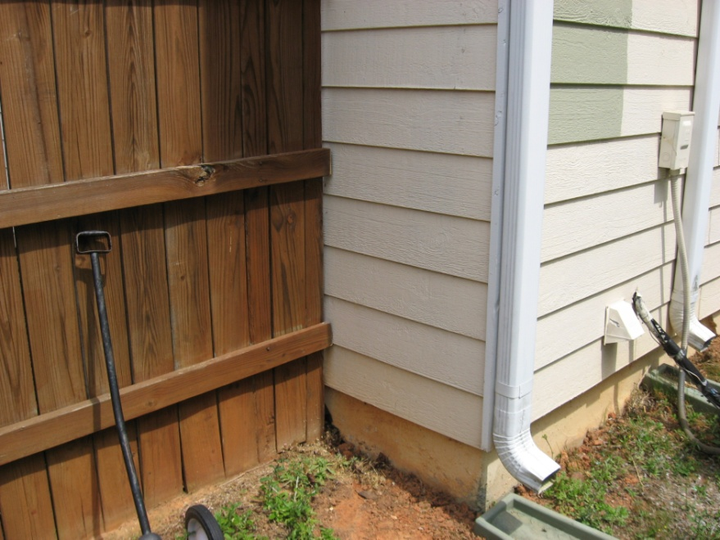
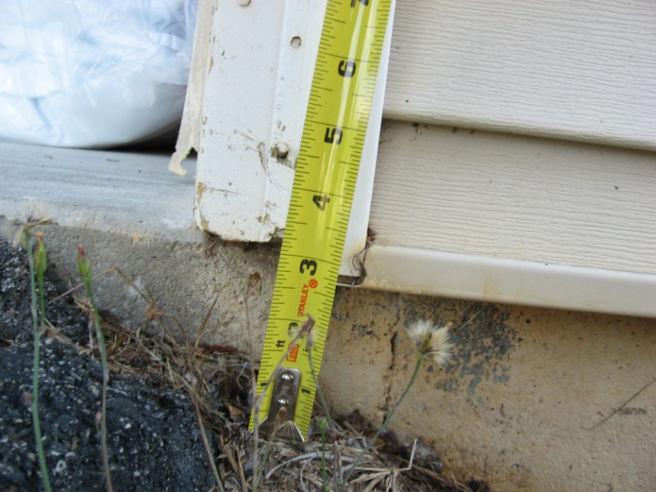
Wooden fence touching the structure
Wooden corner board within 6” of soil
This fence is not part of the house, so it is not considered wood within 6”. However, it must either be moved so that the wood fence is not touching the building or it is alternatively waived.
There are 4 options to correct wood within 6”: replace the wooden corner board with a plastic one, dig the soil away from under the corner board to provide 6” clearance, pour a 6” by 6” slab under the corner board, or alternatively WAIVE 6” clearance.
Slide 15/86

Slide 16
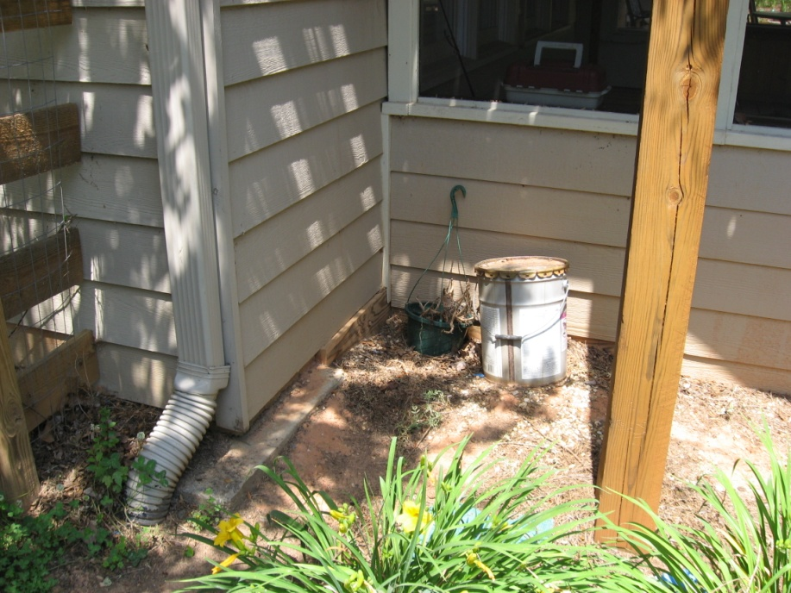
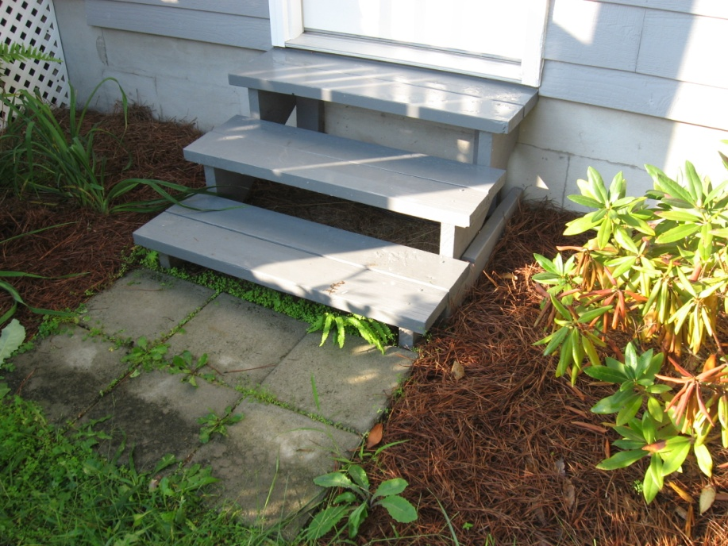
Deck support touching soil and wood siding touching or within 6” of soil and fence touching house within 6”
of soil
Wooden lattice work and frame touching or within 6” of soil and wooden steps and stair stringers touching or within 6” of soil
The siding, corner boards, and deck support
need either to be removed, to be properly
insulated from soil, or alternatively WAIVED.
The fence needs to be cut off so that it is not
touching the house or alternatively WAIVED.
The wooden steps and stair stringers either
need to be removed and replace with brick
or concrete steps, properly insulated from
soil, or alternatively WAIVED.
The lattice work and frame need either to be
removed, properly insulated, or WAIVED.

Slide 17
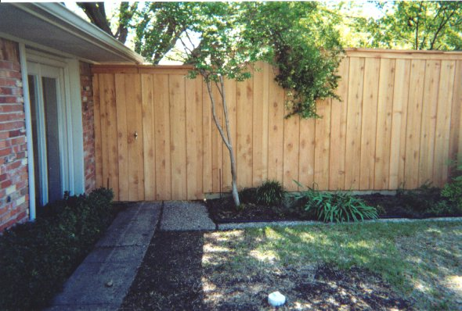
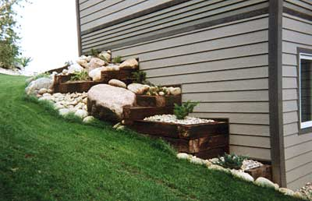
Wood fence post touching house
Wooden railroad ties touching house
The wood fence post touching the wall needs to be moved so that is
it is not touching the building, removed and replaced with a metal fence post, or alternatively be WAIVED
The railroad tie walls either need to be removed and replace with block walls, moved so that they are not touching the building, or alternatively be WAIVED

Slide 18
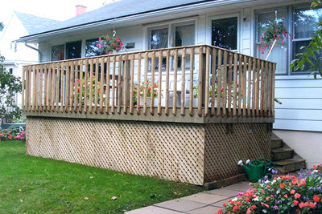
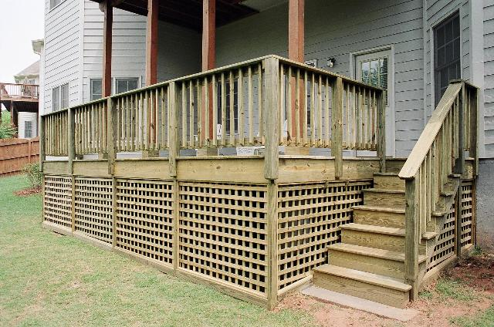
Lattice work, deck posts, stairs and stair railing of the deck touching or within 6” of the soil outside
All wooden elements of deck and stairs that are touching or within 6” of the soil need either to be removed, properly insulated from the soil, or alternatively be WAIVED
But even more importantly, you will need to get under these decks
to be able to trench adjacent to the exterior foundation wall…
otherwise, a defined soil treatment may not be made!

Slide 19
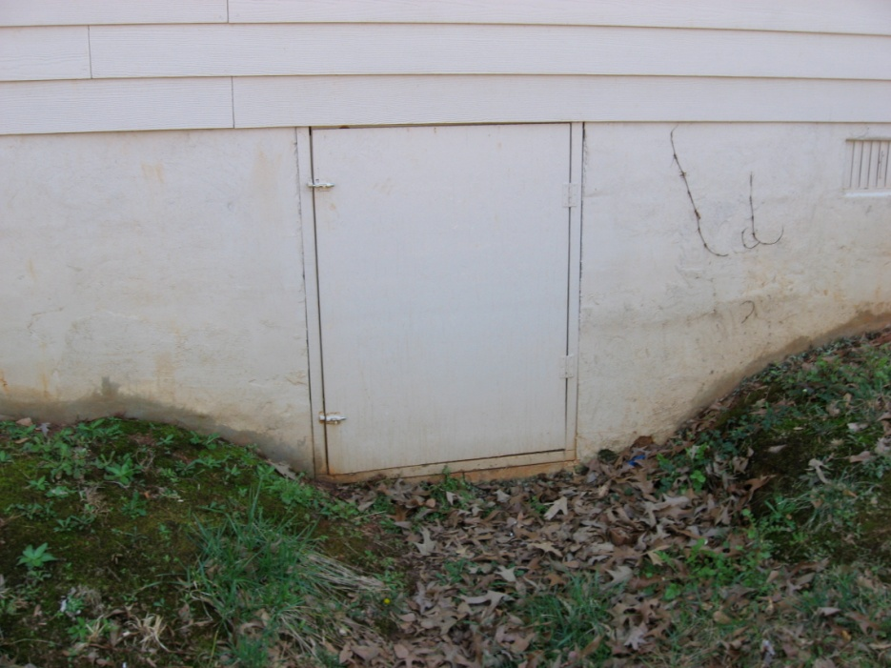
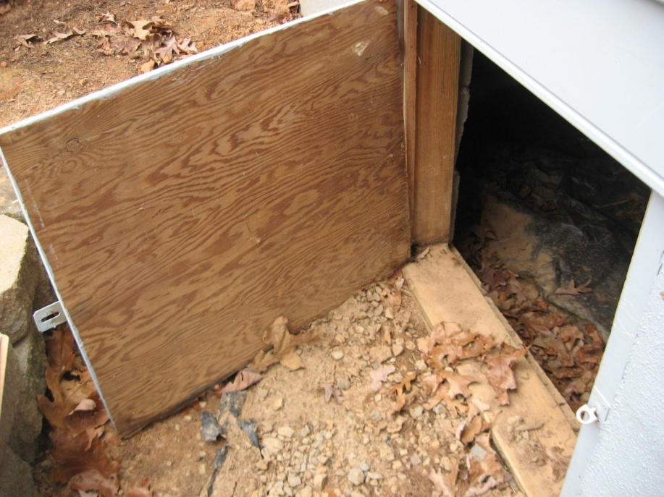
Wooden crawl space doors & frames
Wood crawl space doors & doors frame touching or within 6” of soil
The wood crawl space door & door frames need either to be removed
and replaced with metal or plastic doors (we can sell them), properly
insulated from soil, or alternatively WAIVED

Slide 20
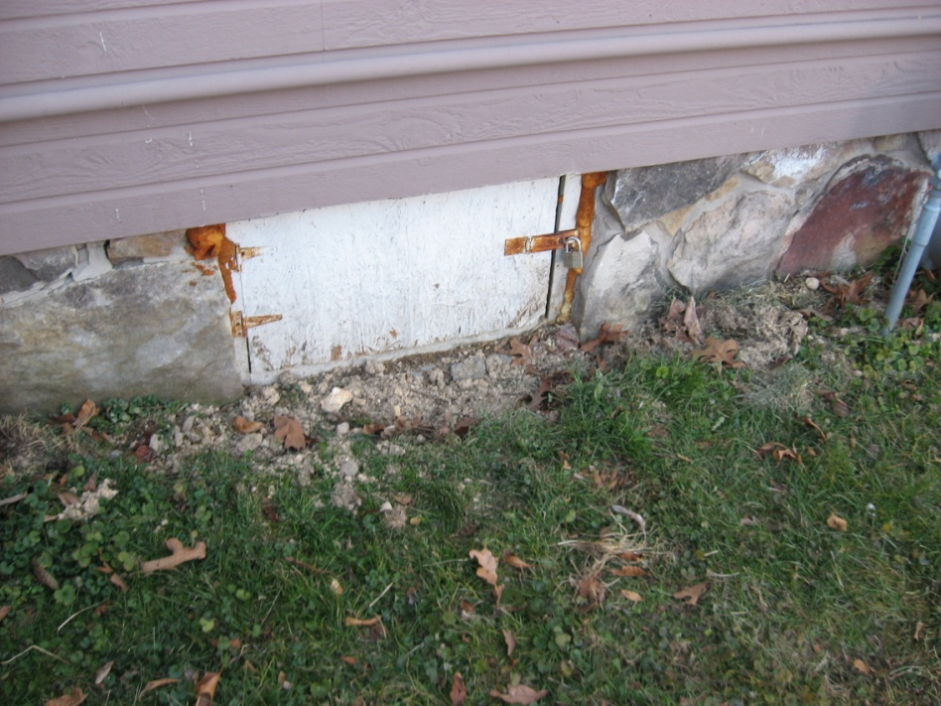
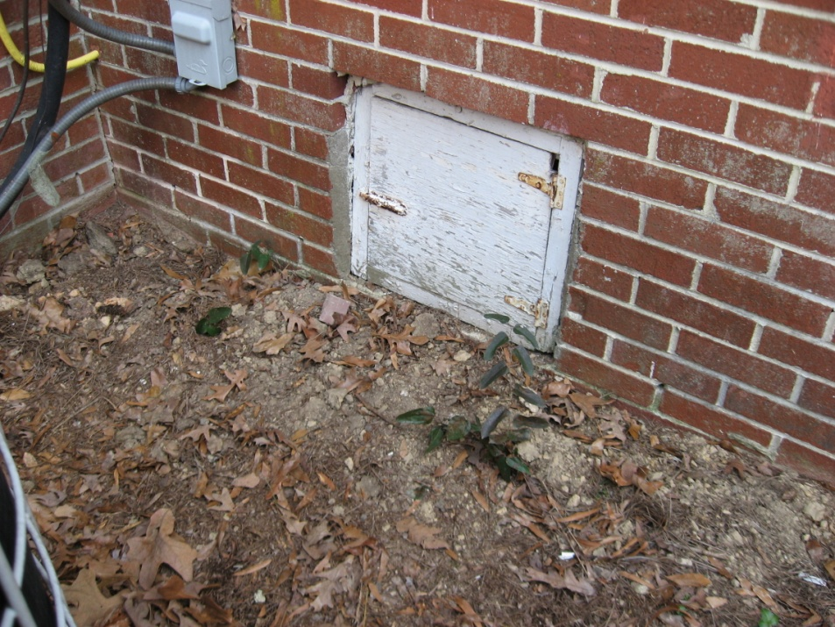
Wooden crawl space doors & frames
Wood crawl space doors & door frames touching or within 6” of soil
The wood crawl space door & door frames need either to be removed and
replaced with metal or plastic doors (we can sell them), properly insulated
from soil, or alternatively WAIVED
Slide 20/86

Slide 21
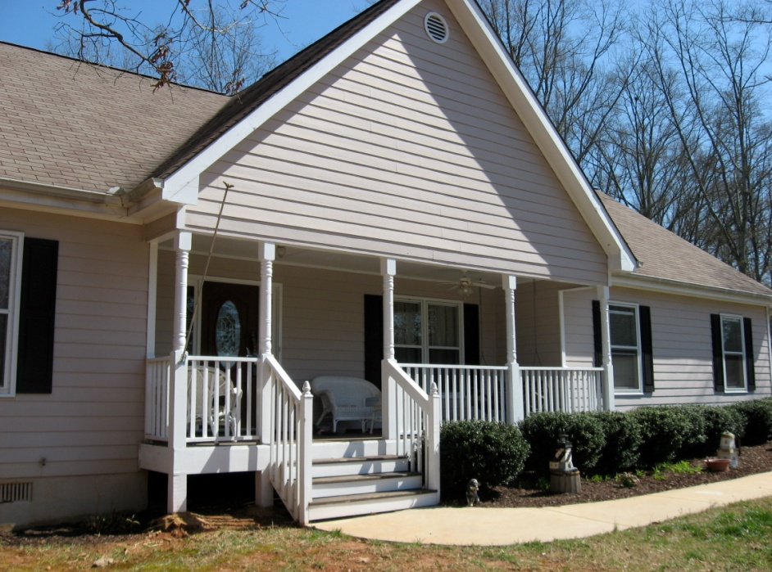
Wooden front porch posts, stairs and stair railings touching or within 6” of soil
All the wooden elements of the deck and stairs touching or within 6” of the
soil need to be removed, properly insulated from soil, or alternatively WAIVED
But more importantly, can we get under the front porch to trench
the exterior foundation wall of the front of this house?

Slide 22
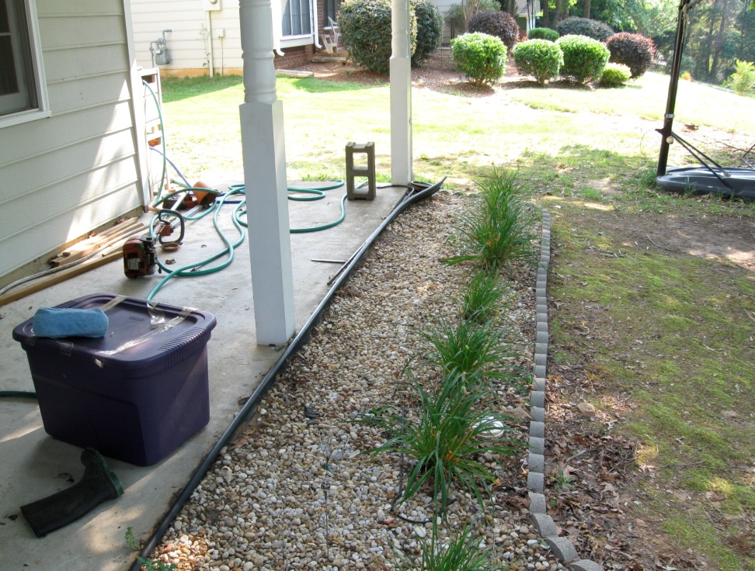
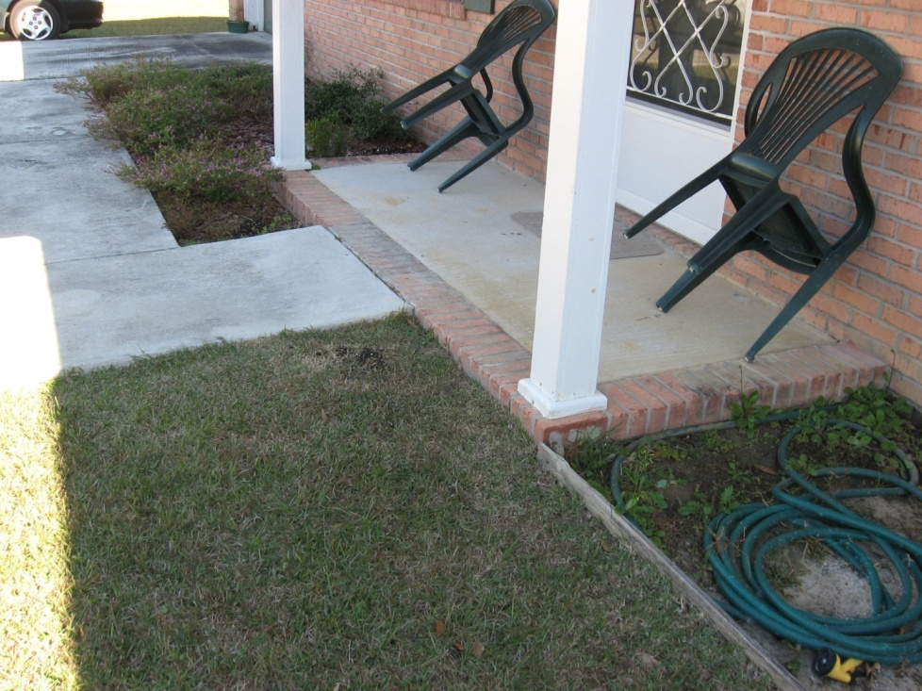
Wooden support columns within 6” of the soil
(Carport, covered walkway, front porch, etc.)
Wooden columns or supports of covered walkway within 6” of soil
Wooden front porch columns within 6” of soil
The wooden columns need either to be replaced by plastic or metal columns, properly insulated from soil, or alternatively WAIVED

Slide 23
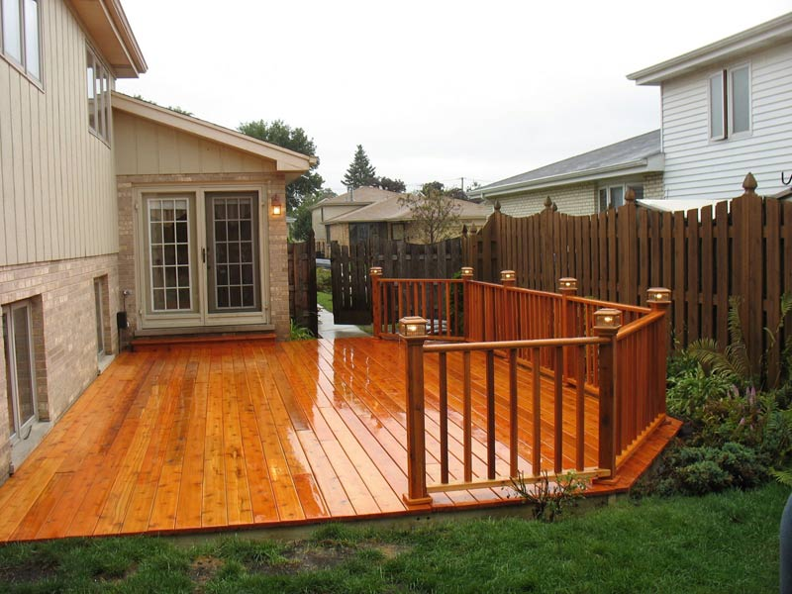
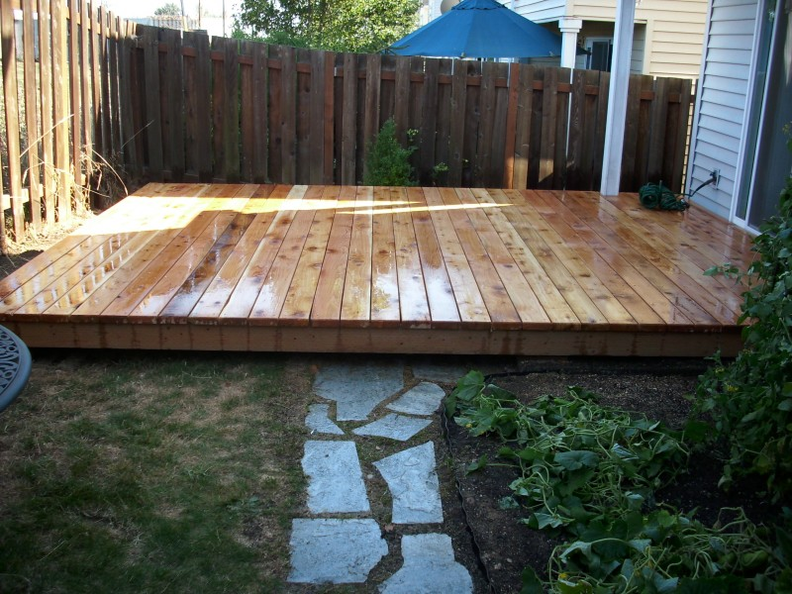
Wooden decks touching soil or with low clearance beneath
These wooden decks are touching the ground and present a significant hazard for subterranean termite attack.
What problem do these decks present to your treatment?
What do you think are the best treatment options for both of these decks?

Slide 24
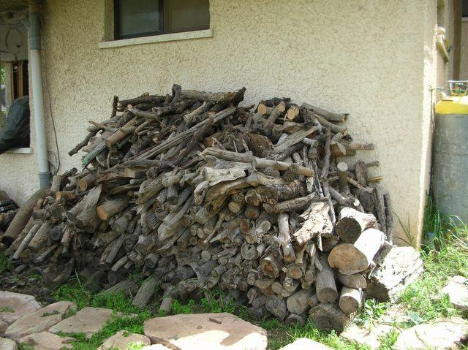
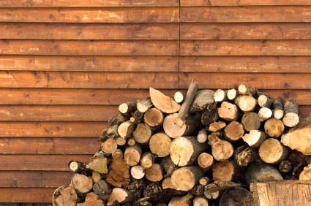
Firewood piles touching or adjacent to an exterior foundation wall of a structure
DON’T WAIVER!
Ask the customer to move the firewood pile away from the wall before we come to perform the treatment or price the job to provide the extra labor so we can move the firewood pile

Slide 25
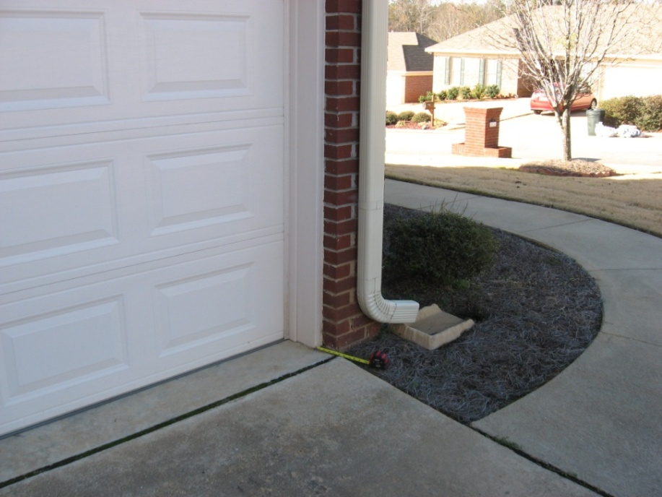
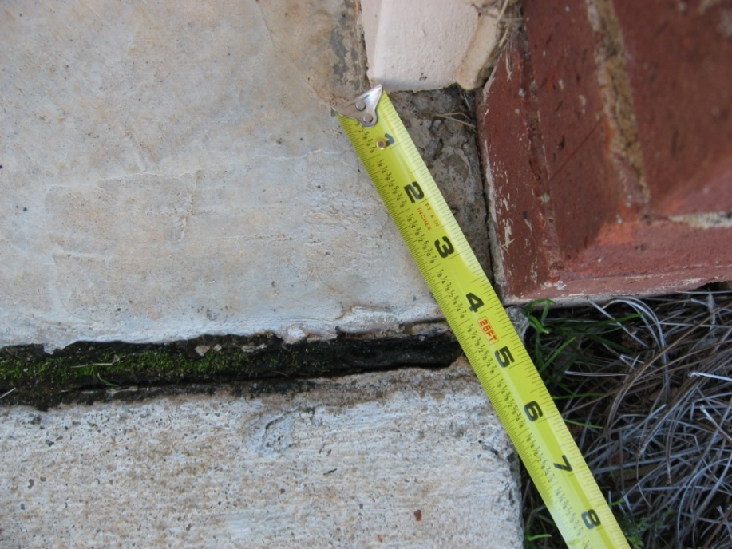
Wooden garage door frames are within 6” of the soil
The customer will generally not want to remove the wood door frame
or properly insulate the wood from the soil by pouring a 6” x 6” slab.
Just ask the customer to WAIVE these wood-to-earth contacts.
Slide 25/86

Slide 26
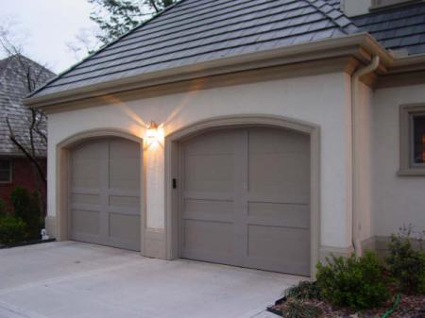
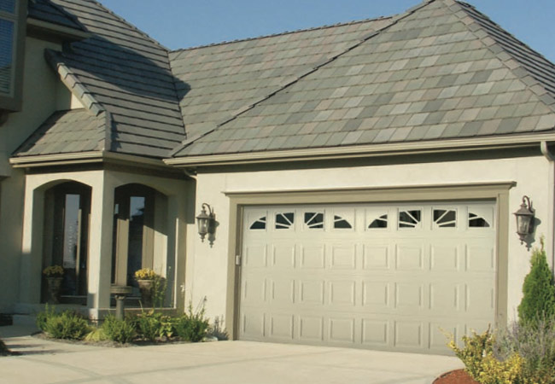
Wooden garage door frames touching or within 6” of the soil
The customer will generally not want to remove the wood door frame
or properly insulate the wood from the soil by pouring a 6” x 6” slab.
Just ask the customer to WAIVE these wood-to-earth contacts.

Slide 27
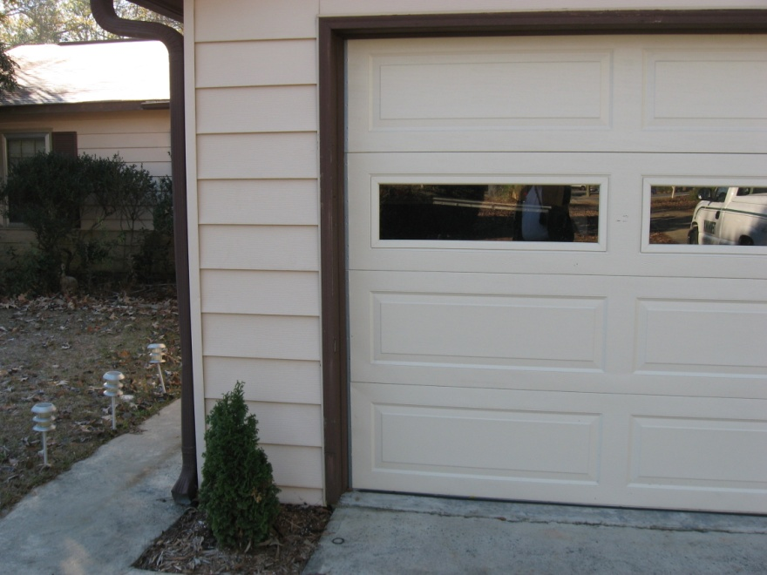
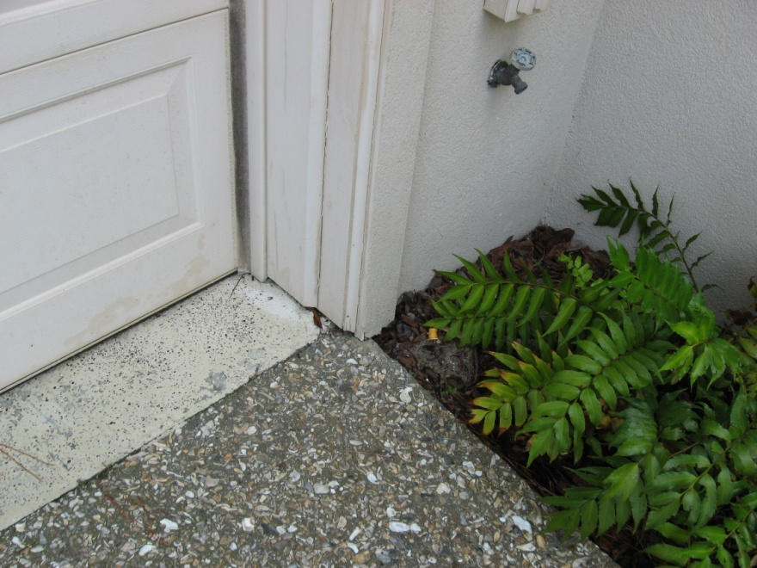
Why am I showing you so many of these garage door frames that are within 6” of the soil?
It’s simple…they’re present on most homes, and are often failed to be properly WAIVED!

Slide 28


Wood is closer to soil than 6”, but it is insulated from soil and is not considered wood-to-earth contact
This requirement shall apply only to those situations where wood is exposed and by design is not separated from the outside soil line by anything other than air space.
Such clearance shall not apply to sill plates or other wooden members of a structure which may be physically closer to the earth than the required clearance but are by design enclosed by and insulated from the earth by brick, stucco or other construction material.
Soil outside
Monolithic slab
Monolithic slab

Slide 29
Wood within 18” of the soil on the inside of the crawl
620-6-.04 (1) (b) 3. Removal of all wooden contacts between buildings
and inside soil, other than those wooden supports which have been
treated with preservatives to a minimum preservative retention
designed for ground contact. In no case shall the minimum clearance
between wood and soil in a crawl space be less than eighteen (18)
inches.

Slide 30
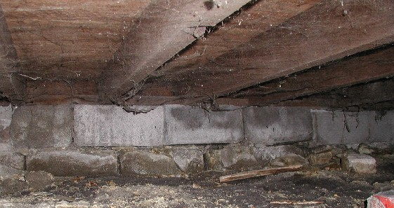
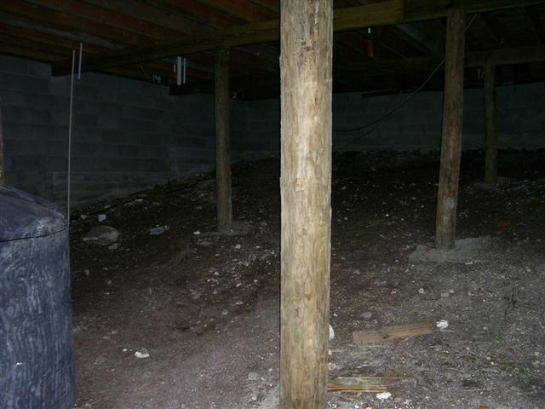
Improper clearance between wooden sill
& some floor joists and the soil
Untreated wooden supports in crawl are touching or within 18”
of the soil
These wooden supports must be removed and replaced with metal
house supports, properly insulated from the soil,
or alternatively WAIVED
The 1st question I would ask is…“Can you gain access in all parts of the crawlspace for treatment?”
If you can…you have two choices you could make before treatment:
Soil must either be removed to provide at least 18” clearance between wood and soil, or….
Proper clearance must alternatively WAIVED.
Slide 30/86

Slide 31
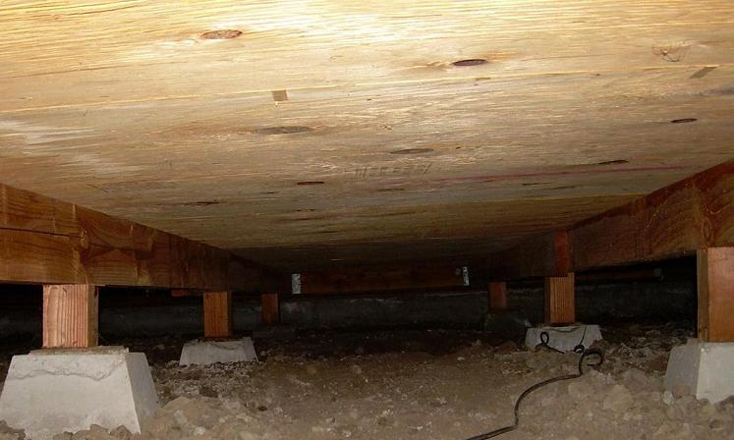
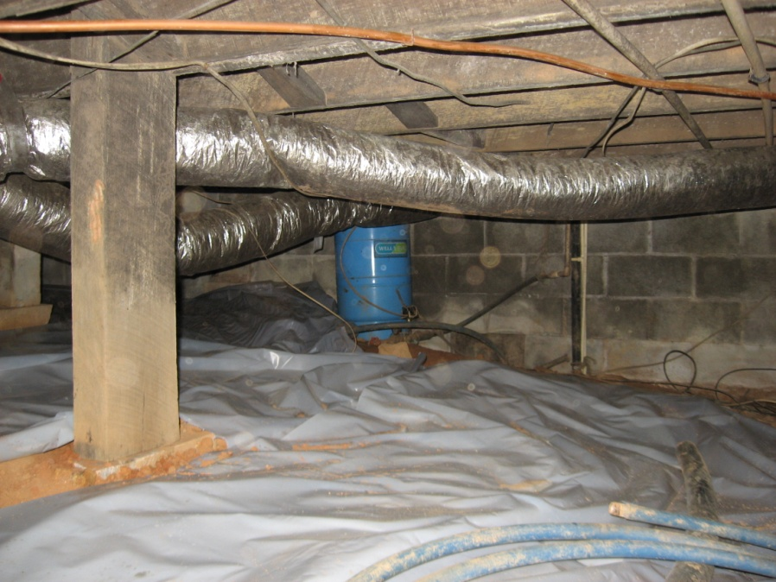
This crawl has access for treatment, but has less than 18” clearance between wood & soil in the crawl
The customer will not want to replace the wooden supports with metal or concrete supports.
These wooden supports will need to be WAIVED.
This wooden support needs to
be replaced with a metal house
support.
It should not be WAIVED.

Slide 32

What do you do if you get to a job to treat
and you do not have enough clearance
to inspect and treat all areas of the entire
crawlspace?

Slide 33
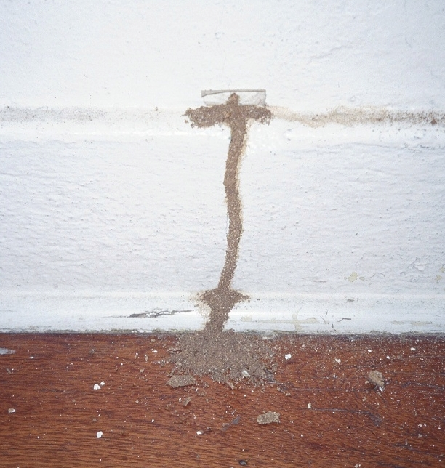
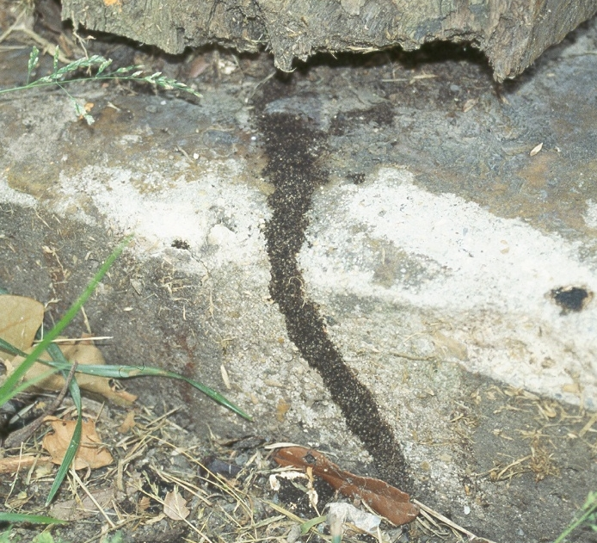
Visible and accessible termite tunnels
620-6-.04 (1) (b) 4. Removal of visible accessible termite tunnels unless
specified on the product label.

Slide 34
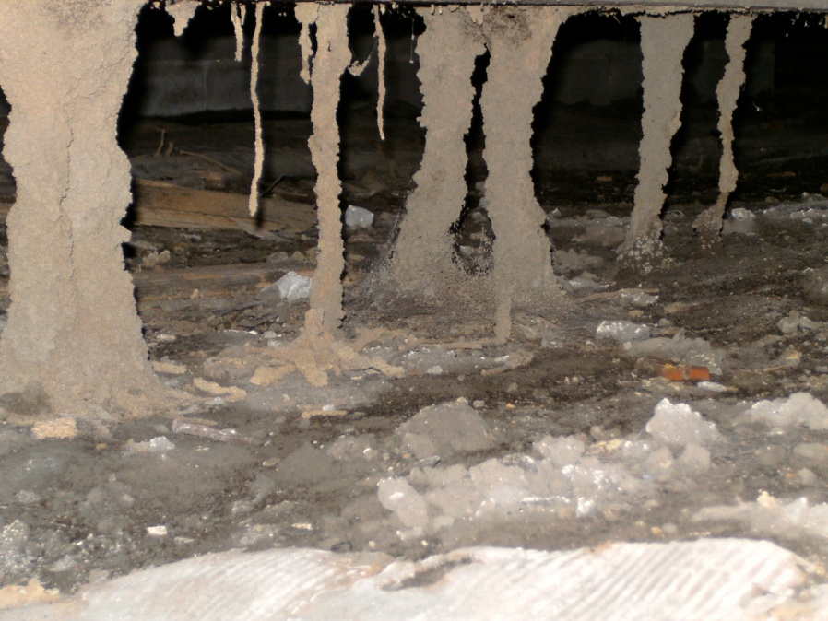
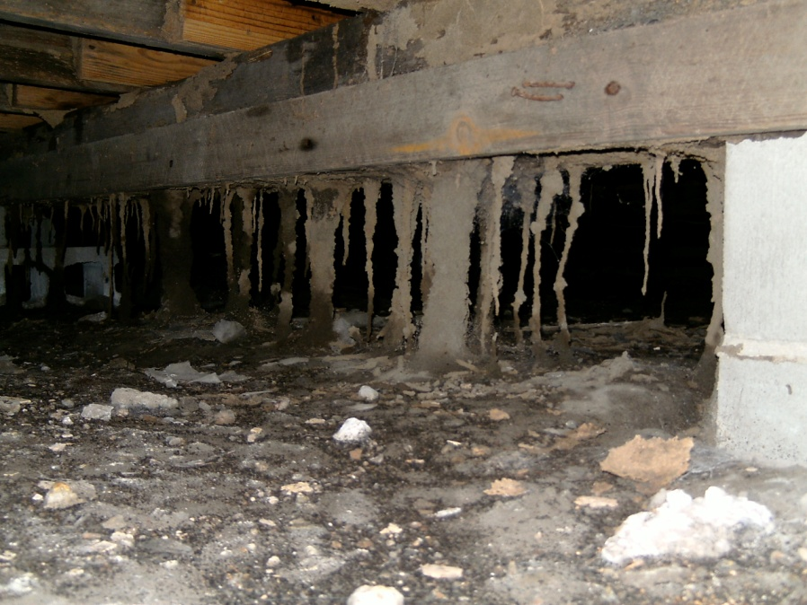
Remember that all visible and termite tunnels
need to be removed unless specified on the label!

Slide 35
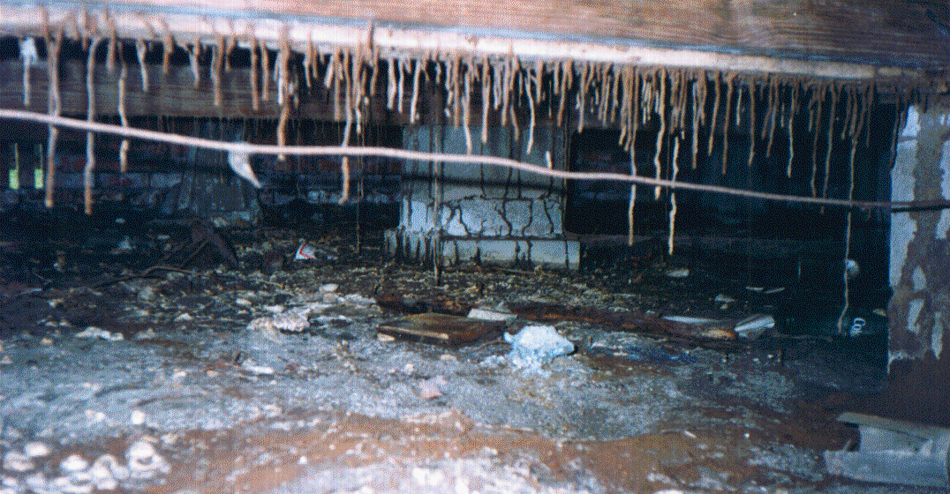
Perhaps there are a few more considerations than removing all the termite tunnels!
What would you be concerned about?
Slide 35/86

Slide 36
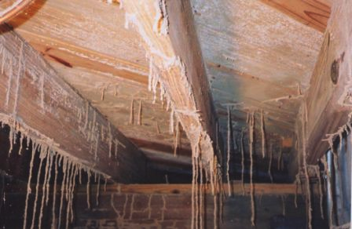
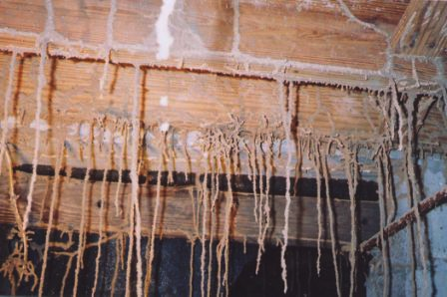


And we think termites are destructive in Georgia…

Slide 37
Rule 620-11-.01 Treatment of Schools
Pesticide applications may be made to schools consistent with the
following:
(a) All pesticide applications shall be made in a manner that minimizes the
exposure of children or students to the pesticide.
(b) Pesticide application may be made to a room only if children or
students are not expected to be present in the room for a minimum of
three (3) hours after application. If the products label directions specify a
longer reentry interval then the longer reentry interval shall apply except
as specified in Rule 620-11-.01(1)(c).
(c) Insecticide baits and rodenticide baits in tamper-resistant containers or
bait stations as well as botanical insecticides, insect growth regulators and
insecticidal soaps may be applied at any time children or students are not
present in a room. No reentry interval is required except if specified by the
products label directions. These products may be applied to any open area
or multi-purpose room if the area within ten (10) feet of the location is
secured and no children or students are present within the secured area
during the time of application.

Slide 38
Rule 620-11-.01 Treatment of Schools
(continued)
(d) Pesticide applications may be made to outdoor school grounds if
children or students are not expected to be present within twenty (20)
feet of the application site at the time of application except as
specified in Rule 620-11-.01(1)(e). These areas must be clearly
marked to discourage entry, and secured by a fence or other similar
barrier stating the reentry interval. If the application site is not
secured by a fence or other similar barrier, pesticide applications may
be made to an outdoor school grounds only if children or students are
not expected to be in the area for a minimum of three (3) hours after
application. If the products label directions specify a longer reentry
interval then the longer reentry interval shall apply except as specified
in Rule 620-11-.01(1)(c). Such areas shall be clearly marked to
discourage entry. All signs required by this section to discourage entry
shall be consistent with the requirements of Rule 620-3-.02(1)(l) 2.

Slide 39
Rule 620-11-.01 Treatment of Schools
(continued)
(e) Insecticide baits and rodenticide baits in tamper resistant
containers or bait stations as well as botanical insecticides, insect
growth regulators and insecticidal soaps may be applied to outdoor
school grounds anytime children or students are not present in the
area. No reentry interval is required except if specified by the
products label directions.
(f) All pesticide use dilutions must be prepared outside child or
student occupied areas of buildings.
(g) All contracts for pest control service and all services provided must
be consistent with any published pest management policy of that
school system or licensed child daycare facility.

Slide 40




Treatment at Schools
Slide 40/86

Slide 41
Trenching adjacent to exterior foundation walls
620-6-.04 (1) (b) 5. (ii) Trenching of soil along the outside
foundation walls to a minimum depth of six (6) inches, but
not lower than the bottom of the footing in contact with the
soil. Rodding may be performed from the bottom of the
trench to lower depths as required.

Slide 42
Remember that you must follow the RULES and the label of the termiticide that you are using
Even though the RULES do not require trenching piers and soil pipes
that lead from the soil to the structure, both the Termidor SC and
Taurus SC labels do require that the soil adjacent to piers be trenched
to a minimum depth of six (6) inches, but not lower than the bottom
of the footing in contact with the soil. Rodding may be performed
from the bottom of the trench to lower depths as required. Both of
the labels also direct you to trench around soil pipes that lead from
the ground to the structure.

Slide 43

Can we trench adjacent to the foundation wall where an object like this propane tank is located?
If there’s an object against
a foundation wall that
can’t be moved to allow
trenching of the soil
adjacent to the wall, you
can not perform a
Defined soil treatment.
You have 3 options:
A bait system treatment
A Comprehensive soil treatment with a WAIVER
“A walk away”
Remember, if you perform a Comprehensive soil treatment, trenching the exterior foundation wall must be WAIVED and that area long-roded instead of trenching or trenching and rodding.

Slide 44

An unmovable object against the exterior foundation wall
If there’s an object up against a foundation wall such as an AC unit that
cannot be moved to allow trenching of the soil adjacent to it or drilling an attached slab that it is resting on, a Defined soil treatment cannot be made. Either a Comprehensive soil treatment must be performed with proper trenching WAIVED and that area long-roded or a bait system treatment performed instead.

Slide 45


Ivy
If the customer will not move their ivy or they will not allow you to damage the ivy or other ground cover that is adjacent to the exterior foundation wall, then you will not be able to trench the soil adjacent to it. You will not be able to perform a Defined soil treatment. You will either need to perform a Bait system treatment or a Comprehensive soil treatment with proper trenching WAIVED and that area rodded instead of trenched or trenched & rodded.
Slide 45/86

Slide 46

A low deck without access underneath it
This deck is too low to the ground to gain access underneath to be able to trench the soil that is beneath the deck
Could that present
a problem?
If the customer won’t remove one or two deck boards that are adjacent to the exterior foundation wall to allow proper trenching in the soil beneath it, a Defined soil treatment may not be performed. A Bait system treatment or a Comprehensive soil treatment may be performed. Proper trenching would need to be WAIVED for the Comprehensive soil treatment and that area treated by drilling through the deck boards adjacent to that wall and rodding the soil beneath it or by long-rodding the soil adjacent to that wall from the sides.

Slide 47
How deep do we need to treat when we trench?
Remember that the RULES state that pesticide
products which allow a Defined soil treatment
(stated as an EP/LI treatment on the label) must
be applied consistent with the individual product’s
registered label directions. Even though the RULES
do not state that you must treat to the footer or a
minimum of 4 feet deep when the footer is deeper
(such as in a basement), the RULES require you to
follow the label. Label directions of both Termidor
SC and Taurus SC require a rate of application of
four (4) gallons per ten (10) linear feet per foot of
depth from the soil surface to the lesser of either
the top of the footings or a depth of four (4) feet
applied to the trenches and backfill be made.

Slide 48

Treatment of attached slabs
620-6-.04 (1) (b) 4. (iii) Treatment of all grade level slabs and earth
filled porches beneath concrete slabs that are contiguous to the
structure with an approved termiticide by drilling and applying along
the entire distance where slab join any part of the structure at
intervals of no more than twelve (12) inches and no more than
twelve (12) inches from the structure wall.
The Termidor SC label permits you to short-rod under the garage or carport slab from either the adjacent basement or crawl space where you are not able to perform vertical drilling, but not for a dirt-filled porch or attached slab.
Vertically drilling
attached slabs
Dirt-filled
Porch
. . . . . . .
.
.
.
.
.
.
.
.
.
.
.
.
.
.
House
Garage

Slide 49





Can you do a Defined soil treatment on these garages of floating and supported slabs
Could you do a Defined soil treatment if the home was an unfinished basement or a crawl space and had any of these garages?

Slide 50
YES…
at 12 inch intervals along and through
the unfinished basement wall or the
crawl space foundation wall at a level
within 1 or 2 inches below the level of
the garage slab. The soil would
need to be rodded with 4 gallons/10
linear feet per foot of depth to the
footer or to a minimum depth of 4 feet.
If there is some obstruction that prevents you from treating under the garage slab (such as these steps) or it is not possible or practical to treat any area of the garage slab that is adjacent to the foundation wall of the house, you could horizontally drill the unfinished basement wall or the crawl space foundation wall instead. Drill the slab
Inside home
Garage
Crawl
space
Drill horizontally
through the
foundation wall
and rod the soil
beneath the slab
It would be wise to reflect this treatment on your graph.
Slide 50/69
Slide 50/86

Slide 51
Can you do a Defined soil treatment on these garages of floating and supported slabs
NO!
Not unless you could move everything within 12” of the garage wall
where it is adjacent to the living space of the home to permit
vertically drilling along the expansion joint.
Could you do a Defined soil treatment in a floating or supported slab home if they had any of these garages?

Slide 52
DO NOT apply product until heating/air conditioning ducts, air vents, plumbing pipes, sewer lines, floor drains, heating pipes, and electrical lines/conduits are known and identified.
DO NOT puncture or contaminate any of these.
TERMITE LABELS state:
YOU SHOULD USE EXTREME CAUTION TO AVOID
THE CONTAMINATION OF DUCTS
AND VENTS.

Slide 53

Sub-slab heat duct system before the slab is poured on a pretreat
What happens if termites gain
entrance to the air ducts here
once the slab is poured?
What happens if the termiticide
accidently gets into the ducts?
How will you identify this structure as having sub-slab
heating system once this structure is built?

Slide 54

This is what might tip-off you or your inspector that the home has intra-slab or sub slab heat ducts in the floor
A bait system would be a better choice for this type of structure!

Slide 55

Don’t treat slabs directly over the basement!
  Check areas below
  prior to treatment
Directions for use to control termites:
USE RESTRICTIONS
Prior to drilling and treating through
concrete structures such as patios,
porches, sidewalks and foundation
slabs applicator should first determine
that there are no habitable areas
below that could be unintentionally
contaminated by the treatment.
Porches directly over basements can be a big problem if not recognized before treatment!
Slide 55/86

Slide 56

What can your employees do to avoid treating a over suspended slab?
Measure every basement
structure from the outside
and make sure that it agrees
with the graph, including all
porches and attached slabs.
Then go downstairs and see
if the configuration of the
basement is the same as the
outside wall.

Slide 57

What can your employees do inside to avoid this?
Inspect the ceiling of
the basement adjacent
to the area where the
porch or slab is attached
to the structure to
determine if there is a
metal pan supporting
that slab which is
directly over the
basement.
Sometimes there is a drop ceiling that,
once removed, will show the metal pan
supporting the slab.

Slide 58
An accident waiting to happen!
Sales graph
How the graph should have looked
Patio Patio
Basement Slab Garage
Basement Slab Garage
29’
Wine
cellar
20’ 20’
DFP
Driveway
The customer allowed us
to clean-up, seal the walls, and replace all the wood of the wine cellar and all the contaminated wine.
This one cost
$35,000+

Slide 59
An accident waiting to happen!
Sales graph
How the graph should have looked
Patio Patio
Basement Slab Garage
16’
21’
Basement Slab Garage
6’
DFP
Freezer
Driveway Driveway
A law suit was filed because of this misapplication of termiticide
It was settled in court for
$600,000

Slide 60

What happens when a customer won’t allow you drill an attached slab?
I don’t want my patio
drilled!
When a customer will not allow you to vertically drill and treat the slab of
a dirt-filled porch, patio or other slab (other than a garage or carport) that
is attached to the structure, a Defined soil treatment cannot be made.
A Bait system treatment or a Comprehensive soil treatment could be
made. If a Comprehensive soil treatment is made, drilling attached slab
must be WAIVED and the soil under the slab that is adjacent to the
exterior foundation wall either short-rodded from the crawl or basement
or long-rodded from the sides.
Slide 60/86

Slide 61
Don’t forget to WAIVE drilling attached slabs!
So, when a Defined soil treatment can’t be performed because the attached slab can’t be vertically drilled and treated…a Defined soil treatment can’t be made. However, a Comprehensive soil treatment may be performed, vertically drilling the attached slab may be WAIVED and the attached slab may be short-rodded or long-rodded instead.
Dirt-filled Dirt-filled
Porch Porch
Long-rodding Long-rodding
Short- rodding
OR
Comprehensive soil treatment Comprehensive soil treatment

Slide 62

Termidor SC - Label Directions for Use To Control Termites
How close is too close to treat
near edible plants?
The Termidor label provides
direction to the PCO:
  USE RESTRICTIONS
  DO NOT treat within a distance
  of one foot out from the drip
  line of edible plants!

Slide 63





Things To Do Before Performing The Termite Treatment
Not so obvious
Tomato plant
Obvious
Garden in early stage-maybe not obvious
Ask the customer whether they have any herbs or vegetables growing next to the foundation wall of the structure you are going to treat!
Garden in later stage-obvious

Slide 64


Things To Do Before Performing The Termite Treatment
thyme & oregano
lavender
Ask the customer if there any edible plants (vegetables,
fruits, herbs, fruit or nut trees, etc.) next to the exterior
foundation wall of the structure being treated. Remember,
we cannot treat within 1 foot of the drip-line of an edible
plant with Termidor.

Slide 65


You can not treat
within 1 foot of the
drip line of a tree
that bears edible
fruit or nuts
Drip line Drip line
Slide 65/86

Slide 66
Drip line Drip line
You can treat if the drip line
of the pecan tree is = or > 1½’
from the foundation wall of
the structure.

Slide 67

Could you make a Defined soil treatment to the front of this house for control of subterranean termites with Termidor SC ?
No, not with Termidor SC

Slide 68
Things To Do Before Performing The Termite Treatment
Confirm that the customer will be there during the treatment or
will leave the structure unlocked. WHY?
Even if the structure is a slab structure that does not require any
treatment indoors, you must have access for both pre & post
treatment inspection, as required by the Termidor SC label.
What are some problems that could occur if you, as a termite
professional did not make a pre & post treatment inspection?

Slide 69

Things To Do Before Performing The Termite Treatment
Ask the customer if there have
been any water leaks in their
basement…and then inspect to
see if there is any evidence of
current or previous leaks.
If there have been any leaks,
they must be corrected and
sealed before treatment is
begun. Maybe a bait system
treatment would be a good
alternative to a soil treatment.

Slide 70
Inspect the basement for any water leaks
When treating adjacent to an existing structure, the applicator must
check the area to be treated and the immediate adjacent areas to the
structure, for visible and accessible cracks and holes to prevent any
leaks or significant exposures to persons occupying the structure.
People present or residing in the structure during application must be
advised to remove their pets and themselves from the structure if they
see any signs of leakage of termiticide.
After application, the applicator is required to check for leaks. All leaks
resulting in the deposition of termiticide in locations other than those
prescribed on this label must be cleaned up prior to leaving the
application site.
Slide 70/86

Slide 71

Things To Do Before Performing The Termite Treatment
Don’t forget to inform the customer that they must turn off
the air circulation system (H/AC unit) before treatment if it
uses the air in the crawlspace and leave it off until the
application has been completed and all termiticide has been
adsorbed by the soil. It is a label requirement!

Slide 72


Preventing back siphoning
5. (iv) Measures must be taken to prevent the back siphoning and the
contamination of public water supplies during dilution and filling
operations.
If not using an Air-Gap
method, attach backflow
preventer to the faucet
and screw the fill hose
into a backflow preventer
before placing the fill
hose in the termite tank.
Your termite tank should use the Air-Gap method of backflow prevention. It is the
best method to prevent backflow and a spill when filling a tank.

Slide 73


“Singing in the rain” is O.K., but not treating in the rain!
(iv) continued.
Do not apply pesticide while precipitation is occurring
in any area where the application would be impacted
by the precipitation.
Areas that might
not be impacted by
precipitation are:
inside the house
in the basement
in the crawlspace
in the garage
in the attic

Slide 74


Post construction Defined soil treatment
5. (v.) Precautions must be taken to prevent to contamination of wells or
cisterns, in or close to the structure treated.
You need to ask the homeowners if they have a well or cistern at the home and be able to recognize a well house that has already been built.

Slide 75


Can you recognize a cistern?
Below ground cistern
Above ground cistern
Slide 75/86

Slide 76
What should you do if you find there is a well or cistern on the property before treatment and your paperwork doesn’t reflect that the property has a well on it?
If arrive at the property and you determine that a well or a
cistern is present on the property, call your service manager
or branch manager before proceeding with the treatment.
If treatment is allowed to be performed, consult the label of
the termiticide that you plan to use and follow its detailed
instructions regarding treatment near a well or cistern.

Slide 77

Let’s look at the instructions on a Termidor SC label for treating a well
Not even by the
Excavation/Backfill
Method
It states that you cannot treat soil within 5’ of a well by any method with Termidor SC
Water storage tank
inside home
> 5’

Slide 78
You must treat soil between 5’ and 10’ of a well by the Excavation/backfill method with Termidor SC
117 117 117 117
117 117
117 117
117 117 117 117
If you treat the soil
between 5’ and 10’
from the well, you
must use the
Excavation/Backfill
method.
You should probably
use the Excavation/
Backfill method for
at least 10’ to 20’
more feet in either
direction from the
well.
117
117
117
117
117
Well
10’
10’
Home
8’
Slide 60/69

Slide 79

Excavation/Backfill Method
Trench and remove soil to be
treated onto heavy plastic
sheeting or similar material or
onto a wheelbarrow.
Treat soil at the rate of 4 gallons of 0.06%, 0.09% or
0.125% Termidor SC per 10 linear feet per foot
of depth of the trench, or 1 gallon of 0.06%, 0.09%
or 0.125% Termidor SC per 1.0 cubic foot of soil.
Mix thoroughly into the soil taking care to contain
the liquid and prevent runoff or spillage.
After the treated soil has absorbed the Termidor
SC finished dilution, return the soil into the trench.

Slide 80
Ventilation Standard for subterranean termite control
There is no more
ventilation standard
for
post construction
subterranean termite
control
620-6-.04 (1) (b) 6. Providing ventilation in soil exposed crawl space at the rate of one standard ventilator (8”x16”) per fifteen (15) linear feet, or portion thereof, of foundation wall. Where structural of other conditions dictate, the required ventilators may be placed in only three sides. When an approved vapor barrier has been applied to a minimum of 70 percent of the ground surface in freestanding private residences, only one standard ventilator shall be required in each side of the structure, and if structural or other conditions dictate, the required number of ventilators may be placed in only three sides. Provided, when any limited or restricted crawl space extends from the primary crawl space, creating air stagnation, one standard ventilator (8”x16”) shall be installed for each fifteen linear feet, or portion thereof, of foundation wall in such space, not considering the linear feet where such limited or restricted area joins the primary crawl space.
Slide 80/86

Slide 81
Does that mean that I should no longer sell
proper ventilation of the under floor space
between the bottom of the floor joists and
the earth that meets the requirements of
the International Residential Building Code
for one and two family dwellings, the latest
edition as adopted and amended by the
Georgia Department of Community Affairs?

Slide 82
NO…just because it is no longer a
subterranean termite treatment requirement
doesn’t mean that you should stop selling
adequate ventilation.
If they do not have adequate ventilation
and they need it, sell it to them!

Slide 83
Some additional things to know when doing a
Defined soil treatment with Termidor SC
If there is any infestation along the foundation wall or through a crack or
penetration through a slab, you will need to treat that area completely in
the area of infestation and at least two (2) feet in either direction.
Soil outside
Treatment zone
Trenching
ST
Crawl Space Home
Drill & treat voids
Trench & treat soil
Soil inside crawl
Trenching
Treatment zone
Trenching
ST
Drill & treat voids
Floating
Slab
Home
. . . . . .
Vertically drill slab & treat soil beneath
or horizontally drill FW from outside & short-rod the soil under the slab
Vertical drilling
Slab inside home
crack in slab
. . . . .
ST
ST

Slide 84
Some additional things to know when making
a Defined soil treatment with Termidor SC
When you have a re-infestation of a structure that has been treated with a Defined soil treatment, you must treat the area/s in the area of the infestation and ten (10) feet in either direction in a complete manner.
Patio
10’
ST
10’
DFP

Slide 85
Some additional things to know when making a Defined soil treatment with Termidor SC
Patio
ST
ST
2nd reinfestation
03/25/2016
3rd reinfestation
04/07/2018
Garage
1st reinfestation
04/15/2015
ST
DFP
Driveway
When you have a re-infestation of a structure that has had 3 or more
different areas of infestation within the past 5 years, you are required to
make a complete Defined soil treatment on the structure (not just a
treatment in the area of infestation and 10 feet in either direction in a
complete manner).
Slide 85/86

Slide 86

So…that’s all folks!
I hope the information that I have provided you has given you a better understanding of how to perform a Defined soil treatment.

Slide 87
Defined soil treatment
Course # W90418
1 hour WDO

Slide 88
TAKE
A
MINUTE
BREAK
5

