Slide 1
Comprehensive soil treatment of a crawl space construction with a hollow block foundation wall
Rear
Patio
slab
Crawl space construction
Garage
DFP
Driveway
KEY
Trenching/trenching & rodding soil
Vertically drilling slab & treating soil beneath
Horizontally drilling & rodding soil under slab
Drilling voids and treating footer

Slide 2
Comprehensive soil treatment of a floating slab construction with a hollow block foundation wall
Rear
Patio
slab
Floating slab construction
Garage
DFP
Driveway
KEY
Trenching/trenching & rodding soil
Vertically drilling slab & treating soil beneath
Horizontally drilling & rodding soil under slab
Drilling voids and treating footer
Treating bath trap areas

Slide 3
What is a Comprehensive Soil Treatment?
The definition of a Comprehensive Soil Treatment in the Rules of the
Structural Pest Control Commission is:
“the treatment of soils and masonry voids at or near
ground level establishing a chemical treatment zone to
protect a structure from attack from termites consistent
with the requirements of Rule 620-6-.04(1)(a).”
In all practicality, it’s the treatment of all potential points of termite entry
to a structure for the prevention or the control of subterranean termites.

Slide 4
Rule 620-6-.04 Control Measures
“Control Measures” means the application of any and all measures for the
purpose of controlling termites, powder post beetles, wood boring beetles,
wood destroying fungi, and any other wood destroying organism in
structures and/or adjacent outside areas. Such measures shall be made
with applications and installations consistent with label requirements.
Minimum adequate control measures shall be as set forth below:
(1) Minimum adequate subterranean termite control treatment for post
construction shall include the following:
(a) For pesticide products applied as a comprehensive soil termiticide
application consistent with registered label directions:

Slide 5
The Official Waiver of the Georgia Minimum Treatment Standards for the control of Subterranean Termites
Before we go over the Rules that regulate a Comprehensive soil treatment, you need to understand that any of the following treatment requirements that cannot be met or that the customer does not wish to be performed may be WAIVED by the customer and not be performed.
The latest edition of the Official Waiver form must be used to waive any treatment standard that cannot be performed or that the customer does not wish to be performed.
The Official Waiver form needs to be properly executed and signed by the property owner or their agent to be valid.

Slide 6
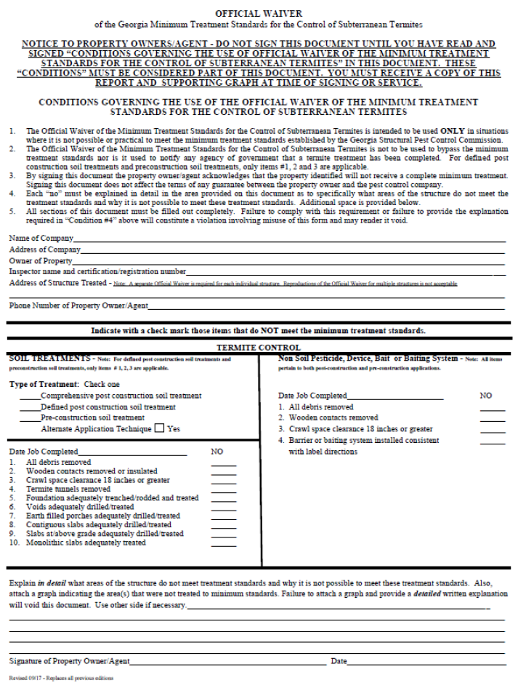
Proper Completion of the
Official Waiver form
List the name of your company on the
line provided
List the address of your company on
the line provided
List the name of the owner of the
property on the line provided
List your name on the your
certification/registration card on
the line provided
List the address of the structure to be
treated on the line provided (Note:
A separate Official Waiver form is
required for each individual structure.
Reproductions of the Official Waiver
for multiple structures is not acceptable.
List the Phone # of the Property Owner/
Agent

Slide 7
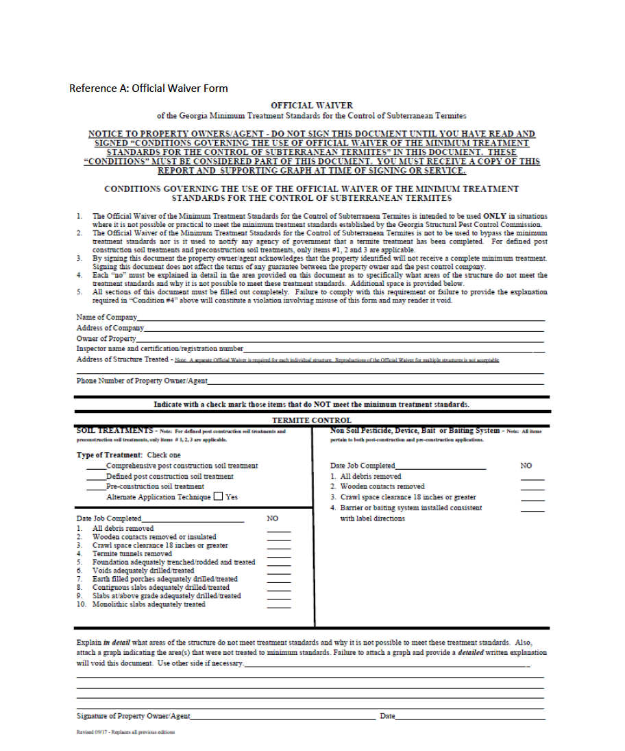
Proper Completion of the
Official Waiver form
Check the Type of Treatment
(Comprehensive post construction
soil treatment, Defined post
construction soil treatment or
Pre-construction soil treatment).
If you performed an Alternate
Application Technique, check
the Yes box.
In the minimum treatment
standards section, make a check
mark in the NO box for each of
the treatments that do not
meet the minimum standards
Note that only #1, #2 and #3 can
be marked NO for defined post
construction soil treatments and
for pre-construction soil treatments
Note that with a Comprehensive
soil treatment, any of the treatment
standards that cannot be performed
may be waived.

Slide 8
What do I do if an Item other than Item #1, #2 and #3 needs to be “waived” to perform a Defined soil treatment or a Preconstruction soil treatment?
If any of the minimum treatment standards (other than Item #1, #2
and #3 on the Official Waiver form) of a Defined post construction soil
treatment or a Preconstruction soil treatment cannot be performed,
the Defined post construction soil treatment or the Preconstruction
soil treatment could not be made.
Instead, a Comprehensive post construction soil treatment or a Bait
system treatment could be made. Any minimum treatment standard
of a Comprehensive post construction soil treatment or a Bait system
treatment that cannot be performed may be “waived” using the most
recent revision of the Official Waiver form.

Slide 9
Proper Completion of the
Official Waiver form
If you sell a Warranty only contract
and any of the minimum treatment
standards of the treatment you
have selected to make at the first
sign of termite infestation cannot
be performed, make a check mark
on the “NO” line of the treatment
standard/s that can’t be performed.
In addition, you need to write the
words “Warranty only contract” on
the Date Job Completed” line.
Warranty only contract

Slide 10
Proper Completion of the
Official Waiver form
Explain in detail what areas of the
structure do not meet treatment
standards and why it is not possible
to meet these treatment standards.
Also, attach a graph indicating the
area(s) that were not treated to
minimum standards. Failure to
attach a graph and provide a
detailed written explanation will
void this document.

Slide 11
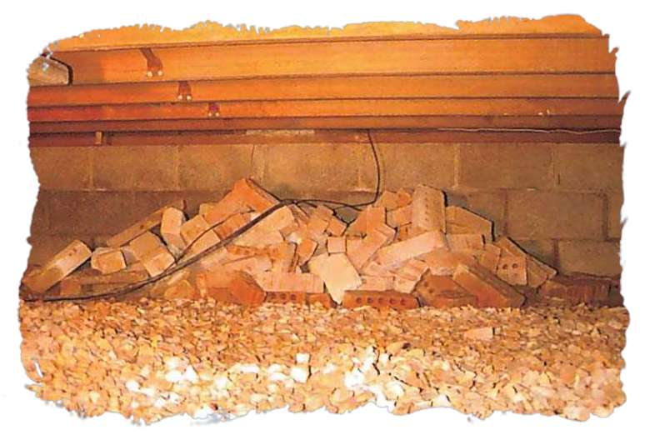
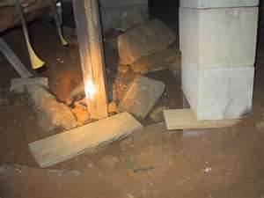
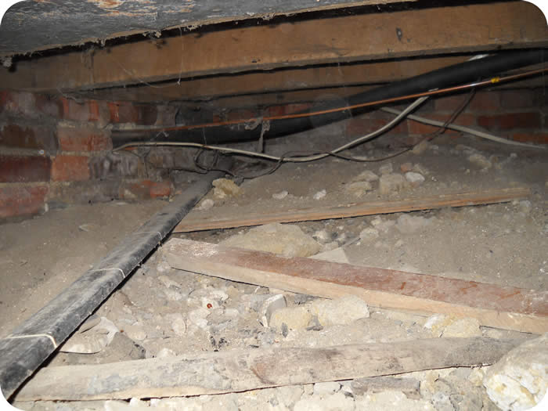
620-6-.04 Control Measures. Amended.
(1) (a) 1. Removal of all cellulosic material from underneath the building
and removal of any other debris which would interfere with inspection or
treatment in such area.
This pile of bricks is debris which would interfere with an inspection or treatment along the foundation wall
Most often, the debris needs to be removed, not Waivered

Slide 12
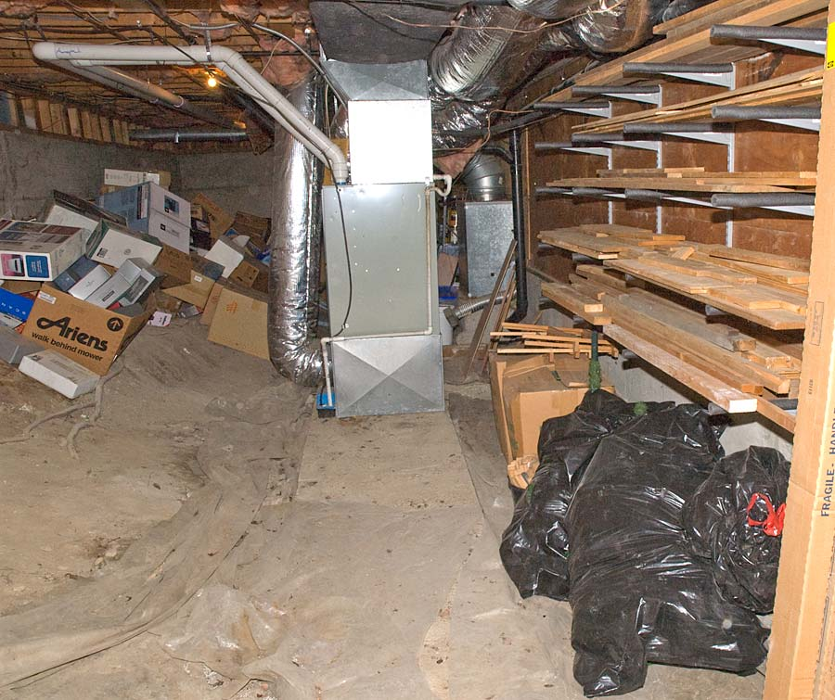
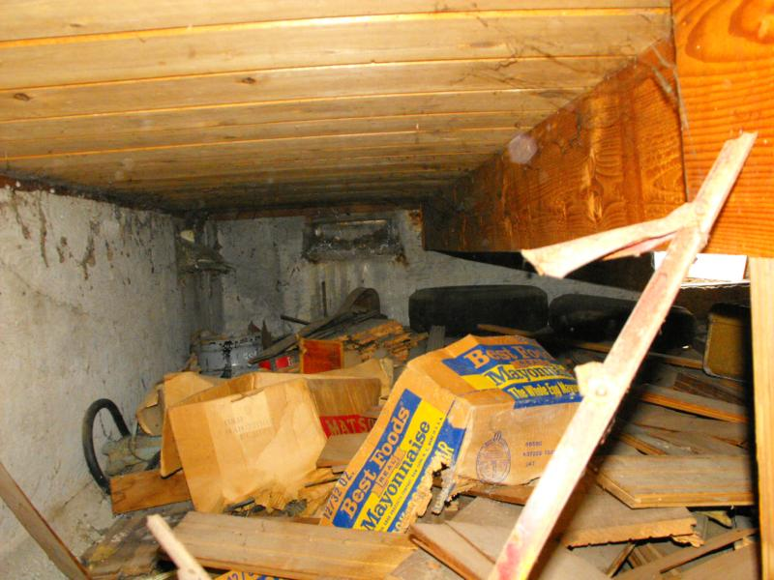
This debris needs to be removed, not Waived

Slide 13
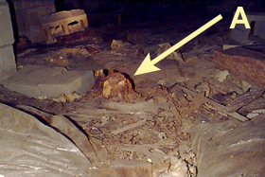
If a stump can’t be
removed from the
crawl space and there
is at least 12” space
between the top of
the stump and the
structural wood
above, I suggest that
it be waived using the
Official Waiver form.
You should consider treating the stump, if the termiticide you use is labeled for treating stumps.
10/81

Slide 14
620-6-.04 (1) (a) 2. Removal of all wooden contacts between buildings
and outside soil, other than wooden supports which have been treated
with preservatives to a minimum preservative retention designed for
ground contact. The top of all supports for untreated wooden
members shall be no closer than six (6) inches to the soil. In no case
shall the minimum clearance between untreated wood and soil be less
than six (6) inches.
Wood
Soil
6”
6” of air is required between wood & soil unless
the wood had been treated for ground contact

Slide 15
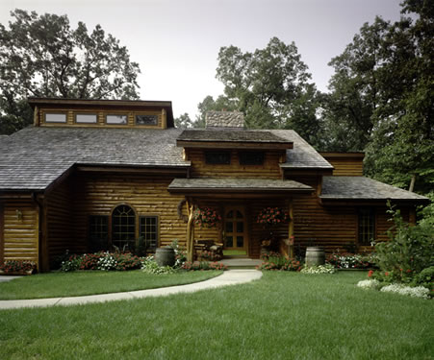
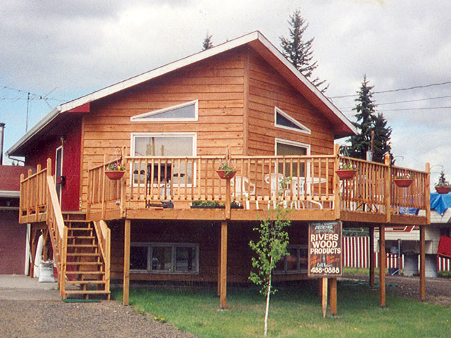
Wooden siding, porch columns, deck posts, and stairs are touching or within 6”
of soil and must either be removed, properly insulated from soil, or alternatively WAIVED

Slide 16
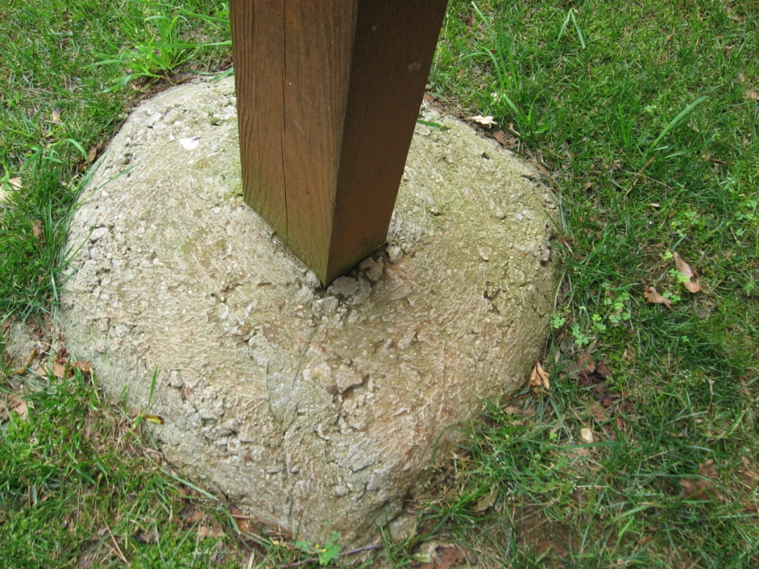
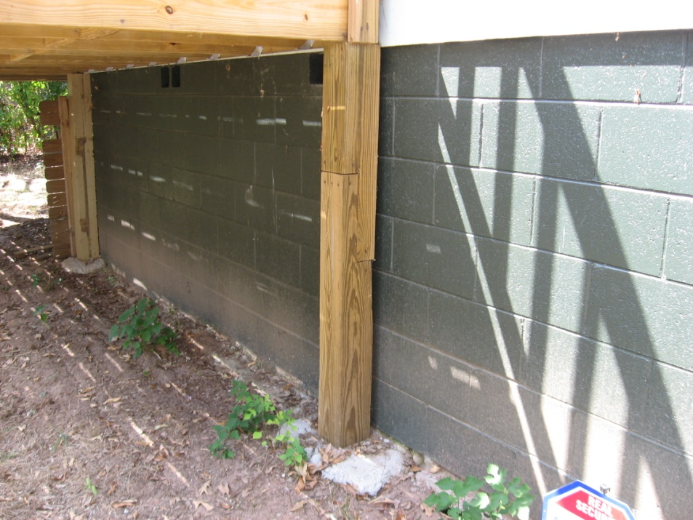
If wooden deck posts are not stamped or plated to show they are treated for ground contact and they are embedded in concrete, they are considered wood-to-earth contacts and need to be either removed, properly insulated from soil, or alternatively WAIVED.
If wooden deck posts are not stamped or plated to show they are treated for ground contact and they are sitting on top of a concrete footer and there is at less than 6” of clearance between the wood and the soil, they need either to be removed, properly insulated from soil, or alternatively WAIVED.

Slide 17
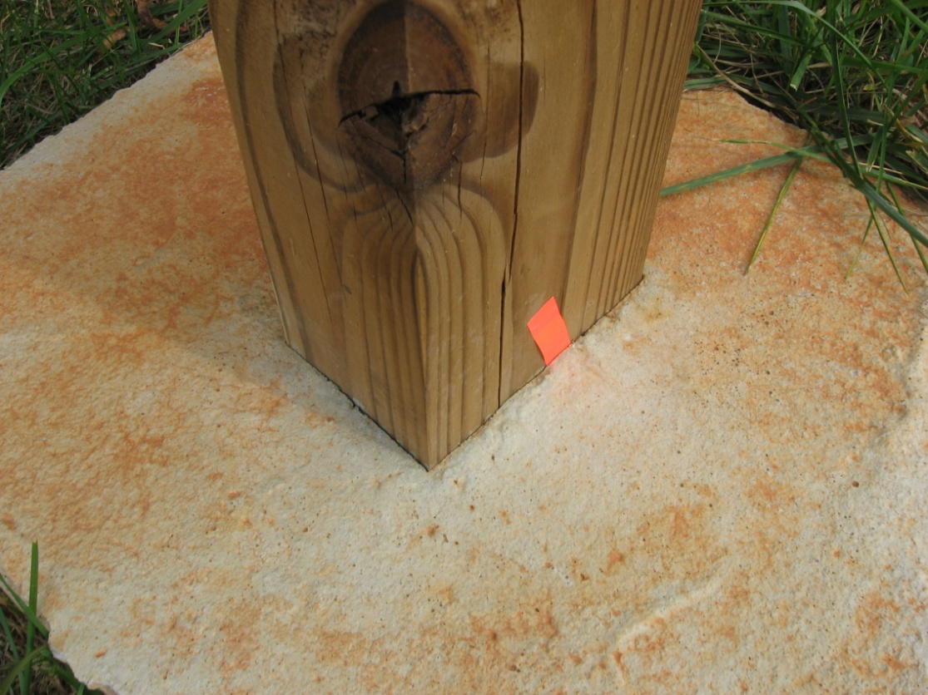
This deck post is embedded in concrete and must either be
removed, properly insulated from soil, or alternatively WAIVED
Slide 10/79

Slide 18
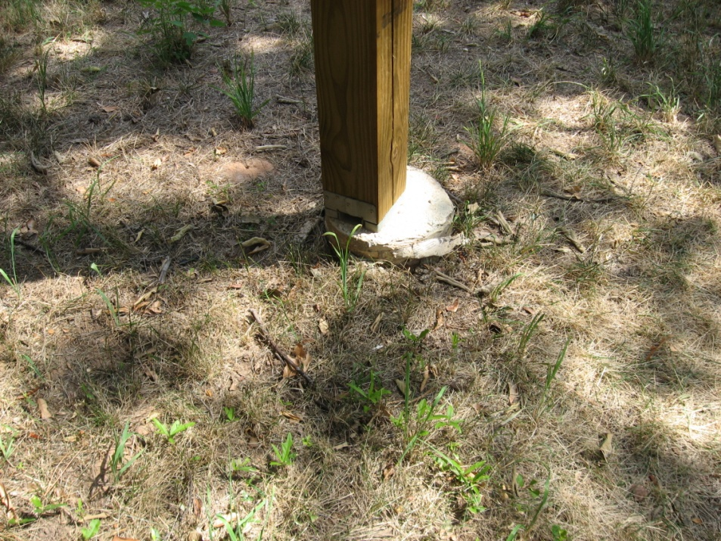
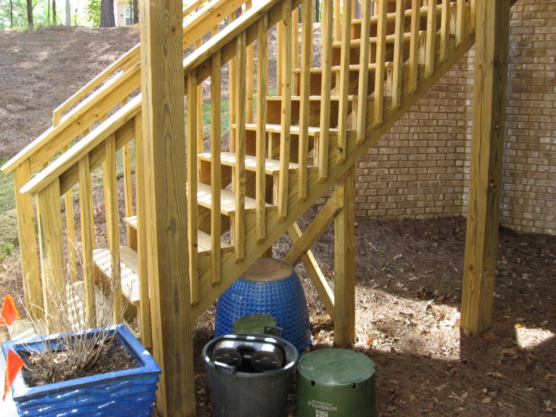
These deck posts and stair stringers are not treated for ground contact and are either resting on top of a footing and within 6” of the soil or are directly contacting the soil. They must either be removed, properly insulated from soil, or alternatively WAIVED

Slide 19
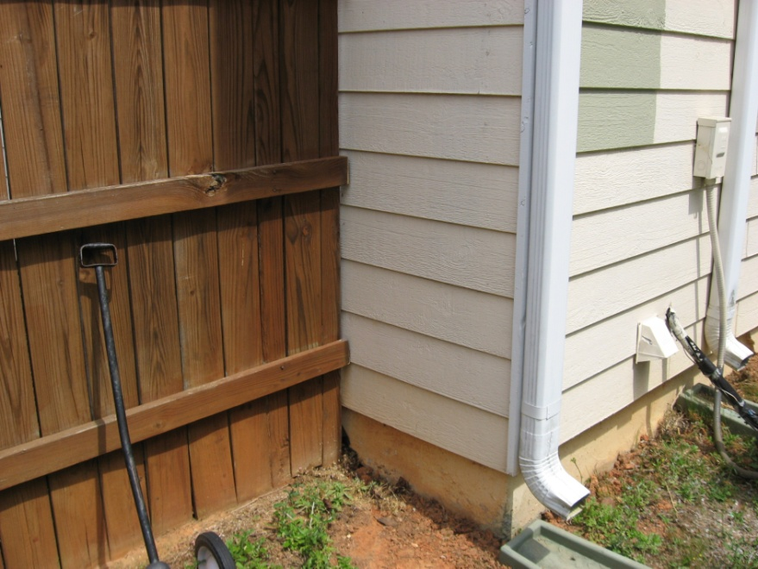
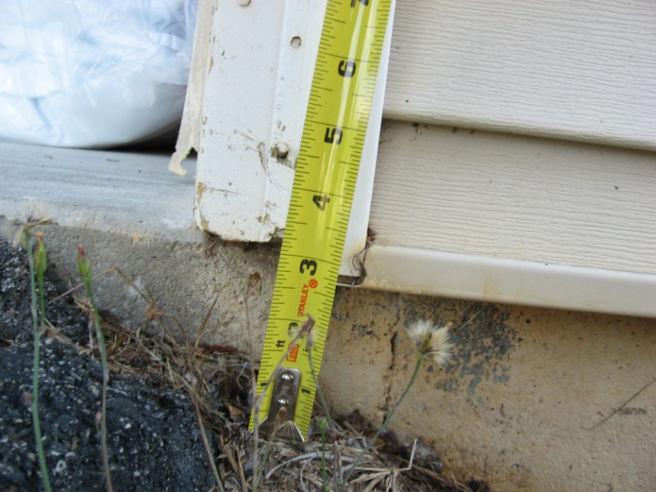
Wooden fence touching structure Wooden corner board within 6” of the soil
The wood attached to the house There are 4 options: replace the wooden
must either be moved or insulated corner board with a plastic one, dig soil
from the house so that the wood away from under the corner board to
of the fence is not touching the provide proper clearance, pour a 6” x 6”
building or it is alternatively slab under the corner board, or
WAIVED. alternatively WAIVE it.

Slide 20
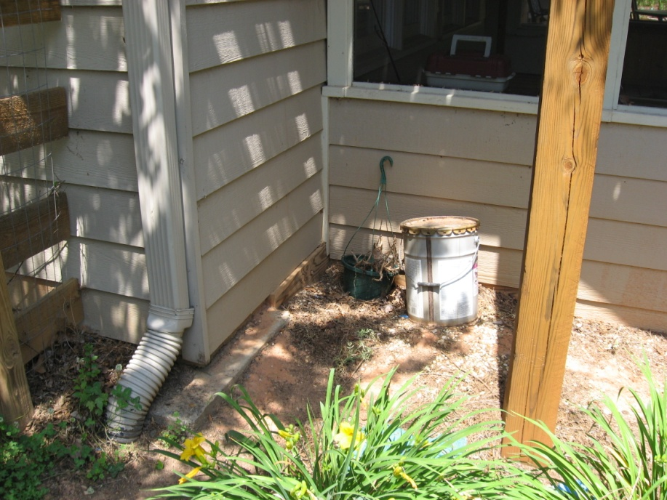
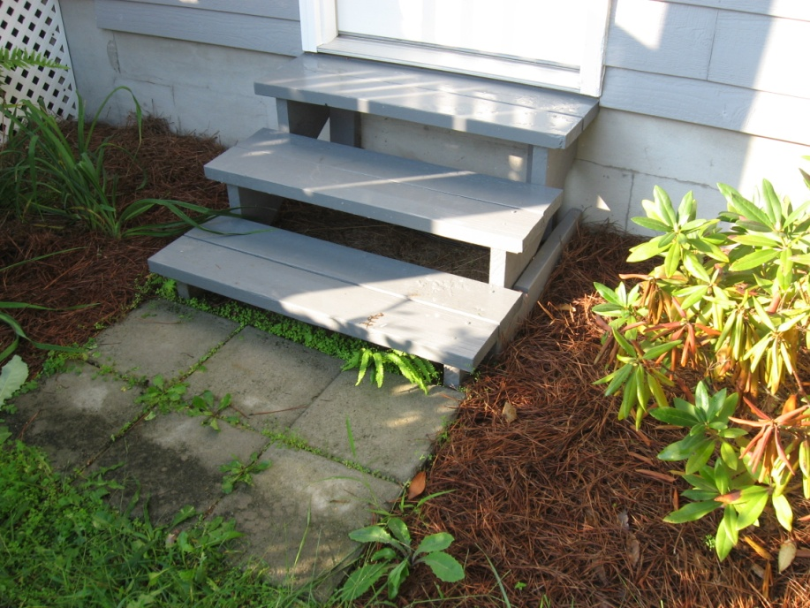
Deck support touching soil Wooden steps touching and within 6”
of soil
The siding, corner boards, and deck support The wooden steps and stair stringers either
need either to be removed, to be properly need to be removed and replace with brick
insulated from soil, or alternatively WAIVED. or concrete steps, properly insulated from
soil, or alternatively WAIVED.
The fence needs to be cut off so that it is not
touching the house or alternatively WAIVED. The lattice work and frame need either to be
removed, properly insulated, or WAIVED.

Slide 21
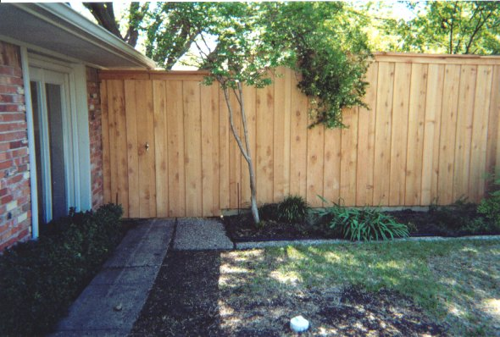
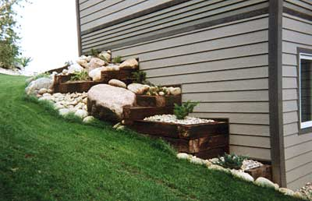
Post construction Comprehensive soil treatment
Wood fence post is touching building
The wood fence post touching the
wall needs to be moved so that is it is
not touching the building, removed
and replaced with a metal fence post,
or alternatively WAIVED.
Wooden railroad ties are touching
building
The railroad tie walls either need to be removed and replace with block walls, moved so that they are not touching the building, or alternatively WAIVED.

Slide 22
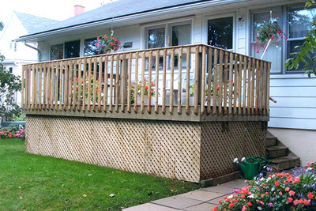
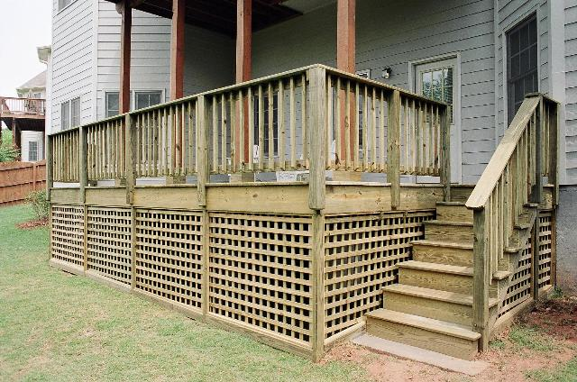
Lattice work, deck posts, stairs, and stair railing of deck are touching or within 6” of soil outside
All wooden elements of deck and stairs need either to be removed, properly insulated from the soil, or alternatively WAIVED
…and don’t forget, we need to have access under the deck for treatment

Slide 23
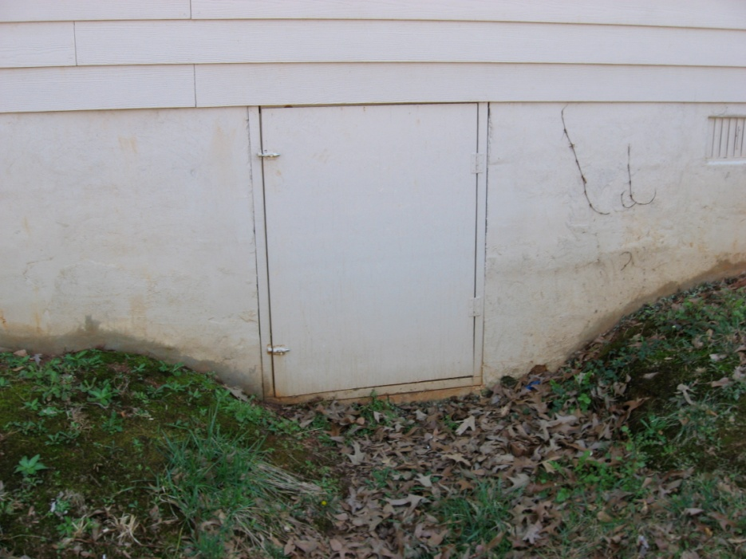
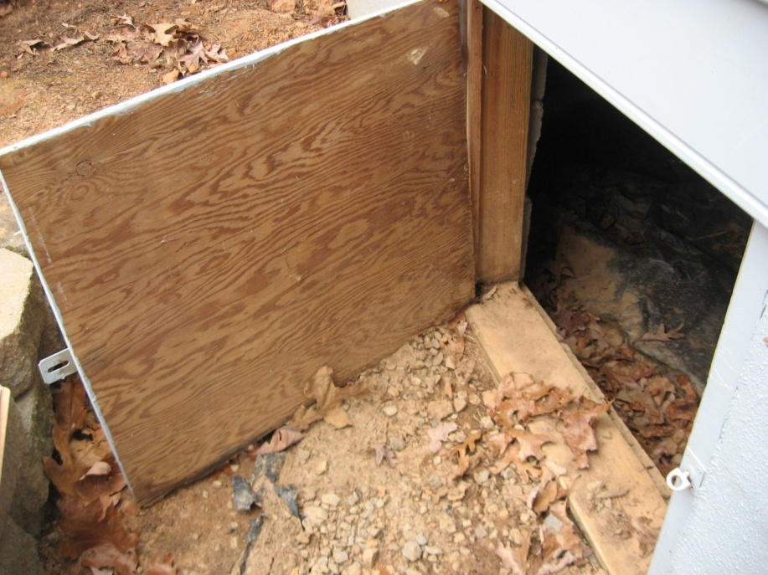
Wood crawl space door & door frame touching or within 6” of soil
The wood crawl space door & door frames need either to be removed and replaced with metal or plastic doors (we can sell them), properly insulated from the soil (provide at least 6” clearance), or alternatively WAIVED.
20/81

Slide 24
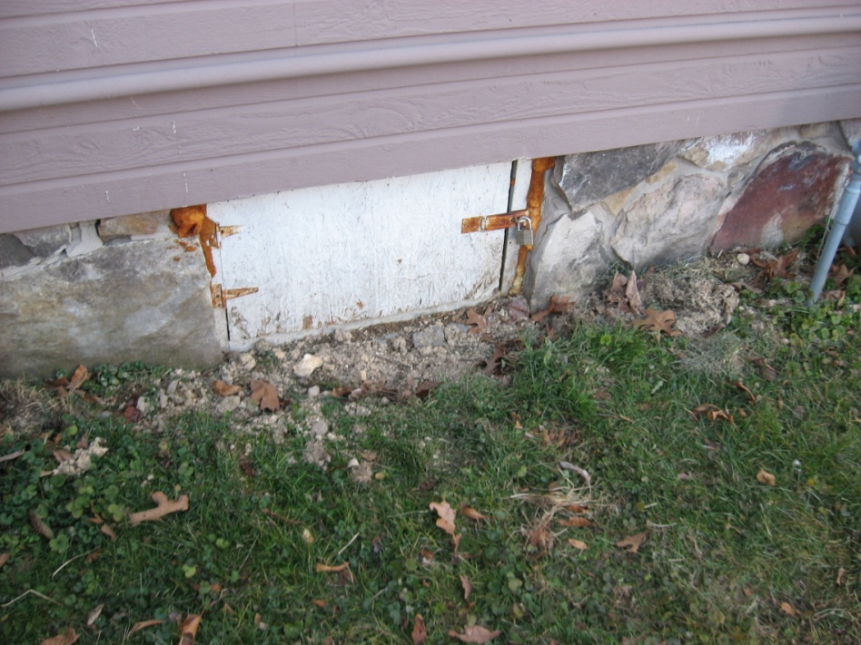
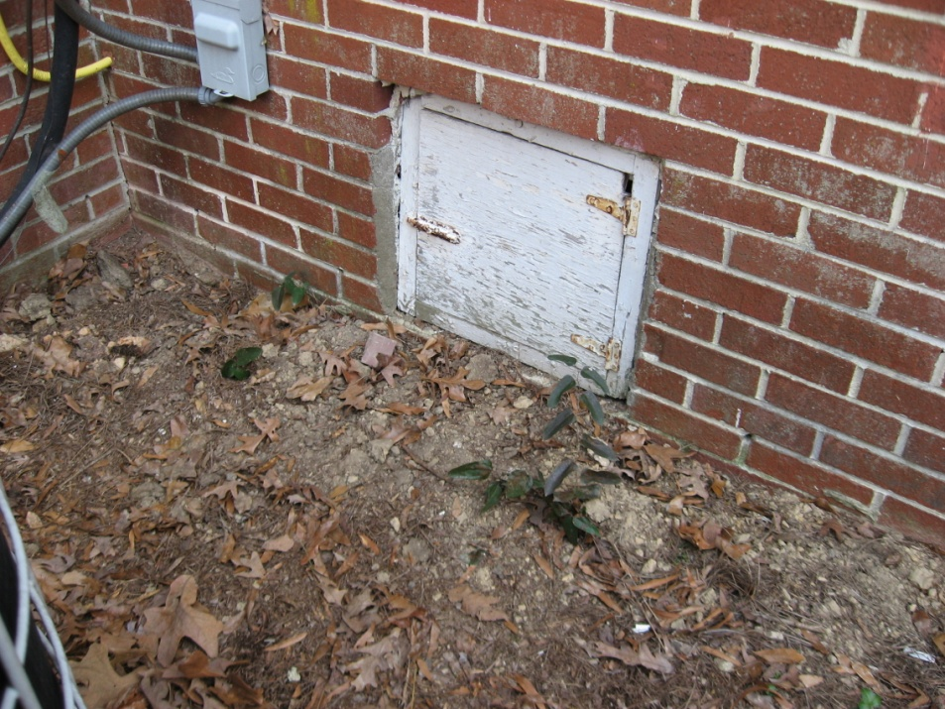
Wood crawl space door & door frame touching or within 6” of soil
The wood crawl space door & door frames need either to be removed and replaced with metal or plastic doors (we can sell them), properly insulated from the soil (provide at least 6” clearance), or alternatively WAIVED

Slide 25
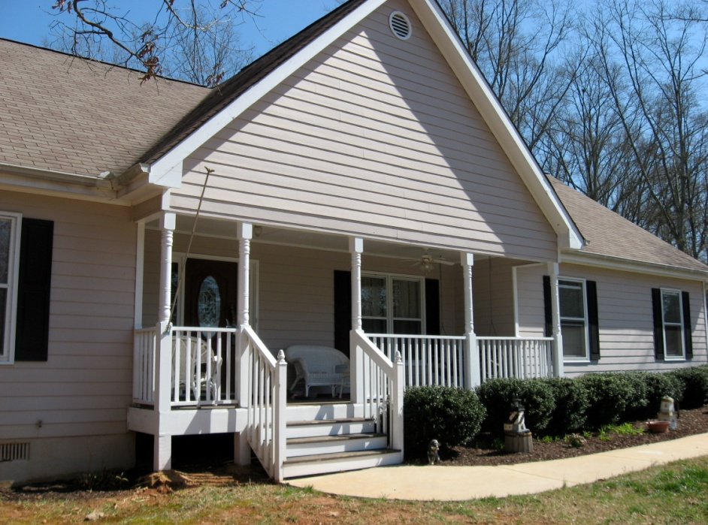
Wood deck posts, stairs and stair railings touching or within 6” of soil
All the wooden elements of the deck and stairs that are touching or
within 6” of the soil need to be removed, properly insulated from soil
(provide at least 6’ clearance), or alternatively WAIVED
Let’s not forget that we must be able to get under the front porch
to treat the soil adjacent to the exterior foundation wall

Slide 26
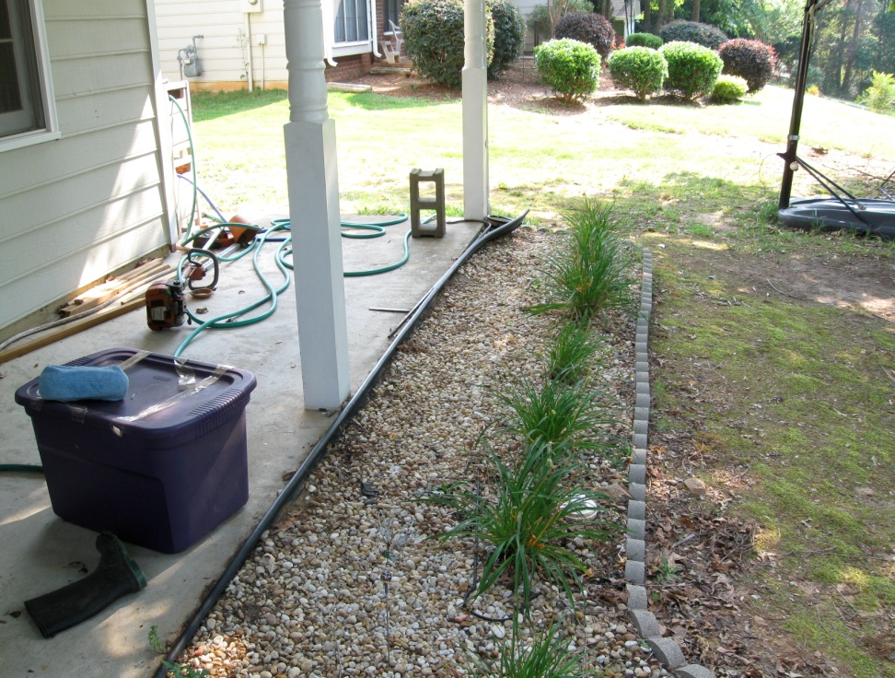
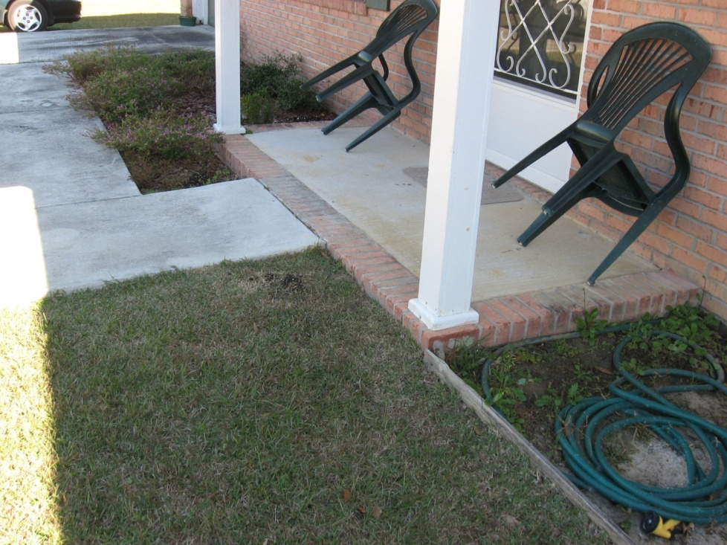
Wooden columns or supports within 6” of soil
Front porch columns touching or within 6” of soil
The wooden columns need either to be replaced by metal plastic or metal columns, properly insulated from soil, or alternatively WAIVED

Slide 27
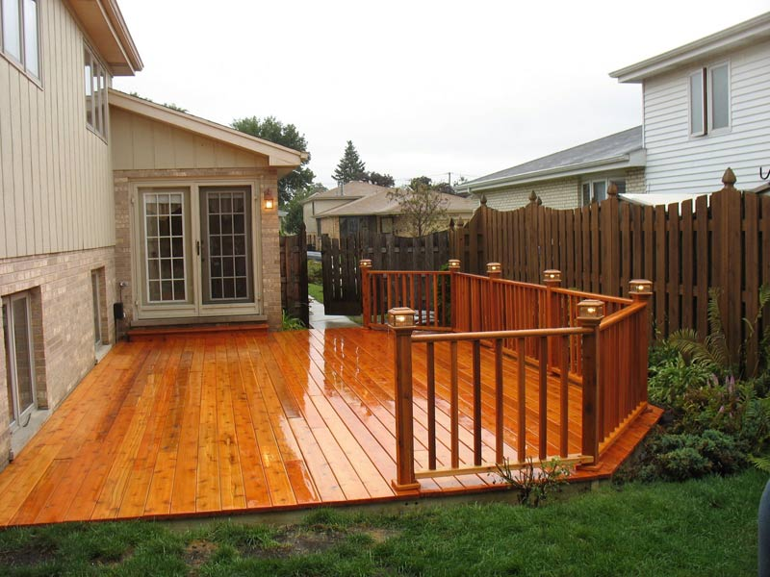
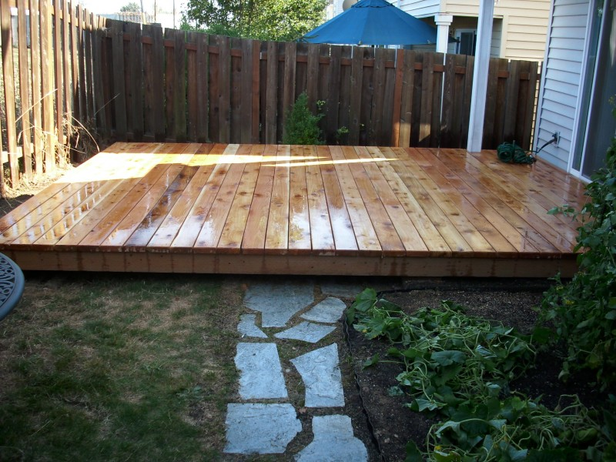
Rear wooden decks and fence posts touching or within 6” of soil
These wooden decks are touching the ground and present a significant hazard
for subterranean termite attack that may not be able to be solved without first experiencing termite damage to the structure.
What do you think the best option would be for each of these decks that don’t permit treatment adjacent to the foundation wall?

Slide 28
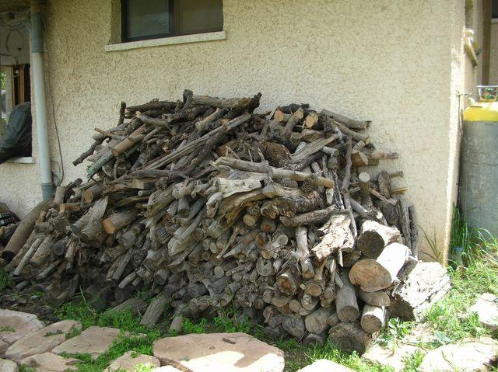
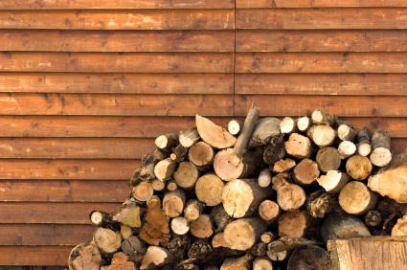
Firewood piles are touching a wall of the structures
DON’T WAIVE! Ask the customer to move the firewood pile away from the
wall before coming to perform the treatment or price the job to provide the
extra labor so you can move the firewood pile
25/81

Slide 29
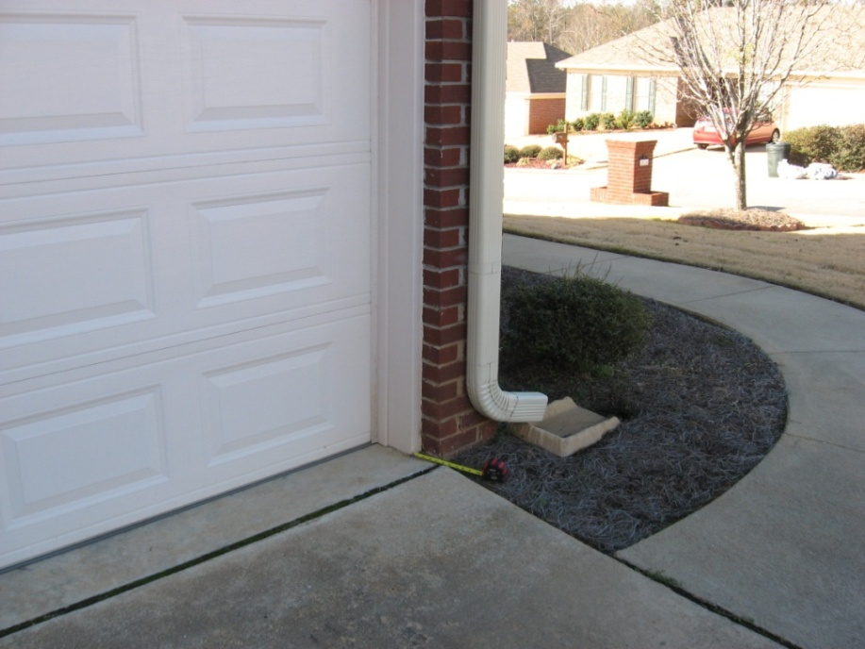
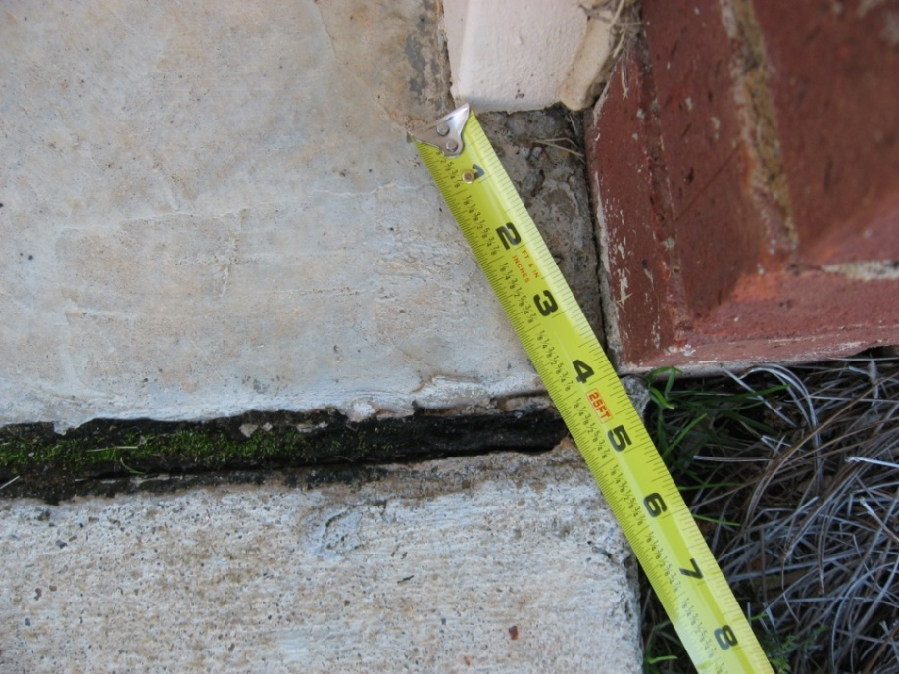
Wooden garage door frames are within 6” of the soil
The customer will generally not want to remove the wood door frame or properly insulate the wood from the soil by pouring a 6” x 6” slab. Just ask the customer to WAIVE these wood-to-earth contacts.

Slide 30
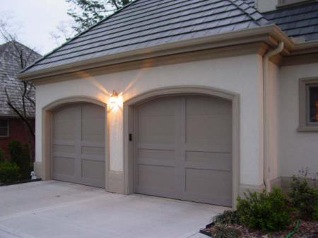
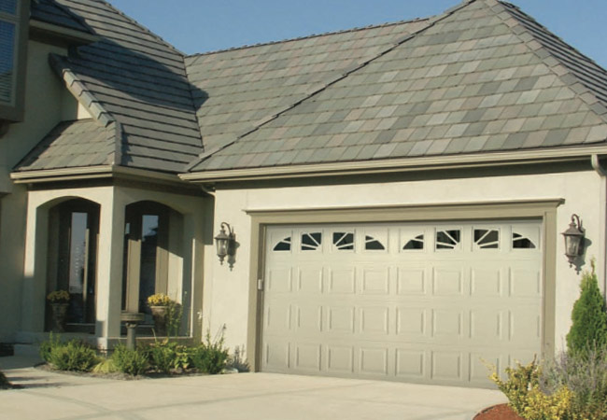
Wooden garage door frames touching or within 6” of the soil
The customer will generally not want to remove the wood door frame or
properly insulate the wood from the soil by pouring a 6” x 6” slab. Just ask
the customer to WAIVE these wood-to-earth contacts.

Slide 31
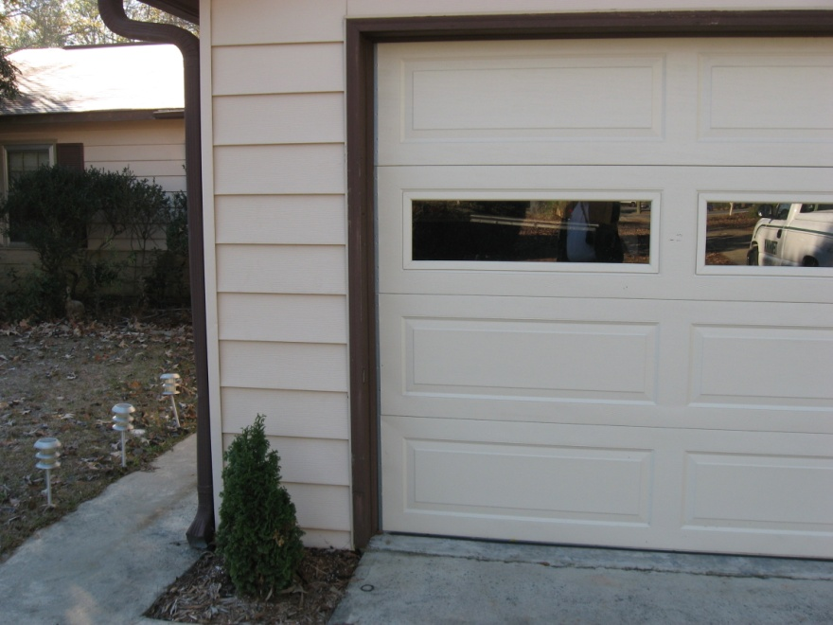
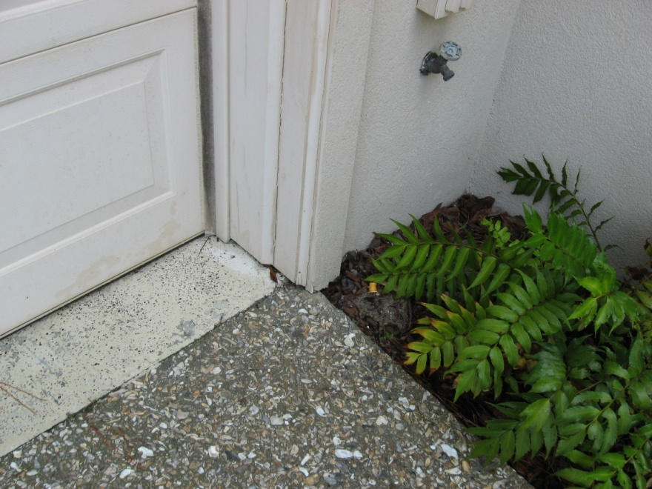
Wooden garage door frames touching or within 6” of the soil
The customer will generally not want to remove the wood door frame or properly insulate the wood from the soil by pouring a 6” x 6” slab. Just ask the customer to WAIVE these wood-to-earth contacts.

Slide 32


Wood is closer to soil than 6”, but it is insulated from soil and is not considered wood-to-earth contact
This requirement shall apply only to those situations where wood is exposed and by design is not separated from the outside soil line by anything other than air space.
Such clearance shall not apply to sill plates or other wooden members of a structure which may be physically closer to the earth than the required clearance but are by design enclosed by and insulated from the earth by brick, stucco or other construction material.
There is less than 6” between the wood base plate inside the home and the soil outside, but this is not considered wood less than 6”, because it is insulated by brick
Soil outside
Monolithic slab
Monolithic slab

Slide 33
620-6-.04 (1) (a) 3. Removal of all wooden contacts between buildings
and inside soil, other than those wooden supports which have been
treated with preservatives to a minimum preservative retention designed
for ground contact. In no case shall the minimum clearance between
wood and soil in a crawl space be less than eighteen (18) inches.
30/81

Slide 34
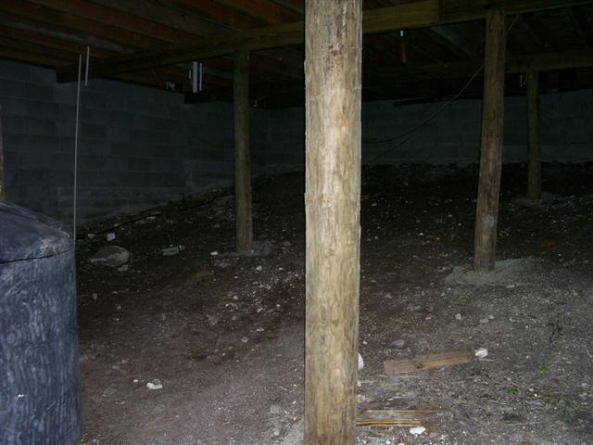
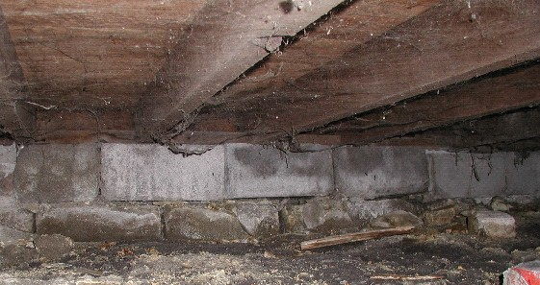
Untreated wooden supports in crawl are touching or within 18”
of the soil
These wooden supports must be removed and replaced with metal house supports, properly insulated from the soil, or alternatively WAIVED
There is wood debris in this crawl…but more
importantly, there is less than 18” clearance between the wooden sill and some of the wooden floor joists & the soil in the crawl
Soil must be removed to provide at least 18” clearance between wood and soil or alternatively WAIVED

Slide 35
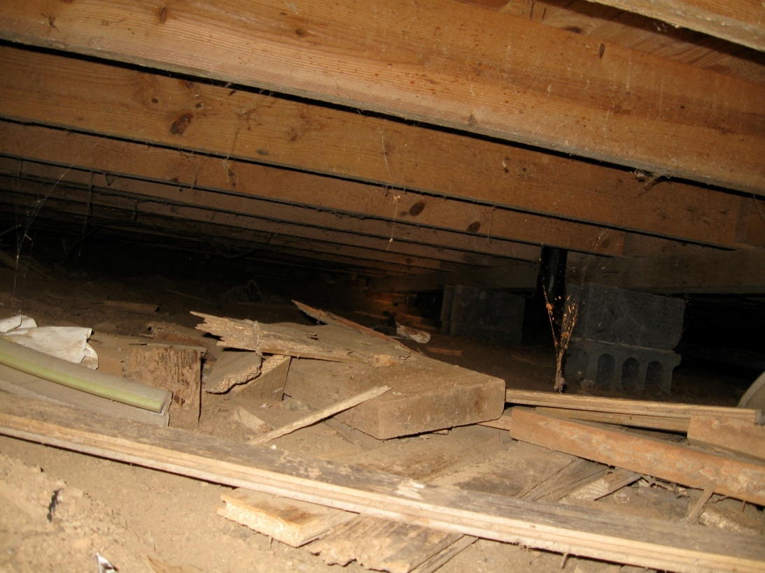
Wood debris is found in the crawl…but more importantly, there is less than
18” clearance between wood & soil in the crawl and it may be inaccessible for treatment. If not WAIVED, it would be a violation of the RULES and we would be required to “dig it out” to provide for 18” clearance between wood and soil.

Slide 36
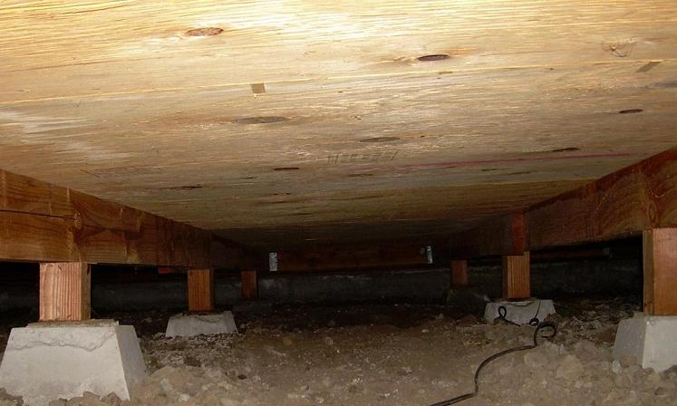
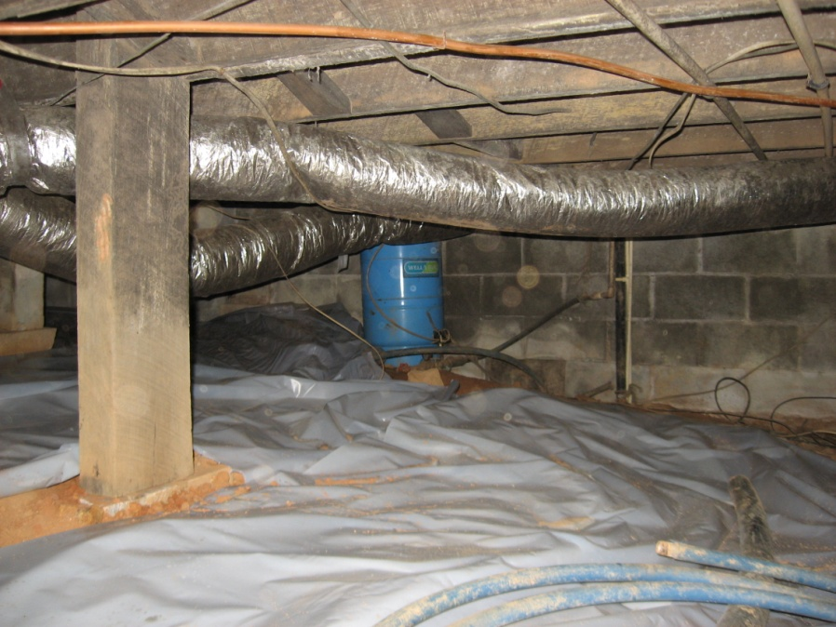
Less than 18” clearance between wood & soil in the crawl
The customer will not want to replace the This wooden support needs to
wooden supports with metal or concrete be replaced with a metal house
supports. Wood within 16” of soil in the support. It should not be
crawl space will need to be WAIVED. WAIVED.

Slide 37

What do you do if you do not have enough clearance to
inspect and treat all areas of the crawlspace?
Slide 30/79

Slide 38
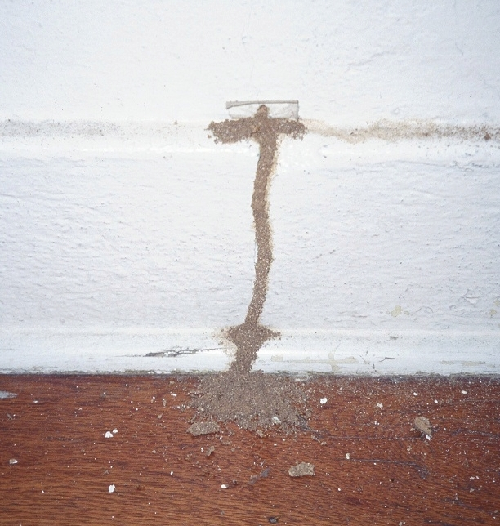
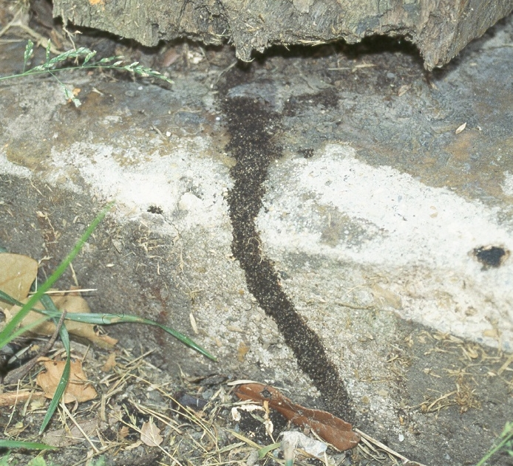
620-6-.04 (1) (a) 4. Removal of all visible accessible termite tunnels.
35/81

Slide 39
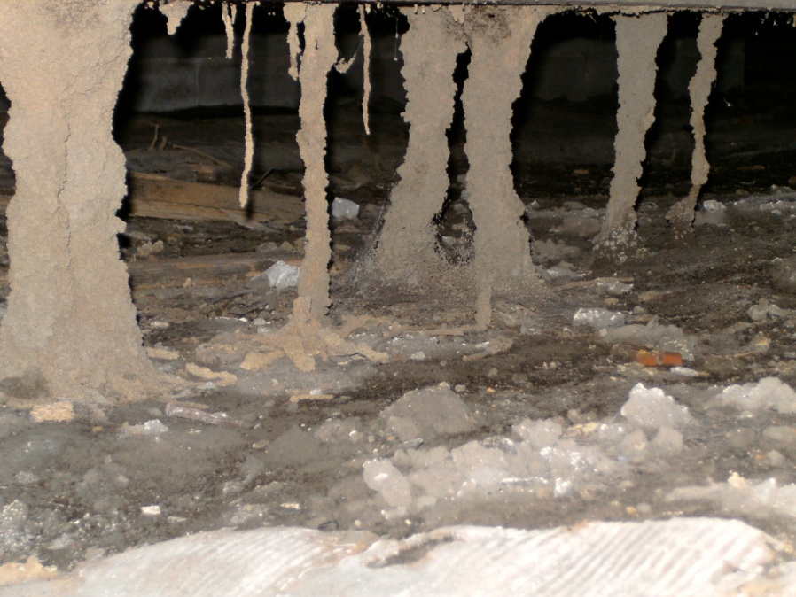
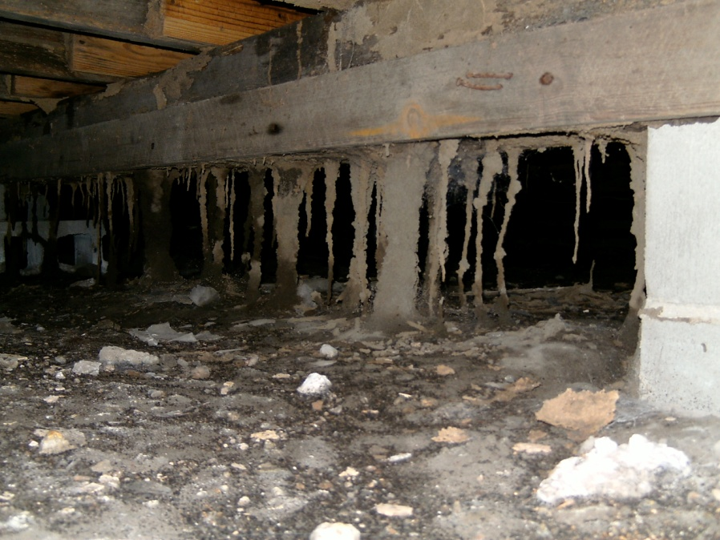
What 2 questions do you ask about termite tunnels?
Are the termite tunnels visible?
Are the termite tunnels accessible?
If they are visible and accessible, they need to be removed!

Slide 40
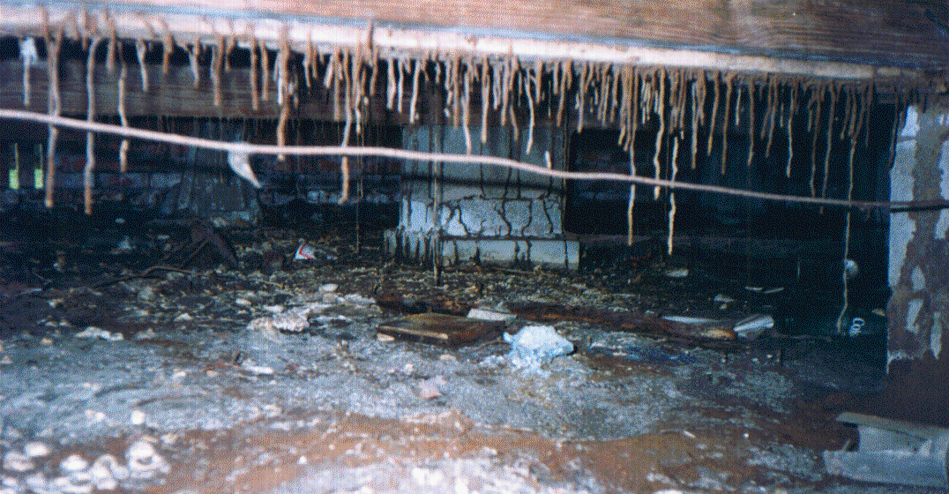
Perhaps it’s best to “walk away” from selling this job!
Why?
Remember – you will need to remove all the termite
tunnels that are visible & accessible or alternatively WAIVER them.

Slide 41
620-6-.04 (1) (a) 5. Trenching of soil along the outside and
inside of foundation walls and around pillars and other
supports to a minimum depth of six (6) inches, but not lower
than the top of the footing in contact with the soil. Rodding
may be performed from the bottom of the trench to lower
depths as required. When the top of any footing is exposed
and not in contact with the soil, trenching should not extend
below the bottom of the footing.

Slide 42

If an object up against a foundation wall cannot be moved to trench
the soil adjacent to it, it must be WAIVED and that area should be
rodded or long-rodded instead of trenching or trenching & rodding.

Slide 43

If an object up against a foundation wall such as an AC unit cannot
be moved to trench the soil adjacent to it, it must be WAIVED and
that area should be rodded or long-rodded instead of trenching or
trenching & rodding.
40/81

Slide 44


If the customer will not move or allow you to damage ivy or other ground cover adjacent to the exterior foundation wall when it trenches the soil adjacent to it, it must be WAIVED and that area should be rodded instead of trenching or trenching & rodding. Just make sure that you rod behind any shrubs that are close to the foundation wall.

Slide 45

A low deck without access underneath it
This deck is too low to the ground to gain access underneath to be able to trench the soil that is beneath the deck
Could that present
a problem?
If the customer won’t remove one or two deck boards that are adjacent to the exterior foundation wall to allow proper trenching in the soil beneath it, a Defined soil treatment may not be performed. A Bait system treatment or a Comprehensive soil treatment may be performed. Proper trenching would need to be WAIVED for the Comprehensive soil treatment and that area treated by drilling through the deck boards adjacent to that wall and rodding the soil beneath it or by long-rodding the soil adjacent to that wall from the sides.

Slide 46
Rule 620-11-.01 Treatment of Schools
Pesticide applications may be made to schools consistent with the
following:
(a) All pesticide applications shall be made in a manner that minimizes the
exposure of children or students to the pesticide.
(b) Pesticide application may be made to a room only if children or
students are not expected to be present in the room for a minimum of
three (3) hours after application. If the products label directions specify a
longer reentry interval then the longer reentry interval shall apply except
as specified in Rule 620-11-.01(1)(c).
(c) Insecticide baits and rodenticide baits in tamper-resistant containers or
bait stations as well as botanical insecticides, insect growth regulators and
insecticidal soaps may be applied at any time children or students are not
present in a room. No reentry interval is required except if specified by the
products label directions. These products may be applied to any open area
or multi-purpose room if the area within ten (10) feet of the location is
secured and no children or students are present within the secured area
during the time of application.

Slide 47
Rule 620-11-.01 Treatment of Schools
(continued)
(d) Pesticide applications may be made to outdoor school grounds if
children or students are not expected to be present within twenty (20)
feet of the application site at the time of application except as
specified in Rule 620-11-.01(1)(e). These areas must be clearly
marked to discourage entry, and secured by a fence or other similar
barrier stating the reentry interval. If the application site is not
secured by a fence or other similar barrier, pesticide applications may
be made to an outdoor school grounds only if children or students are
not expected to be in the area for a minimum of three (3) hours after
application. If the products label directions specify a longer reentry
interval then the longer reentry interval shall apply except as specified
in Rule 620-11-.01(1)(c). Such areas shall be clearly marked to
discourage entry. All signs required by this section to discourage entry
shall be consistent with the requirements of Rule 620-3-.02(1)(l) 2.

Slide 48
Rule 620-11-.01 Treatment of Schools
(continued)
(e) Insecticide baits and rodenticide baits in tamper resistant
containers or bait stations as well as botanical insecticides, insect
growth regulators and insecticidal soaps may be applied to outdoor
school grounds anytime children or students are not present in the
area. No reentry interval is required except if specified by the
products label directions.
(f) All pesticide use dilutions must be prepared outside child or
student occupied areas of buildings.
(g) All contracts for pest control service and all services provided must
be consistent with any published pest management policy of that
school system or licensed child daycare facility.

Slide 49




Schools
Schools

Slide 50
Treatment adjacent to the exterior foundation wall of a structure
6. (ii) Rate of application shall be four (4) gallons
per ten (10) linear feet per foot of depth from
the soil surface to the lesser of either the top
of the footings or a depth of four (4) feet applied
to the trenches and backfill.
Soil into which pipes extend from the structure,
soil under expansion joints, and soil in any other
critical point of potential termite entry must also
be treated with the approved termiticide at the
above application rate: expansion joints, bath
trap areas and visible cracks in the floor that
might permit entry.
117
Trench
& rod
soil to
the footer or to a 4 foot
depth

Slide 51


6. (iii) Measures must be taken to prevent the back siphoning
and the contamination of public water supplies during
dilution and filling operations.
If not using an Air-Gap
method, attach backflow
preventer to the faucet
and screw the fill hose
into a backflow preventer
before placing the fill
hose in the termite tank.
Your termite tank should use
the Air-Gap method of backflow prevention.

Slide 52

6. (iii) continued. Do not apply pesticide while precipitation
is occurring in any area where the application would
be impacted by the precipitation.

Slide 53


6. (iv.) Precautions must be taken to prevent contamination
of wells or cisterns, in or close to the structure treated.
Ask the homeowners if they have a well or cistern at the home and be able to recognize a well house that has already been built.
50/81

Slide 54


Can you recognize a cistern?
Below ground cistern
Above ground cistern

Slide 55
What do you do if you find there is a well or cistern on the property?
If arrive at the property and you determine that a well or a
cistern is present on the property, call your service manager
or branch manager before proceeding with the treatment.
If treatment is allowed to be performed, consult the label of
the termiticide that you plan to use and follow its detailed
instructions regarding treatment near a well or cistern.
Slide 50/79

Slide 56

Let’s look at the Termidor SC label
It states that you cannot treat soil within 5’ of a well by any method with Termidor SC
Water storage tank
inside home
well
> 5’

Slide 57
You must treat the soil within 5’ of a well by the Excavation/Backfill method with Termidor SC
If you treat the soil
between 5’ and 10’
from the well, you
must use the
Excavation/Backfill
method.
You should probably
use the Excavation/
Backfill method for
at least 10 – 20 feet
in either direction
from the well.
Well
10’
10’
Home
8’

Slide 58

Backfill Method
1. Trench and remove soil to be
treated onto heavy plastic
sheeting or similar material or
into a wheelbarrow.
2. Treat soil at the rate of 4 gallons of 0.06%, 0.09% or 0.125%
Termidor SC per 10 linear feet per foot of depth of the trench,
or 1 gallon of 0.06%, 0.09% or 0.125% Termidor SC per 1.0
cubic foot of soil. Mix thoroughly into the soil taking care to
contain the liquid and prevent runoff or spillage.
3. After the treated soil has absorbed the Termidor SC finished
dilution, return the soil into the trench.
55/81

Slide 59

7. The drilling of all brick, concrete
block, or other type of cavity walls,
chimneys, hollow pillars or other
similar structure parts and the
application of the approved
termiticide at a rate of two (2)
gallons per ten (10) linear feet.
Drilling of concrete blocks or other
hollow masonry parts shall be
made into the large voids only, as
opposed to the vertical mortar
joints, at horizontal intervals of no
more than twelve (12) inches.
Drill the single brick of a brick veneer
hollow block wall at 12” intervals or
less
Drill hollow block with 2 voids at 8” to 12” intervals in each block

Slide 60
What do you do when the hollow block
voids are filled with concrete?
Try to drill a few holes in the voids of hollow block
on each side of the structure. If they are filled with
concrete on each side, use the Official Waiver form
to WAIVE treatment of voids. State on the Official
Waiver form that the voids of the hollow blocks are
filled with concrete and you are unable to treat them.

Slide 61
Application of the termiticide shall be made through drill holes no more
than eighteen (18) inches above the lowest of soil or the slab surfaces
contiguous to the opposite side of the vertical wall. In case of uncapped
hollow parts, the termiticide may be applied through the top opening,
provided the termiticide is released no higher than eighteen (18) inches
above the top of the footing.
Make sure that this slab is a floating or a supported slab and not a monolithic slab!
Why?
Outside home Inside home
Drill no higher than 18” from the lower of the soil or slab level

Slide 62


Outside home Inside home
Don’t do it!
Soil
This is what happens when you drill a brick wall above the level of the monolithic slab…a spill.

Slide 63
Drill into the voids at no higher than 18” above the lower of the soil or slab level adjacent to the wall
Outside home Inside home
Inside home Outside home
Supported
slab
Basement
60/81

Slide 64

If the customer will not allow you to drill the voids of a
foundation wall (such as a hollow block basement wall)
or it is impossible to drill and treat voids of the foundation
wall within 18” of the lowest of the soil or slab surfaces
contiguous to the opposite side of the vertical wall, this
treatment standard must be WAIVED.

Slide 65


If you can’t drill and treat the voids between the brick veneer and the block and of the hollow block foundation wall behind the AC unit within 18” of the soil, this treatment standard must be WAIVED.
If it is impossible to drill and treat voids of the
foundation wall within 18” of the lowest of the
soil or slab surfaces contiguous to the opposite
side of the vertical wall, such as in this hollow
block/brick veneer wall of this supported slab
structure where the AC unit will not permit the
proper void treatment, this treatment standard
must be WAIVED.
Slide 60/79

Slide 66
There is no more
treatment standard
for providing adequate ventilation
in the crawl space
for subterranean termite control!
620-6-.04 (1) (a) 8. Providing ventilation in soil exposed crawl space at the rate of one standard ventilator (8”x16”) per fifteen (15) linear feet, or portion thereof, of foundation wall. Where structural of other conditions dictate, the required ventilators may be placed in only three sides. When an approved vapor barrier has been applied to a minimum of 70 percent of the ground surface in freestanding private residences, only one standard ventilator shall be required in each side of the structure, and if structural or other conditions dictate, the required number of ventilators may be placed in only three sides. Provided, when any limited or restricted crawl space extends from the primary crawl space, creating air stagnation, one standard ventilator (8”x16”) shall be installed for each fifteen linear feet, or portion thereof, of foundation wall in such space, not considering the linear feet where such limited or restricted area joins the primary crawl space.

Slide 67
Does that mean that I should no longer sell
proper ventilation of the under floor space
between the bottom of the floor joists and
the earth that meets the requirements of
the International Residential Building Code
for one and two family dwellings, the latest
edition as adopted and amended by the
Georgia Department of Community Affairs?

Slide 68
NO…just because it is no longer a
subterranean termite treatment requirement
doesn’t mean that you should stop selling
adequate ventilation.
If they do not have adequate ventilation
and they need it, sell it to them!

Slide 69
620-6-.04 (1) (a) 8. Treatment of the entire inside perimeter
walls of all earth filled porches beneath concrete slabs
contiguous to the structure with an approved termiticide at
the rate of four (4) gallons per ten (10) linear feet by one of
the following:
65/81

Slide 70
Voiding the dirt-filled porch
(i) Making access openings, by removing a six (6) inch band of
soil along the entire inside perimeter walls and applying the
termiticide in the trench.
This standard was performed from the crawlspace
when it only had to be performed on the side of
the dirt-filled porch that was adjacent to the
structure, but is practically never performed any
more…as it would look unsightly on all 4 perimeter
walls of the dirt-filled porch.

Slide 71
Vertically drilling the slab from above
(ii) Drilling from the top of the entire perimeter of the slab at
intervals of no more than twelve (12) inches and no more
than twelve (12) inches from the perimeter wall and
applying the termiticide.
. . . . . . . . .
. . .
. .
. .
. .
. .
. .
. . . . . . . . .
Dirt- filled porch

Slide 72
Short-rodding the slab
Drilling through the foundation wall from the sides, about 1”
below the slab level and treating the soil directly under the slab
(iii) Drilling, rodding, and applying the approved termiticide
from the inside of the foundation at no more than twelve
(12) inch intervals along the entire inside perimeter and
as close as possible to the lower edge of the slab.
Dirt- filled porch

Slide 73
Long-rodding the slab
Drilling through the foundation wall within 1” of the slab along the inside of each foundation wall and treating soil under the slab
adjacent to each of the perimeter walls
(iv) Drilling, rodding, and applying the approved termiticide
from the sides of the earth fill along the entire perimeter
provided no horizontal rodding distance shall exceed
twenty (20) feet.
Dirt- filled porch

Slide 74

I don’t want my front porch drilled…not on the top or the sides!
What happens when the customer will not allow you to treat
the entire inside perimeter walls of all earth filled porches
beneath concrete slabs contiguous to the structure with an
approved termiticide at the rate of four (4) gallons per ten
(10) linear feet by one of the options allowed by the Rules?
This standard, proper treatment of an earth-filled slab, must
be WAIVED. The pest control company must decide what
policy it has on offering any guaranty, retreatment or repair,
on the structure.
70/81

Slide 75

620-6-.04 (1) (a) 9. Treatment of all grade level slabs
contiguous to the structure with an approved termiticide at
the rate of four (4) gallons per ten (10) linear feet by drilling
and applying along the entire distance where the slab joins
any part of structure at intervals of no more than twelve (12)
inches and no more than twelve (12) inches from the
structure wall.
Vertically drilling
attached slab
Patio
. . . . .

Slide 76
When unable to vertically drill & treat the soil beneath the slab, waive that treatment procedure and use one of the alternative treatment techniques.
If a customer will not allow you to drill and treat the grade level
slab that is attached to the structure, it must be WAIVED and the
soil area under the slab that is adjacent to the structure should be
short-rodded from the crawl space or the basement or long-rodded
from the outside.
Patio Patio
Long-rodding Long-rodding
Short- rodding
OR

Slide 77
10. Treatment of all structures with concrete slabs at or above
grade level with an approved termiticide at a rate of four
(4) gallons per ten (10) linear feet by one of the following:
(i) Treating from inside by drilling through from the top of the
slab and applying the approved termiticide at intervals of
no more than twelve (12) inches and no more than twelve
(12) inches from the outside edge of the slab along the
entire perimeter and at all other points of potential termite
entry through the slab. After such application, all such
holes shall be securely sealed to prevent any upward
movement of the termiticide.

Slide 78
Vertically drill and treat from the inside (expansion joints,
cracks in the slab, and plumbing penetrations)
…usually only performed in garage & carports and on unfinished basement slabs near grade only
…………………………………………………………..………………….……..
…………………………………………………………..... .….
.
. .
. .
. .
. .
. .
. .
. .
. .
. .
. .
. .
.
.
.
.
.
.
.
.
.
.
.
Slab House
Garage
.
.
.
.
.
.
.
.
.
.
.
.
.
.
.
.
.
.
. .
Driveway

Slide 79
Drilling through the exterior foundation wall and
short-rodding from the outside
(ii) Treating from the outside by rodding and applying
termiticide along and under the entire perimeter of the
slab by inserting the rod as close as possible to the lower
edge of the slab.
Floating slab home
75/81

Slide 80
When a customer will not allow you to drill and treat any part
or all of the concrete slabs at or above grade, this treatment
standard must be WAIVED.
The pest control company must decide what policy it has on
offering any guaranty, retreatment or repair, on the
structure.

Slide 81


11. Treatment of monolithic slabs by trenching and
application of the approved termiticide to the soil
along the entire perimeter of the slab at a rate of
four (4) gallons per ten (10) linear feet and to any
openings through the slab (bath traps, visible
cracks in the slab and pipe penetrations).

Slide 82
Monolithic slab treatment
Treatment of monolithic slabs by trenching and the
application of the approved termiticide to the soil
along the entire perimeter of the slab at a rate of
four (4) gallons per ten (10) linear feet and to any
openings through the slab.
Bath trap openings
Monolithic Slab

Slide 83
And what happens when you cannot trench adjacent to the exterior
foundation wall of a monolithic structure or treat openings through
the slab?
You must WAIVE this treatment on the Official Waiver form.
Sometimes this treatment is prevented by ivy, a deck against the
exterior foundation wall that is too low to the ground (you can’t gain
access underneath it) or items against the exterior foundation wall
that cannot be moved (AC unit, propane tank, etc.). You should follow
your company’s policy on treatment and standards for offering any
guaranty, retreatment or repair of damage…and don’t forget to WAIVE
any required treatment standard that can’t be performed.

Slide 84
Comprehensive soil treatments are no longer performed on most homes.
A Comprehensive soil treatment offers one advantage that a Defined soil
treatment cannot offer…any treatment that cannot be performed may be
WAIVED.
Defined soil treatments with non-repellent termiticides offer the same
degree of control at a cheaper price and take less than half the time to
treat. Defined soil treatments are also less intrusive than Comprehensive
soil treatments. However, not all homes can be treated with a Defined
soil treatment. Remember…only 3 things can be WAIVED on the Official
Waiver form when a Defined soil treatment:
If a treatment which requires a termiticide to be applied on a Defined soil
treatment can’t be performed, it cannot be WAIVED and the Defined soil
treatment cannot be made. A Comprehensive soil treatment, with an
Official Waiver form obtained on any treatment that can’t be performed,
or a bait treatment are 2 other treatment options.
Wood within 6” of the soil on the outside
Wood within 18” of the soil on the inside of the crawl space
Cellulose debris in the crawl space
80/81

Slide 85

So…that’s all folks!
I hope the information that I have provided you has given you a better understanding of how to perform a Comprehensive soil treatment.

Slide 86
Comprehensive soil treatment
Course # W90417
1 hour WDO

Slide 87
TAKE
A
MINUTE
BREAK
5

